Slide 1
Dynamics and Estimation

Slide 2
Dynamics
Brief overview of methods (RK4, RKF78, DOPRI87, odeint, ode)
Description of code inputs/outputs
  general_dynamics function

Slide 3
Estimation
Brief overview of methods (batch, EKF, UKF)
Description of code inputs/outputs
  measurement/truth generation
  Setup for analysis functions
Description of test cases/analysis/tuning
  Linear, Balldrop, TwoBody
  SNC tuning
  DMC
  Convergence criteria

Slide 4
Least Squares Batch

Slide 5
Test Case – Linear 1D Setup
Assume simple straight-line motion of a single object in one dimension (e.g. car driving on a straight road)
Range measurements collected with Gaussian noise added
  Measurement and state origin are the same, so range measurement is just equal to the position state with noise added
Measurements collected at 10 second interval for 900 seconds (91 total measurements)
Measurement data not saved, no random seed set, so each run will use different measurements
State and Noise Parameters

Slide 6
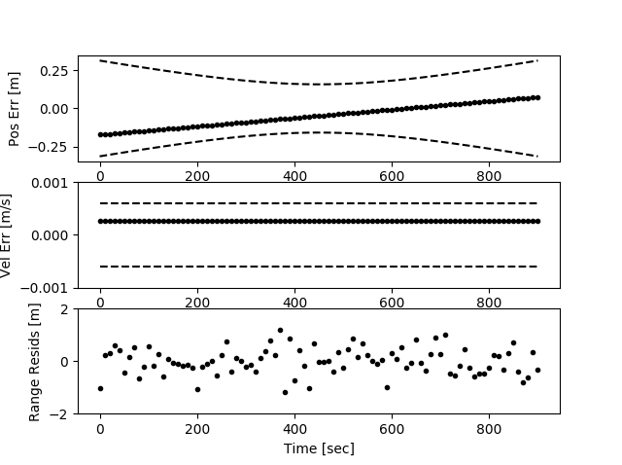
Linear 1D Results - Batch
Iteration Number: 1
xo_hat_mag = 70.99858287240174
Iteration Number: 2
xo_hat_mag = 7.203241947165541e-12
Error Statistics
Pos mean and std [m]: 0.036, 0.002
Vel mean and std [m/s]: 0.000, 0.000
Rg Resids mean and std [m]: 0.000, 0.510

Slide 7
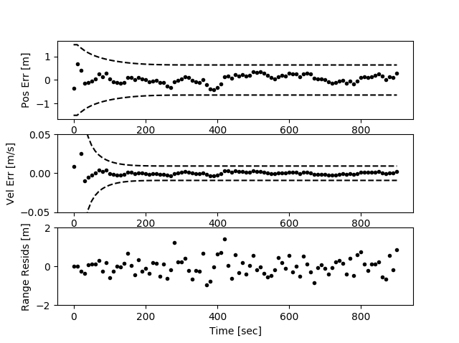
Linear 1D Results - EKF
Error Statistics
Pos mean and std [m]: 0.057, 0.187
Vel mean and std [m/s]: 0.001, 0.011
Rg Resids mean and std [m]: 0.006, 0.441

Slide 8
Test Case – Linear 1D Discussion
Different measurements were used for batch and EKF runs
Batch converged after one iteration
Batch has small errors throughout, EKF errors converge quickly
EKF convergence criteria (trace(P) > 0.9*trace(P_prior)) met after 8 measurements processed
  This is the point it switches from CKF to EKF

Slide 9
Test Case – Balldrop Setup
Assume a ball dropping in a straight line, accelerating due to gravity (still a linear system)
Direct measurements of position and velocity states are made, with Gaussian noise added
Measurements collected at 1 second interval for 100 seconds (101 total measurements)
Measurement data not saved, no random seed set, so each run will use different measurements
State and Noise Parameters

Slide 10
Balldrop Results - Batch
Iteration Number: 1
xo_hat_mag = 0.954074683089492
Iteration Number: 2
xo_hat_mag = 1.107471372888574e-11
Error Statistics
Pos mean and std [m]: -0.008, 0.017
Vel mean and std [m/s]: 0.001, 0.000
Pos Resids mean and std [m]: -0.000, 0.107
Vel Resids mean and std [m]: 0.000, 0.009

Slide 11
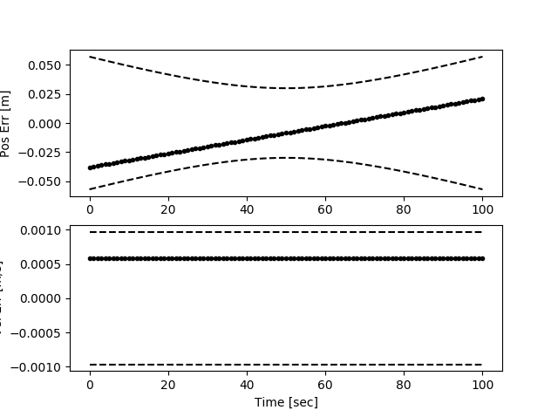
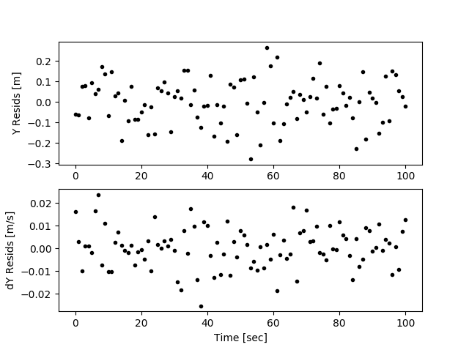
Balldrop Results - Batch

Slide 12
Balldrop Results - EKF
Error Statistics
Pos mean and std [m]: -0.008, 0.023
Vel mean and std [m/s]: 0.001, 0.002
Pos Resids mean and std [m]: -0.001, 0.104
Vel Resids mean and std [m]: -0.000, 0.009

Slide 13
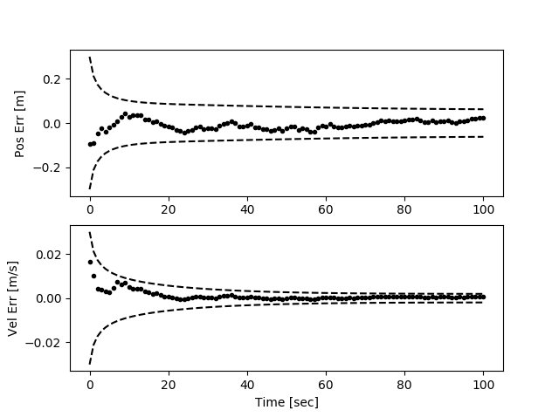
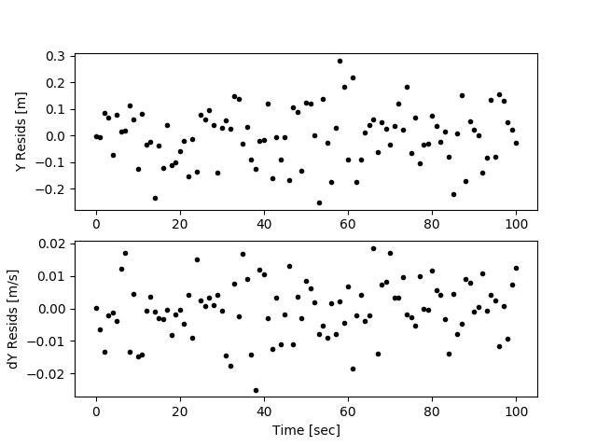
Balldrop Results - EKF

Slide 14
Test Case – Balldrop Discussion
Same measurements were used for batch and EKF runs
Batch converged after one iteration
Batch has small errors throughout, EKF errors converge quickly
EKF convergence criteria (trace(P) > 0.9*trace(P_prior)) met after 8 measurements processed
  This is the point it switches from CKF to EKF

Slide 15
Test Case – TwoBody GEO Setup
Assume an object in geostationary orbit tracked by a single ground-based optical sensor (nonlinear problem)
Measurements of topocentric right ascension and declination collected with standard optical constraints (object above horizon, station dark, object not eclipsed)
Simulation run for 24 hours, measurements attempted for 10 minutes, at 1 minute interval, at top of each hour, provided constraints are met
Measurement data are saved, no random seed set, can use same measurements in different estimators
State and Noise Parameters

Slide 16
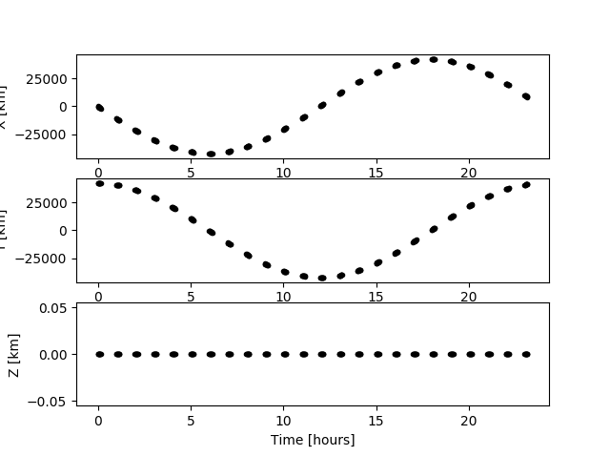
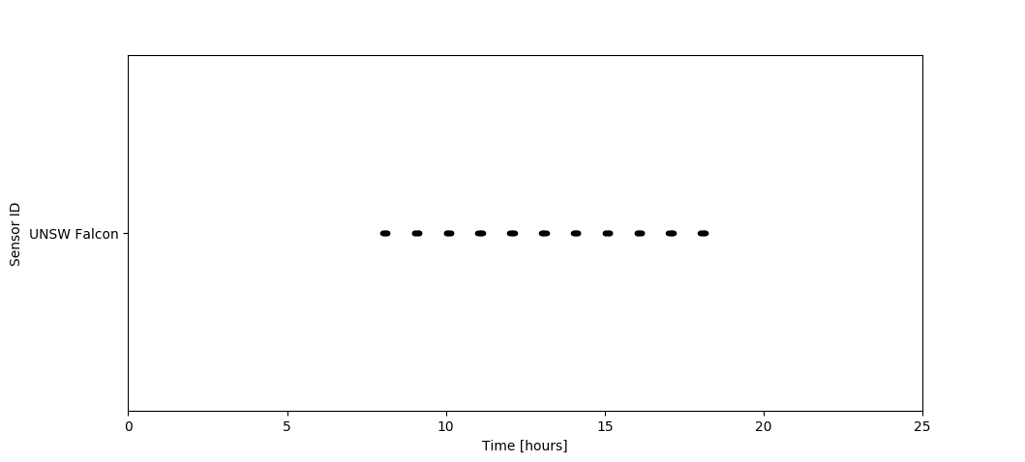
Test Case – TwoBody GEO Setup
Truth Data (Position)
Measurement Times

Slide 17
TwoBody GEO Results - Batch
Iteration Number: 1
xo_hat_mag = 1.3176562340750781
Iteration Number: 2
xo_hat_mag = 0.004967499699112295
Iteration Number: 3
xo_hat_mag = 2.106175913947732e-08
State Error and Residuals Analysis
Mean STD
----------------------------------------
X ECI [m] -1.31E+02 2.21E+02
Y ECI [m] 1.41E+02 6.08E+01
Z ECI [m] -9.36E-03 4.77E+01
dX ECI [m/s] 1.17E-02 9.93E-03
dY ECI [m/s] -1.20E-03 1.24E-02
dZ ECI [m/s] 1.35E-05 3.49E-03
Radial [m] 1.08E+02 1.52E+02
In-Track [m] -3.17E+01 2.32E+02
Cross-Track [m] -9.36E-03 4.77E+01
RA [arcsec] 1.15E-02 4.37E+00
DEC [arcsec] -2.31E-01 5.10E+00

Slide 18
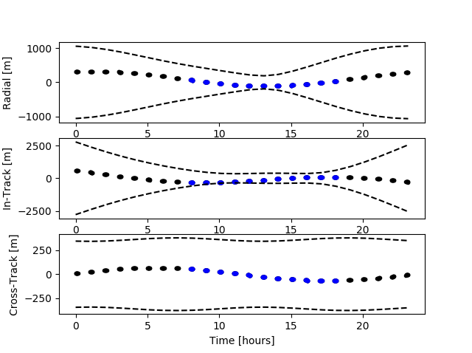
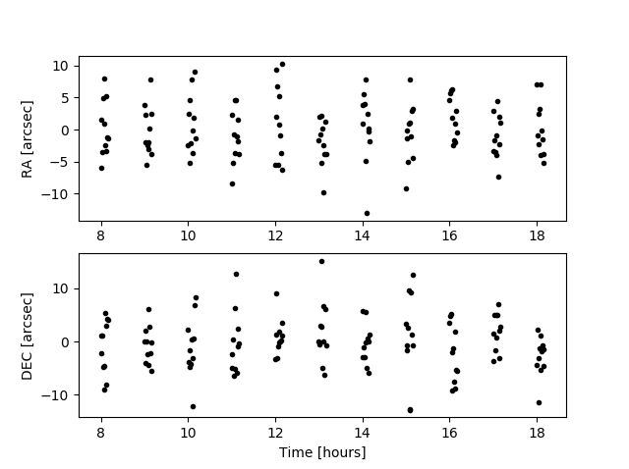
TwoBody GEO Results - Batch
RIC Errors
Measurement Residuals

Slide 19
Test Case – TwoBody LEO Setup
Assume an object in LEO polar/SSO tracked by a five ground-based laser sensors (nonlinear problem)
Measurements of range, topocentric right ascension and declination collected with standard constraints (object above horizon)
Simulation run for 12 hours, measurements attempted at 10 second interval from all sensors provided constraints are met
Measurement data are saved, no random seed set, can use same measurements in different estimators
State and Noise Parameters

Slide 20
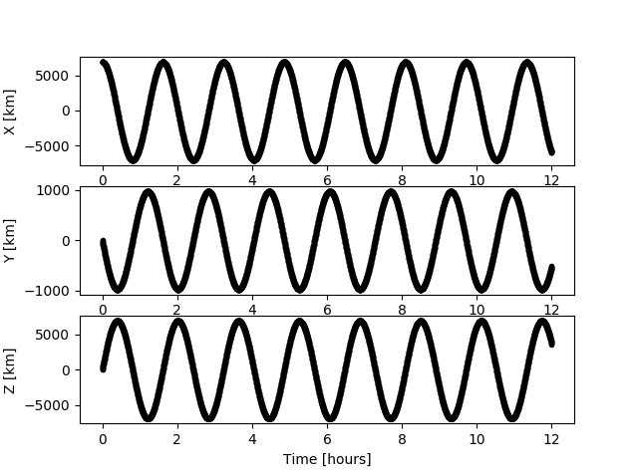
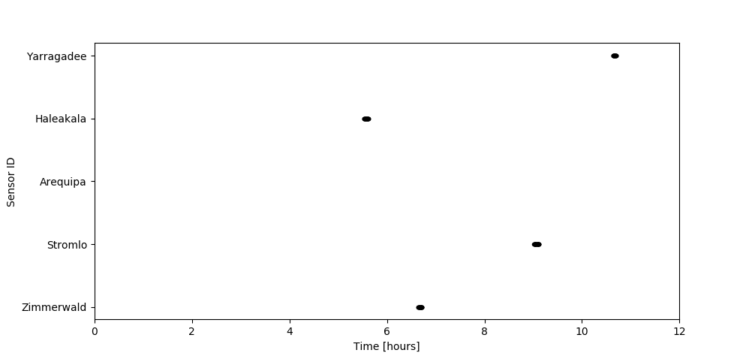
Test Case – TwoBody LEO Setup
Truth Data (Position)
Measurement Times

Slide 21
TwoBody LEO Results - Batch
Iteration Number: 1
xo_hat_mag = 22.81259142629789
Iteration Number: 2
xo_hat_mag = 21.482444790180732
Iteration Number: 3
xo_hat_mag = 0.034861221457569855
Iteration Number: 4
xo_hat_mag = 0.0436075782441822
Iteration Number: 5
xo_hat_mag = 1.2467396852626277e-07
State Error and Residuals Analysis
Mean STD
----------------------------------------
X ECI [m] 3.18E-02 2.35E-01
Y ECI [m] 4.19E-02 2.01E-01
Z ECI [m] -3.35E-01 2.17E-01
dX ECI [m/s] 4.53E-06 2.91E-04
dY ECI [m/s] -1.25E-05 2.19E-04
dZ ECI [m/s] 4.67E-06 2.82E-04
Radial [m] 4.40E-03 1.59E-01
In-Track [m] -1.52E-01 4.17E-01
Cross-Track [m] 5.12E-03 1.86E-01
Range [m] -6.12E-03 1.03E+00
RA [arcsec] -2.61E-01 5.43E+00
DEC [arcsec] 3.44E-01 4.91E+00

Slide 22
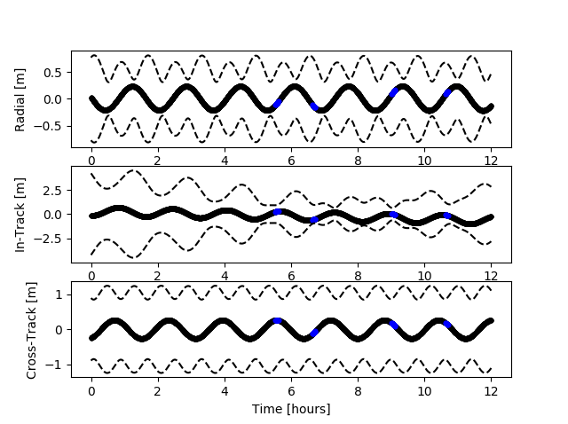
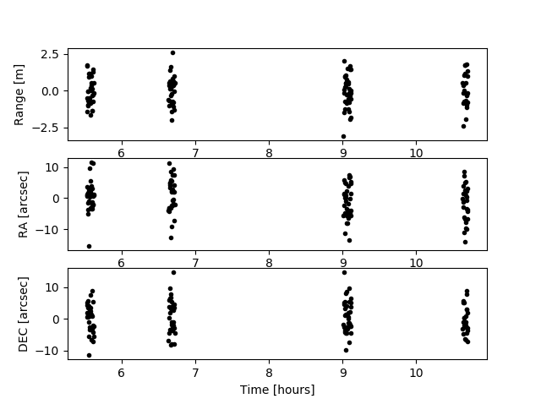
TwoBody LEO Results - Batch
RIC Errors
Measurement Residuals

