Slide 1
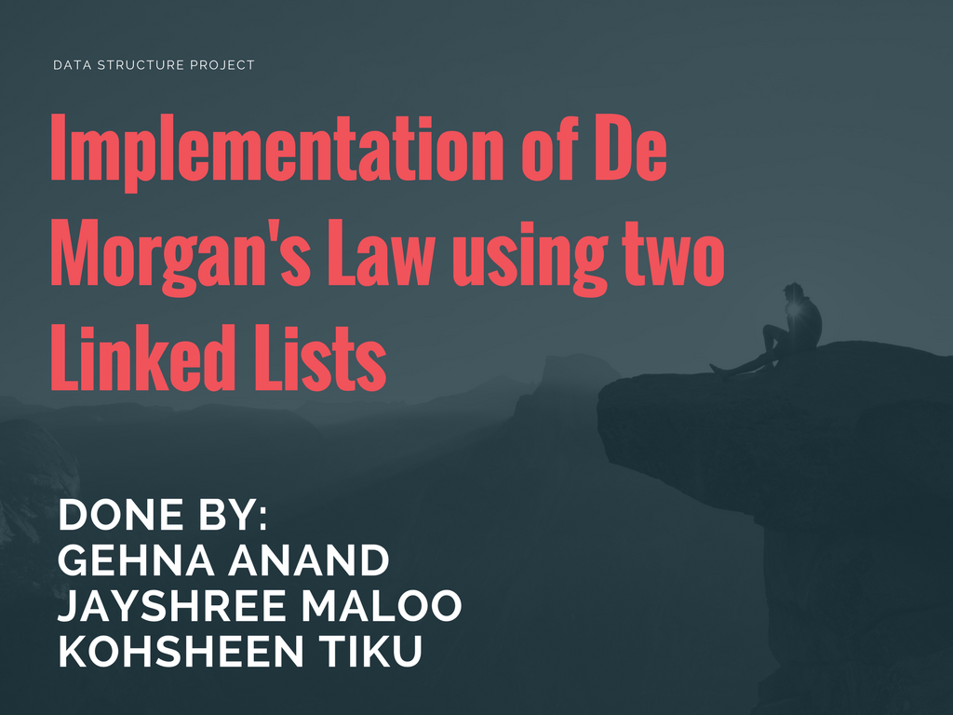

Slide 2


Slide 3
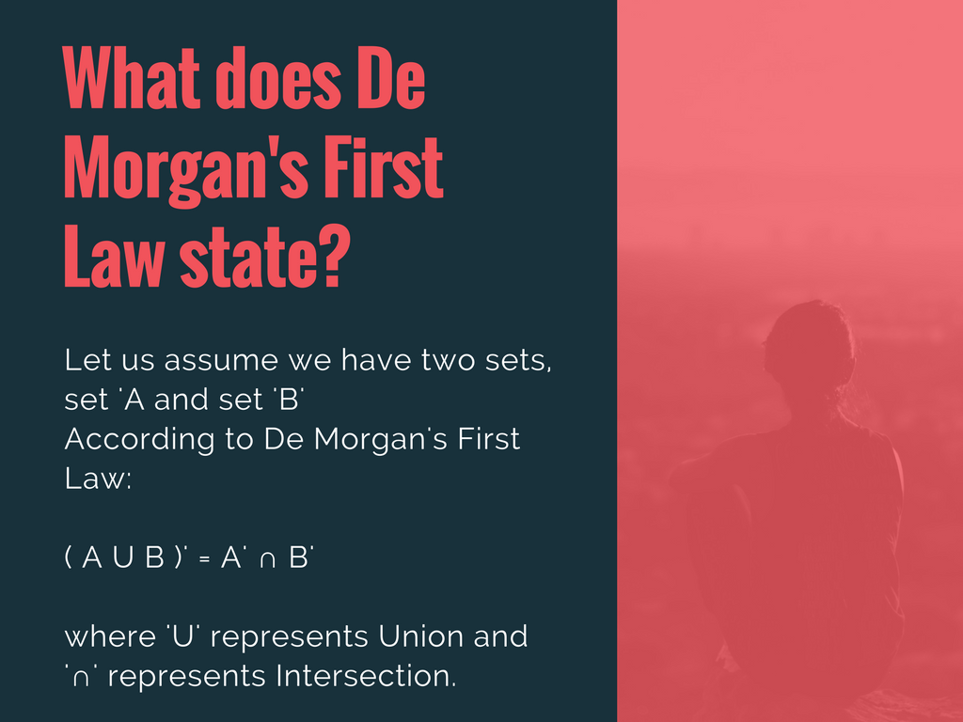

Slide 4

HENCE, (A U B)’ = A’ ∩ B’
FIRST LAW VERIFIED

Slide 5


Slide 6
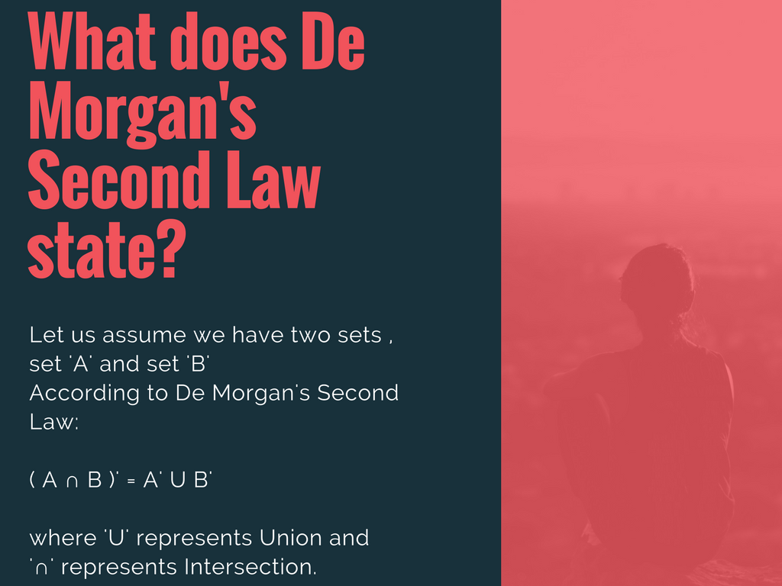

Slide 7

HENCE, (A ∩ B)’ = A’ U B’
SECOND LAW VERIFIED

Slide 8


Slide 9
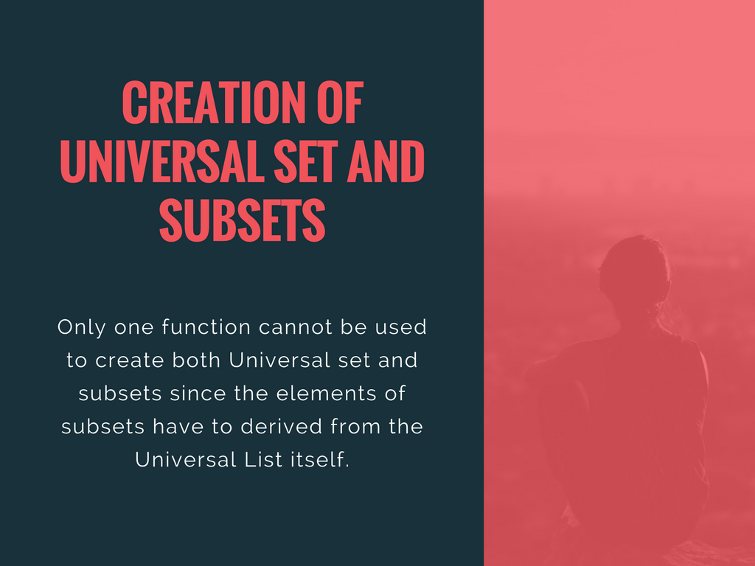

Slide 10
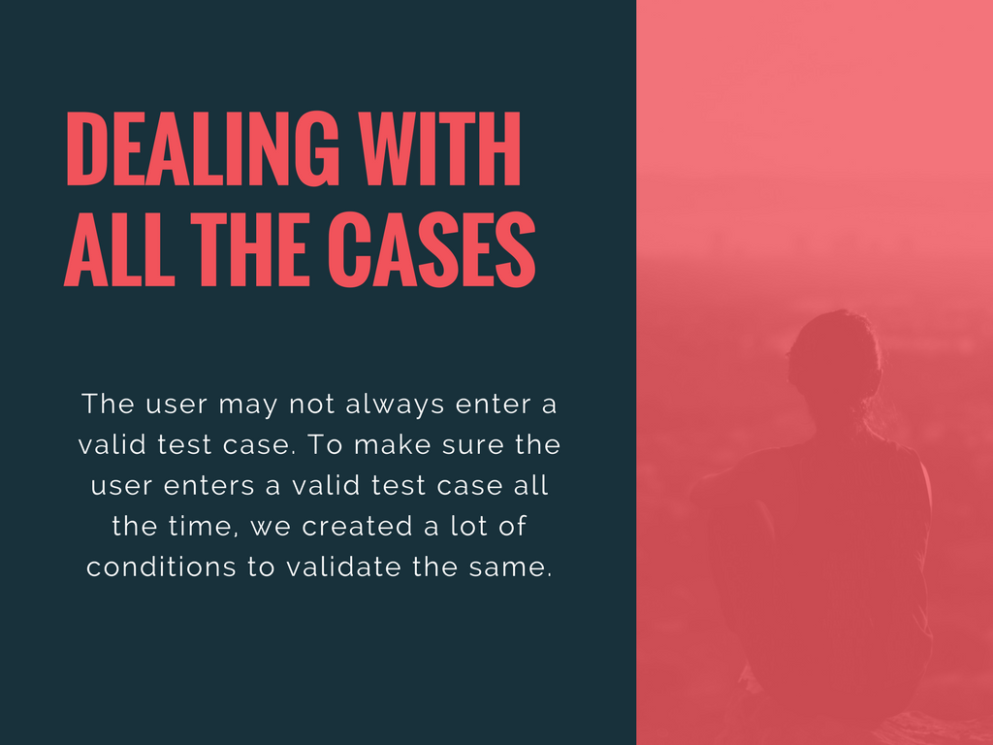

Slide 11
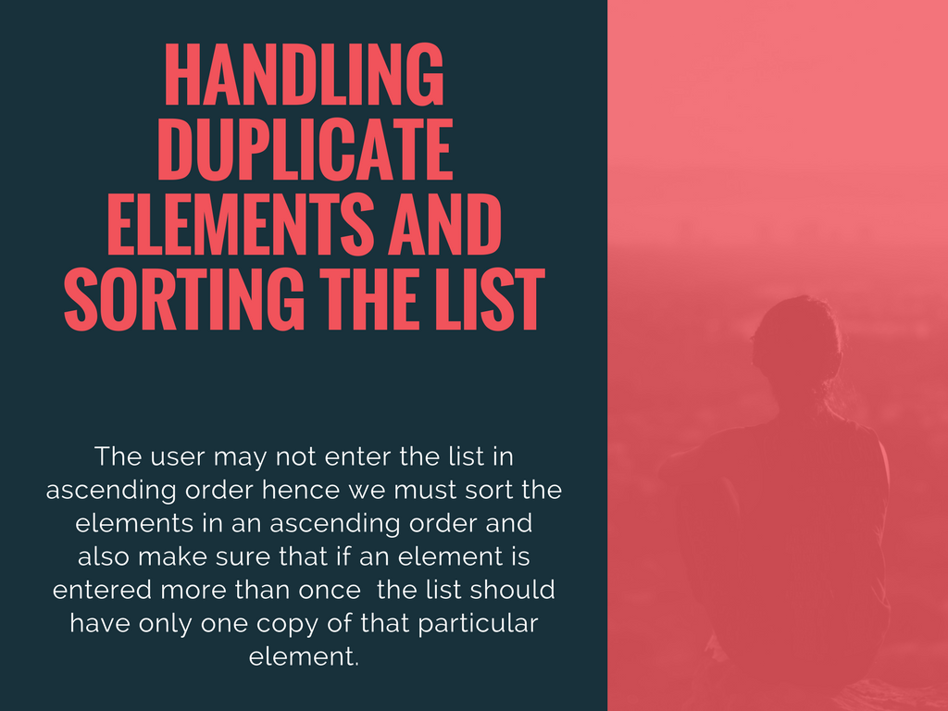

Slide 12

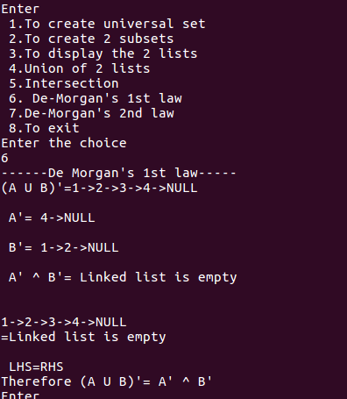
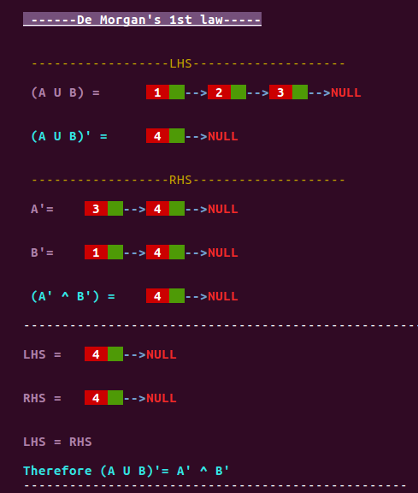

Slide 13
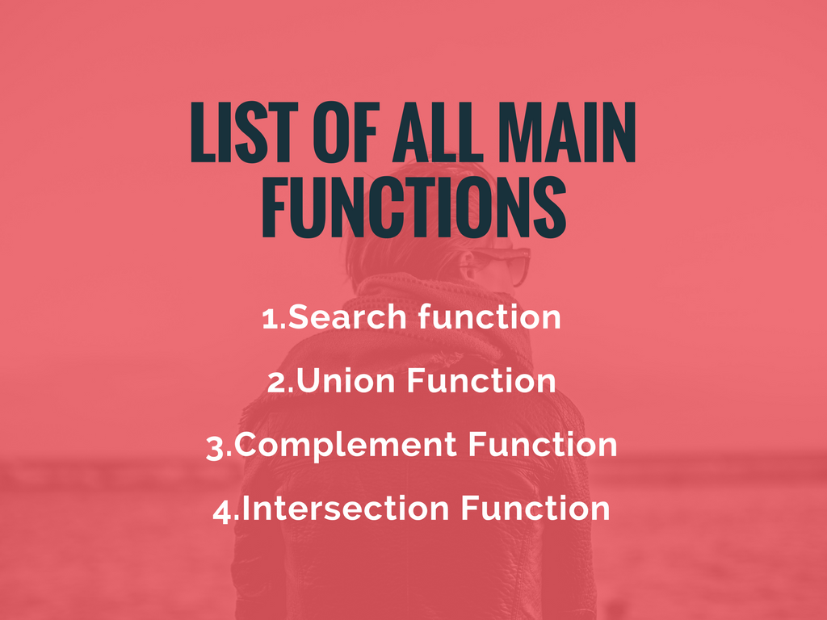

Slide 14


Slide 15
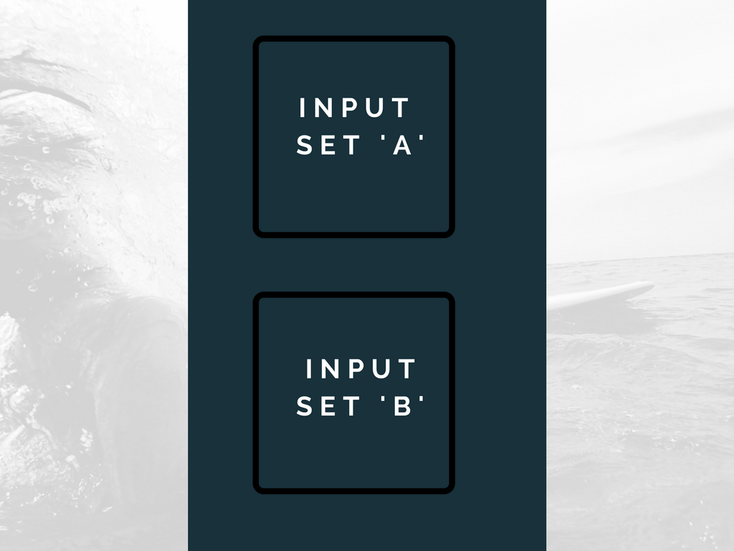

Slide 16
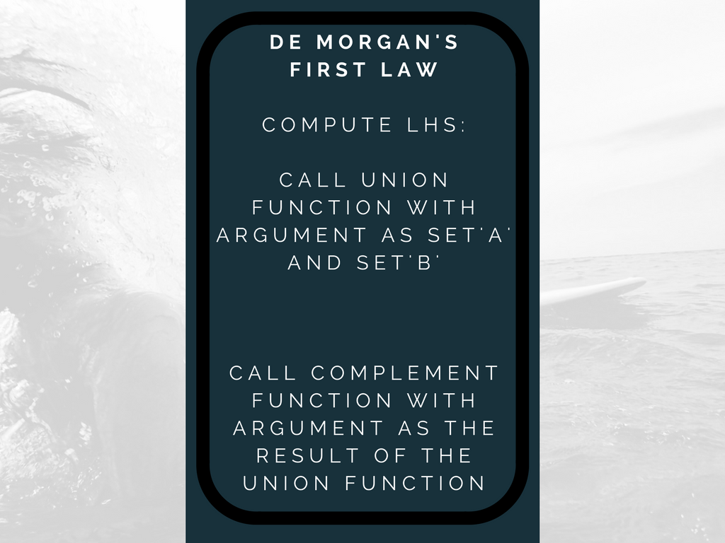

Slide 17
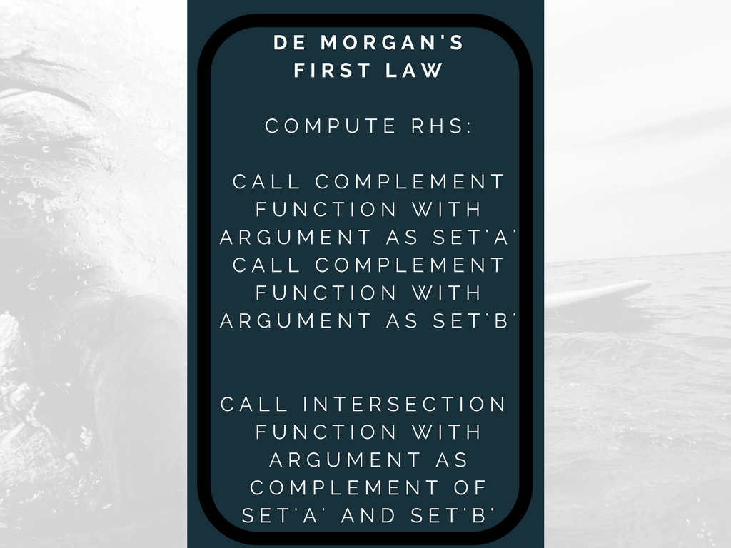

Slide 18


Slide 19
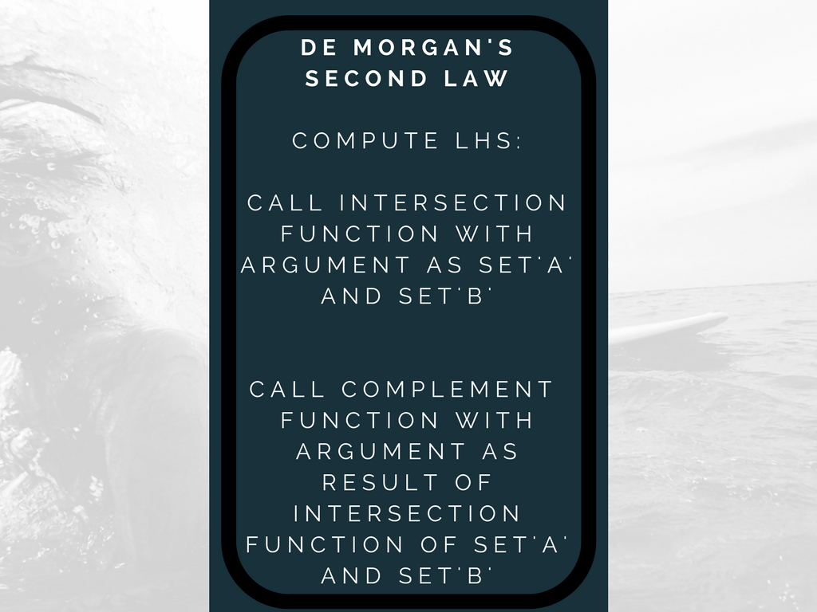

Slide 20
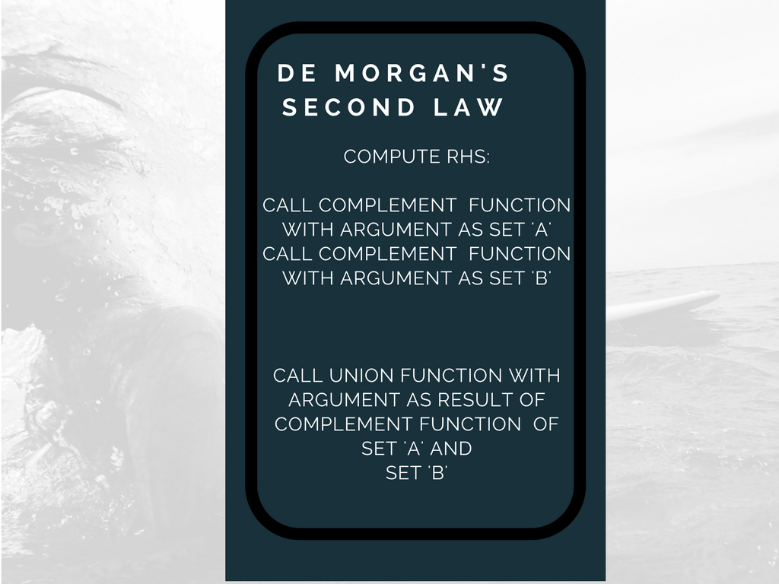

Slide 21


Slide 22


