Slide 1
Notes:
31-Mar-2018
Updated slides and re-organized a little
Check slide notes for details

Slide 2


Deploying and managing PeopleSoft on Oracle Cloud Infrastructure
Oracle PeopleSoft Cloud Manager Hands-On Lab
PSFT CM Development Team
Oracle

Slide 3


PeopleSoft Cloud Manager
Features for Oracle Cloud
Self Service Deployment
Manage Life Cycle
One touch provisioning
Rapid, on-demand deployment
Manage instances - create Demo, Dev, Test or Prod environments
Subscribe to Update Release Channels
Set up PUM environments
Safely test and evaluate new features and customizations
PeopleSoft
Cloud Manager
Publish App Blueprints
Migrate to Cloud
Customize your application deployment
Define your topology
Monitor and scale up to workloads
Lift and Shift your on-premise systems to Cloud
Securely backup and restore your PeopleSoft environments on Oracle Cloud
Notes:
Let us take a look at what we mean by extension of SaaS applications.
For successful SaaS adoption, modern Cloud applications need to offer the ability to easily Personalize the applications for business needs, Connect them to other Cloud, on-premise, mobile and 3rd party applications, and Secure them as per their organizational standards. We will go deeper into each of these areas of Personalized, Connected and Secure and show how Oracle Cloud offers these capabilities of a Modern Cloud application.

Slide 4
https://www.oracle.com/corporate/events/cloudtestdrive https://github.com/rkon02/TestDrive

Slide 5

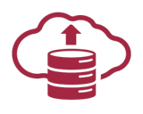


Running PeopleSoft on Oracle Cloud – More with Less
Cloud Manager Automation
Automation
Infrastructure Deployment
PeopleSoft Services
Create your services
Define Blueprint
Self Service
Deploy test, UAT, prod
Clone
30%
Manage Life Cycle
PUM updates
Tools Update
Tools Upgrade
On demand Scaling
Backup, Restore
Migrate
Lift and Shift
Migration Tools
Import database
60%
25%
Notes:
Open with how configuration is typically performed for PeopleSoft applications.
PeopleSoft Administrator spend manual, repetitive and exhaustive tasks for configuring env.
Discuss Use Cases :- How to you create environments , and configure them for demo, staging and prod?
How do we keep configuration identical between systems – Production and Staging?

Slide 6


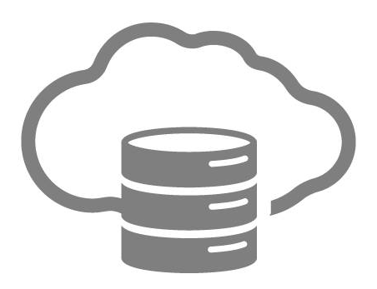





Build your own service offerings
Your own Service Offerings
Cloud Manager
“Know It & Demo” Service
Subscribe to updates
“PeopleTools update testing” Service
+
=
“Dev & test” Service
Move & Improve
Application Packages
Topology
Environment Templates
On Premise Instances
“Selective Adoption” service
Notes:
Change business configuration
Review newly delivered features
Develop new customization
Test impact of planned changes
End user training
Roll out new applications
Deploy to new geographies/BUs

Slide 7



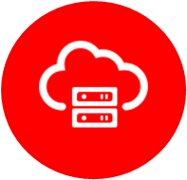
PeopleSoft Cloud Manager
Deployment
Cloud Manager
Image 10 available in
OCI Marketplace
Setup OCI Network infrastructure
VCN, Subnet, Sec list, Users
Install CM on Compute VM
Bootstrap installation
Configure Settings
Set MoS credentials
Linux/Windows VM OCID
Cloud Manager Manager Image
HTTPS
PeopleSoft Environments
PeopleSoft Cloud Manager VM
Your Tenancy
Oracle Cloud
7

Slide 8


Storyboard
Go to LAB Workbook :
Workshop Overview → Workshop Overview
What
How
Notes
Exercise 1: Log in to Your Trial Tenancy
Get trial account details from your email
Sign-up for a trial account at the welcome desk
Download and run the Cloud Manager network automation package script
Download, run the automation package , generate keys , Package scripts and upload to Resource Manager
Exercise 2: Generate keys and package automation script
Exercise 3: Deploy automation through resource manager cloud stack
Launch Resource Manager Stack
Create a new instance from Marketplace
Create user, group, compartment and network resources
Cloud (OCI)
Subscribe and accept license agreement of CM and Linux Ref image
Bootstrap install of CM
Exercise 4: Log in to Cloud Manager , configure Settings and Subscribe to Release channels
Configure Settings of CM, Create File Server and Subscribe to Channel
Use the Oracle PeopleSoft Cloud Manager user interface
Exercise 5: Create Template and Provision PUM instance
Create new topology and template for PUM, and provision a environment
Use the Oracle PeopleSoft Cloud Manager user interface

Slide 9
Workshop Architecture
Download and run install package
Generate SSH and API keys
Repackage and upload scripts
Provision OCI Resources using Resource Manager
Creation of OCI resources
Creation of Network resources
Creation of CM compute VM
Installation of CM bootstrap
Configure Settings
Define MoS credentials
Set Linux Ref Image OCID
Subscribe to Release channel
Create Env1
Create Template
Provision Env
Cloud Marketplace
PeopleSoft Cloud Manager Image
Resource
Manager
HTTPS
Env 1
SSH
Env 2
Laptop
Modern Browser
Git Bash for Win
PeopleSoft Cloud Manager VM
Trial Tenancy
Oracle Cloud Infrastructure
CM Automation Script
OCI Console
Git Bash for Windows
9

Slide 10
Hands-on Lab Setup

Slide 11
Set Up Lab Workstation
Go to HOL Workbook :
2. Requirements
Connect to WIFI – no VPN usage
[ADD WIFI Connectivity Information HERE]
Validate Prerequisites
Modern browser (Google Chrome, Mozilla Firefox)
Do not use Safari as it is not compatible with the OCI Console
Ensure Git Bash is installed on your laptop/workstation.
Download automation scripts bundle ‘psftcm-setup.zip’ – DOWNLOAD
Notes:
Review based on Security solution
Add Wifi info

Slide 12
Exercise 1
Exercise 1: Log in to Your Trial Tenancy

Slide 13
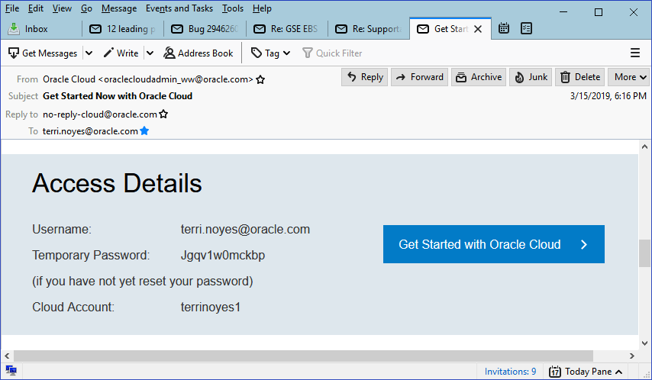
Registration Email

Slide 14
Exercise 2
Exercise 2: Generate keys and package automation script

Slide 15
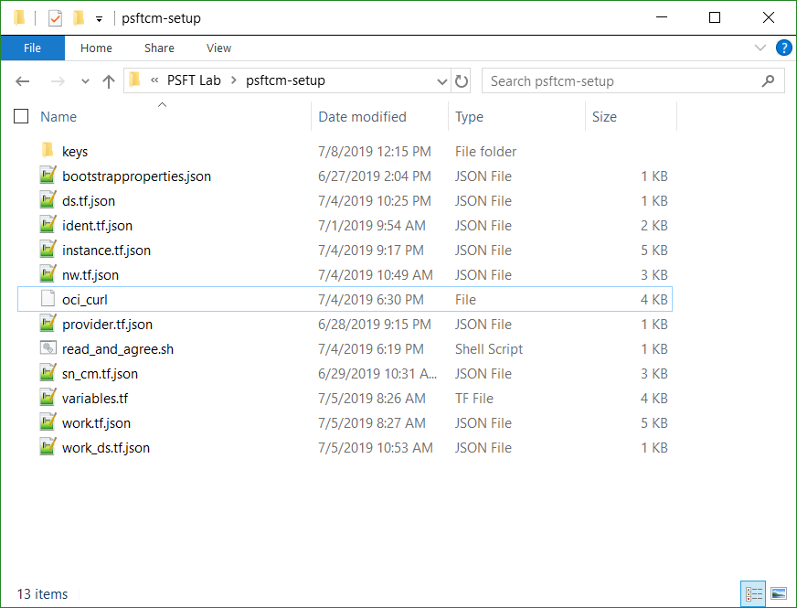
Prepare automation package
Extract psftcm-setup.zip to a new folder on the laptop/workstation. Let’s call it ‘psftcm-setup’.

Slide 16
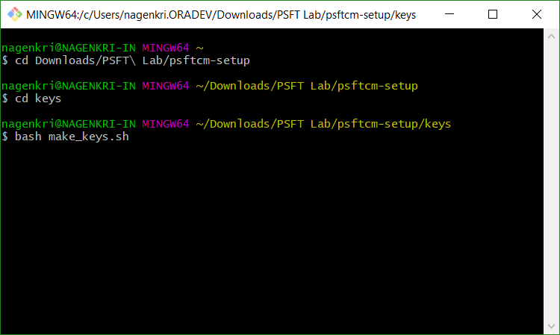
Generate SSH and API key
Launch Git Bash command line and navigate to the newly extracted folder – ‘psftcm-setup’.
Change directory to “keys” folder, under the extracted folder

Slide 17
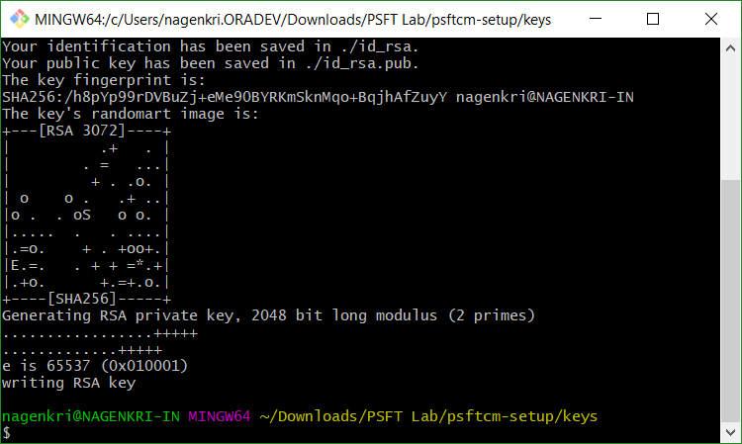
Generate SSH and API key
Run the script “bash make_keys.sh

Slide 18
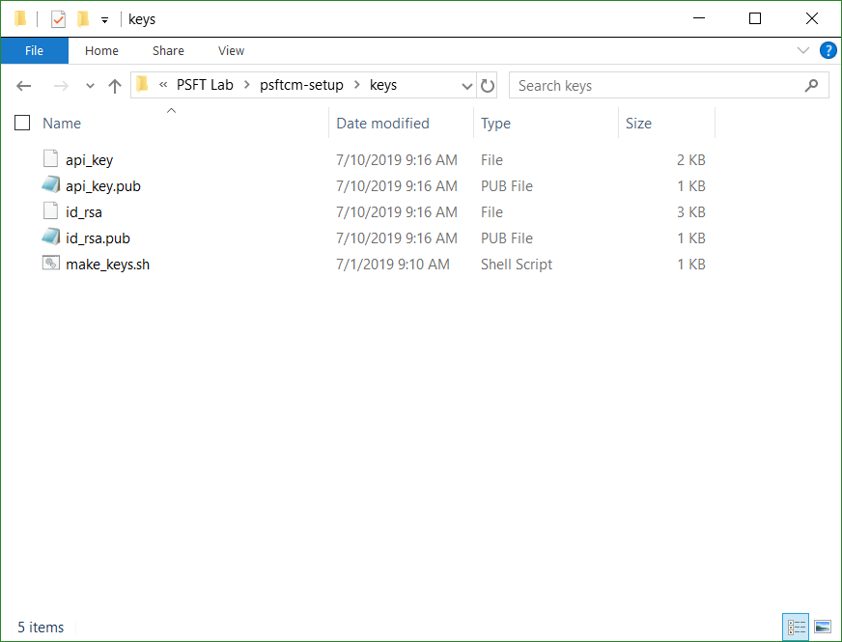
Review keys
Below set of key files are generated. There are two sets of keys –
API Signing keys – api_key and api_key.pub
SSH key pair – id_rsa and id_rsa.pub

Slide 19
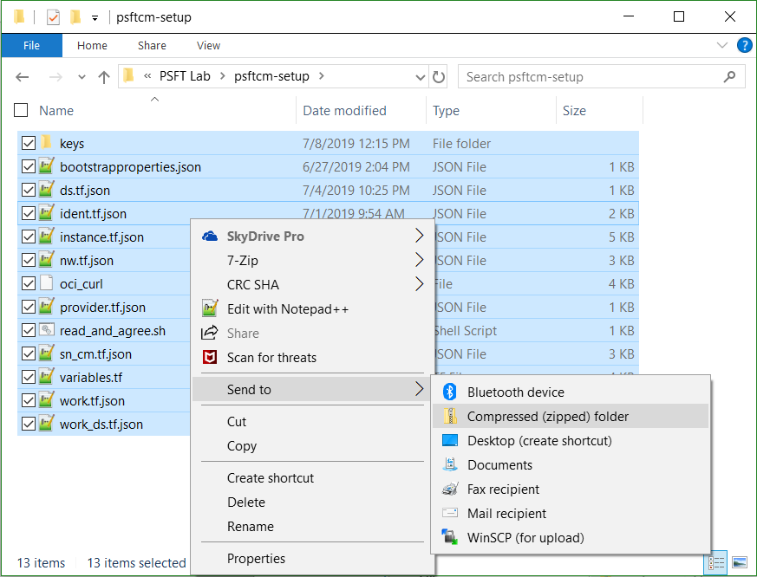
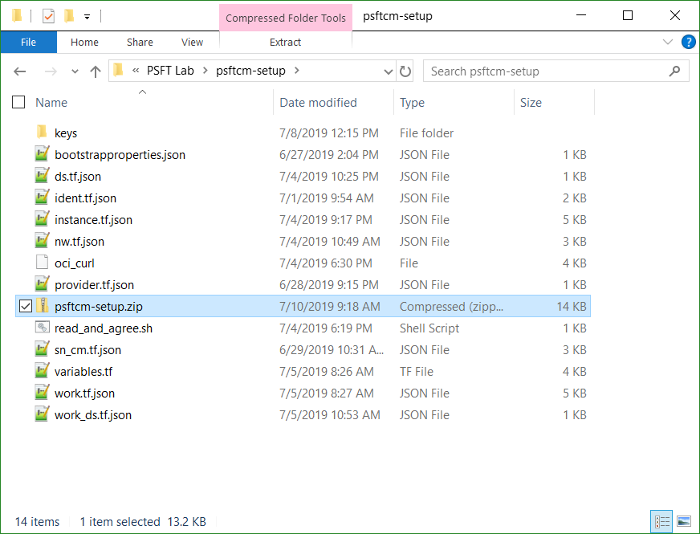
Package Keys
Zip the contents in the extracted folder into a new zip file. Let’s call it ‘psftcm-setup-3.0.zip’. Note – The zip file should be created as shown below. Select all files → right-click → Send to → Compressed folder. Rename the zip file.

Slide 20
Exercise 3
Exercise 3: Deploy automation through Resource Manager and Cloud Stack

Slide 21
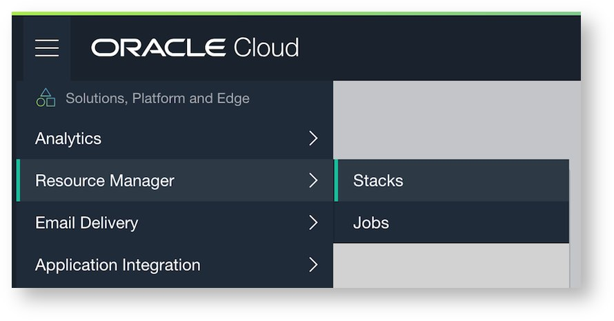
Oracle Cloud Infrastructure Resource Manager
OCI Resource Deployment Automation with Terraform

Slide 22
Resource Manager Deploys OCI Resources
Users/Groups
Firewall
OCI Region
Availability Domain – 1
Availability Domain – 2
AD – 3
Compartment – “PSFT_Lab”
ID & Access
Management
VCN – “labnet (10.0.0.0/16)
Public Subnet
“cm”
10.0.6.0/24
Public Subnet
“envs”
10.0.7.0/24
Security Lists
Cloud Manager
Internet Gateway
Policies

Slide 23
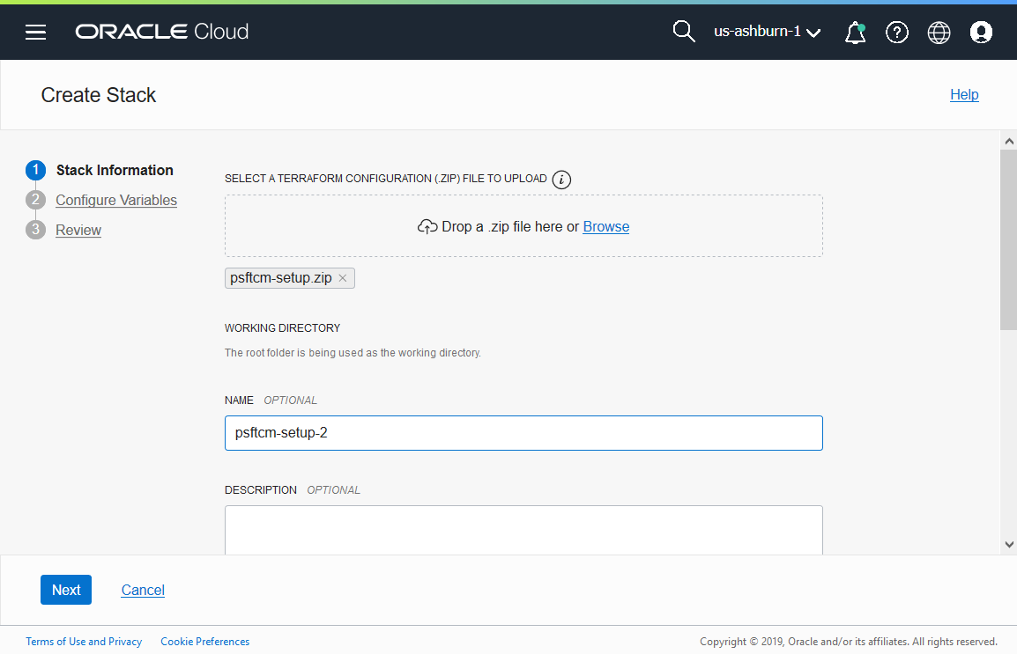
Resource Manager Deployment
Logon to OCI Console
In a browser, launch the OCI console and navigate to Resource Manager →Stacks
Add a new stack by uploading the newly created psftcm-setup.zip file.

Slide 24
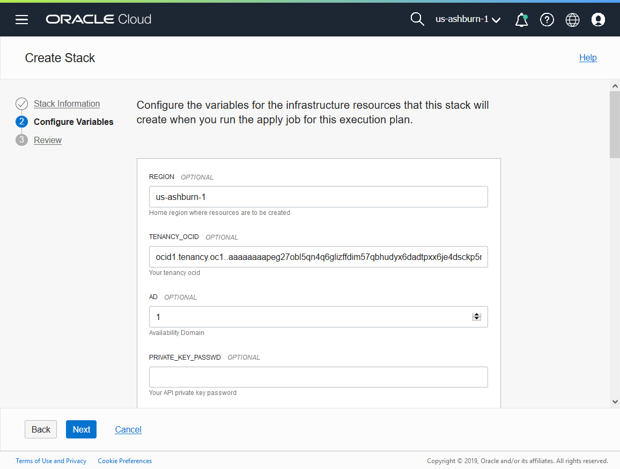
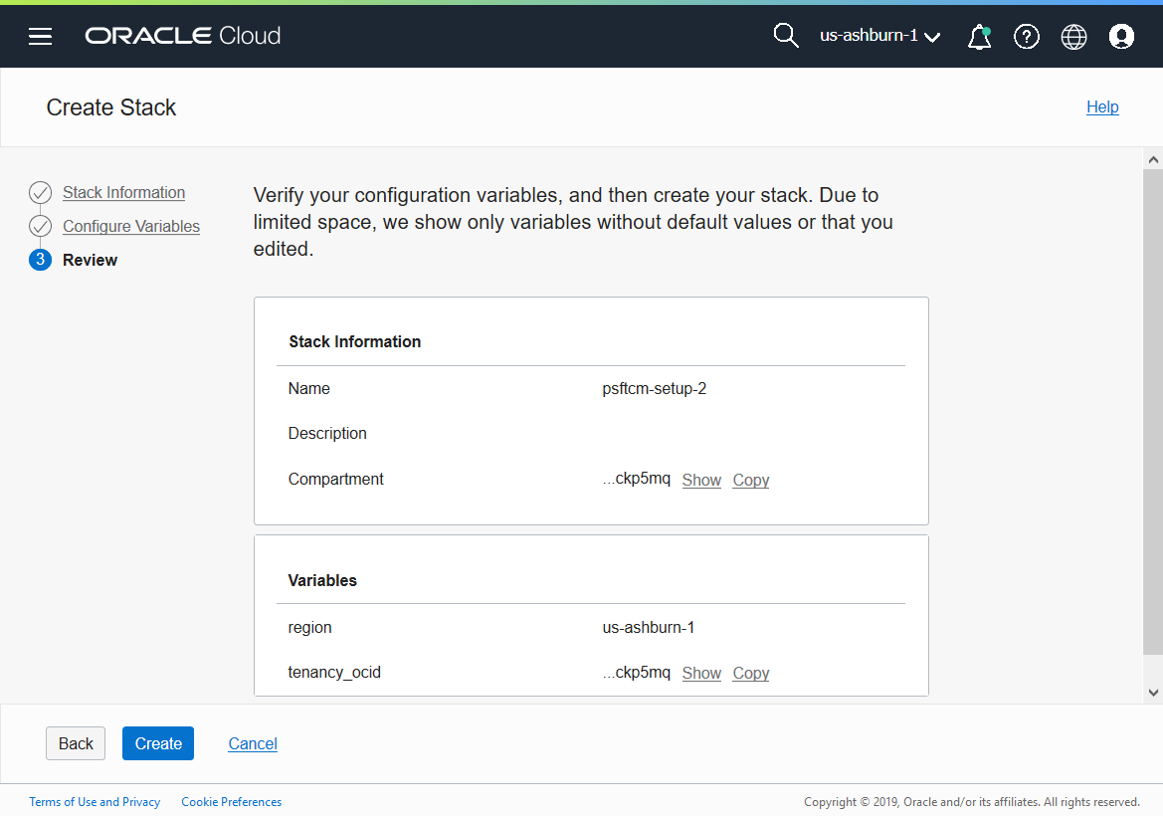
Using Resource Manager
Click Next..
Click Create. This will add a new stack and open the stack details page.

Slide 25
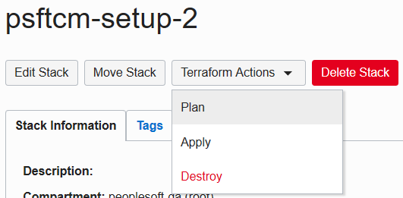
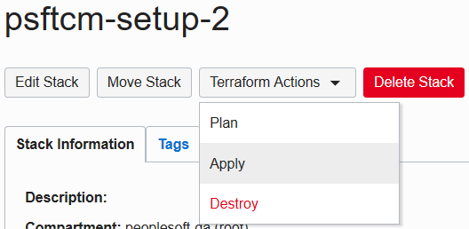
Deploy CM using Resource Manager
On the stack details page, under “Terraform Actions”, click Plan.
After the Plan completes successfully, run Terraform Apply.

Slide 26
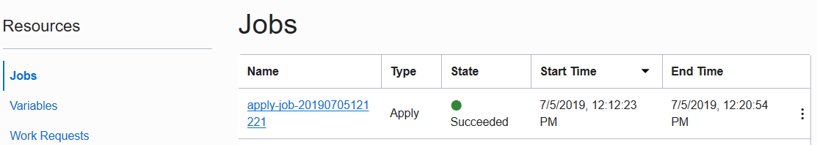
Deploy using Resource Manager
Terraform Apply job is a long running process. After it completes, the output from this job will have the IP address and PIA URL of CM instance. To obtain those details, click on the Job name.

Slide 27
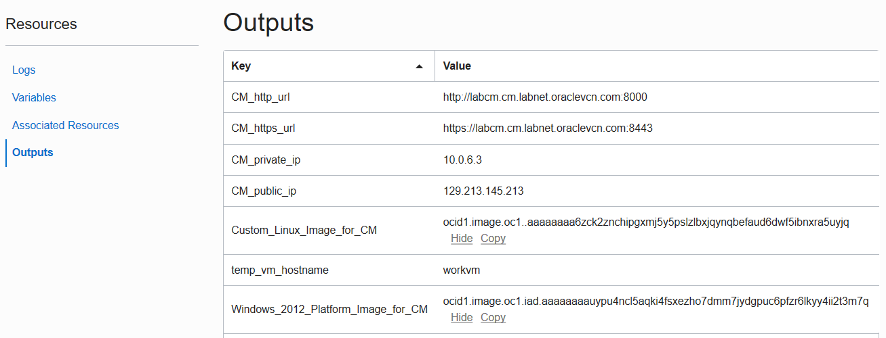
Deploy using Resource Manager
On the job details page, click on Output link under Resources.
Make a note of Custom_Linux_Image_for_CM and Windows_2012_Platform_Image_for_CM values. These OCIDs will be required in the next section.
Make a note of CM_public_ip and CM_http_url.

Slide 28
Completing CM deployment
Wait for Terraform job to complete
Add an entry to C:\Windows\System32\drivers\etc\hosts entry on your laptop/workstation as shown below. Use the hostname value for attribute
Add an entry 129.213.145.213 labcm.cm.labnet.oraclevcn.com

Slide 29
Exercise 4
Exercise 4: Log in to Cloud Manager , configure Settings and Subscribe to Release channels

Slide 30
Making Resources available
Delete the temporary workvm
On the OCI console, navigate to Menu → Compute → Instances. Click on the ‘workvm’. Delete this instance, by clicking on Actions → Terminate. Wait for few seconds for the status to change to TERMINATING or TERMINATED.

Slide 31
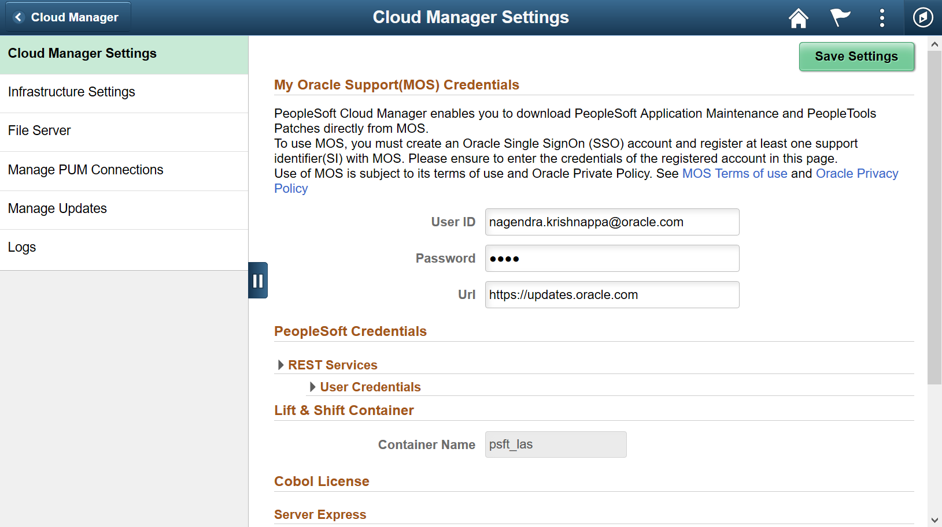
Configuring Cloud Manager
Navigate to Cloud Manager Dashboard | Cloud Manager Settings | Cloud Manager Settings
Update My Oracle Support (MOS) Credentials. This is required to download DPKs and PRPs automatically.

Slide 32
Configuring Cloud Manager Settings
Navigate to Infrastructure Settings and update Operating System Images using below provided OCIDs. Use the OCIDs that were obtained in earlier steps.
Save
Click ‘Refresh OCI Metadata’ button on top of the page and wait for few minutes
Linux | ocid1.image.oc1..aaaaaaaa6zck2znchipgxmj5y5pslzlbxjqynqbefaud6dwf5ibnxra5uyjq
Windows | ocid1.image.oc1.iad.aaaaaaaauypu4ncl5aqki4fsxezho7dmm7jydgpuc6pfzr6lkyy4ii2t3m7q
Windows Password | Any complex password. For e.g zScSGFEhV^sQ6

Slide 33
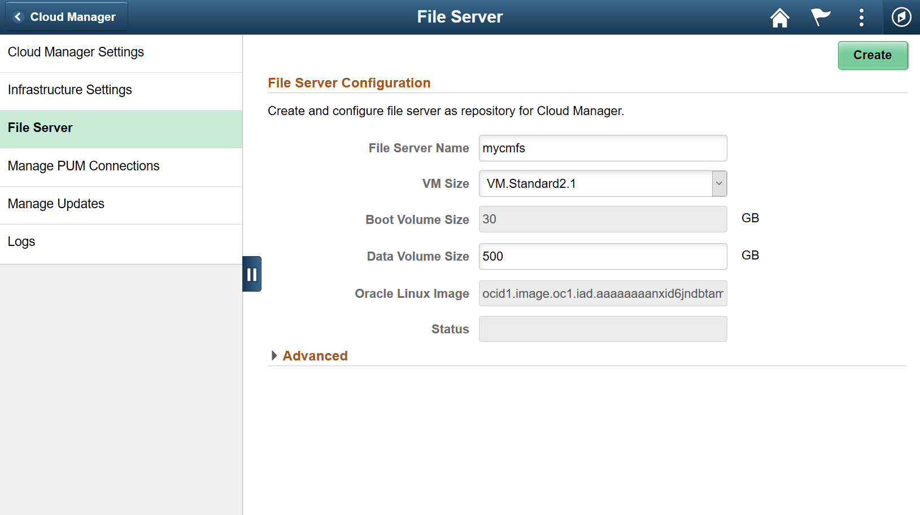
Configuring File Server
Next, navigate to File Server tab. Provide the following inputs and hit Create
File Server Name | mycmfs
VM Size | VM.Standard2.1 (Modify in case your tenancy does not have this shape)
Boot Volume Size | 30 GB
Data Volume Size | 500 GB

Slide 34
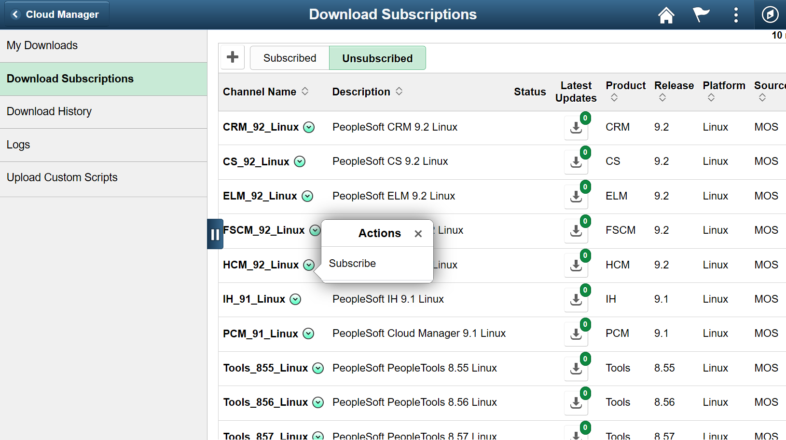
Subscribe to Channels
Subscribe to Channels
Navigate to Cloud Manager Dashboard Repository → Download Subscriptions→
Go to the Unsubscribed tab
On a download channel of your choice, click on related actions menu and click Subscribe. E.g, HCM_92_Linux.

Slide 35
Exercise 5
Create Template and Provision PUM instance

Slide 36
Topology Edits
Navigate to Dashboard | Topology | PUM Fulltier topology. This topology will be used to create a new
Review the nodes and update the Shapes. Click Full Tier node and select a shape that is available in your AD 2. In this case, select VM.Standard2.1.
Delete the Windows node from the topology. Click ‘Delete’ on the page shown below and save the topology.

Slide 37
Create New Template
Navigate to Dashboard | Environment Template. Click Add New Template button. Provide below details and click Next
On Select Topology page, click on search icon to search for a topology and select the PUM Fulltier topology you modified in earlier step
Select Custom attributes , Click Edit
Expand the Region and Availability Domains section. Select the Region and Availability Domain in which Cloud Manager instance is NOT deployed (AD-2).
Click Next, Review and Submit

Slide 38
Create Environment
Navigate to Dashboard | Environments. Click Create Environment button.
Provide a unique environment name. Select the Template that was created in previous section – MYPUM. Expand all sections under Environment Attributes and provide all inputs. Use the table given below for quick and default values. Click Done to begin the environment provisioning process.
Monitor the deployment logs under Dashboard | Environments | <Environment> | Action Menu | Details | Logs

Slide 39
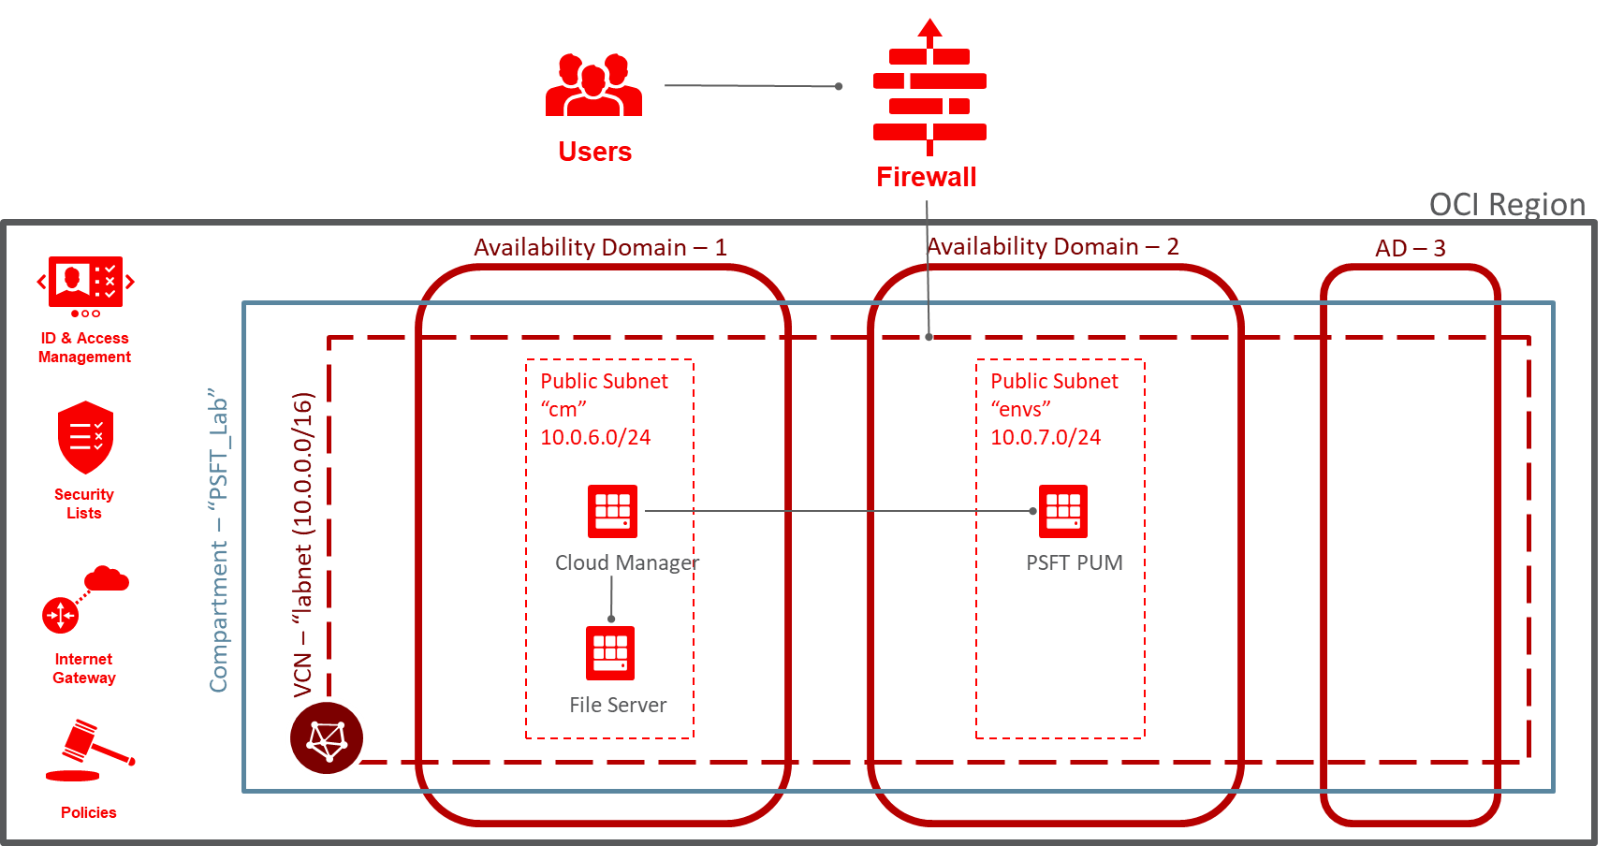
After deployment…

Slide 40
Summary

