Slide 1
Comparisons in performance between python Implementations
Gehrig Weber

Slide 2
IMPLEMENTATIONS CONSIDERED
CPython 2
CPython 3
Default Python interpreters
PyPy 2
PyPy 3
Just-in-time Python compilers
IronPython
Runs Python 2 on the .NET runtime (CLR)
Jython
Runs Python 2 on the Java Virtual Machine

Slide 3
BENCHMARK PROGRAMS USED
Binary Trees 2
Allocates and deallocates numerous perfect binary trees of increasing depth, from 4 to N
Fannkuch Redux 6
Involves iterating through N! permutations of 1 to N and doing O(n) work for each
N-Body 2
Involves performing a constant number of calculations N times
N-Body 1
Same as above, but uses “** 0.5” instead of “math.sqrt()”
Pi Digits 4
Prints the first N digits of pi
Spectral Norm 6
Calculates the spectral norm of an N-by-N matrix

Slide 4
BENCHMARK PROGRAMS USED
N Queens
Uses backtracking to return all possible solutions to the N queens problem: Can N queens be placed on an N-by-N chess board without threatening each other?
Knight’s Tour
Implements Warnsdorff’s algorithm to return an open tour of an N-by-N chess board with a knight, if one exists
Starting point is always the top left corner of the board
Four Squares
Involves going through N!/(N - 7)! Iterations, and doing constant work at each
100 Prisoners
Involves going through N iterations of a constant-time simulation

Slide 5
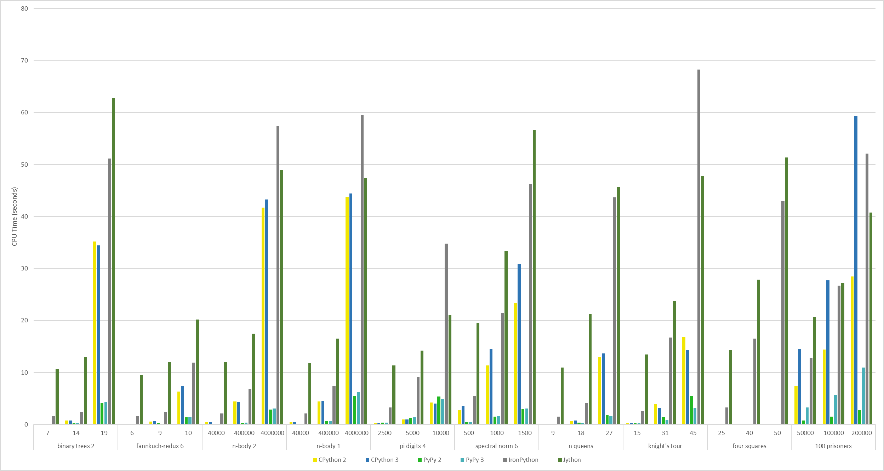
PERFORMANCE COMPARISONS

Slide 6
PYPY
An implementation of Python that uses a tracing just-in-time (JIT) compiler
Like most compilers, is faster than CPython’s interpreter
Ends up being faster than IronPython and Jython’s JIT compilers
PyPy 2 is faster than PyPy 3 largely because CPython 2 is faster than CPython 3
Efficient garbage collector that results in programs using less memory
PyPy 2 is compatible with all of Python 2.7’s core language
PyPy 3 is compatible with most of Python 3.6.9’s core language

Slide 7
CPYTHON
The default Python implementation
Uses an interpreter
Ends up being faster than IronPython and Jython’s JIT compilers
CPython 2 is faster than CPython 3 due to the fact that, in CPython 3, an int is what a long was in CPython 2, and longs do not exist
Thus, every operation with an int takes longer in CPython 3

Slide 8
JYTHON
And then you explain what it is and why its FASTER THAN OTHEr 2 (USUALLY), maybe a little repeat of why Slower than pypy and cpython and iron, will be mostly same as ironpython reasosn
ALSO ADVANTAGES OF JVM

Slide 9
IRONPYTHON
And then you explain what it is and why its FASTER THAN OTHEr 2 (USUALLY), maybe a little repeat of why Slower than pypy and cpython
ALSO ADVANTAGES OF NET

Slide 10
EXCEPTIONS
JUST KEEP GOING UNTIL DONE
Probably include smol graphs
Also mention exact numbers where it would help

Slide 11
EXCEPTIONS
JUST KEEP GOING UNTIL DONE
Probably include smol graphs

Slide 12
CONCLUSIONS
?
Maybe
Rember to add links to programs, proboboly in writeup, but maybe here, too

