Slide 1
Comparisons in performance between python Implementations
Gehrig Weber

Slide 2
IMPLEMENTATIONS CONSIDERED
CPython 2
CPython 3
Default Python interpreters
PyPy 2
PyPy 3
Just-in-time Python compilers
IronPython
Runs Python 2 on the .NET runtime (CLR)
Jython
Runs Python 2 on the Java Virtual Machine (JVM)

Slide 3
BENCHMARK PROGRAMS USED
Binary Trees 2
Allocates and deallocates numerous perfect binary trees of increasing depth, from 4 to N
Fannkuch Redux 6
Involves iterating through N! permutations of 1 to N and doing O(n) work for each
N-Body 2
Involves performing a constant number of calculations N times
N-Body 1
Same as above, but uses “** 0.5” instead of “math.sqrt()”
Pi Digits 4
Prints the first N digits of pi
Spectral Norm 6
Calculates the spectral norm of an N-by-N matrix

Slide 4
BENCHMARK PROGRAMS USED
N Queens
Uses backtracking to return all possible solutions to the N queens problem: Can N queens be placed on an N-by-N chess board without threatening each other?
Knight’s Tour
Implements Warnsdorff’s algorithm to return an open tour of an N-by-N chess board with a knight, if one exists
Starting point is always the top left corner of the board
Four Squares
Involves going through N!/(N - 7)! Iterations, and doing constant work at each
100 Prisoners
Involves going through N iterations of a constant-time simulation

Slide 5
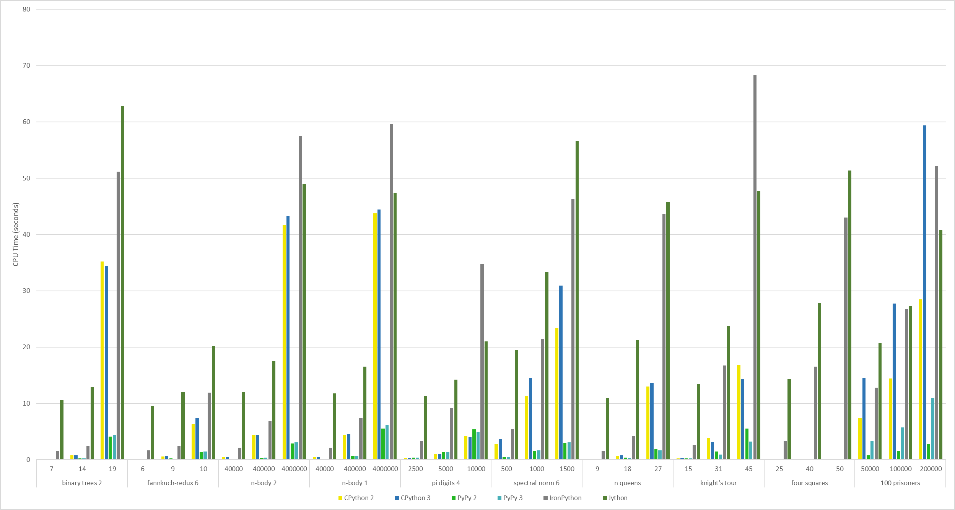
PERFORMANCE COMPARISONS

Slide 6
PYPY
An implementation of Python that uses a tracing just-in-time (JIT) compiler
Like most compilers, is faster than CPython’s interpreter
Ends up being faster than IronPython and Jython’s JIT compilers
PyPy 2 is faster than PyPy 3 largely because CPython 2 is faster than CPython 3
Efficient garbage collector that results in programs using less memory
PyPy 2 is compatible with all of Python 2.7’s core language
PyPy 3 is compatible with most of Python 3.6.9’s core language

Slide 7
CPYTHON
The default Python implementation
Uses an interpreter
Ends up being faster than IronPython and Jython’s JIT compilers
CPython 2 is faster than CPython 3 due to the fact that, in CPython 3, an int is what a long was in CPython 2, and longs do not exist
Thus, every operation with an int takes longer in CPython 3

Slide 8
JYTHON & IRONPYTHON
Jython is a Java implementation of Python that runs on the JVM
Has access to all of Java’s libraries
IronPython is a C# implementation of Python that runs on the CLR
Has access to all .NET libraries
Both have their respective JIT compilers, but are the two slowest implementations due to inefficient translation into bytecode
Jython is a bit faster than IronPython because the JVM only compiles “hot” methods and interprets the rest, while the CLR compiles everything

Slide 9
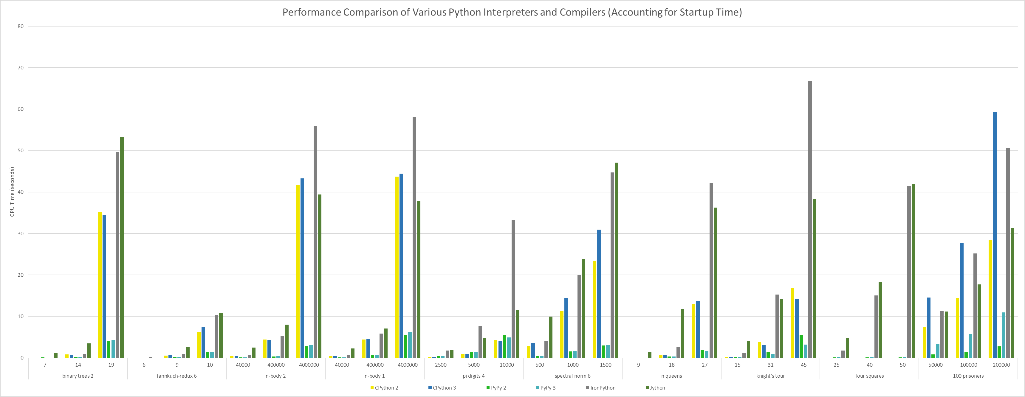
EXCEPTIONS
Jython performance suffers from a ~9.5 second JVM startup time
IronPython performance suffers from a ~1.5 second CLR startup time

Slide 10
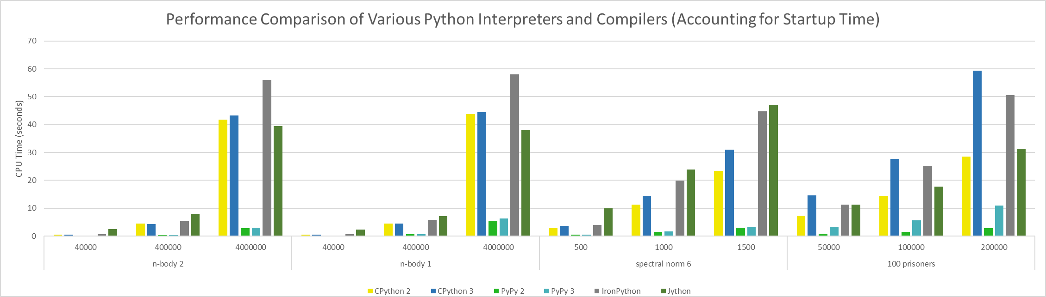
EXCEPTIONS
In the following programs, CPython is much closer to Jython and IronPython in terms of performance, due to it using an interpreter
These programs are mostly loops, which can be optimized by Jython and IronPython’s respective JIT compilers

Slide 11
EXCEPTIONS
In Spectral Norm 6 and especially 100 Prisoners, CPython 3 is much slower than CPython 2, due to the difference in their ints
These programs contain a lot of complex calculations, amplifying the additional time it takes to operate on ints in CPython 3

Slide 12
EXCEPTIONS
In N-Body 1, PyPy is much slower than in N-Body 2, due to the difference in how the programs calculate the square root of a number
N-Body 1 uses “** 0.5” while N-Body 2 uses “math.sqrt()”
The former is slower than the latter in Python in general, but in PyPy, it is far slower

Slide 13
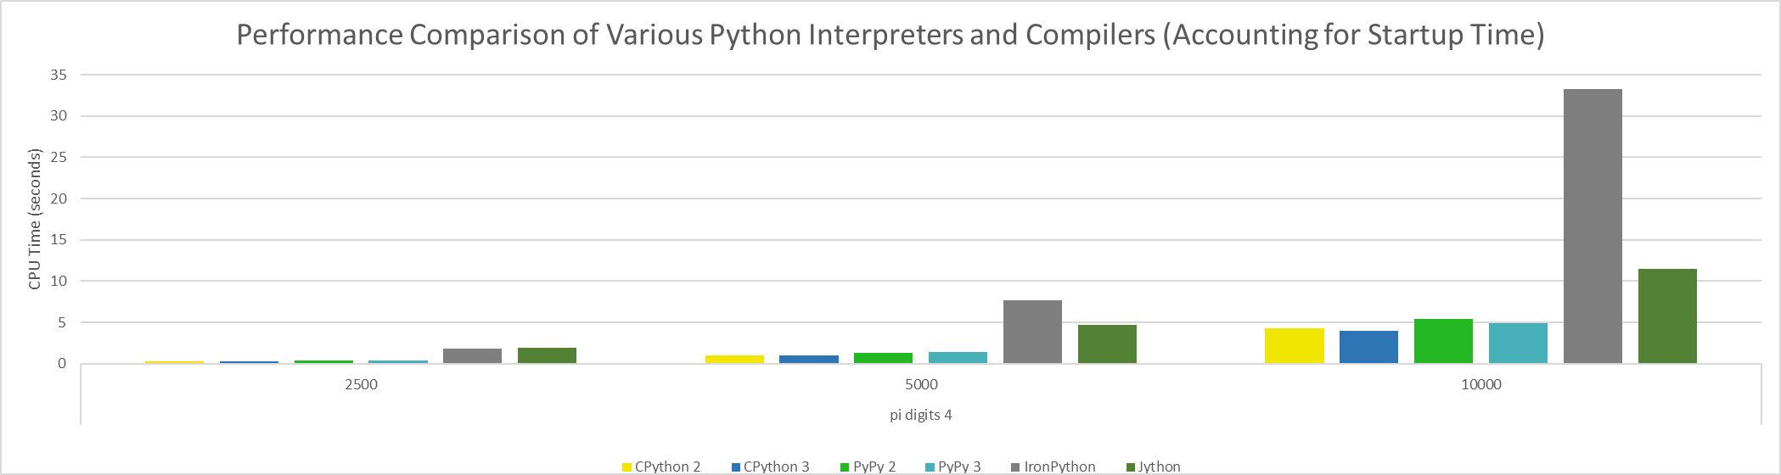
EXCEPTIONS
In Pi Digits 4, CPython is faster than PyPy, due to the use of global variables
Global variables cause a noticeable decrease in performance in Python in general, but this effect is exacerbated in PyPy

Slide 14
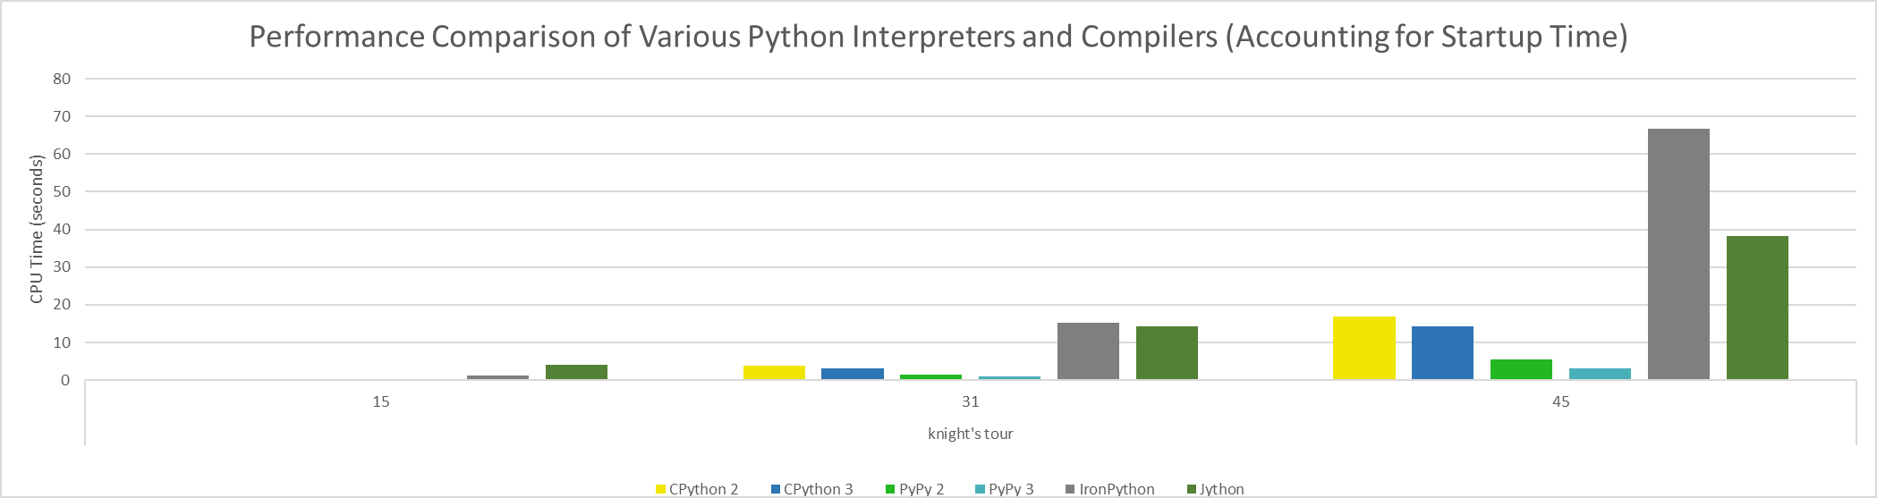
EXCEPTIONS
In Knight’s Tour, CPython and PyPy 3 are faster than CPython and PyPy 2, respectively
This program uses “copy.deepcopy()”, which is almost twice as slow in Python 2 than it is in Python 3
This function was made more efficient for Python 3

Slide 15
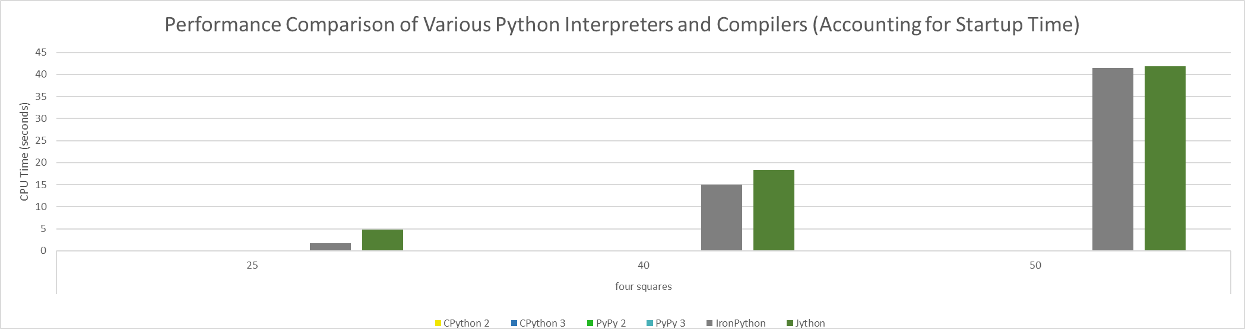
EXCEPTIONS
In Four Squares, execution is trivial for all implementations except Jython and IronPython
This program finds all unique solutions to a problem and prints them out
Printing them out (to the console) is extremely slow for the JVM and the CLR

Slide 16
CONCLUSIONS
Due to its speed and compatibility with Python, PyPy should be used whenever possible
CPython is a competent default, when compared to other Python implementations
Jython and IronPython’s performance is acceptable if access to either the Java or .NET libraries, respectively, is necessary
None of the implementations completely outclass any of the others

