Slide 1
Path to ES modules
A story of how encapsulation of JS Code evolved over time

Slide 2



About myself
Markus Hösel (Nickname: haezl)
Web Dev and DevOps Engineer @ 3-S-IT
External Lecturer @ University of Applied Sciences Vienna
Open Source Contributor and Meetup Organizer
@iamhaezl
haezl

Slide 3
Concept of modules
Organizes and encapsulates code
Enforced clear boundaries with the outside world
Has a dependency on module loaders or runtime support

Slide 4
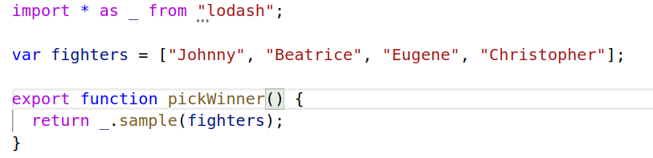
Example

Slide 5
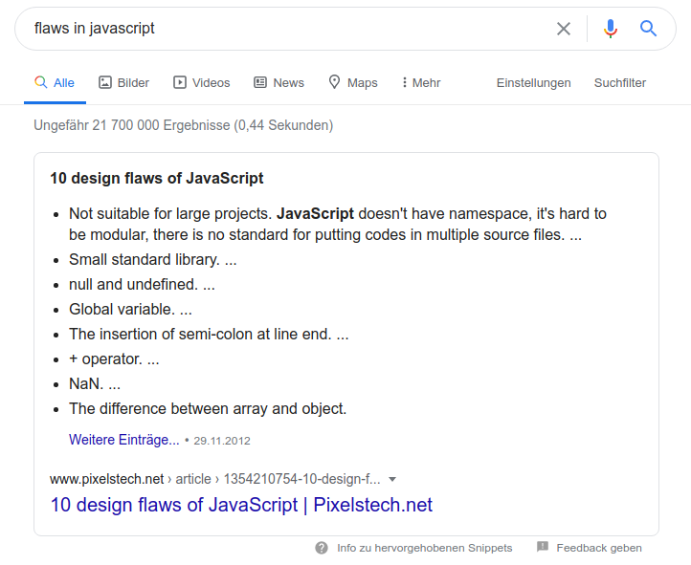

Slide 6
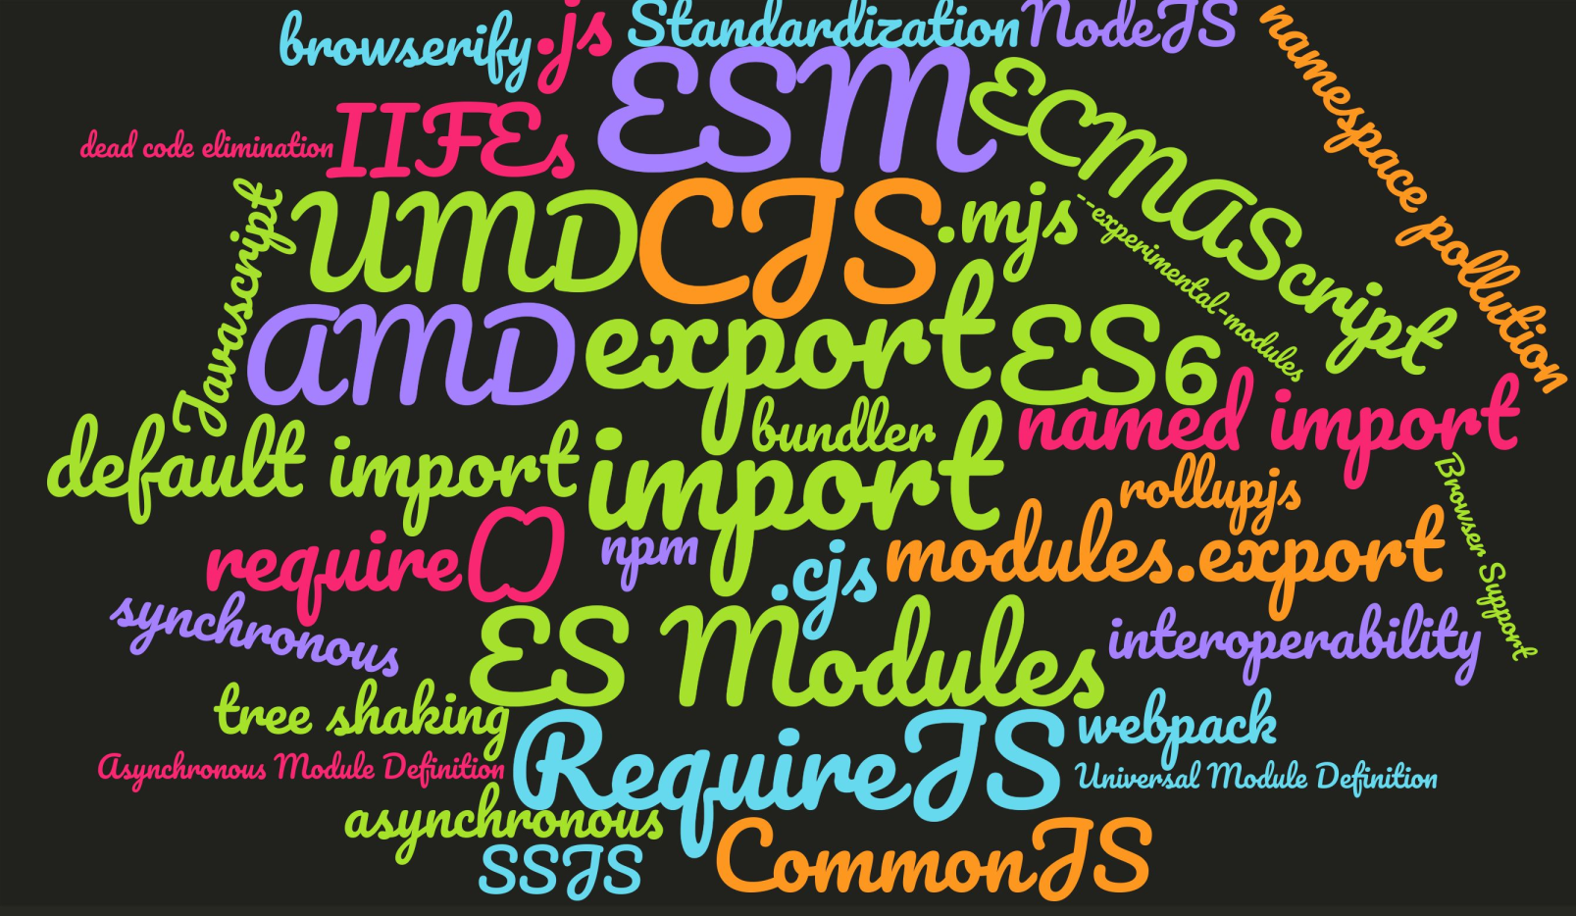

Slide 7
Part 1 – The early days of JS
Global namespace pollution and IIFEs

Slide 8
Namespace pollution
Occurs when code which should be organized in separate namespaces is mashed together into a common namespace

Slide 9
IIFEs
Immediately Invoked Function Expressions (IIFEs) are
functions which are defined and then executed immediately
They are often used as a pattern to create a
private scope within the current scope

Slide 10
Coding Examples
Exploring namespace pollution and IIFEs

Slide 11
Part 2 – The rise of SSJS
NodeJS, CommonJS and npm

Slide 12


Slide 13
What is CommonJS?
Collection of standards, including
  Modules
  Local and remote packages and package management
Active between January 2009 and November 2014
Standards partially implemented by projects like
NodeJS or MongoDB among others

Slide 14
The fall of CommonJS
“Forget CommonJS. It's Dead.
We are ServerSide Javascript.”
https://github.com/nodejs/node-v0.x-archive/issues/5132#issuecomment-15432598

Slide 15
CommonJS Modules
The CommonJS module specification is
the standard used in NodeJS for working with modules

Slide 16
CommonJS Downsides
Loads modules synchronous
Is not supported by browsers

Slide 17



CommonJS on the Frontend

Slide 18
Coding Example
How to use a CommonJS module
in NodeJS and the Browser

Slide 19
Part 3 – Web Modules
AMD, UMD and RequireJS

Slide 20
AMD
The Asynchronous Module Definition (AMD) API specifies a mechanism for defining modules such
that the module and its dependencies can be asynchronously loaded

Slide 21
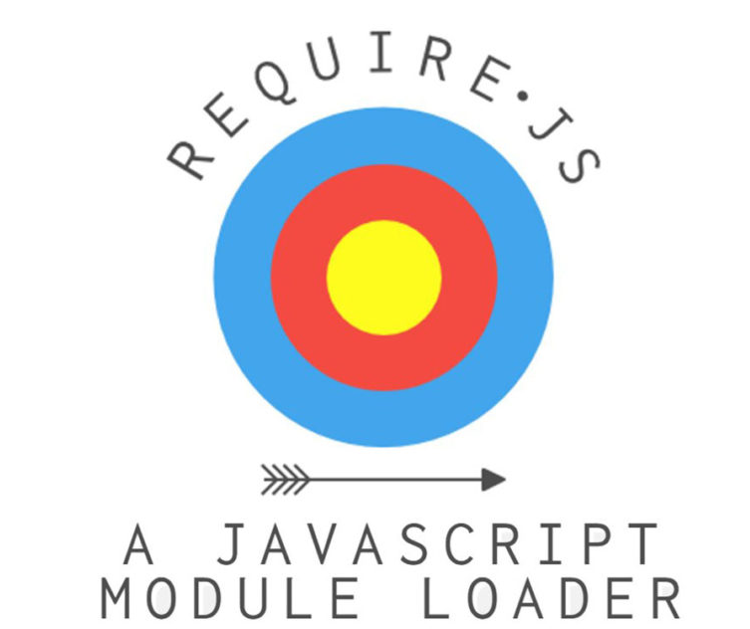
RequireJS
Javascript file and module loader
with support for the AMD definition

Slide 22
UMD
Universal Module Definition (UMD) is a pattern to offer compatibility with various script loaders
Notes:
Typically the script loaders used are AMD as a base, followed by CommonJS and finally the dependencies are made available globally

Slide 23
Coding Example
How to use AMD and UMD Module
in the Browser

Slide 24
Part 4 – Standardization
The concept of ES Modules

Slide 25
ES Modules
ES6 / ECMAScript 2015 defines
a Module System named ES Modules
The Module System is supported by all modern
browsers via <script type=”module”>

Slide 26
ES Modules Advantages
support for synchronous and asynchronous loading
support for tree shaking and dead code elimination
support for dynamic imports currently in Stage4 of TC39 process

Slide 27
Coding Example
How to use ES modules in the browser

Slide 28
Part 5 – ES Modules in NodeJS
Standarization, File Formats, Interoperability

Slide 29
Status Quo
NodeJS fully supports ECMAScript modules as they
are currently specified and provides limited interoperability between them and the existing module format, CommonJS.

Slide 30
Support Status
NodeJS 8.5: Support was added via flag --experimental-modules
Modules Team was formed by the NodeJS Committee
Node 12.0: New implementation was added
Node 13.2: Supports ESM Modules without flag

Slide 31
Phases of the new implementation
Phase 0: Start Fresh
Phase 1: The Minimal Kernel
Phase 2: Minimum Viable Product: Required to Upstream
Phase 3: Path to Stability: Removing --experimental-modules Flag
Phase 4: Further Improvements After Unflagging

Slide 32
.cjs and .mjs files
.mjs files are always loaded as ES Modules
.cjs files are always loaded as CommonJS Modules

Slide 33
.js files and the new field “type”
field “type” in package.json determines handling
files are loaded as ES Modules when value is “module”,
and as CJS Modules when value is “commonjs” or not specified

Slide 34
Interoperability
CJS Modules can be imported from ES Modules -
but only with a default import
ES Modules can be imported from CJS Modules -
but only using dynamic import() which is async by nature

Slide 35
Coding Example
How to use ES modules standalone and together with CommonJS modules in NodeJS

Slide 36
Outlook
Migrating Applications from CJS to ESM
(e.g with babel-plugin-transform-commonjs)
Dual-Mode Packages
(bare imports / deep imports)

Slide 37
Thanks for listening!
Slides and Examples are on Github https://github.com/haezl/path-to-es-modules

