Slide 1
App development with
react-native and expo
by Markus Hösel

Slide 2
react-native
“With React Native, you don't build a "mobile web app", an "HTML5 app", or a "hybrid app". You build a real mobile app that's indistinguishable from an app built using Objective-C or Java. React Native uses the same fundamental UI building blocks as regular iOS and Android apps. You just put those building blocks together using JavaScript and React.”
Source: https://facebook.github.io/react-native/

Slide 3

Internals of react-native
Source: https://www.reactnative.guide/3-react-native-internals/3.1-react-native-internals.html

Slide 4
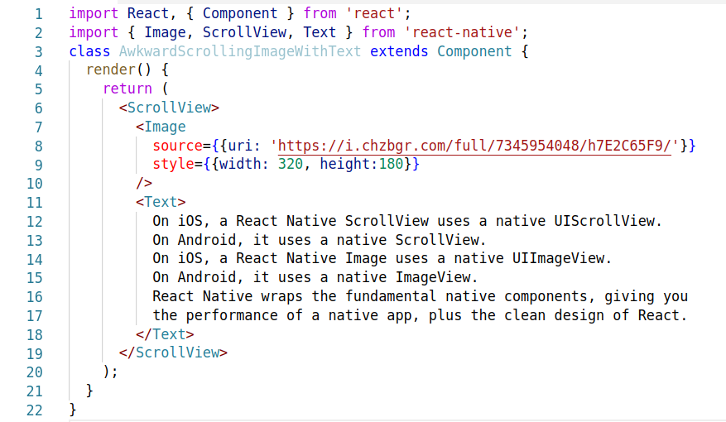
Component Example

Slide 5
Expo
Expo is a free and open source toolchain built around React Native to help you build native iOS and Android projects using JavaScript and React.
Benefits:
Support for iOS and Android without a seperate build process.
Instant Updating (OTA)
Access to system functionality such as contacts or camera
Drawbacks
No native modules without detaching
Source: https://expo.io/

Slide 6


