Slide 1
PSO Week 10
Query optimization example for 3 tables

Slide 2
Cost estimate for a simple three-table join
Today we will be going over an example for calculating the cost estimate for a 3 table join.
We will be using a sample e-commerce database for this example. The schema has been provided in the next slide. The sql queries to make the database is at https://searchcode.com/codesearch/raw/92265810/. It is to be noted that I have removed the primary keys from the database for this example.
We are going to be using Explain for optimizing the query.
The table orders has 326 rows
The table orderdetails has 2996 rows
The table products has 110 rows

Slide 3
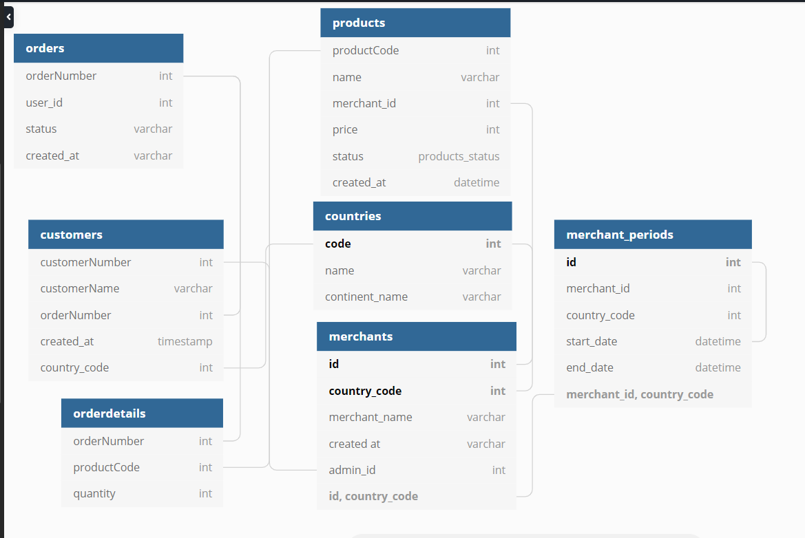
The SQL database schema
We will be using the an
ecommerce database.
The schema for the database is:
The tables being used

Slide 4
The Query to be optimized
The query that we are going to calculate the cost for:
EXPLAIN SELECT * FROM
products p
INNER JOIN orderdetails d ON p.productCode = d.productCode
INNER JOIN orders o ON d.orderNumber = o.orderNumber
WHERE o.orderNumber = ‘10101G’

Slide 5
products JOIN orderdetails VS orderdetails join orders
p JOIN d VS d JOIN o
We are going to be joining products and orderdetails table and see the intermediate result of rows.
We are going to compare the above result with the result of joining orderdetails with orders first.
Then after that we are going to be seeing the result of explain for all the joins
Lastly, we will try and improve the cost estimate by using create index.

Slide 6
products JOIN orderdetails
For products JOIN orderdetailswe, we know that products table has 110 rows and orderdetails has 2996 rows
After the join we will have 110*2996 = 329560 rows
You can do this manually and then use EXPLAIN for more information

Slide 7
orderdetails JOIN orders
For orderdetails JOIN order, we know that orders has 326 rows and orderdetails has 2996 rows.
After the join we will have 326*2996 = 976696 rows which is greater than 329560
We can see that the number of rows for the intermediate steps may differ when you are joining 3 tables. This is why join order is important.

Slide 8
The Query to be optimized
The query that we are going to calculate the cost for:
EXPLAIN SELECT * FROM
products p
INNER JOIN orderdetails d ON p.productCode = d.productCode
INNER JOIN orders o ON d.orderNumber = o.orderNumber
WHERE o.orderNumber = ‘10101G’

Slide 9
Output of explain
Result of Explain on the query
Output:
id select_type table partitions type possible_keys key key_len ref rows filtered Extra
1 SIMPLE o NULL ALL NULL NULL NULL NULL 326 10.00 Using where
1 SIMPLE p NULL ALL NULL NULL NULL NULL 110 100.00 Using join buffer (hash join)
1 SIMPLE d NULL ALL NULL NULL NULL NULL 2996 1.00 Using where; Using join buffer (hash join)

Slide 10
Cost estimation for 3 table join(1):
If you look at the above result, you can see all of the symptoms of a bad query. But even if I wrote a better query, the results would still be the same since there are no indexes. The join type is shown as “ALL” (which is the worst), which means MySQL was unable to identify any keys that can be used in the join and hence the possible keys and key columns are null. Most importantly, the rows column shows MySQL scans all of the records of each table for query. That means for executing the query, it will scan 326 × 110 × 2996 = 107436560 records to find the three matching results. That’s horrible, and it will only increase exponentially as the database grows.
We can add primary keys for each table to optimize but we are going to use create index and execute the query once again. As a rule of thumb, you can look at the columns used in the JOIN clauses of the query as good candidates for keys because MySQL will always scan those columns to find matching records.

Slide 11
Altering tables
You can add primary key to optimize:
ALTER TABLE orderdetails
ADD PRIMARY KEY (orderNumber, productCode);
ALTER TABLE orders
ADD PRIMARY KEY (orderNumber),
ADD KEY (customerNumber);
ALTER TABLE products
ADD PRIMARY KEY (productCode),
You can create index
CREATE INDEX i
ON orderdetails (productCode);
OR

Slide 12
Output of RERUN of explain
Result of Explain on the query after create index
Output:
id select_type table partitions type possible_keys key key_len ref rows filtered Extra
1 SIMPLE p NULL ALL NULL NULL NULL NULL 110 100.00 NULL
1 SIMPLE d NULL ref c c 17 test.p.productCode 27 100.00 Using where
1 SIMPLE o NULL ALL NULL NULL NULL NULL 326 1.00 Using where; Using join buffer (hash join)

Slide 13
Cost estimation for 3 table join(2):
After adding index i, the number of records scanned has been brought down to 326 × 110 × 27 = 968220. As you can see the number of rows for orderdetails came down from 2996 to 27 for the join.
If we add the primary keys for the tables then we can bring it further down to 1 × 1 × 4 = 4. That means for each record with orderNumber 10101 in the orderdetails table, MySQL was able to directly find the matching record in all other tables using the indexes and didn’t have to resort to scanning the entire table.

Slide 14
References
https://dbdiagram.io/d
https://www.sitepoint.com/using-explain-to-write-better-mysql-queries/
https://searchcode.com/codesearch/raw/92265810/

