Slide 1
CS448 PSO
Week 14
CS448 Staff

Slide 2
Triggers
A trigger is a procedure that is automatically invoked by the DBMS in response to specified changes to the database
A database that has a set of associated triggers is called an active database.
A trigger description contains three parts:
Event: A change to the database that activates the trigger
Condition: A query or test that is run when the trigger is activated
Action: A procedure that is executed when the trigger is activated and its condition is true

Slide 3
Example 1: statement-level trigger
CREATE TRIGGER initCount BEFORE INSERT ON Students
DECLARE
count INTEGER;
BEGIN
count := 0;
END
/* Event */
/* Action */
Notes:
The trigger called initCount initializes a counter variable before every execution of an INSERT statement that adds tuples to the Students relation.
This trigger executes before the activating statement.
It is executed just once per INSERT statement, regardless of the number of records inserted => statement-level trigger

Slide 4
Example 2: row-level trigger
CREATE TRIGGER incrCount AFTER INSERT ON Students
WHEN (new.age < 18)
FOR EACH ROW
BEGIN
count := count + 1;
END
/* Event */
/* Condition */
/* Action */
Notes:
The trigger called incrCount increments the counter for each inserted tuple that satisfies the condition age<18.
This trigger executes after the activating statement.
We have to examine the age field of the inserted Students record to decide whether to increment the count, the triggering event should be defined to occur for each modified record; the FOR EACH ROW clause is used to do this=> row-level
'new' is just-inserted tuple

Slide 5
Example 3: set-oriented trigger
CREATE TRIGGER setCount AFTER INSERT ON Students
REFERENCING NEW TABLE AS InsertedTuples
FOR EACH STATEMENT
INSERT
INTO StatTable(ModifiedTable, ModificationType, Count)
SELECT 'Students', 'Insert', COUNT *
FROM InsertedTuples T
WHERE T.age < 18
/* Event */
Statement-level
/* Action */
Notes:
It would be useful to be able to refer to the set of inserted Students records, rather than just one changed record at a time.
NEW TABLE enables us to give a table name (InsertedTuples) to the set of newly inserted tuples.
The trigger is evaluated once for each SQL statement that inserts tuples into Students, and inserts a single tuple into a table that contains statistics on modifications to database tables.
Example 2 only computes the count; an additional trigger is required to insert the appropriate tuple into the statistics table.

Slide 6
Triggers in Oracle

Slide 7
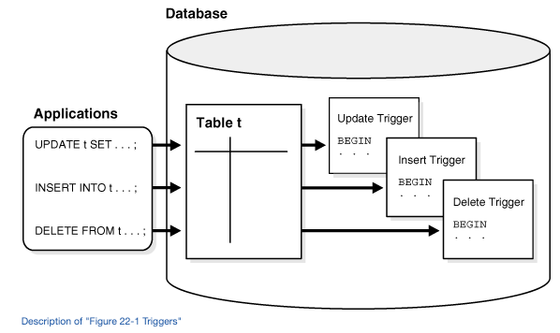
Triggers in Oracle
Figure source: https://docs.oracle.com/cd/B19306_01/server.102/b14220/triggers.htm
Figure shows a database application with some SQL statements that implicitly fire several triggers stored in the database. Notice that the database stores triggers separately from their associated tables.

Slide 8
Cascading triggers
Although triggers are useful for customizing a database, use them only when necessary. Excessive use of triggers can result in complex interdependencies, which can be difficult to maintain in a large application. For example, when a trigger fires, a SQL statement within its trigger action potentially can fire other triggers, resulting in cascading triggers. This can produce unintended effects.
Notes:
Discuss the tradeoffs of using a trigger:
Unintended behavior VS. no better option

Slide 9
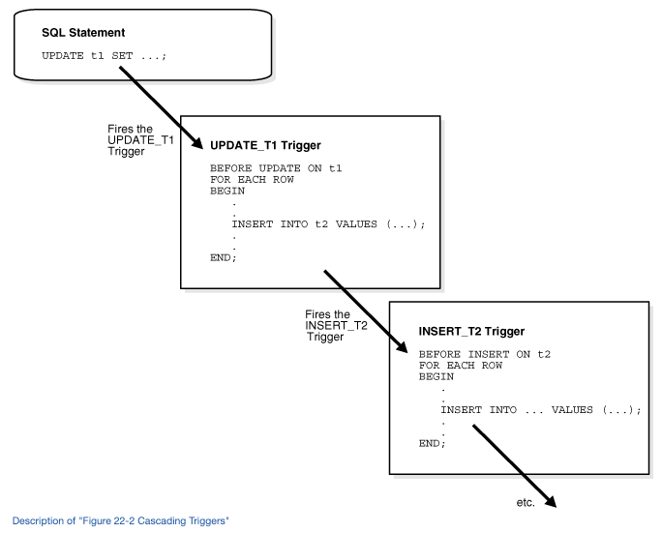
Figure source: https://docs.oracle.com/cd/B19306_01/server.102/b14220/triggers.htm
Figure shows cascading triggers. One SQL statement fires the UPDATE_T1 trigger, which fires the INSERT_T2 trigger, and so on.

Slide 10
Types of Triggers
Row triggers and Statement triggers
BEFORE and AFTER triggers
INSTEAD OF triggers
Triggers on system event and user events

Slide 11
Row Trigger and Statement Trigger
Row trigger: fired each time the table is affected by the triggering statement
Useful if the code in the trigger action depends on data provided by the triggering statement or rows
e.g. A row trigger is fired once for each row affected by the UPDATE statement.
Statement trigger: fired once on behalf of the triggering statement, regardless of the number of rows in the table that the triggering statement affects, even if no rows are affected.
Useful if the code in the trigger action does not depend on the data provided by the triggering statement or the rows affected.
e.g. make a complex security check on the current time or user

Slide 12
BEFORE and AFTER trigger
BEFORE triggers run the trigger action before the triggering statement is run. It is commonly used when:
When the trigger action determines whether the triggering statement should be allowed to complete. Using a BEFORE trigger for this purpose, you can eliminate unnecessary processing of the triggering statement and its eventual rollback in cases where an exception is raised in the trigger action.
To derive specific column values before completing a triggering INSERT or UPDATE statement.
AFTER Triggers
AFTER triggers run the trigger action after the triggering statement is run.

Slide 13
INSTEAD OF triggers
On views
INSTEAD OF triggers provide a transparent way of modifying views that cannot be modified directly through DML statements (INSERT, UPDATE, and DELETE).
You can write normal INSERT, UPDATE, and DELETE statements against the view and the INSTEAD OF trigger is fired to update the underlying tables appropriately. INSTEAD OF triggers are activated for each row of the view that gets modified.

Slide 14
Example
CONTACTS
ID Email
CUSTOMERS
ID Name Address Credit_limit
CREATE VIEW view_customers AS
SELECT ID, Name, Address, Credit_limit, Email
FROM Customers
INNER JOIN Contacts USING (ID);
INSERT INTO view_customers VALUES
(123, 'John Doe', 'Lafayette', '10k', 'jd@some');
ERROR
Reference: https://www.oracletutorial.com/plsql-tutorial/oracle-instead-of-triggers/

Slide 15
Example (cont'd)
CREATE TRIGGER new_customer_trigger
INSTEAD OF INSERT ON view_customers
FOR EACH ROW
BEGIN
-- insert a new customer first
INSERT INTO customers(ID, name, address, credit_limit)
VALUES(:NEW.ID, :NEW.NAME, :NEW.address, :NEW.credit_limit);
-- insert the contact
INSERT INTO contacts(ID, email)
VALUES(:NEW.ID, :NEW.email);
END;
Reference: https://www.oracletutorial.com/plsql-tutorial/oracle-instead-of-triggers/

Slide 16
MySQL
Doesn't have INSTEAD OF triggers
Has updatable views
For a view to be updatable, there must be a one-to-one relationship between the rows in the view and the rows in the underlying table.
Cannot have: aggregate functions, DISTINCT, GROUP BY, HAVING, UNION/UNION ALL, subquery in the select list, …...

Slide 17
Triggers on system events and user events
Triggers can be used to publish information about database events to subscribers.
Events can include:
System events (can be defined at the database level or schema level)
Database startup and shutdown
Data guard role transitions
Server error message events
User events
User logon and logoff
DDL statements
DML statements

Slide 18
Execution model for triggers
Recall a single SQL statement can fire up to four types of triggers:
BEFORE row triggers
BEFORE statement triggers
AFTER row triggers
AFTER statement triggers

Slide 19
Orders of running triggers
Run all BEFORE statement triggers that apply to the statement.
Loop for each row affected by the SQL statement.
Run all BEFORE row triggers that apply to the statement.
Lock and change row, and perform integrity constraint checking. (The lock is not released until the transaction is committed.)
Run all AFTER row triggers that apply to the statement.
Complete deferred integrity constraint checking.
Run all AFTER statement triggers that apply to the statement.
Note that the execution model is recursive because of cascading triggers.

Slide 20
References
"The cow book": Database management systems by Raghu Ramakrishnan and Johannes Gehrke
https://docs.oracle.com/cd/B19306_01/server.102/b14220/triggers.htm
https://www.oracletutorial.com/plsql-tutorial/oracle-instead-of-triggers/

