Slide 1
Introduction to DBMS

Slide 2
What is a DBMS?
Definition of DBMS.
Importance of DBMS in modern applications.
Overview of types of DBMS
(e.g., hierarchical, network, relational,object-oriented)

Slide 3
Data
Definition: Data is the collection of raw facts figures without context that can be recorded and that have implicit meaning. It can be in various forms, such as numbers, text, images, or sounds.
Characteristics:
Raw: Data represents basic facts that, on their own, may not provide much meaning.
Unorganized: Data is typically unstructured and requires processing to be useful.
Types: Data can be quantitative (numerical) or qualitative (descriptive).
Examples: Temperature readings, survey responses, dates, names, and numeric values.
Information: Proess Data is called Information.
Data Base: This collection of related data with an implicit meaning is a database.

Slide 4
A database has the following implicit properties:
A database represents some aspect of the real world, sometimes called the miniworld or the universe of discourse (UoD). Changes to the miniworld are reflected in the database.
A database is a logically coherent collection of data with some inherent meaning. A random assortment of data cannot correctly be referred to as a database.
A database is designed, built, and populated with data for a specific purpose. It has an intended group of users and some preconceived applications in which these users are interested.

Slide 5
DBMS Definition:
A database management system (DBMS) is a system software that enables users to create and maintain a database. The DBMS is a general-purpose software system that facilitates the processes of defining, constructing, manipulating, and sharing databases among various users and applications.
Defining a database involves specifying the data types, structures, and constraints of the data to be stored in the database. The database definition or descriptive information is also stored by the DBMS in the form of a database catalog or dictionary; it is called meta-data.

Slide 6
Constructing the database is the process of storing the data on some storage medium that is controlled by the DBMS.
Manipulating a database includes functions such as querying the database to retrieve specific data, updating the data base to reflect changes in the miniworld, and generating reports from the data.
Sharing a database allows multiple users and programs to access the database simultaneously.

Slide 7
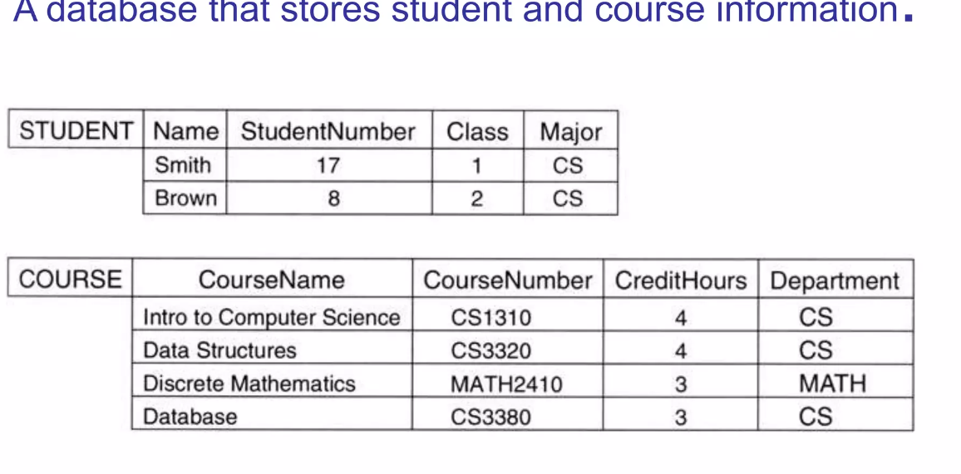
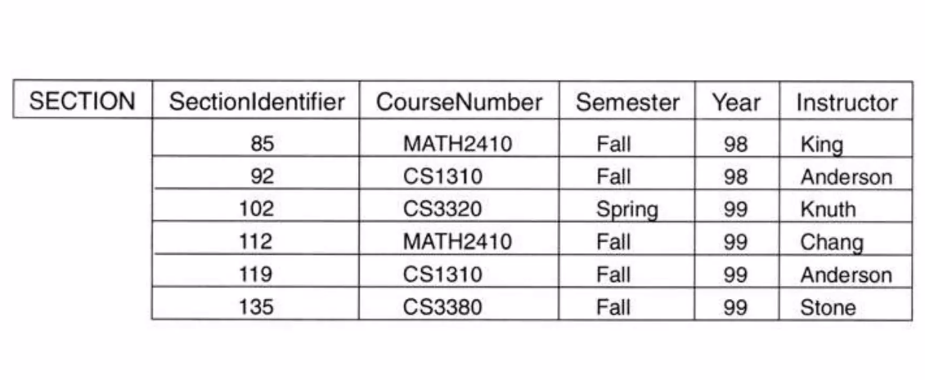
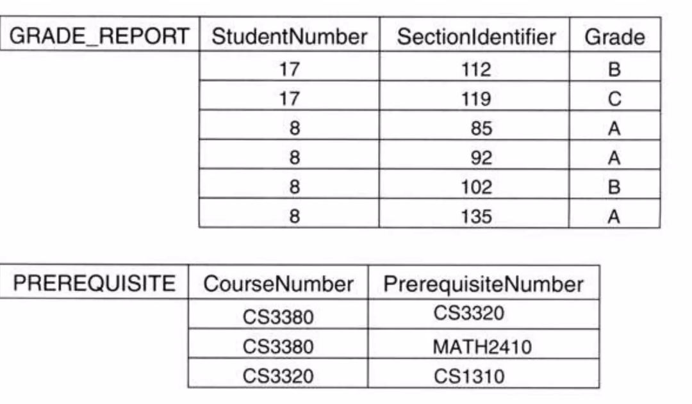

Slide 8
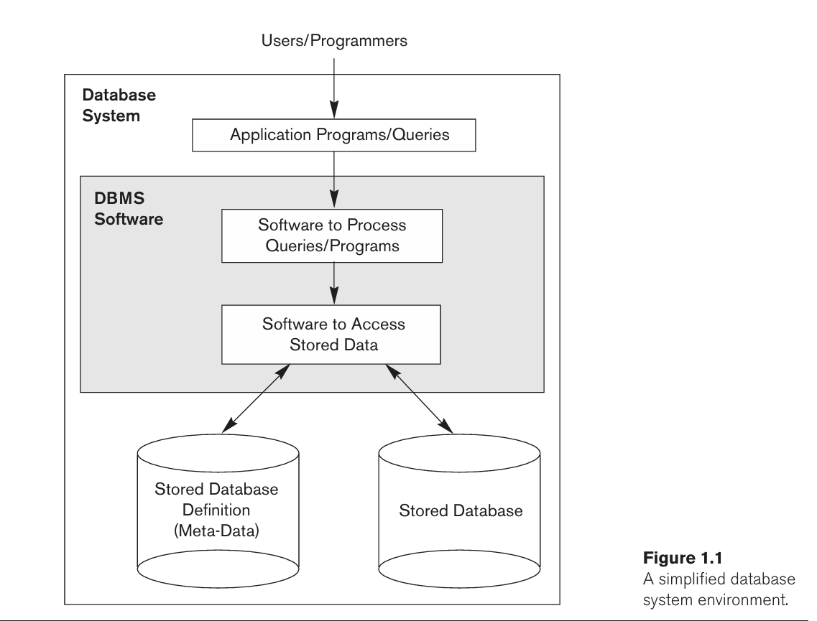

Slide 9
Characteristics of the Database Approach:
The main characteristics of the database approach versus the file-processing approach are the following:
■ Self-describing nature of a database system
■ Insulation between programs and data, and data abstraction
■ Support of multiple views of the data
■ Sharing of data and multiuser transaction processing

Slide 10
Self-describing nature of a database system:
A fundamental characteristic of the database approach is that the database system contains not only the database itself but also a complete definition or description of the database structure and constraints.
This definition is stored in the DBMS catalog, which contains information such as the structure of each file, the type and storage format of each data item, and various constraints on the data. The information stored in the catalog is called meta-data, and it describes the structure of the primary database
Database System – Database + Meta Data(DB Definition)
Stored in- DBMS Catalog
Used By: DBMS Software+ Database Users.

Slide 11
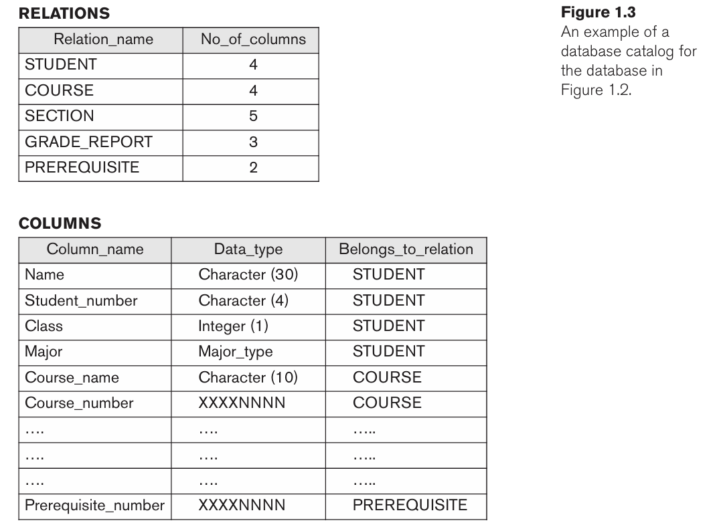

Slide 12
*DBMS catalog will store the definitions of all the files.
*DBMS S/w must work with equally well with any number of database Application.
*In tradition File processing , Data Definition(Meta Data)-> Part of the Application Program-> Work with only one specific DB.

Slide 13
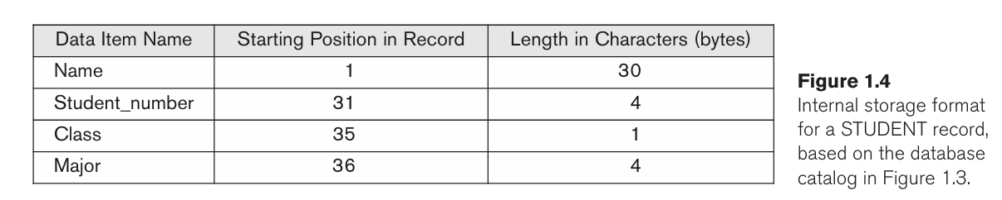
Insulation between programs and data, and data abstraction:
In traditional file processing, the structure of data files is embedded in the application programs, so any changes to the structure of a file may require changing all programs that access that file.
By contrast, DBMS access programs do not require such changes in most cases. The structure of data files is stored in the DBMS catalog separately from the access programs. We call this property program-data independence.

Slide 14
Support of Multiple Views of the Data:
A database typically has many types of users, each of whom may require a different perspective or view of the database. A view may be a subset of the database or it may contain virtual data that is derived from the database files but is not explicitly stored.
Sharing of Data and Multiuser Transaction Processing :
A multiuser DBMS, as its name implies, must allow multiple users to access the database at the same time. This is essential if data for multiple applications is to be integrated and maintained in a single database. The DBMS must include concurrency control software to ensure that several users trying to update the same data do so in a controlled manner so that the result of the updates is correct.
OLTP-( Online Transaction Processing) –Major Part of database application.
DBMS Must Enforce several transaction properties
-Atomicity
-Isolation

Slide 15

Disadvantages of Traditional File System :
Data redundancy and inconsistency.
Difficulty in accessing data.
Data isolation – multiple files and formats.
Integrity problems.
Unauthorized access is not restricted.
It co-ordinates only physical access.

Slide 16
Advantages of DBMS over File system:
1.Data redundancy and inconsistency:
Redundancy means repeating the data in a system. In a normal file system, there is a high chance that there can be various files of the same data used by different users for specific purposes. If any user changes the data in its files, then the changes are not reflected in all files. This creates inconsistency in the data, and it may lead to the failure of the system. But in the DBMS, there is only one repository of data, and multiple users can use it. If any user changes the data, then it is reflected to each user as they are using the same repository.
2. Data Sharing:
In the normal file system, data sharing is too difficult because file sharing is a complex task. In DBMS, all the data is centralized, so data sharing is a very easy task.
3. Data Concurrency:
When more than one user accesses the database simultaneously, then it is called concurrency. In a file system, when multiple users are using the files at the same time, then there may be a chance of anomalies in the data due to changes, and it does not provide any method to detect anomalies. But in DBMS, we have a locking system to detect the anomalies so we can protect the data.

Slide 17
Data Searching:
To search the data in a file system, we have to write a specific program and run it. In DBMS, we have query languages by which we can write small queries to get the data we want from the database.
Data Integrity:
When we insert new data into the database, we require some specific constraints on the data like integer or not null, etc. The file system does not provide any system to check the constraints, whereas DBMS has the functionality to check the constraints on the data, and it allows user defined data types.
that means DBMS maintains data integrity by enforcing user-defined constraints on data by itself.
System crashing: In the case of file systems because once the system crashes, there will be no recovery of the data that’s been lost. DBMS has a recovery manager which can recover the data if the system crashes.
Data Security:
In the file system, we have only password protection to save the files and data, but it is not reliable. In DBMS, we have special algorithms and features to secure the data.

Slide 18
Backup: It creates a backup subsystem to restore the data if required.
Interfaces: It provides different multiple user interfaces like graphical user interface and application program interface.
Easy Maintenance: It is easily maintainable due to its centralized nature.
Disadvantage:
1-Increased cost
Cost of Hardware and Software
Cost of staff training
Cost of data conversion
2-Cost of Staff Training
3-Complexity:
4.Frequency Upgrade/Replacement Cycles
5. Performance

Slide 19
Applications of DBMS :
Banking: All transaction
Airlines: reservation , Schedules
Universities: registration, grade
Sales: customer , product, purchase
Manufacturing: Production , inventory, order, supply chain
Human Resources: Employee record , salaries , tax Deductions
* Data base touch all aspects of our lives.

Slide 20
Actors on the Scene:
one person typically defines, constructs, and manipulates the database. However, many persons are involved in the design, use, and maintenance of a large database with a few hundred users. The people whose jobs involve the day-to-day use of a large database; we call them the "actors on the scene."
"workers behind the scene"—
those who work to maintain the database system environment, but who are not actively interested in the database itself.
1.Database Administrators
2.Database Designers
3. End Users
4. System Analysts and Application Programmers (Software Engineers)

Slide 21
Database Administrators: In a database environment, the primary resource is the database itself and the secondary resource is the DBMS and related software. Administering these resources is the responsibility of the database administrator (DBA).
The DBA is responsible for-
Authorizing access to the database,
For coordinating and monitoring its use,
For acquiring software and hardware resources as needed.
Controlling its use and monitoring efficiency of operation
The DBA is accountable for problems such as breach of security or
poor system response time. In large organizations, the DBA is assisted by a staff that helps carry out
these functions.

Slide 22
Database Designers:
Database designers are responsible for identifying the data to be stored in the database and for choosing appropriate structures to represent and store this data.
It responsible to define content, the structure, Constraints , and function or transaction against the database. They Must communicate with end users and understand their needs
End Users:
End users are the people whose jobs require access to the database for querying, updating, and generating reports; the database primarily exists for their use. There are several categories of end users:
Casual User
Naïve Use parametric end user
Sophisticated end user
Stand Alone User

Slide 23
Casual end users:
-access the database occasionally( Not frequently) .example : High level and middle level manager other occasional browsers .But they may need different information each time.
• Naive or parametric end users:
-constantly querying and updating the database, using standard types of queries and updates—called canned transactions—that have been carefully programmed and tested.
Example: Bank tellers check account balances and post withdrawals and deposits.
Reservation clerks for airlines, hotels, and car rental companies check availability for a given request and make reservations.
Sophisticated end users:
these include engineers, scientists, business analysts, and others who thoroughly familiar with system capabilities . May use tool in the form of software package that work closely with the system database .
To develop own data base application, meet their requirement.

Slide 24
• Stand-alone users :
- maintain personal databases by using ready-made program packages that provide easy-to-use menu- or graphics-based interfaces.
An example is the user of a tax package that stores a variety of personal financial data for tax purposes
System Analysts and Application Programmers (Software Engineers):
System Analysts - determine the requirements of end users, especially naive and parametric end users,
- and develop specifications for canned transactions that meet these requirements.
Application programmer- implement these specifications as programs; then they test, debug, document, and maintain these canned transactions. Such analysts and programmers (nowadays called software engineers) should be familiar with the full range of capabilities provided by the DBMS to accomplish their tasks.

Slide 25
Workers behind the Scene:
Are people who maintain database system environment .they deal with the design development and operational of the data base system environment
DBMS system designers and implementers
-A persons who design and implement the DBMS modules and interfaces as a software package.
DBMS – consist of very complex software system which consists of many components like- implementing the catalog, query language, interface processors, data access, concurrency control, recovery, and security. -DBMS must interface with other system software, such as the operating system and compilers for various programming languages.
Tool developers:
- A persons who design and implement tool which is nothing but software packages . These software package are optional and can be purchased separately to help to improve performance of data base system
Operators and maintenance personnel:
- responsible for the actual running and maintenance of the hardware and software environment for the database system environment.

Slide 26
Questions
1.1. Define the following terms: data, database, DBMS, database system, database catalog, program-
data independence, user view, DBA, end user, canned transaction, deductive database system,
persistent object, meta-data, transaction processing application.
1.2. What three main types of actions involve databases? Briefly discuss each.
1.3. Discuss the main characteristics of the database approach and how it differs from traditional file
systems.
1.4. What are the responsibilities of the DBA and the database designers?
1.5. What are the different types of database end users? Discuss the main activities of each.
1.6. Discuss the capabilities that should be provided by a DBMS.

Slide 27
Database System Concepts and Architecture:
Data Models, Schemas, and Instances
DBMS Architecture and Data Independence
Database Languages and Interfaces
The Database System Environment
Classification of Database Management Systems

Slide 28
Data Models:
—a collection of concepts that can be used to describe the structure of a database.
—provides the necessary means to achieve abstraction( DBMS provides some level of data abstraction by hiding details of data storage that are not needed by most database users.)
-By structure of a database means-
the data types,
relationships between relation,
and constraints that should hold on the data.
-Most data models also include a set of basic operations for specifying retrievals and updates on the database.

Slide 29
Categories of Data Models
High Level or Conceptual Data model:
-It describe the data model at a very high level and it useful to understands the need of requirement of database (Requirement gathering process).
Example- E-R Model.
* Object Data Model Near conceptual data model.
Low-level or physical data models: provide
-It describe the details of how data is stored in the computer.
All data in a database is stored physically on a secondary storage device such as HDD, Tape etc. This is stored in file ,records and certain other data structure.
Representational (or implementation) data model:
-This type of data model is used to represent Logical part of data base , does not represent physical structure of database.
Example: Relational data model, network and hierarchical models

Slide 30
Type of data Models:
Hierarchical Data Model
Network Data Model
Relational Data Model
E-R Data Model
Object Oriented Data Model & Object relational data Model
No SQL Data Model
Semi structured Data Model(Example: Web Page)

Slide 31
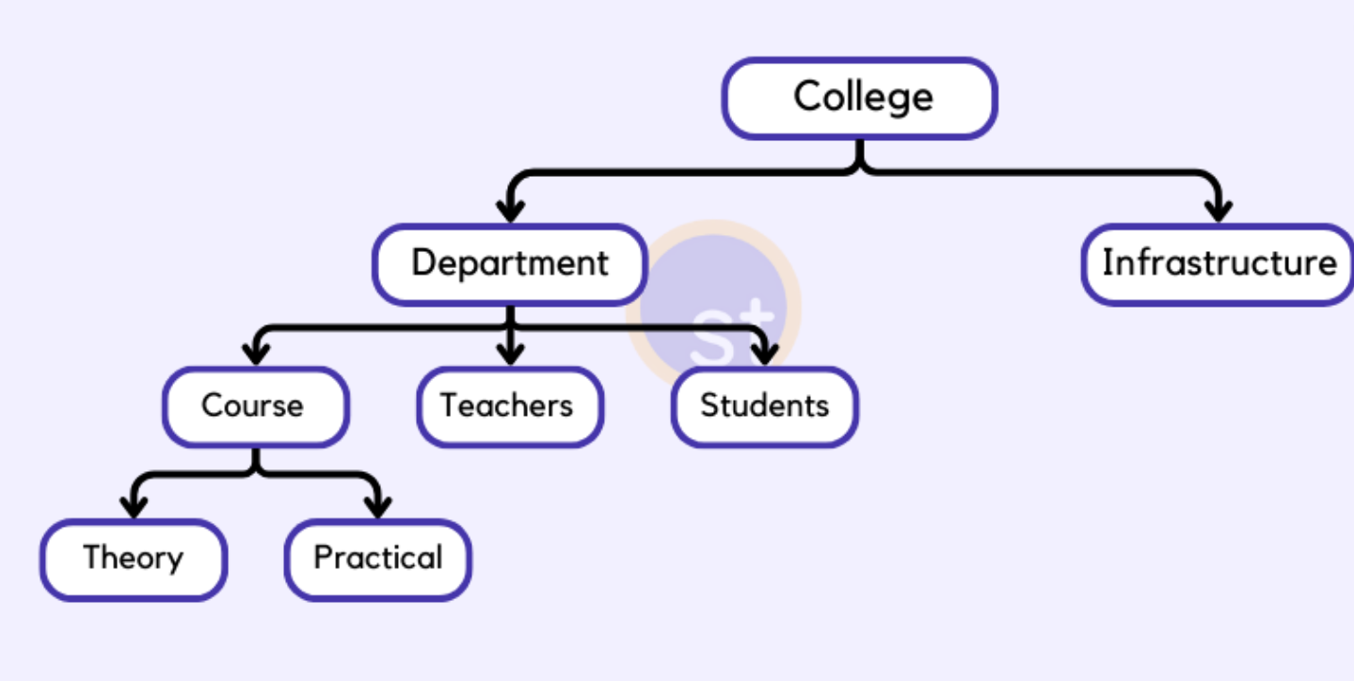
Hierarchical Model:
- Organize data into a tree –like structure with single root ,to which all the other data is linked.
Each child node has only one parent Node.
Efficient for representing relationships like an index book.
Example- IMB’s Information Management System developed late 1960’s.
Data is organized into a tree-like structure with a one-to-many relationship between two different types of data, for example, one department can have many courses, many teachers, and of course many students

Slide 32
Advantages/Disadvantages of the Hierarchical Model
Advantage:
-it has one-to-many relationships between different types of data so it is easier and fast to fetch the data.
- Any modification in parent node , is reflected automatically in child node.
Disadvantage:
- it doesn't support many-to-many relationships.
-Hierarchical model is less flexible.
- If parent node removed , the child node removed as well.
Network Model:
- Network Model is an extension of the Hierarchical model.
-data is organized more like a graph , and allowed to have more than one parent node.
-data is more related as more relationships are established in this database model, as the data is more related, hence accessing the data is easier and fast.

Slide 33
- This database model uses many-to-many data relationships.
-Integrated Data Store (IDS) is based on this database model( developed 1960’s ).
-This was the most widely used database model before Relational Model was introduced.
Advantage:
It supports complex relationships
It allows more flexibility.
Data retrieval is faster.
Disadvantage:
-The implementation of the Network model is complex, and it's very difficult to maintain it.
-System is more complicated to grow more relationship.

Slide 34
College
CSE Department
Library
Students

Slide 35
Entity-relationship Model:
-It is a high-level data model which is used to define the data and the relationships between them.
- Real world problem is depicted in visual form.
-Different entities are related using relationships.
-ER Models are defined to represent the relationships in pictorial form to make it easier for different stakeholders to understand
-This model is good to design a database, which can then be turned into tables in a relational model.
Example- If we have to design a School Database, then the Student will be an entity with attributes name, age, address, etc. As an Address is generally complex, it can be another entity with attributes street, pincode, city, etc, and there will be a relationship between them
Name
Address
Rollno.
Student

Slide 36
Advantages of the ER Model:
It is easy to understand and design.
Using the ER model we can represent data structures easily.
Disadvantage:
3. ER model cannot be directly implemented into a database model, it is just a step toward designing the relational database model.

Slide 37
Relation Model:
- data is organized in two-dimensional tables and the relationship is maintained by storing a common field.
- This model was introduced by E.F Codd in 1970, and since then it has been the most widely used database model.
- The basic structure of data in the relational model is tables. All the information related to a particular type is stored in rows of that table.
-Hence, tables are also known as relations in the relational model.
-You can design tables, normalize them to reduce data redundancy, and use Structured Query language or SQL to access data from the tables.
-Some of the most popular databases are based on this database model. For example, Oracle, MySQL, Informix, Sqlserver etc.
Advantage:
It's simple and easy to implement.
Poplar database software is available for this database model.
It supports SQL using which you can easily query the data.

Slide 38
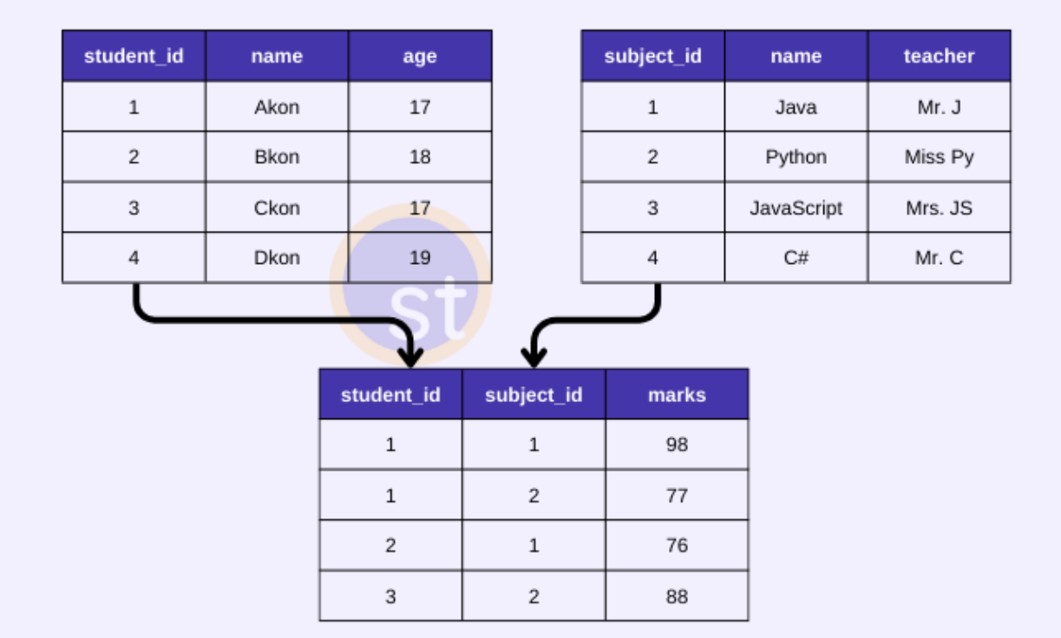

Slide 39
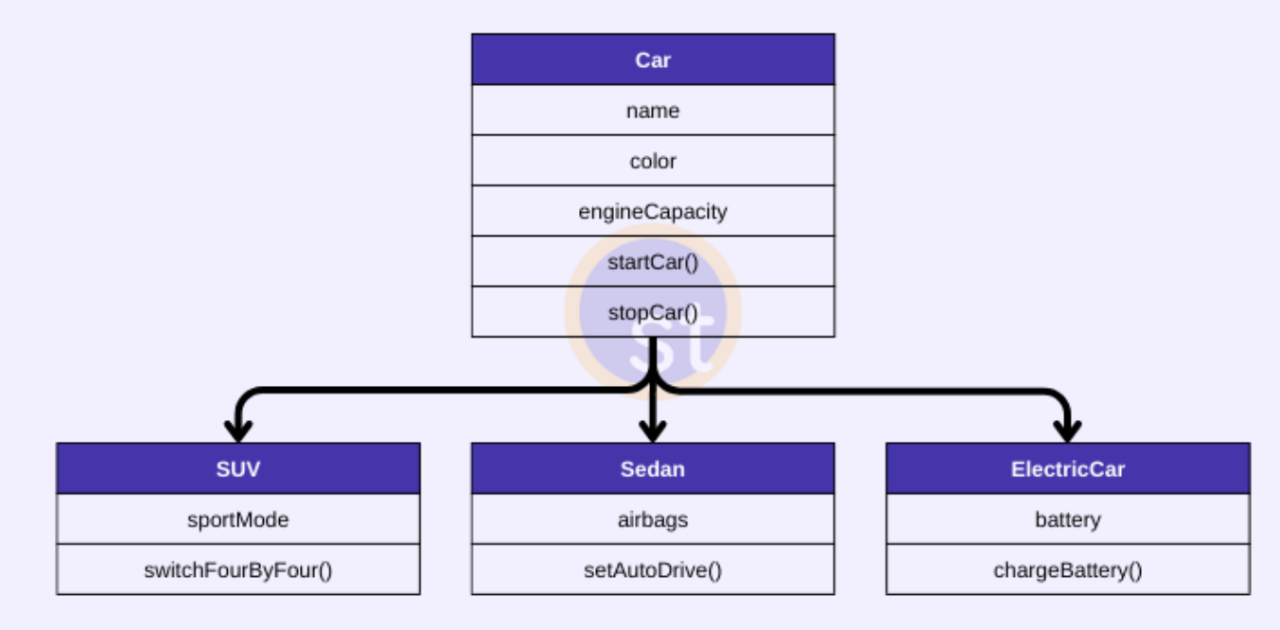
Object-Oriented Data Model:
data and their relationships are contained in a single structure which is referred to as an object in this data model. In this, real-world problems are represented as objects with different attributes.
All objects have multiple relationships between them.
-A very popular example of an Object Database management system or ODBMS is MongoDB which is also a NoSQL database.
-This database model is not mature enough as compared to the relational database model.

Slide 40
Object- Relation Data Model:
it is a combination of Object Oriented programming and a Relational Database Model. This model was developed to bridge gap between the object-oriented and relational model.
Advantage:
It can easily support complex data structures, with relationships.
It also supports features like Inheritance, Encapsulation, etc

Slide 41
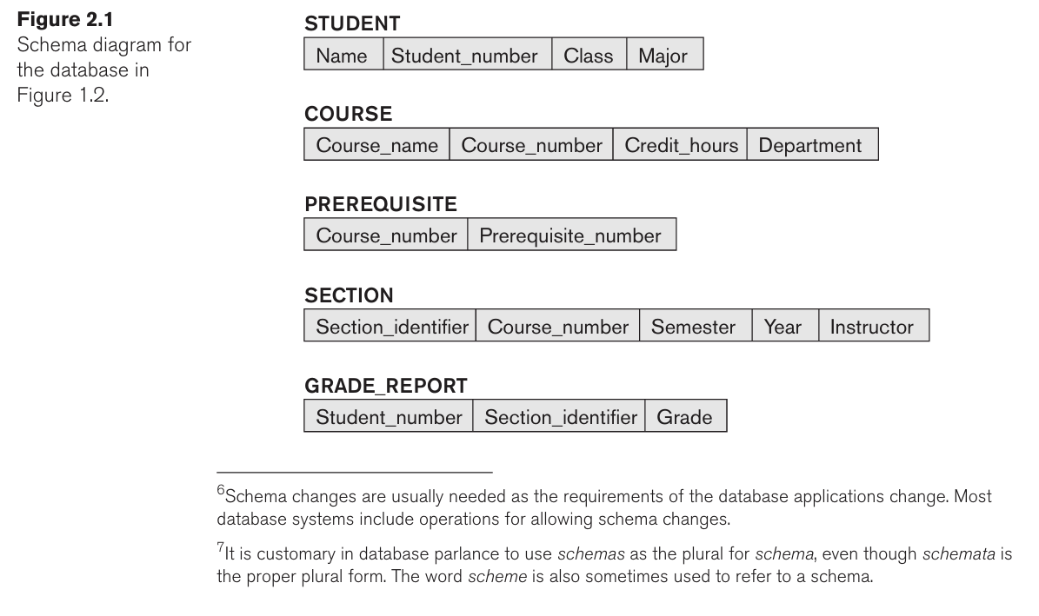
Schemas:
It is a overall description of the data base.
The basic structure of how the data will be stored in the database is called schema, which specified during database design.
It is not to change frequently.
A displayed schema is called a schema diagram in fig.2.1.
each object in the schema—such as STUDENT or COURSE—a schema construct.
A schema diagram displays only some aspects of a schema, such as the names of record types and data items, and some types of constraints.
Other aspects are not specified in the schema diagram; for example the data type of each data item and the relationships among the various files.

Slide 42
Instance and database state:
The data in the database at a particular moment in time is called a database state or snapshot. It is also called the current set of occurrences or instances in the database.
In a given database state, each schema construct has its own current set of instances;
for example, the STUDENT construct will contain the set of individual student entities (records) as its instances. Many database states can be constructed to correspond to a particular database schema. Every time we insert or delete a record, or change the value of a data item in a record, we change one state of the database into another state.
The distinction between database schema and database state is very important.
When we define a new database, we specify its database schema only to the DBMS. At this point, the corresponding database state is the empty state with no data. We get the initial state of the database when the database is first populated or loaded with the initial data. From then on, every time an update operation is applied to the database, we get another database state. At any point in time, the database has a current state
*The schema is sometimes called the intension, and a database state is called an extension of the schema.

Slide 43
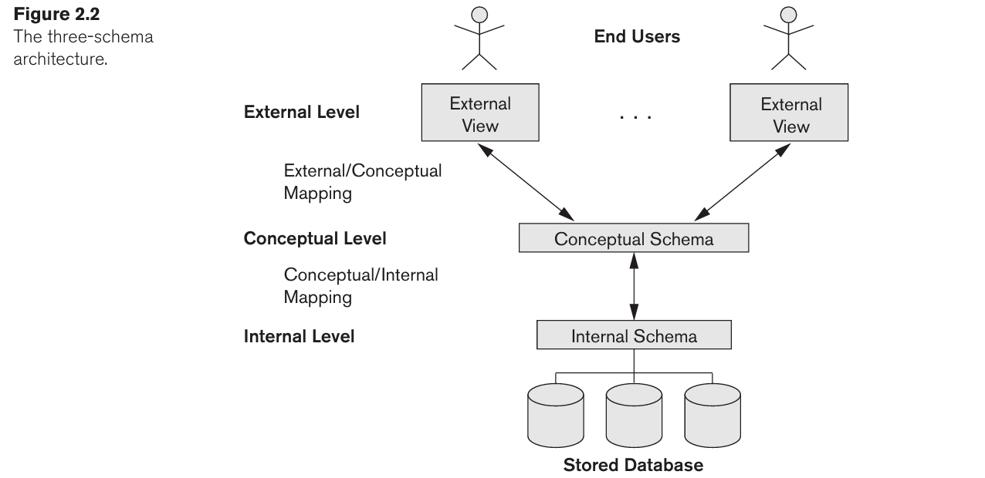
Three-Schema Architecture and Data Independence: To Proposed to support DBMS characteristics .
The goal of the three-schema architecture, is to separate the user applications from the physical database. In this architecture, schemas can be defined at the following three levels

Slide 44
1. Internal Level:
The internal level has an internal schema, which describes the physical storage structure of the database. The internal schema uses a physical data model and describes the complete details of data storage and access paths for the database.
2. conceptual level :
The conceptual level has a conceptual schema, which describes the structure of the whole database for a community of users. The conceptual schema hides the details of physical storage structures and concentrates on describing entities, data types, relationships, user operations, and constraints. Usually, a representational data model is used to describe the conceptual schema when a database system is implemented. This implementation conceptual schema is often based on a conceptual schema design in a high-level data mode

Slide 45
3. External Level:
The external or view level includes a number of external schemas or user views. Each external schema describes the part of the database that a particular user group is interested in and hides the rest of the database from that user group. As in the previous level, each external schema is typically implemented using a representational data model, possibly based on an external schema design in a high-level conceptual data model.
* The processes of transforming requests and results between levels are called mappings.

Slide 46
Data Independence
The three-schema architecture can be used to further explain the concept of data independence, which can be defined as the capacity to change the schema at one level of a database system without having to change the schema at the next higher level.
There are two types of data independence:
1. Logical data independence:
Logical data independence is the capacity to change the conceptual schema without having to change external schemas or application programs.
We may change the conceptual schema to expand the database (by adding a record type or data item), to change constraints, or to reduce the database (by removing a record type or data item). In the last case, external schemas that refer only to the remaining data should not be affected

Slide 47
2. Physical data independence:
Physical data independence is the capacity to change the internal schema without having to change the conceptual schema. Hence, the external schemas need not be changed as well.
For example, the internal schema may be changed when certain file structures are reorganized or new indexes are created to improve database performance.
physical data independence exists in most databases and file environments where physical details, such as the exact location of data on disk, and hardware details of storage encoding, placement, compression, splitting, merging of records, and so on are hidden from the user.
Note: Data independence occurs because when the schema is changed at some level, the schema at the next higher level remains unchanged; only the mapping between the two levels is changed. Hence, application programs refer ring to the higher-level schema need not be changed.

Slide 48
DBMS Languages:
Data Definition Language (DDL)
2. Data Manipulation Language (DML)
Data Definition Language (DDL):
Used by the DBA and database designers to specify the conceptual schema of a database.
DDL is used to specify the conceptual schema only.
Another language, the storage definition language (SDL), is used to specify the internal schema.
The mappings between the two schemas may be specified in either one of these languages. In most relational DBMSs today, there is no specific language that performs the role of SDL.
In many DBMSs, the DDL is also used to define internal and external schemas (views).

Slide 49
The third language, the view definition language (VDL), to specify user views and their mappings to the conceptual schema, but in most DBMSs the DDL is used to define both conceptual and external schemas.
In relational DBMSs, SQL is used in the role of VDL to define user or application views as results of predefined queries
Data Manipulation Language (DML):
Used to specify database retrievals and updates .
There are two main types of DMLs………

Slide 50
High-level or nonprocedural DML:
A high-level or nonprocedural DML can be used on its own to specify complex database operations concisely.
High-level DMLs, such as SQL, can specify and retrieve many records in a single DML statement; therefore, they are called set-at-a-time or set-oriented DMLs.
A query in a high-level DML often specifies which data to retrieve rather than how to retrieve it; therefore, such languages are also called declarative.
Low level or procedural DML:
A low level or procedural DML must be embedded in a general-purpose programming language.
This type of DML typically retrieves individual records or objects from the database and processes each separately.
it needs to use programming language constructs, such as looping, to retrieve and process each record from a set of records.
Low-level DMLs are also called record-at-a-time DMLs

Slide 51
DBMS Interfaces:
Menu-based Interfaces for Web Clients or Browsing:
These interfaces present the user with lists of options (called menus) that lead the user through the formulation of a request.
2. Apps for Mobile Devices: These interfaces present mobile users with access to their data. For example, banking, reservations, and insurance companies, among many others, provide apps that allow users to access their data through a mobile phone or mobile device.
3.Forms-based Interfaces:
A forms-based interface displays a form to each user. Users can fill out all of the form entries to insert new data, or they can fill out only certain entries, in which case the DBMS will retrieve matching data for the remain ingentries. Forms are usually designed and programmed for naive users as interfaces to canned transactions.

Slide 52
4. Graphical User Interfaces:
A GUI typically displays a schema to the user in diagrammatic form. The user then can specify a query by manipulating the diagram. In many cases, GUIs utilize both menus and forms.
5.Natural Language Interfaces:
These interfaces accept requests written in Eng lish or some other language and attempt to understand them. A natural language interface usually has its own schema, which is similar to the database conceptual schema, as well as a dictionary of important words.
6. Keyword-based Database Search:
It is similar to Web search engines, which accept strings of natural language (like English or Spanish) words and match them with documents at specific sites (for local search engines) or Web pages on the Web at large (for engines like Google or Ask). They use predefined indexes on words and use ranking functions to retrieve and present resulting documents in a decreasing degree of match.
7. Speech Input and Output:
Limited use of speech as an input query and speech as an answer to a question or result of a request is becoming commonplace. Appli cations with limited vocabularies, such as inquiries for telephone directory, flight arrival/departure, and credit card account information, are allowing speech for input and output to enable customers to access this information.

Slide 53
8. Interfaces for Parametric Users:
Parametric users, such as bank tellers, often have a small set of operations that they must perform repeatedly.
9. Interfaces for the DBA:
Most database systems contain privileged commands that can be used only by the DBA staff. These include commands for creating accounts, setting system parameters, granting account authorization, changing a schema, and reorganizing the storage structures of a database.

Slide 54
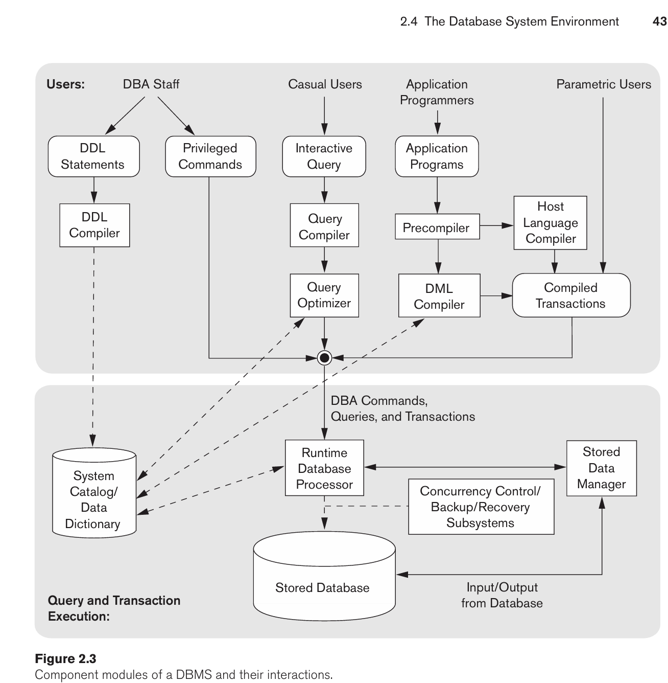
The Database System Environment:

Slide 55
The query optimizer is concerned with the rearrangement and possible reordering of operations, elimination of redundancies, and use of efficient search algorithms during execution. It consults the system catalog for statistical and other physical information about the stored data and generates executable code that performs the necessary operations for the query and makes calls on the runtime processor.
A higher-level stored data manager module of the DBMS controls access to DBMS information that is stored on disk, whether it is part of the database or the catalog.
The DBA staff works on defining the database and tuning it by making changes to its definition using the DDL and other privileged commands.
The DDL compiler processes schema definitions, specified in the DDL, and stores descriptions of the schemas (meta-data) in the DBMS catalog. The catalog includes information such as the names and sizes of files, names and data types of data items, storage details of each file, mapping information among schemas, and constraints

Slide 56
Application programmers write programs in host languages such as Java, C, or C++ that are submitted to a precompiler.
The precompiler extracts DML commands from an application program written in a host programming language.
These commands are sent to the DML compiler for compilation into object code for database access. The rest of the program is sent to the host language compiler.
The object codes for the DML commands and the rest of the program are linked, forming a canned transaction whose executable code includes calls to the runtime database processor
Runtime database processor: Its executes
the privileged commands,
the executable query plans,
(3) the canned transactions with runtime parameters.
It works with the system catalog and may update it with statistics.
It also works with the stored data manager, which in turn uses basic operating system services for carrying out low-level input/output (read/write) operations between the disk and main memory.

Slide 57
These queries are parsed and validated for correctness of the query syntax, the names of files and data elements, and so on by a query compiler that compiles them into an internal form. This internal query is subjected to query optimization.
The client program that accesses the DBMS running on a separate computer or device from the computer on which the database resides.
The database and the DBMS catalog are usually stored on disk. Access to the disk is controlled primarily by the operating system (OS), which schedules disk read/write. Many DBMSs have their own buffer management module to sched ule disk read/write, because management of buffer storage has a considerable effect on performance.

Slide 58
Database System Utilities: Most DBMSs have database utilities that help the DBA manage the database system. Common utilities have the following types of functions:
Loading data stored in files into a database. Includes data conversion tools.
Backing up the database periodically on tape.
Reorganizing database file structures.
Report generation utilities.
Performance monitoring utilities.
Other functions, such as sorting, user monitoring, data compression, etc.

Slide 59
Tools, Application Environments, and Communications Facilities:
Data dictionary / repository: Used to store schema descriptions and other information such as design decisions, application program descriptions, user information, usage standards, etc.
Active data dictionary is accessed by DBMS software and users/DBA.
Passive data dictionary is accessed by users/DBA only.
Application Development Environments and CASE (computer-aided software engineering) tools:
Examples:
PowerBuilder (Sybase)
JBuilder (Borland)
JDeveloper 10G (Oracle)

Slide 60
The DBMS also needs to interface with communications software, whose function is to allow users at locations remote from the database system site to access the database through computer terminals, workstations, or personal computers. These are connected to the database site through data communications hardware such as Internet routers, phone lines, long-haul networks, local networks, or satellite communication devices. Many commercial database systems have communication packages that work with the DBMS.

Slide 61
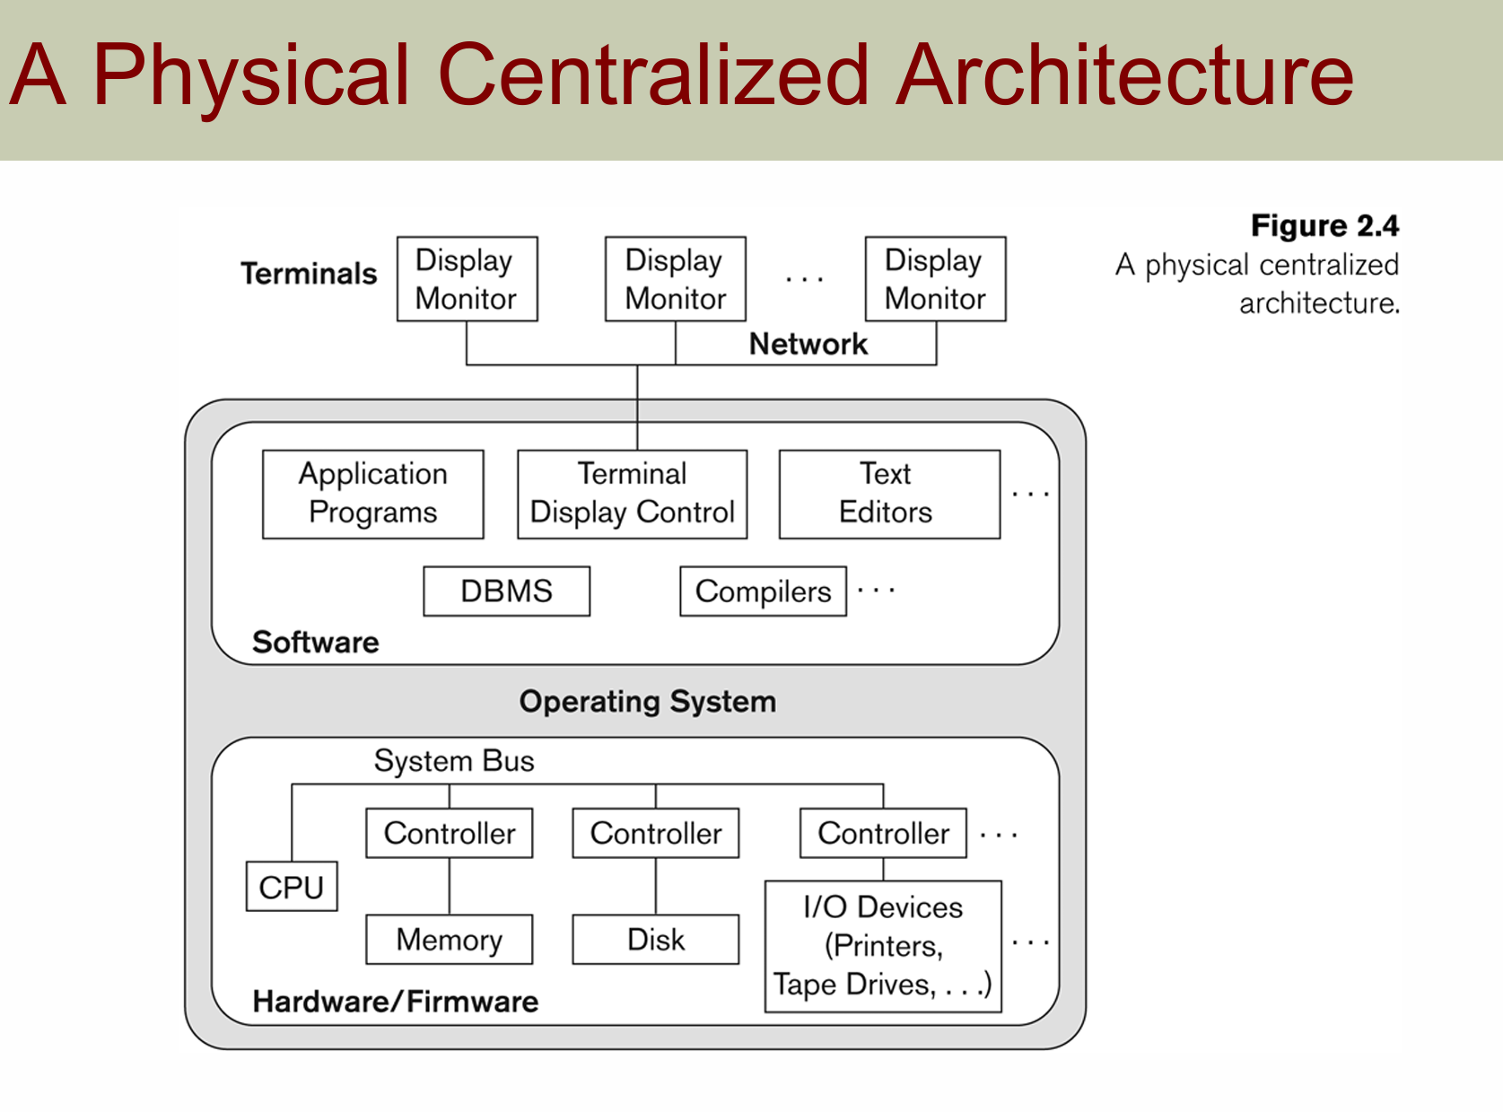
Centralized and Client-Server DBMS Architectures:
Centralized DBMS:
Combines everything into single system including- DBMS software, hardware, application programs,
and user interface processing software.
User can still connect through a remote terminal – however, all processing is done at centralized site.

Slide 62
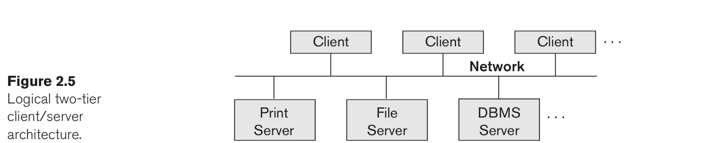
Basic 2-tier Client-Server Architectures:
The client/server architecture was developed to deal with computing environments in which a large number of PCs, workstations, file servers, printers, database servers, Web servers, e-mail servers, and other software and equipment are connected via a network. The idea is to define specialized servers with specific functionalities.
For example, it is possible to connect a number of PCs or small workstations as clients to a file server that maintains the files of the client machines.
Another machine can be designated as a printer server by being connected to various printers; all print requests by the clients are forwarded to this machine.
Web servers or e-mail servers also fall into the specialized server cate gory

Slide 63
Clients :
Provide appropriate interfaces through a client software module to access and utilize the various server resources.
Clients may be diskless machines or PCs or Workstations with disks with only the client software installed.
Connected to the servers via some form of a network (LAN: local area network, wireless network, etc.)
DBMS Server:
Provides database query and transaction services to the clients
Relational DBMS servers are often called SQL servers, query servers, or transaction servers
Applications running on clients utilize an Application Program Interface (API) to access server databases via standard interface such as:
ODBC: Open Database Connectivity standard
JDBC: for Java programming access
Client and server must install appropriate client module and server module software for ODBC or JDBC.

Slide 64
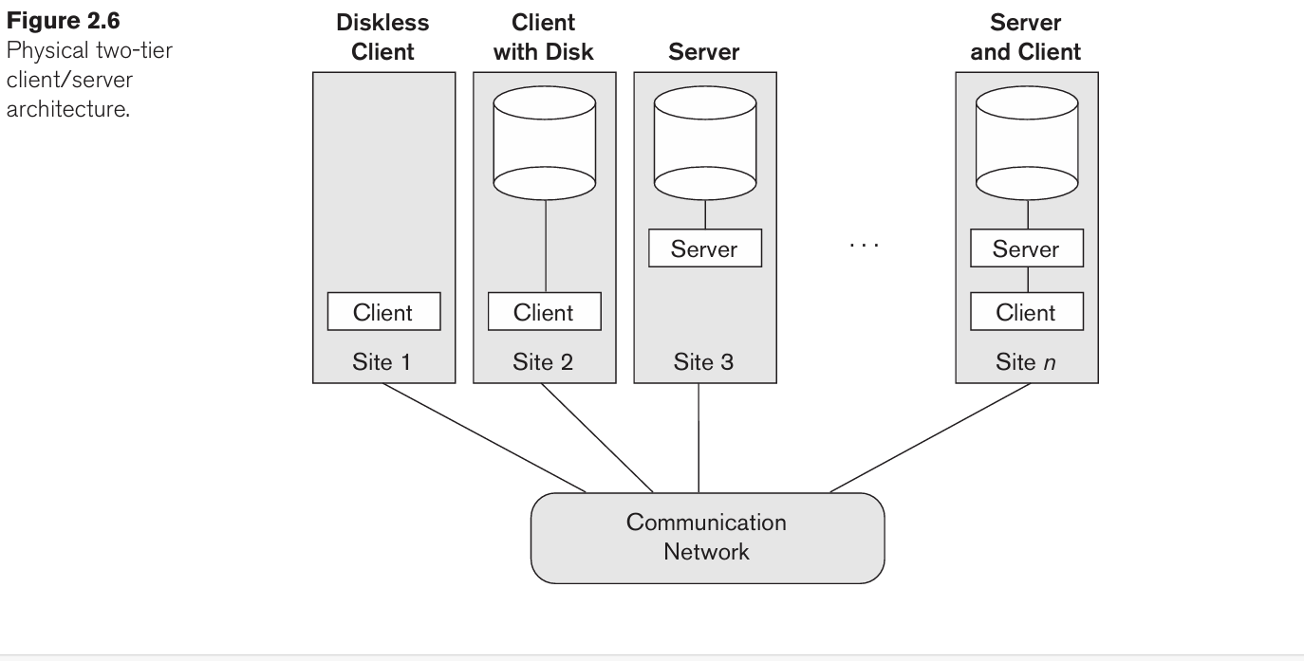
Two Tier Client-Server Architecture:
A client program may connect to several DBMSs, sometimes called the data sources.
In general, data sources can be files or other non-DBMS software that manages data.
Other variations of clients are possible: e.g., in some object DBMSs, more functionality is transferred to clients including data dictionary functions, optimization and recovery across multiple servers, etc.

Slide 65
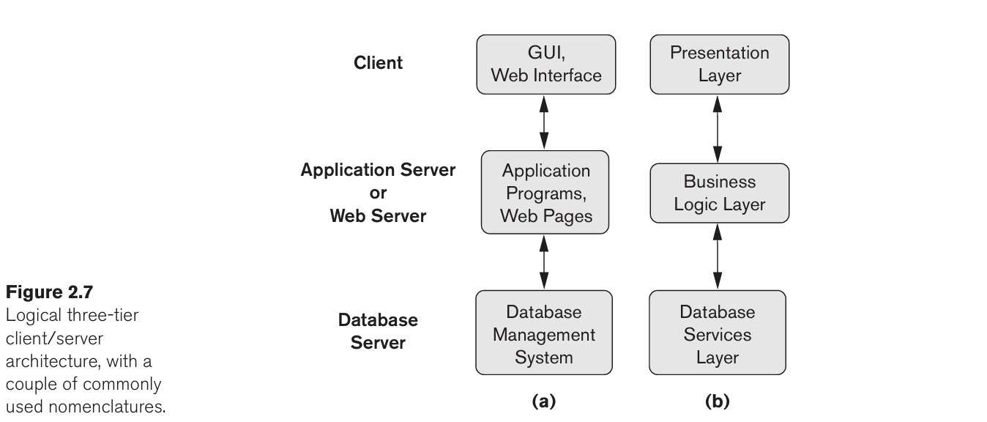
Three-Tier and n-Tier Architectures for Web Applications:
Common for Web applications
Intermediate Layer called Application Server or Web Server:
a)Stores the web connectivity software and the business logic part of the application used to access the corresponding data from the database server .
b)Acts like a conduit for sending partially processed data between the database server and the client.
Three-tier Architecture Can Enhance Security:
a)Database server only accessible via middle tier
b)Clients cannot directly access database server

Slide 67
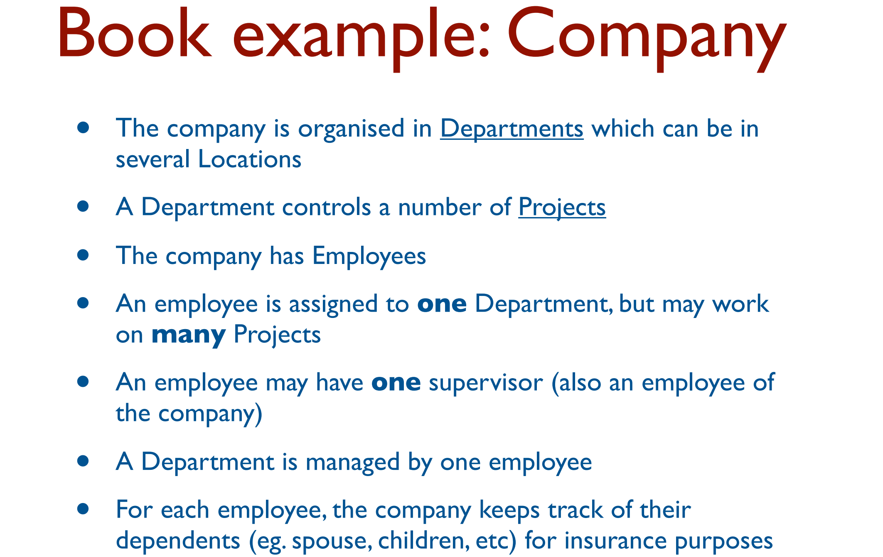

Slide 68
E-R Model

Slide 69
Data modeling Using ER Model:
This is a popular high-level conceptual data model. This model and its variations are frequently used for the conceptual design of database applications.
The conceptual schema is a concise description of the data requirements of the users and includes detailed descriptions of the entity types, relationships, and constraints.
These are expressed using the concepts provided by the high-level data model.
E-R Model concept do not include implementation details, they are usually easier to understand and can be used to communicate with nontechnical users.
The high-level conceptual schema can also be used as a reference to ensure that all users’ data requirements are met and that the requirements do not conflict.
The next step in database design is the actual implementation of the database, using a commercial DBMS ex. Relational or the object-relational database model.

Slide 70
The conceptual schema is transformed from the high-level data model into the implementation data model. This step is called logical design or data model mapping.
The last step is the physical design phase, during which the internal storage structures, file organizations, indexes, access paths, and physical design parameters for the database files are specified.
And application programs are designed and implemented as database transactions corresponding to the high level transaction specifications.
High level Design
E-R model
Phase-1
Logical Design/ Data Modeling mapping
Relational or Object Model
Phase-2
Physical Design
Phase-3
Internal Storage Structure

Slide 71
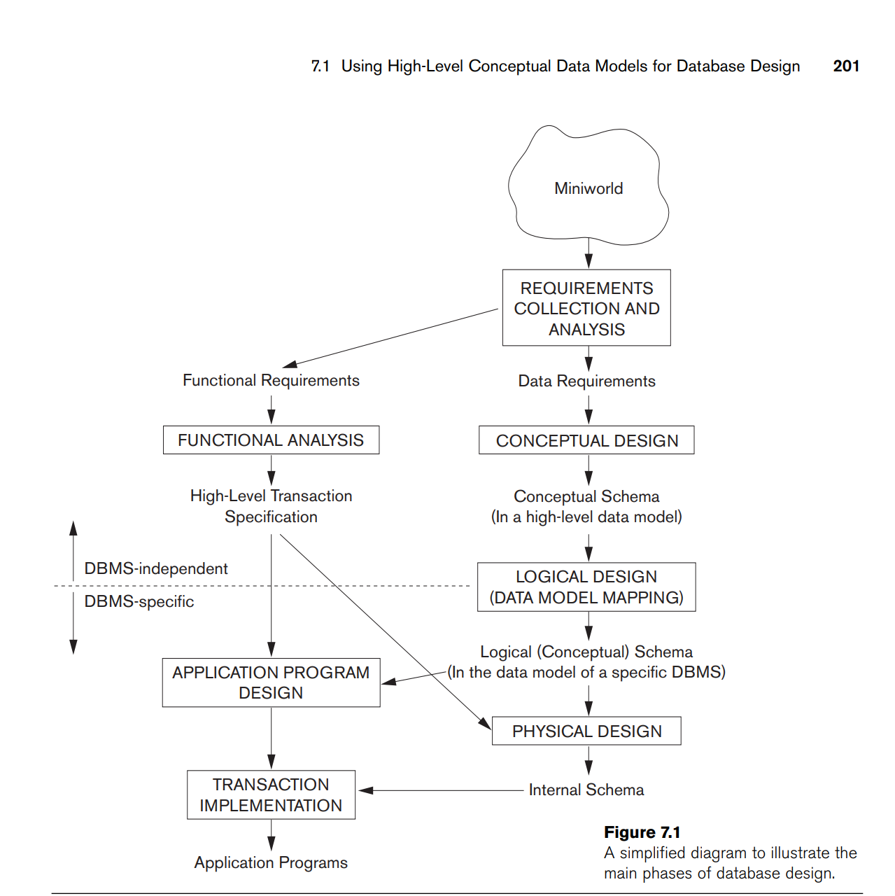

Slide 72
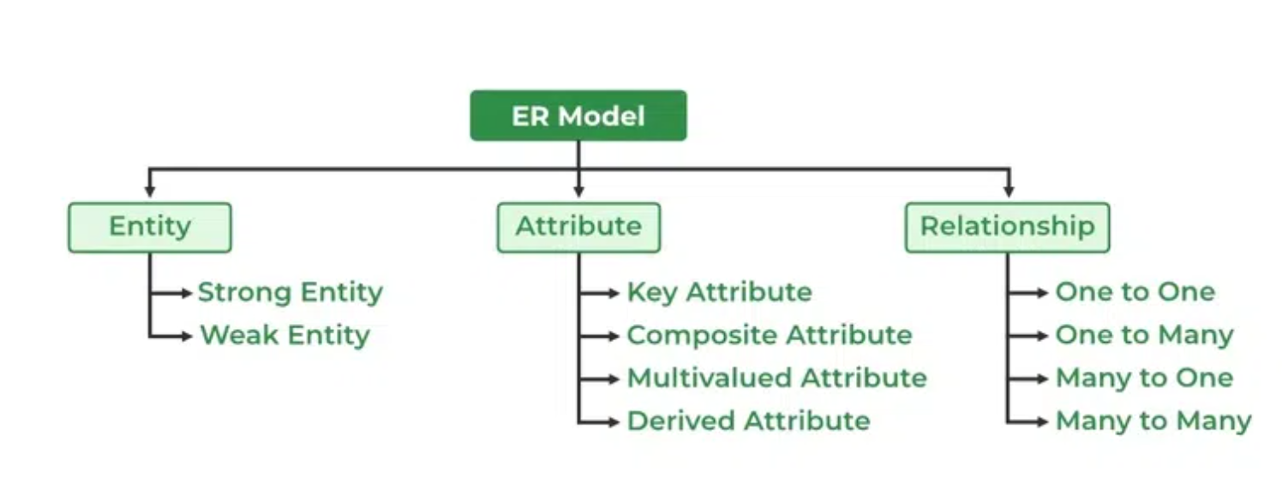
Entity- Relationship Diagram:
An Entity–relationship model (ER model) describes the structure of a database with the help of a diagram, which is known as Entity Relationship Diagram (ER Diagram).
An ER model is a design or blueprint of a database that can later be implemented as a database.
The main components of E-R Diagram are:
Entity
Attribute
Relationship

Slide 73
Entity Types, Entity Sets, Attributes and Keys
• Entity:
A “ thing” in the real-world with an independent existence and which is distinguishable from other objects.
An Entity may be an object with physical existence- Example are a person, car, customer, product, book etc.
An Entity may be an object wit h conceptual /logical existence - Example are a company, a job, a university course etc.
Each entity has attributes. It is a properties that describes the entity.
An Entity is represented by rectangle.

Slide 74
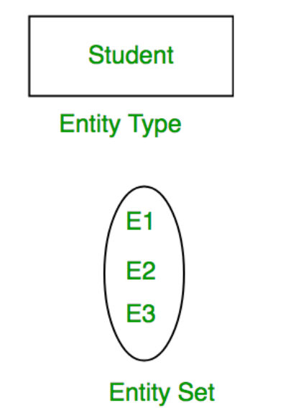
• Entity Type: Collection of entities that all have the same attributes, e.g., persons, cars, customers etc.
• Entity Set: Collection of entities of a particular entity type at any point in time; entity set is typically referred to using the same name as entity type.

Slide 75
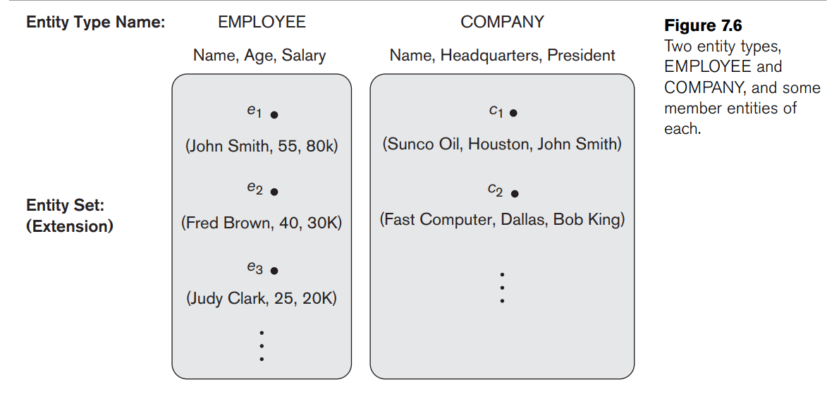

Slide 76
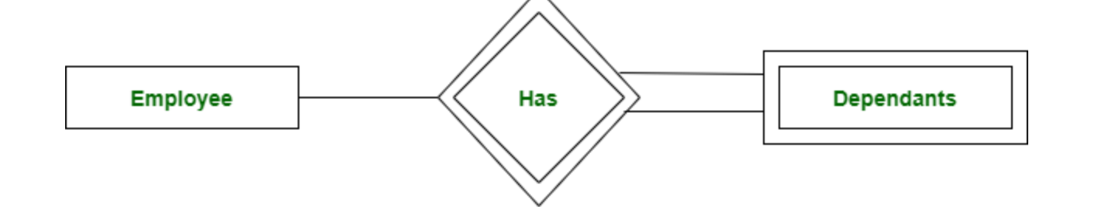
Types of Entity: there are two types of entity:
Strong Entity:
A Strong Entity is a type of entity that has a key Attribute. Strong Entity does not depend on other Entity in the Schema. It has a primary key, that helps in identifying it uniquely, and it is represented by a rectangle. These are called Strong Entity Types.
2. Weak Entity
An Entity type has a key attribute that uniquely identifies each entity in the entity set. But some entity type exists for which key attributes can’t be defined. These are called Weak Entity Types.
A weak entity type is represented by a Double Rectangle. The participation of weak entity types is always total. The relationship between the weak entity type and its identifying strong entity type is called identifying relationship and it is represented by a double diamond.

Slide 77
Attributes:
An entity is represented by a set of attributes (its descriptive properties), e.g., name, age, salary, price etc.
Attribute values that describe each entity become a major part of the data eventually stored in a database.
• With each attribute a domain is associated, i.e., a set of permitted values for an attribute. Possible domains are integer, string, date, etc.
Type of Attribute:
1- Composite versus Simple (Atomic) Attributes
2- Single-Valued versus Multivalued Attributes
3-Stored versus Derived Attributes.
4-NULL Values
5-Complex Attributes.
6-Key Attribute

Slide 78
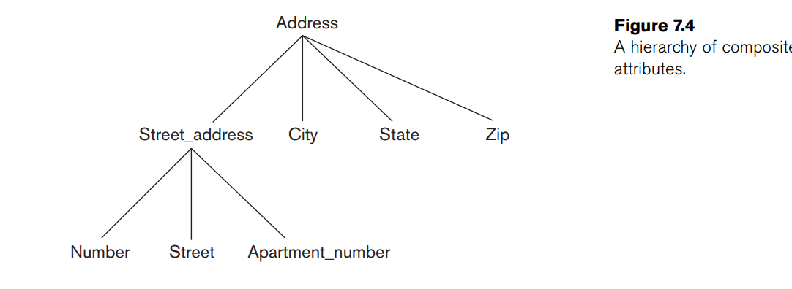
Composite attributes:
It can be divided into smaller subparts, which represent more basic attributes with independent meanings. Example Address attribute. The value of a composite attribute is the concatenation of the values of its component simple attributes.
Simple Attribute:
Attributes that are not divisible are called simple or atomic attributes. Example rollno in student table.

Slide 79

Single-Valued versus Multivalued Attributes:
Most attributes have a single value for a particular entity; such attributes are called single-valued. For example, Age is a single-valued attribute of a person.
An attribute consisting of more than one value for a given entity.
example-
Phone_No (can be more than one for a given student).
- a Colors attribute for a car.
- or a College_degrees attribute for a person
In ER diagram, a multivalued attribute is represented by a double oval.

Slide 80
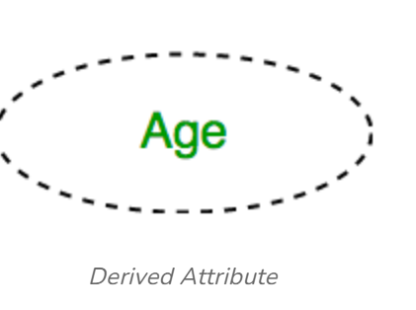
Stored versus Derived Attributes:
Derived Attribute
An attribute that can be derived from other attributes of the entity type is known as a derived attribute. e.g.; Age (can be derived from DOB). In ER diagram, the derived attribute is represented by a dashed oval
The Age attribute is hence called a derived attribute and is said to be derivable from the Birth_date attribute, which is called a stored attribute.
Some attribute values can be derived from related entities; for example, an attribute Number_of_employees of a DEPARTMENT entity can be derived by counting the number of employees related to (working for) that department.

Slide 81
NULL Values:
In some cases, a particular entity may not have an applicable or Unknown value for an attribute.
Null value used if we do not known the value of an attribute for a particular entity.
For example, the Apartment_number attribute of an address applies only to addresses that are in apartment buildings and not to other types of residences, such as single-family homes.
Null- Not applicable and Unknown ( Appartment No. is Not Applicable)
Unknown- Missing and Not Known (ex- height of person is Missing and phone number is Not Known)
Complex Attributes: Group of composite and multivalued attributes is called complex attribute.
For example, if a person can have more than one residence and each residence can have a single address and multiple phones, an attribute Address_phone for a person can be specified Complex attribute. Both Phone and Address are themselves composite attributes.
-a composite attribute represent parentheses ().
-and displaying multivalued attributes between braces { }.
Example- {college Degree(college, year, field)}

Slide 82

Key attributes of an Entity Type:
• Entities of an entity type need to be distinguishable.
An important constraint on the entities of an entity type is the key or uniqueness constraint on attributes. An entity type usually has one or more attributes whose values are distinct for each individual entity in the entity set. Such an attribute is called a key attribute, and its values can be used to identify each entity uniquely.

Slide 84

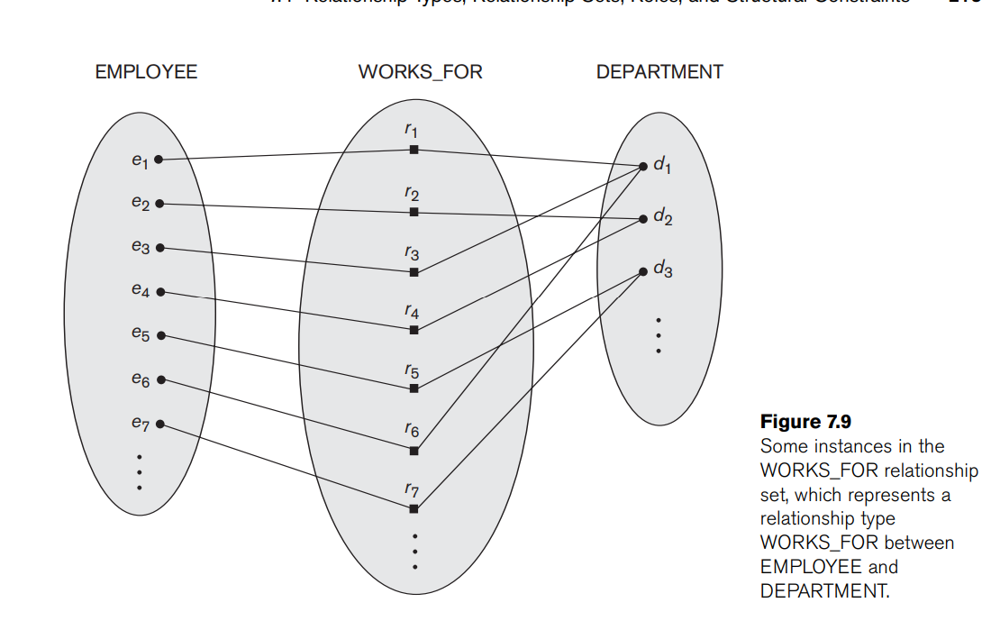
Relationship Type and Relationship Set:
A Relationship Type represents the association between entity types.
For example, ‘Enrolled in’ is a relationship type that exists between entity type Student and Course. In ER diagram, the relationship type is represented by a diamond and connecting the entities with lines
A set of relationships of the same type is known as a relationship set.

Slide 85
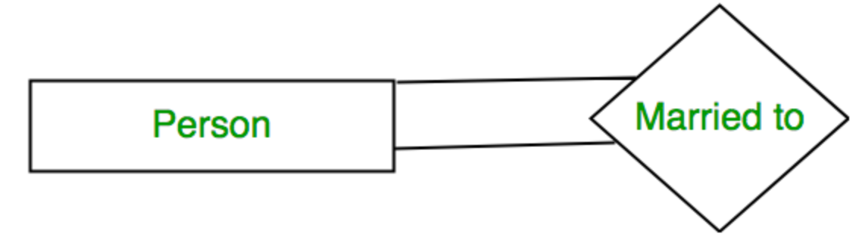
Degree of a Relationship Type:
The degree of a relationship type is the number of participating entity types.
Unary Relationship: When there is only ONE entity set participating in a relation, the relationship is called a unary relationship. For example, one person is married to only one person.
Binary Relationship: When there are TWO entities set participating in a relationship, the relationship is called a binary relationship. For example, a Student is enrolled in a Course.
Example: the WORKS_FOR relationship is of degree two. A relationship type of degree two is called binary.
Ternary Relationship: When there are three entity sets participating in a relationship, the relationship is called a ternary relationship.

Slide 86
Relationship:
Cardinality Ratios:The number of times an entity of an entity set participates in a relationship set is known as cardinality. Cardinality can be of different types.
A relationship is represented by diamond shape in ER diagram, it shows the relationship among entities. There are four types of cardinal relationships:
One to One
One to Many
Many to One
Many to Many

Slide 87
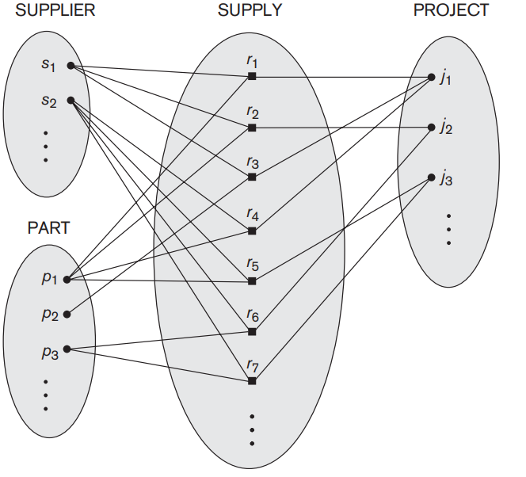

Slide 88
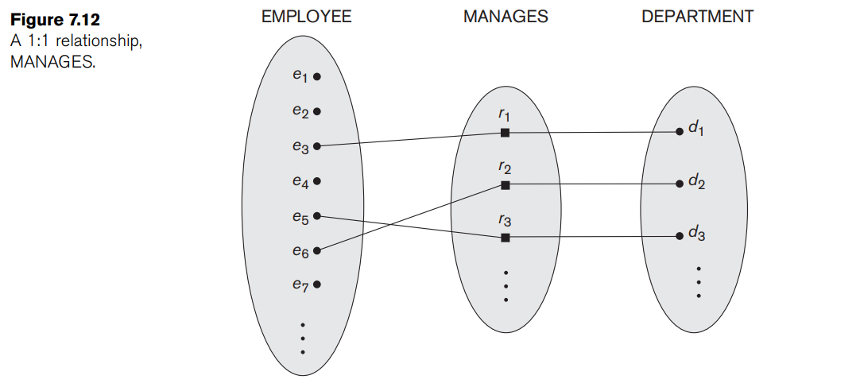
One to One Relationship:
When a single instance of an entity is associated with a single instance of another entity then it is called one to one relationship.
An example of a 1:1 binary relationship is MANAGES (Figure 7.12), which relates a department entity to the employee who manages that department. This represents the miniworld constraints that—at any point in time—an employee can manage one department only and a department can have one manager only

Slide 89


One to Many Relationship:
When a single instance of an entity is associated with more than one instances of another entity then it is called one to many relationship. For example – a customer can place many orders but a order cannot be placed by many customers.
Many-to-one relationship
When more than one instance of the entity on the left, and only one instance of an entity on the right associates with the relationship then it is known as a many-to-one relationship.
For example, Student enrolls for only one course, but a course can have many students.

Slide 90

Many-to-man relationship
When more than one instance of the entity on the left, and more than one instance of an entity on the right associates with the relationship then it is known as a many-to-many relationship. For example, Employee can assign by many projects and project can have many employees.
Participation Constraints : Participation Constraints tell us that the participation in a relationship can either be total or partial.
Total Participation:
When each entity in an entity set participates in a relation, it is called Total Participation.
Partial Participation:
However, when all entities in the given entity set do not participate in a relation, it is called Partial Participation

Slide 91
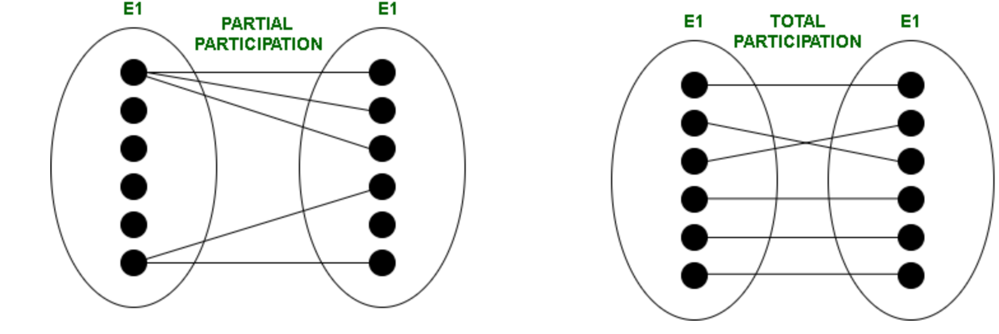

Slide 92
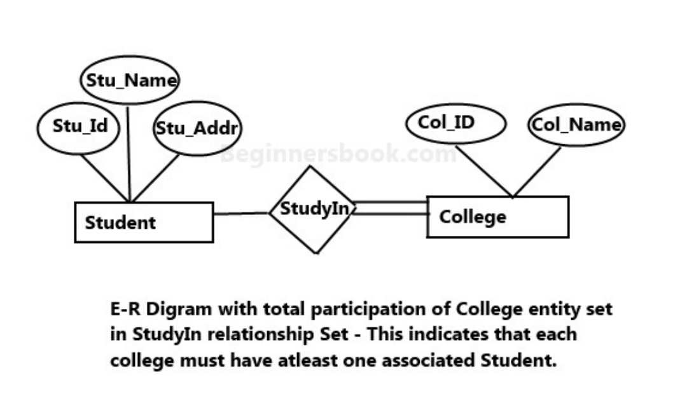
Total Participation For example:
In the below diagram each college must have at-least one associated Student.

Slide 93
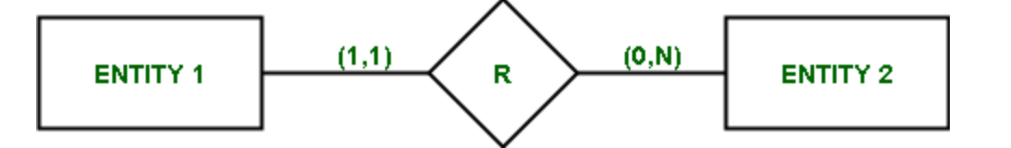
Structural Constraints :
Structural Constraints are also called Structural properties of a database management system (DBMS). Cardinality Ratios and Participation Constraints taken together are called Structural Constraints.
The Structural constraints are represented by Min-Max notation. This is a pair of numbers(m, n) that appear on the connecting line between the entities and their relationships. The minimum number of times an entity can appear in a relation is represented by m whereas, the maximum time it is available is denoted by n.
If m= 0 ->the entity is participating in the relation partially,
if m >= 1, it denotes total participation of the entity.
Note – Number of times an entity participates in a relationship is same as the number appearance of the entity in the tuples.

Slide 94
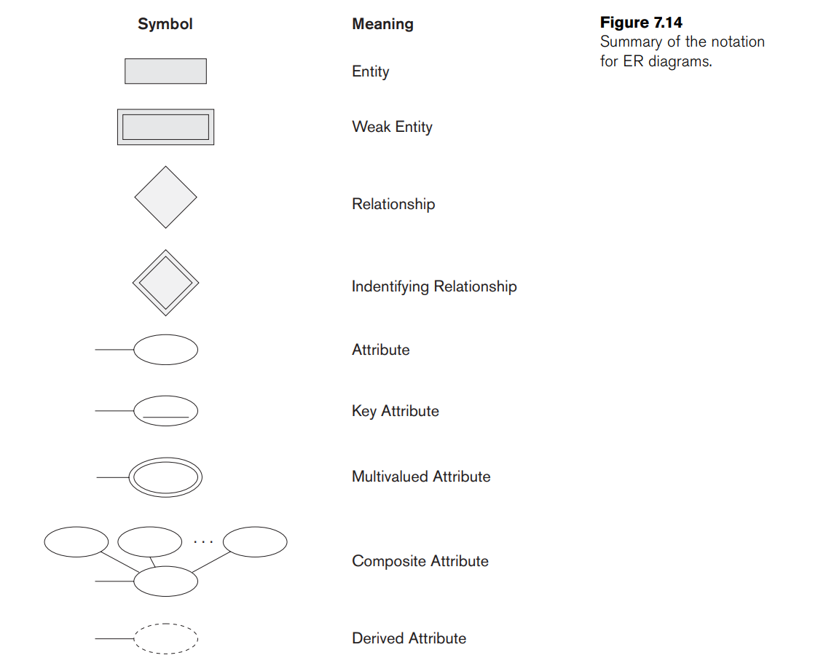

Slide 95
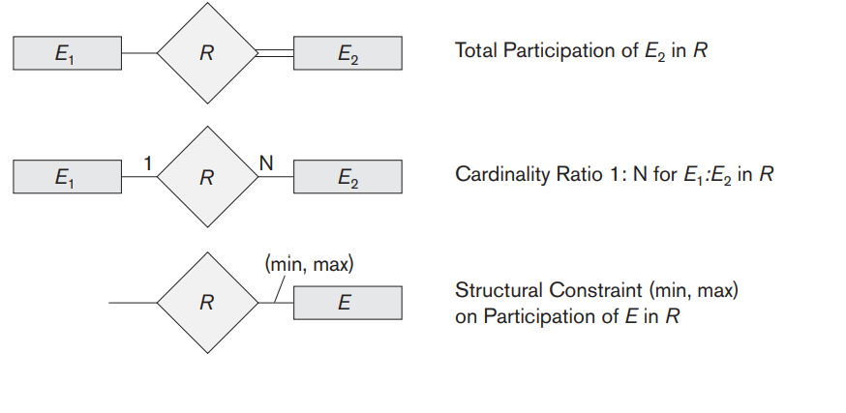

Slide 96
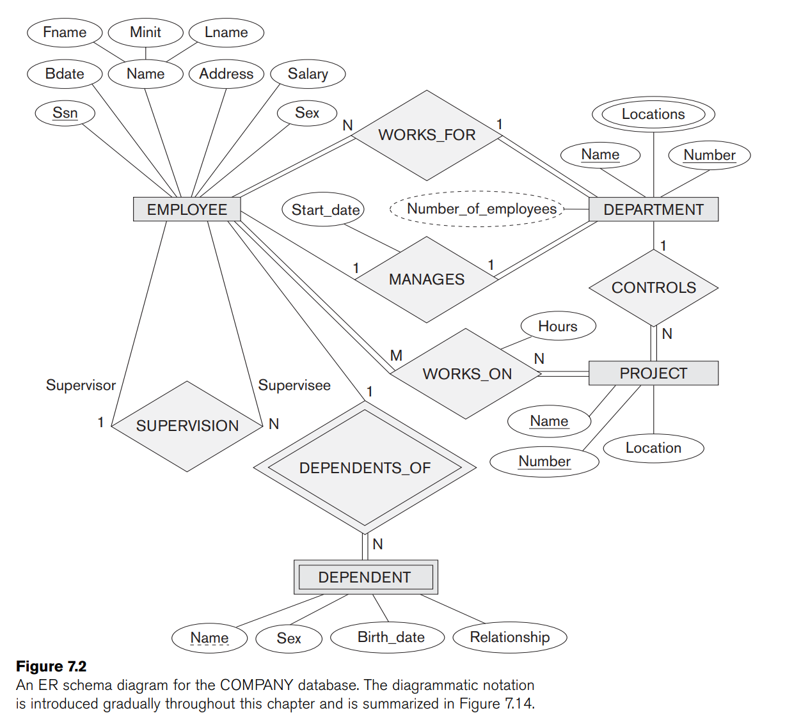

Slide 97
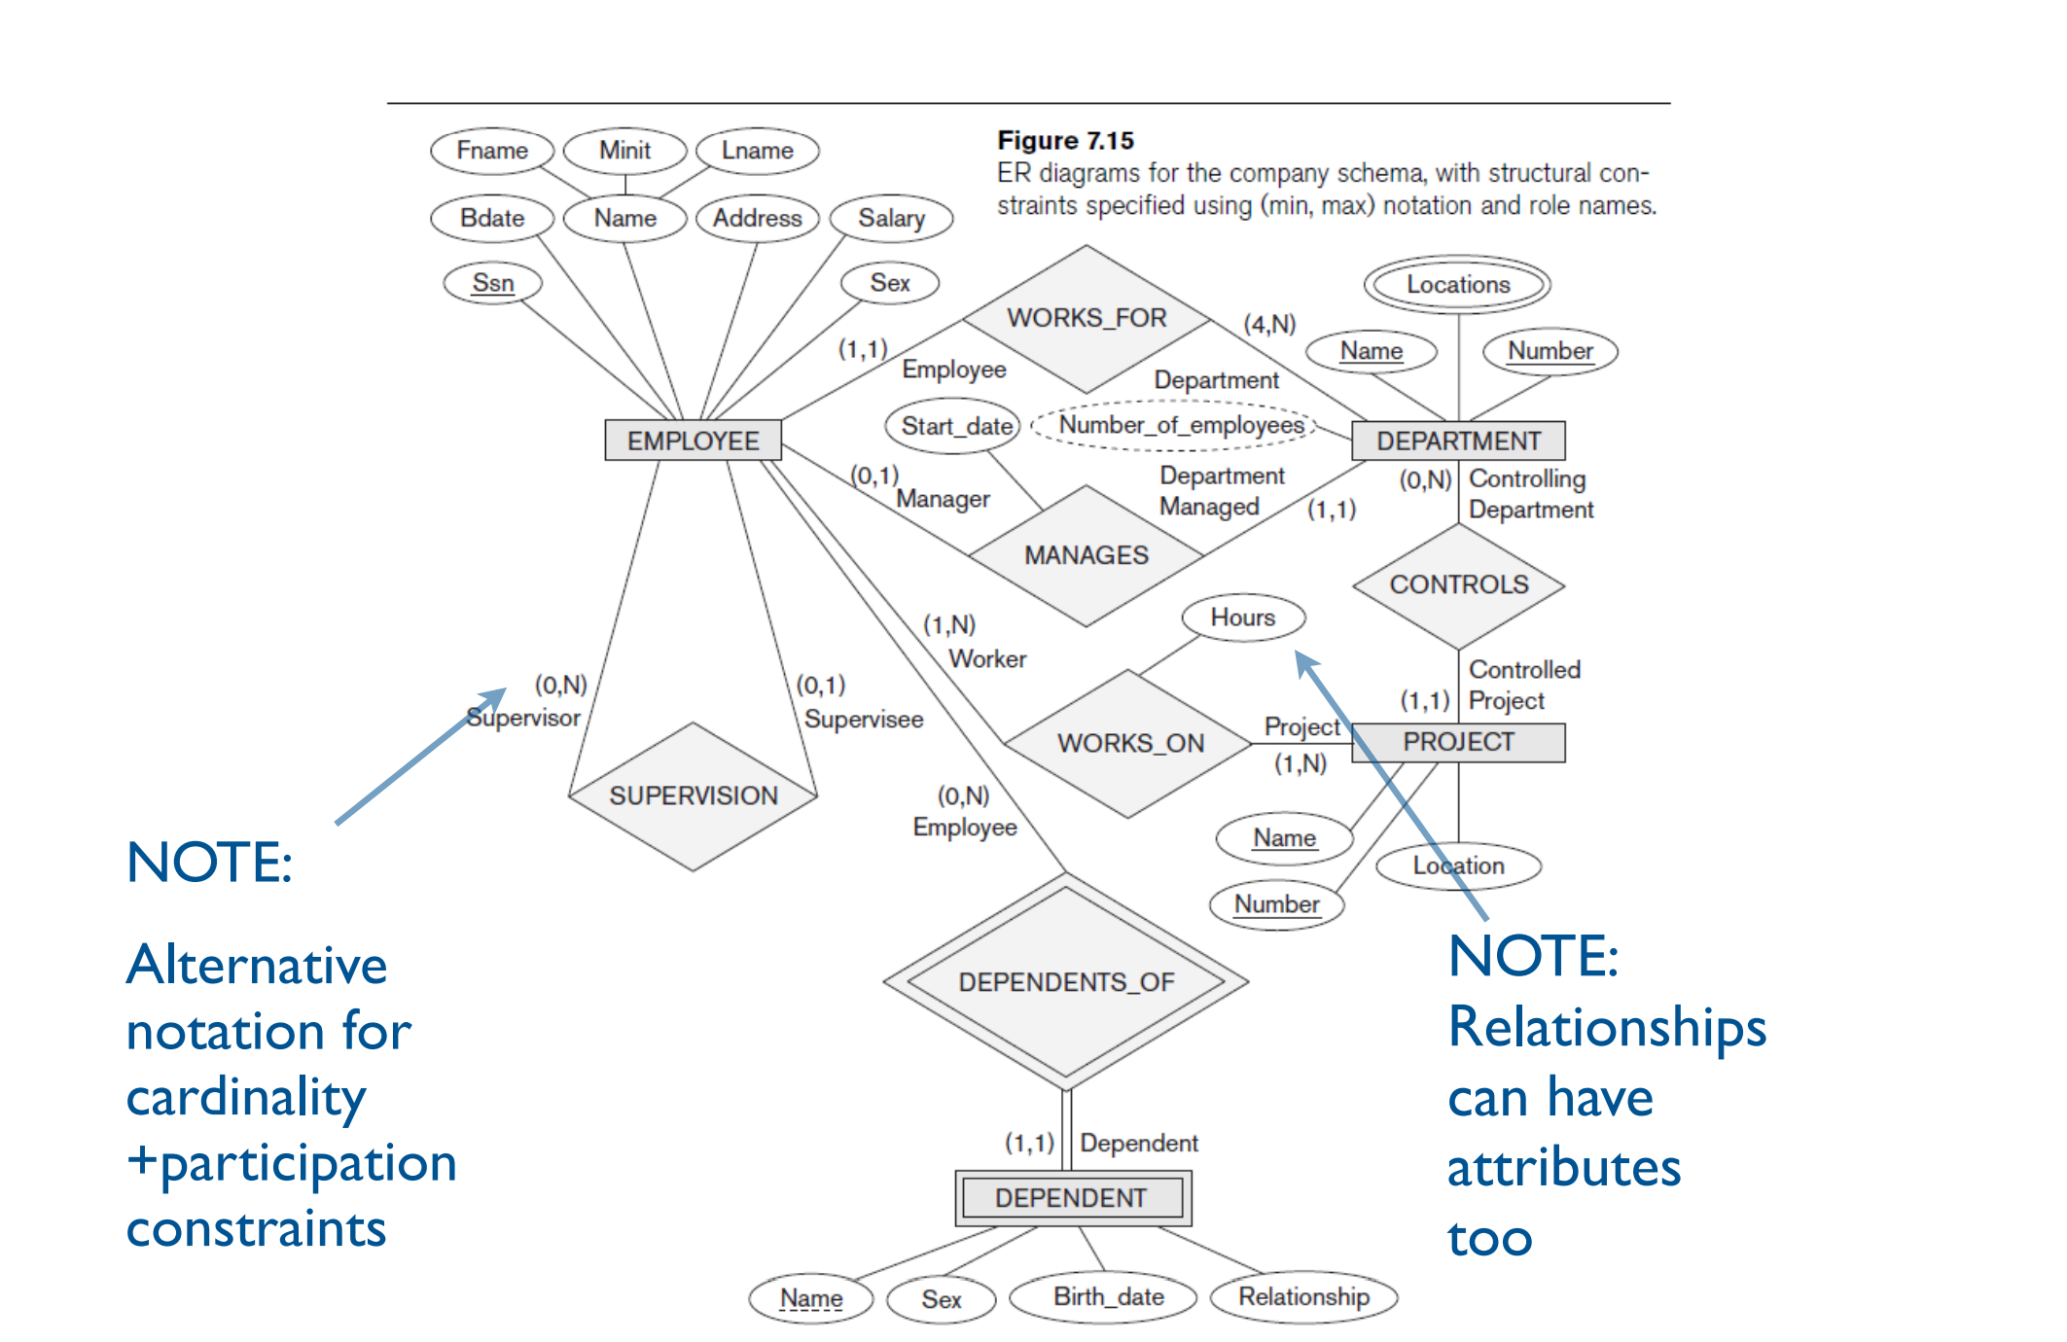

Slide 98
Key in DBMS:
Keys play an important role in the relational database.
It is used to uniquely identify any record or row of data from the table. It is also used to establish and identify relationships between tables.
Type Of Key:
Super Key
Primary key
Candidate key
Alternative key
Composite key
Super Key:
Super key is an attribute or set of attribute that can uniquely identify a tuple (row). A super key is a group of single or multiple keys that identifies rows in a table. It supports NULL values.
A super key is a superset of a candidate key.
Adding zero or more attributes to the candidate key generates the super key.
A candidate key is a super key but vice versa is not true.
Super Key values may also be NULL.

Slide 99
Candidate Key:
The minimal set of attributes that can uniquely identify a tuple is known as a candidate key. For Example, STUD_NO in STUDENT relation.
Some Important point:
It is a minimal super key.
It is a super key with no repeated data is called a candidate key.
The minimal set of attributes that can uniquely identify a record.
It must contain unique values.
It can contain NULL values.
Every table must have at least a single candidate key.
A table can have multiple candidate keys but only one primary key.
The value of the Candidate Key is unique and may be null for a tuple.
There can be more than one candidate key in a relationship.

Slide 100
Primary Key:
There can be more than one candidate key in relation out of which one can be chosen as the primary key.
Example :
STUD_NO, as well as STUD_PHONE, are candidate keys for relation STUDENT but STUD_NO can be chosen as the primary key.
only one primary key out of many candidate keys
It is a unique key.
It can identify only one tuple (a record) at a time.
It has no duplicate values, it has unique values.
It cannot be NULL.
Primary keys are not necessarily to be a single column; more than one column can also be a primary key for a table.

Slide 101
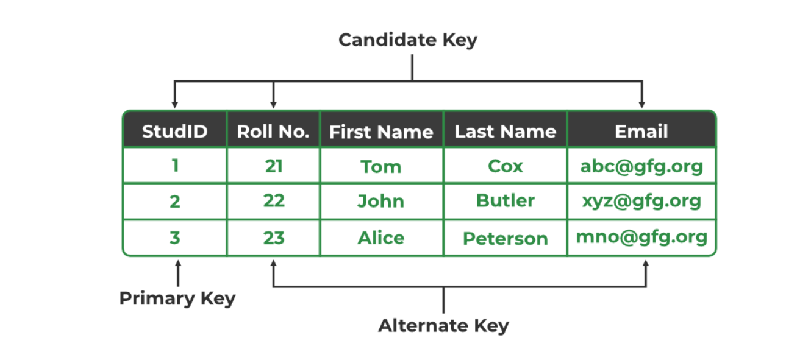
Alternate Key
The candidate key other than the primary key is called an alternate key.
All the keys which are not primary keys are called alternate keys.
It is a secondary key.
It contains two or more fields to identify two or more records.
These values are repeated.
Eg:- SNAME, and ADDRESS is Alternate keys

Slide 102
Composite Key:
Sometimes, a table might not have a single column/attribute that uniquely identifies all the records of a table. To uniquely identify rows of a table, a combination of two or more columns/attributes can be used.
It acts as a primary key if there is no primary key in a table
Two or more attributes are used together to make a composite key.
Different combinations of attributes may give different accuracy in terms of identifying the rows uniquely.
Example: Full name + DOB can be combined together to access the details of students.

Slide 103
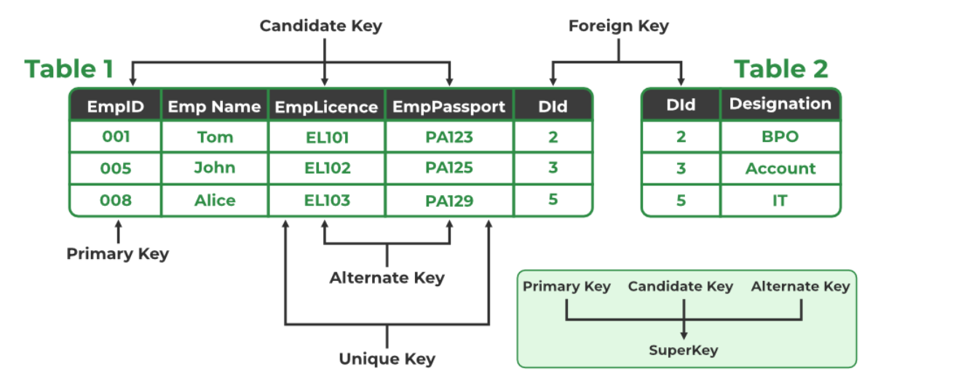
Foreign Key:
It is a key it acts as a primary key in one table and it acts as secondary key in another table.
It combines two or more relations (tables) at a time.
They act as a cross-reference between the tables.
example: DNO is a primary key in the DEPT table and a non-key in EMP

