Slide 1
Relational Algebra
Chapter 4
Notes:
1

Slide 2
Relational Query Languages
Query languages: Allow manipulation and retrieval of data from a database.
Relational model supports simple, powerful QLs:
  Strong formal foundation based on algebra/logic.
  Allows for much optimization.
Notes:
2
We’ve seen examples of manipulation commands in Ch. 3.
Expand on logic, deductive databases, prolog and logic programming.
Mention relational completeness rather than Turing completeness.. The joins don’t come out on PC fonts.
Query Languages != programming languages!
QLs not expected to be “Turing complete”.
QLs not intended to be used for calculations.
QLs support easy, efficient access to large data sets.

Slide 3
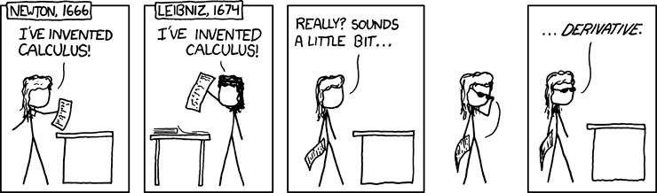
Formal Relational Query Languages
Two mathematical Query Languages form the basis for “real” languages (e.g. SQL), and for implementation:
  Relational Algebra: More operational, very useful for representing execution plans.
  Relational Calculus: Lets users describe what they want, rather than how to compute it. (Non-operational, declarative.) Not covered in cours.
Notes:
Relational Calculus relates to Query By Example

Slide 4
Overview
Notation
Relational Algebra
Relational Algebra basic operators.
Relational Algebra derived operators.

Slide 5
Preliminaries
A query is applied to relation instances, and the result of a query is also a relation instance.
  Schemas of input relations for a query are fixed
  The schema for the result of a given query is also fixed! Determined by definition of query language constructs.
Notes:
4

Slide 6
Preliminaries
Positional vs. named-attribute notation:
  Positional notation
    Ex: Sailor(1,2,3,4)
    easier for formal definitions
  Named-attribute notation
    Ex: Sailor(sid, sname, rating,age)
    more readable
Advantages/disadvantages of one over the other?
Notes:
Cartesian product works well with positional notation. For some joins, need to know names of fields (natural join talks about fields that have the same name).

Slide 7
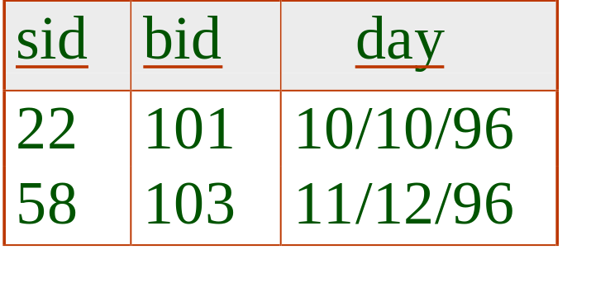
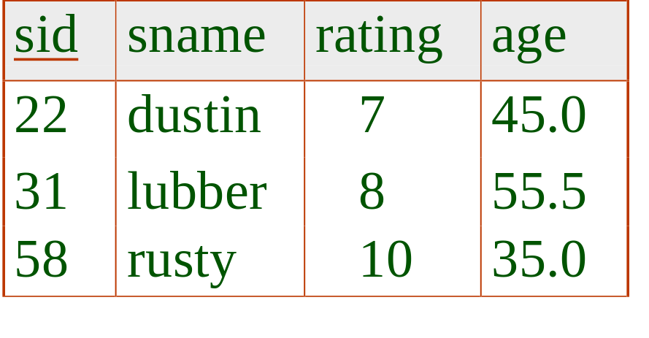
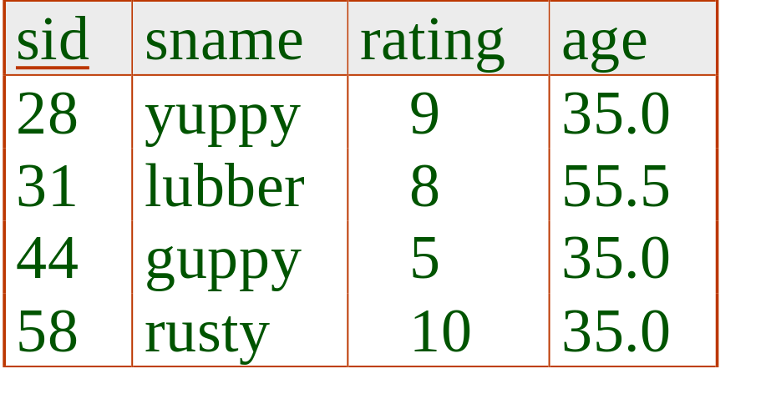
Example Instances
R1
“Sailors” and “Reserves” relations for our examples.
We’ll use positional or named field notation.
Assume that names of fields in query results are inherited from names of fields in query input relations.
S1
S2
Notes:
5
Cut out tables with records to manipulate them

Slide 8
Relational Algebra

Slide 9
Algebra
In math, algebraic operations like +, -, x, /.
Operate on numbers: input are numbers, output are numbers.
Can also do Boolean algebra on sets, using union, intersect, difference.
Focus on algebraic identities, e.g.
  x (y+z) = xy + xz.
(Relational algebra lies between propositional and 1st-order logic.)
3
7
4
Notes:
draw more examples on overhead projects.
Matrix multiplication.

Slide 10
Relational Algebra
Every operator takes one or two relation instances
A relational algebra expression is recursively defined to be a relation
  Result is also a relation
  Can apply operator to
    Relation from database
    Relation as a result of another operator

Slide 11

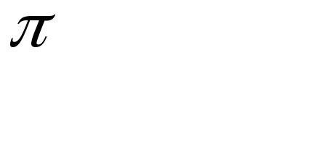



Relational Algebra Operations
Basic operations:
  Selection ( ) Selects a subset of rows from relation.
  Projection ( ) Deletes unwanted columns from relation.
  Cross-product ( ) Allows us to combine two relations.
  Set-difference ( ) Tuples in reln. 1, but not in reln. 2.
  Union ( ) Tuples in reln. 1 and in reln. 2.
Additional derived operations:
  Intersection, join, division, renaming.
  Not essential, but very useful.
Since each operation returns a relation, operations can be composed!
Notes:
6
derived operation: like a macro
relational algebra is closed. Unlike XML.

Slide 12
Basic Relational Algebra Operations

Slide 13
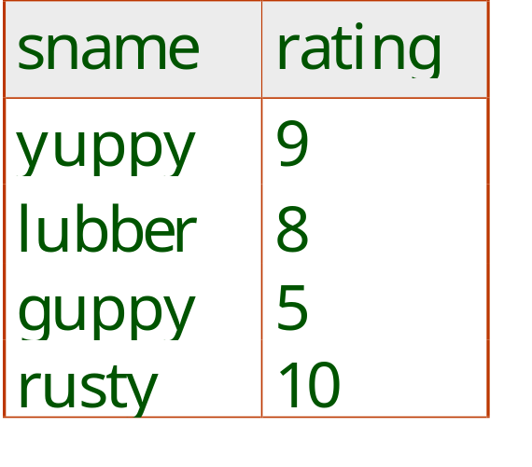
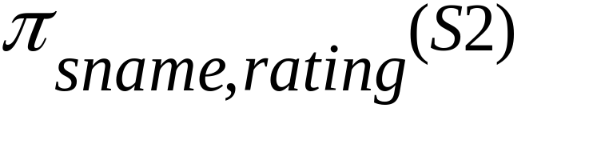
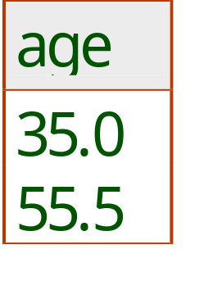
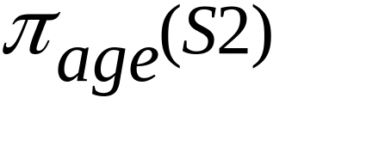
Projection
Deletes attributes that are not in projection list.
Schema of result contains exactly the fields in the projection list, with the same names that they had in the (only) input relation.
Projection operator has to eliminate duplicates! (Why??)
Notes:
7
Note: real systems typically don’t do duplicate elimination unless the user explicitly asks for it. (Why not?)

Slide 14
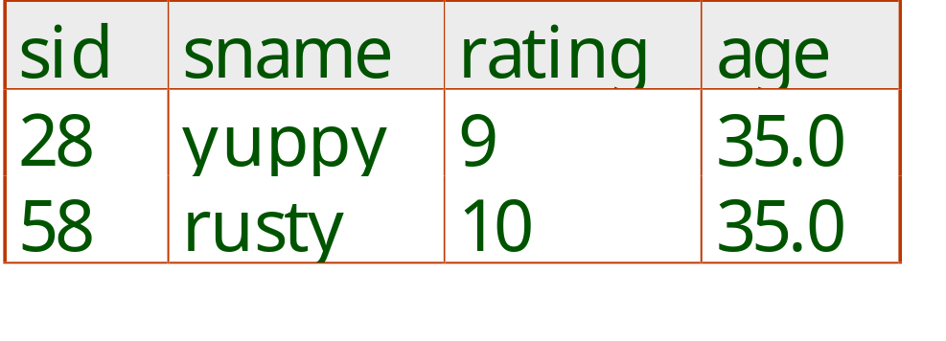
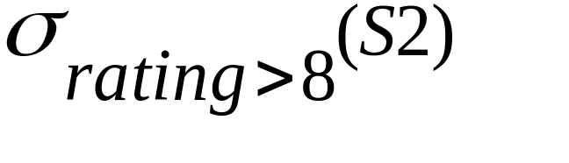
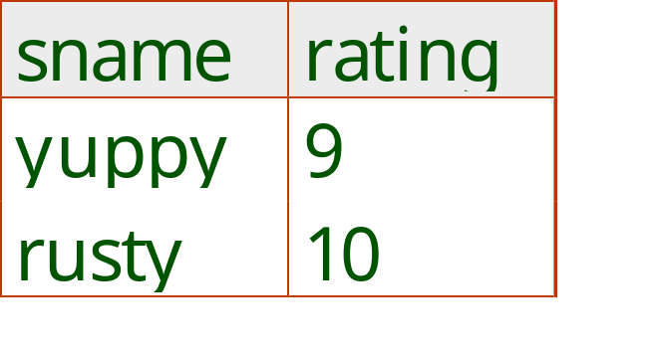
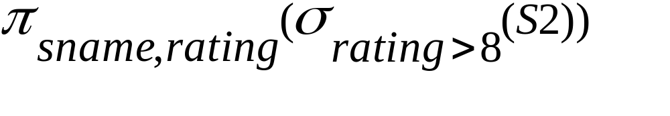
Selection
Selects rows that satisfy selection condition.
No duplicates in result! (Why?)
Schema of result identical to schema of (only) input relation.
Selection conditions:
  simple conditions comparing attribute values (variables) and / or constants or
  complex conditions that combine simple conditions using logical connectives AND and OR.
Notes:
8
Show with cut-out records

Slide 15
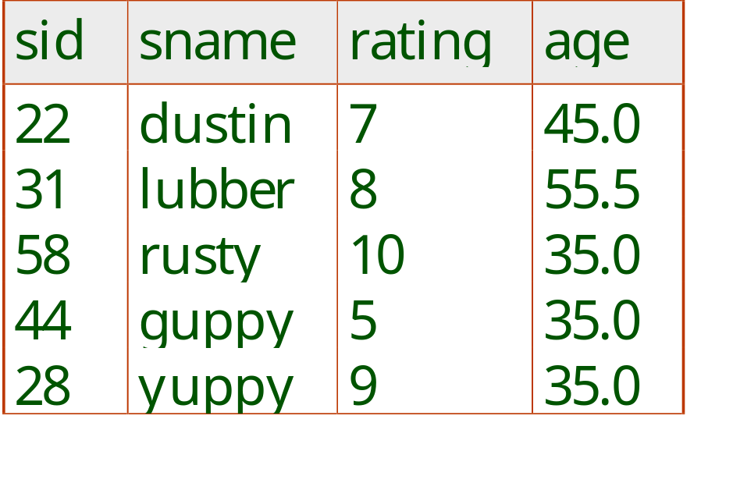
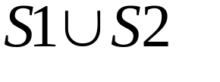
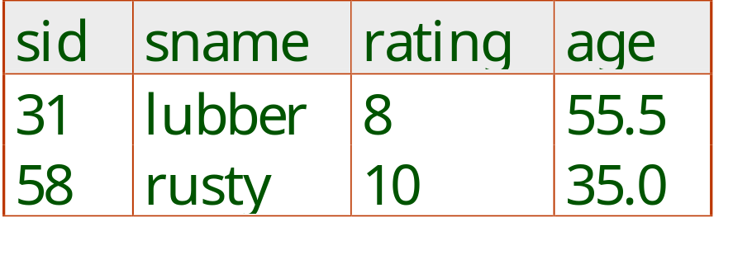
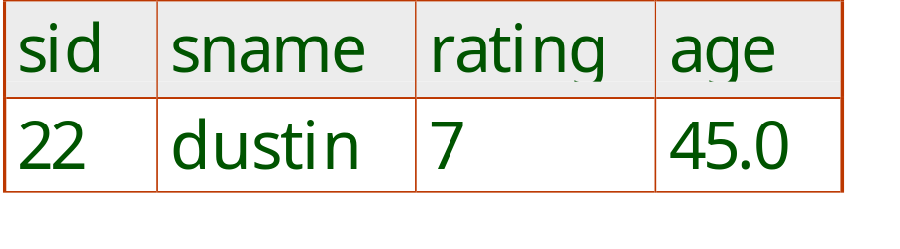


Union, Intersection, Set-Difference
All of these operations take two input relations, which must be union-compatible:
  Same number of fields.
  “Corresponding” fields have the same type.
What is the schema of result?
Notes:
9
Schema of R union S is schema of R. Similar for R intersect S.
In SQL, same field names.

Slide 16
Exercise on Union
Number | shape | holes
1 | round | 2
2 | square | 4
3 | rectangle | 8
Number | shape | holes
4 | round | 2
5 | square | 4
6 | rectangle | 8
Blue blocks (BB)
Yellow blocks(YB)
Which tables are union-compatible?
What is the result of the possible unions?
bottom | top
4 | 2
4 | 6
6 | 2
Stacked(S)
Notes:
Bring in lego blocks. Cut out tables and show with record manipulation the result

Slide 17
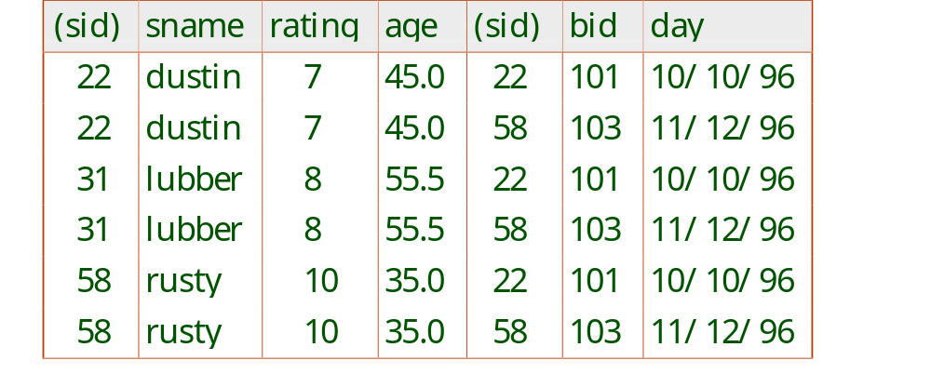
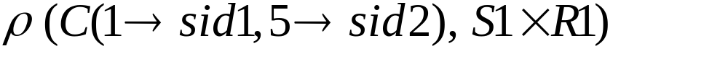
Cross-Product
Each row of S1 is paired with each row of R1.
Result schema has one field per field of S1 and R1, with field names inherited if possible.
  Conflict: Both S1 and R1 have a field called sid.
Renaming operator:
Notes:
10
Show with Records. No two fields must have the same name.

Slide 18
Exercise on Cross-Product
Number | shape | holes
1 | round | 2
2 | square | 4
3 | rectangle | 8
Number | shape | holes
4 | round | 2
5 | square | 4
6 | rectangle | 8
Blue blocks (BB)
Write down 2 tuples in BB x S.
What is the cardinality of BB x S?
bottom | top
4 | 2
4 | 6
6 | 2
Stacked(S)
Notes:
Show with records

Slide 19
Derived Operators
Join and Division

Slide 20

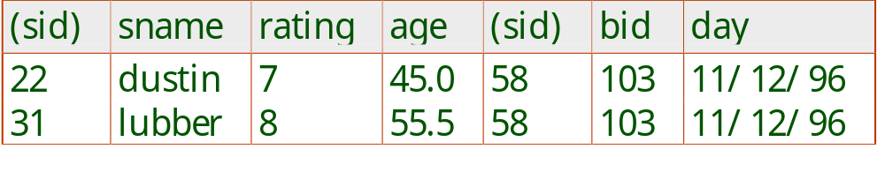
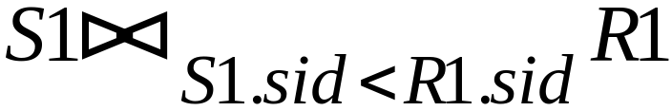
Joins
Condition Join:
Result schema same as that of cross-product.
Fewer tuples than cross-product, might be able to compute more efficiently. How?
Sometimes called a theta-join.
Π-σ-x = SQL in a nutshell.
Notes:
11
Show with cut-outs

Slide 21
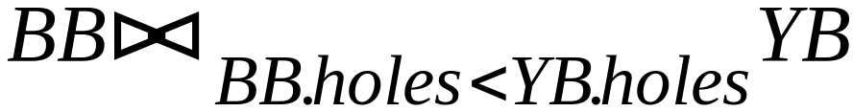
Exercise on Join
Number | shape | holes
1 | round | 2
2 | square | 4
3 | rectangle | 8
Number | shape | holes
4 | round | 2
5 | square | 4
6 | rectangle | 8
Blue blocks (BB)
Yellow blocks(YB)
Write down 2 tuples in this join.
Notes:
Show with records

Slide 22
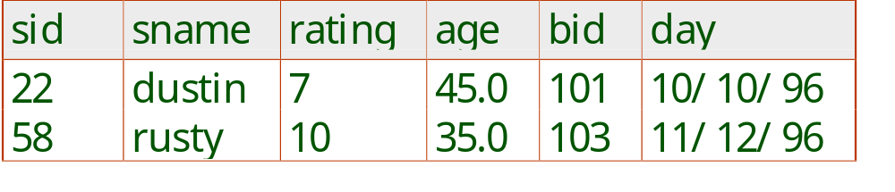
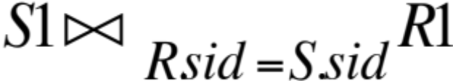

Joins
Equi-Join: A special case of condition join where the condition c contains only equalities.
Result schema similar to cross-product, but only one copy of fields for which equality is specified.
Natural Join: Equijoin on all common fields.
Without specified condition
means the natural join of A and B.
Notes:
12

Slide 23
Example for Natural Join
Number | shape | holes
1 | round | 2
2 | square | 4
3 | rectangle | 8
shape | holes
round | 2
square | 4
rectangle | 8
Blue blocks (BB)
Yellow blocks(YB)
What is the natural join of BB and YB?
Notes:
Show with cut-outs

Slide 24
Join Examples

Slide 25
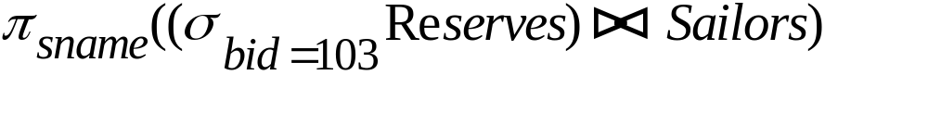
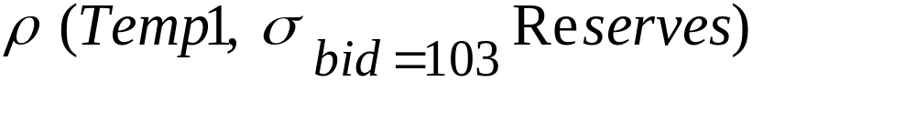
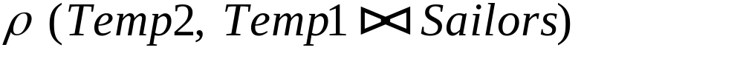
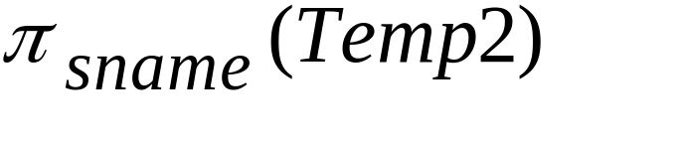
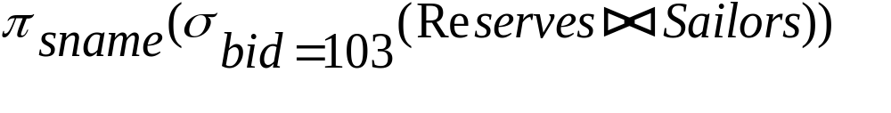
Find names of sailors who’ve reserved boat #103
Solution 1:
Solution 2:
Solution 3:
Notes:
16

Slide 26
Exercise: Find names of sailors who’ve reserved a red boat
Information about boat color only available in Boats; so need an extra join:
A more efficient solution:
A query optimizer can find this, given the first solution!
Notes:
17
Can visualize as evaluation tree.

Slide 27
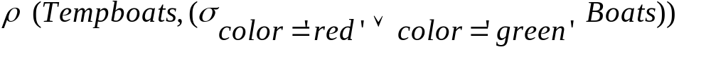
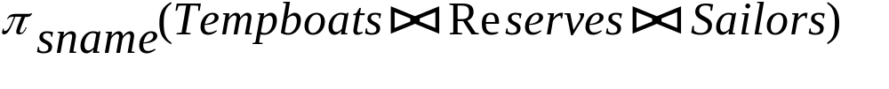


Find sailors who’ve reserved a red or a green boat
Can identify all red or green boats, then find sailors who have reserved one of these boats:
Can also define Tempboats using union! (How?)
What happens if is replaced by in this query?
Notes:
18

Slide 28
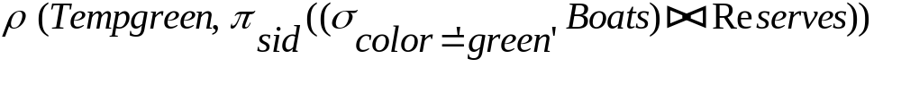
Exercise: Find sailors who’ve reserved a red and a green boat
Previous approach won’t work! Must identify sailors who’ve reserved red boats, sailors who’ve reserved green boats, then find the intersection (note that sid is a key for Sailors):
Notes:
19
Perhaps make this exercise. Or else add some other exercises.

Slide 29
Division
Not supported as a primitive operator, but useful for expressing queries like: Find sailors who have reserved all boats.
Typical set-up: A has 2 fields (x,y) that are foreign key pointers, B has 1 matching field (y).
Then A/B returns the set of x’s that match all y values in B.
Example: A = Friend(x,y). B = set of 354 students. Then A/B returns the set of all x’s that are friends with all 354 students.
Notes:
13
See also Richard Frank’s notes.

Slide 30
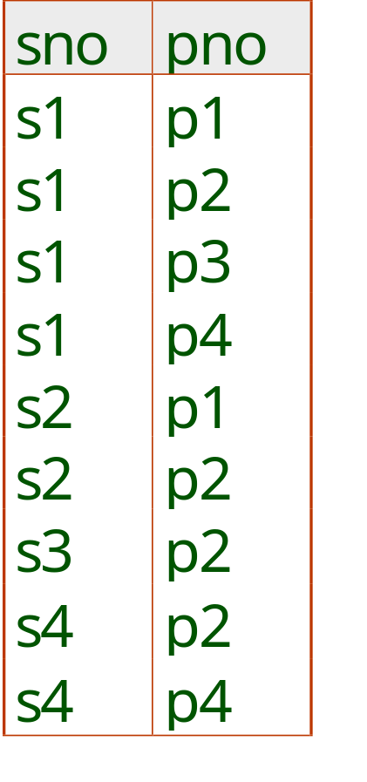
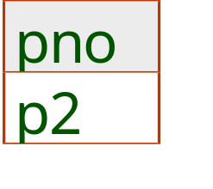
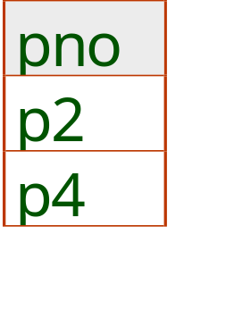
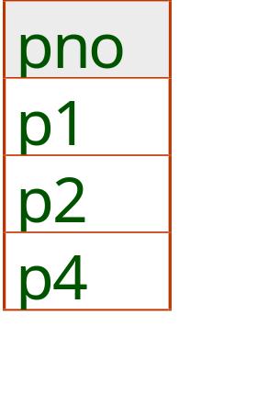
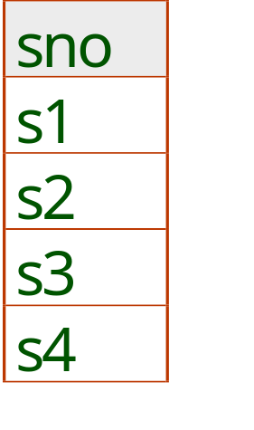
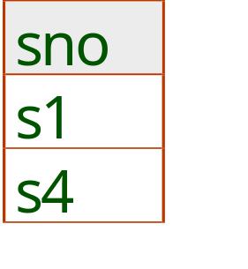
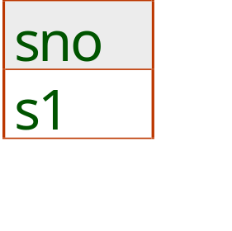
Examples of Division A/B
B1
B2
B3
A
A/B1
A/B2
A/B3
Notes:
14

Slide 31
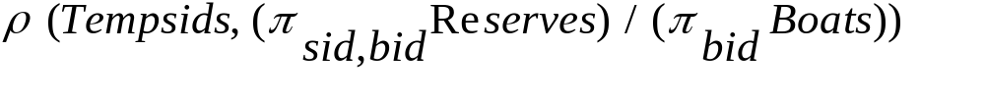
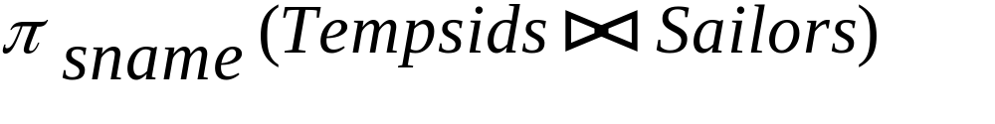
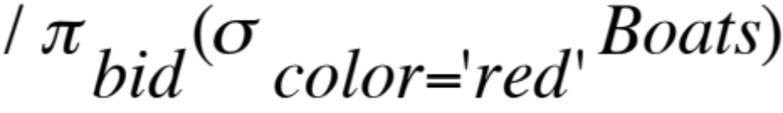
Find the names of sailors who’ve reserved all boats
Uses division; schemas of the input relations to / must be carefully chosen:
To find sailors who’ve reserved all ‘red boats:
.....
Notes:
20

Slide 32
Division in General
In general, x and y can be any lists of fields; y is the list of fields in B, and (x,y) is the list of fields of A.
Then A/B returns the set of all x-tuples such that for every y-tuple in B, the tuple (x,y) is in A.
Notes:
13
See also Richard Frank’s notes.

Slide 33
Summary
The relational model supports rigorously defined query languages that are simple and powerful.
Relational algebra is more operational.
Useful as internal representation for query evaluation plans.
Several ways of expressing a given query; a query optimizer should choose the most efficient version.
Book has lots of query examples.

Slide 34
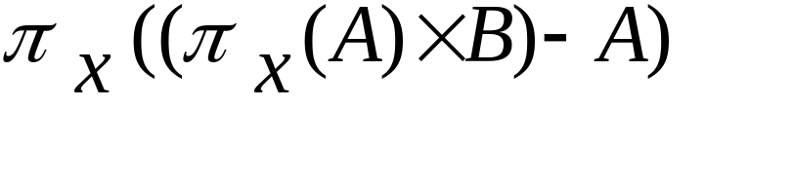
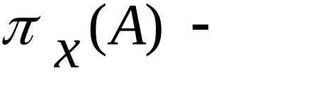
Expressing A/B Using Basic Operators
Division is not essential op; just a useful shorthand.
  (Also true of joins, but joins are so common that systems implement joins specially.)
Idea: For A/B, compute all x values that are not `disqualified’ by some y value in B.
  x value is disqualified if by attaching y value from B, we obtain an xy tuple that is not in A.
  Disqualified x values:
A/B:
all disqualified tuples
Notes:
15

Slide 35
Relational Calculus
Chapter 4, Part B
Notes:
The slides for this text are organized into chapters. This lecture covers relational calculus from Chapter 4. The relational algebra part can be found in Chapter 4, Part A.
Chapter 1: Introduction to Database Systems
Chapter 2: The Entity-Relationship Model
Chapter 3: The Relational Model
Chapter 4 (Part A): Relational Algebra
Chapter 4 (Part B): Relational Calculus
Chapter 5: SQL: Queries, Programming, Triggers
Chapter 6: Query-by-Example (QBE)
Chapter 7: Storing Data: Disks and Files
Chapter 8: File Organizations and Indexing
Chapter 9: Tree-Structured Indexing
Chapter 10: Hash-Based Indexing
Chapter 11: External Sorting
Chapter 12 (Part A): Evaluation of Relational Operators
Chapter 12 (Part B): Evaluation of Relational Operators: Other Techniques
Chapter 13: Introduction to Query Optimization
Chapter 14: A Typical Relational Optimizer
Chapter 15: Schema Refinement and Normal Forms
Chapter 16 (Part A): Physical Database Design
Chapter 16 (Part B): Database Tuning
Chapter 17: Security
Chapter 18: Transaction Management Overview
Chapter 19: Concurrency Control
Chapter 20: Crash Recovery
Chapter 21: Parallel and Distributed Databases
Chapter 22: Internet Databases
Chapter 23: Decision Support
Chapter 24: Data Mining
Chapter 25: Object-Database Systems
Chapter 26: Spatial Data Management
Chapter 27: Deductive Databases
Chapter 28: Additional Topics

Slide 36
Relational Calculus
Comes in two flavors: Tuple relational calculus (TRC) and Domain relational calculus (DRC).
Calculus has variables, constants, comparison ops, logical connectives and quantifiers.
  TRC: Variables range over (i.e., get bound to) tuples.
  DRC: Variables range over domain elements (= field values).
  Both TRC and DRC are simple subsets of first-order logic.
Expressions in the calculus are called formulas. An answer tuple is essentially an assignment of constants to variables that make the formula evaluate to true.

Slide 37
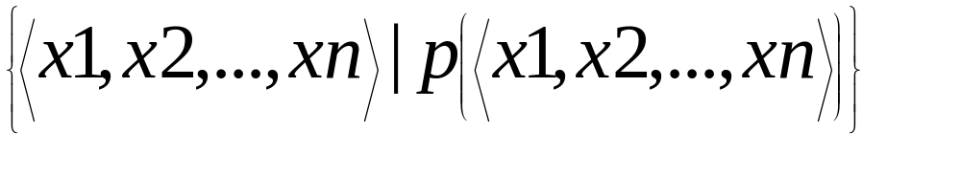
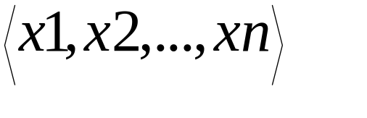
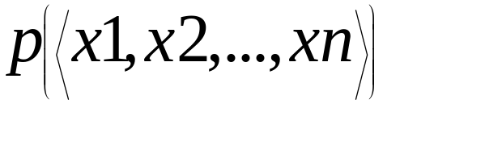
Domain Relational Calculus
Query has the form:
Answer includes all tuples that
make the formula be true.
Formula is recursively defined, starting with
simple atomic formulas (getting tuples from
relations or making comparisons of values),
and building bigger and better formulas using
the logical connectives.

Slide 38
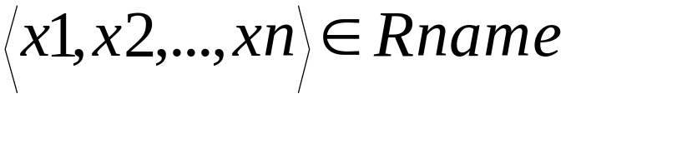

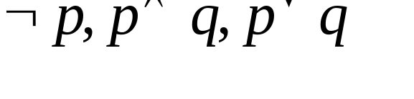
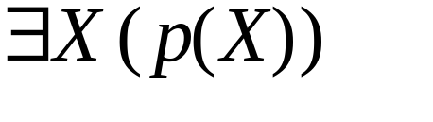



DRC Formulas
Atomic formula:
  , or X op Y, or X op constant
  op is one of
Formula:
  an atomic formula, or
  , where p and q are formulas, or
  , where variable X is free in p(X), or
  , where variable X is free in p(X)
The use of quantifiers and is said to bind X.
  A variable that is not bound is free.

Slide 39
Free and Bound Variables
The use of quantifiers and in a formula is said to bind X.
  A variable that is not bound is free.
Let us revisit the definition of a query:
There is an important restriction: the variables x1, ..., xn that appear to the left of `|’ must be the only free variables in the formula p(...).

Slide 40



Find all sailors with a rating above 7
The condition ensures that the domain variables I, N, T and A are bound to fields of the same Sailors tuple.
The term to the left of `|’ (which should be read as such that) says that every tuple that satisfies T>7 is in the answer.
Modify this query to answer:
  Find sailors who are older than 18 or have a rating under 9, and are called ‘Joe’.
Notes:
Make question below fly in. Prepare Solution.

Slide 41




Find sailors rated > 7 who’ve reserved boat #103
We have used as a shorthand for
Note the use of to find a tuple in Reserves that `joins with’ the Sailors tuple under consideration.
Notes:
Make this exercise. Make solution fly in

Slide 42


Find sailors rated > 7 who’ve reserved a red boat
Observe how the parentheses control the scope of each quantifier’s binding.
This may look cumbersome, but with a good user interface, it is very intuitive. (MS Access, QBE)
Notes:
Make solution fly in

Slide 43




Find sailors who’ve reserved all boats
Find all sailors I such that for each 3-tuple either it is not a tuple in Boats or there is a tuple in Reserves showing that sailor I has reserved it.
Notes:
Make solution fly in

Slide 44



Find sailors who’ve reserved all boats (again!)
Simpler notation, same query. (Much clearer!)
To find sailors who’ve reserved all red boats:
.....

Slide 45

Unsafe Queries, Expressive Power
It is possible to write syntactically correct calculus queries that have an infinite number of answers! Such queries are called unsafe.
  e.g.,
It is known that every query that can be expressed in relational algebra can be expressed as a safe query in DRC; the converse is also true.
Relational Completeness: Query language (e.g., SQL) can express every query that is expressible in relational algebra/safe calculus.

Slide 46
Summary
Relational calculus is non-operational, and users define queries in terms of what they want, not in terms of how to compute it. (Declarativeness.)
Algebra and safe calculus have same expressive power, leading to the notion of relational completeness.

