Slide 1
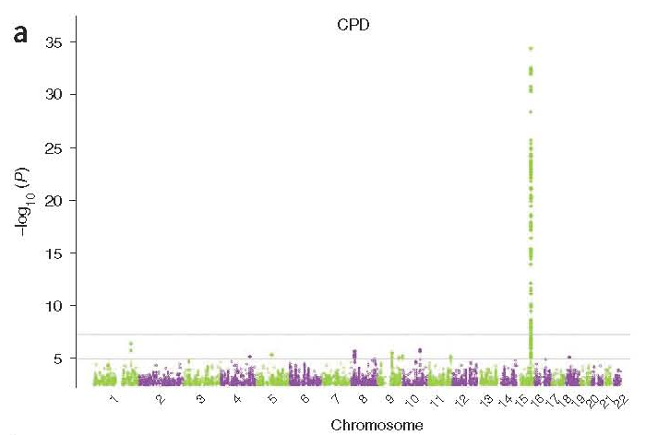
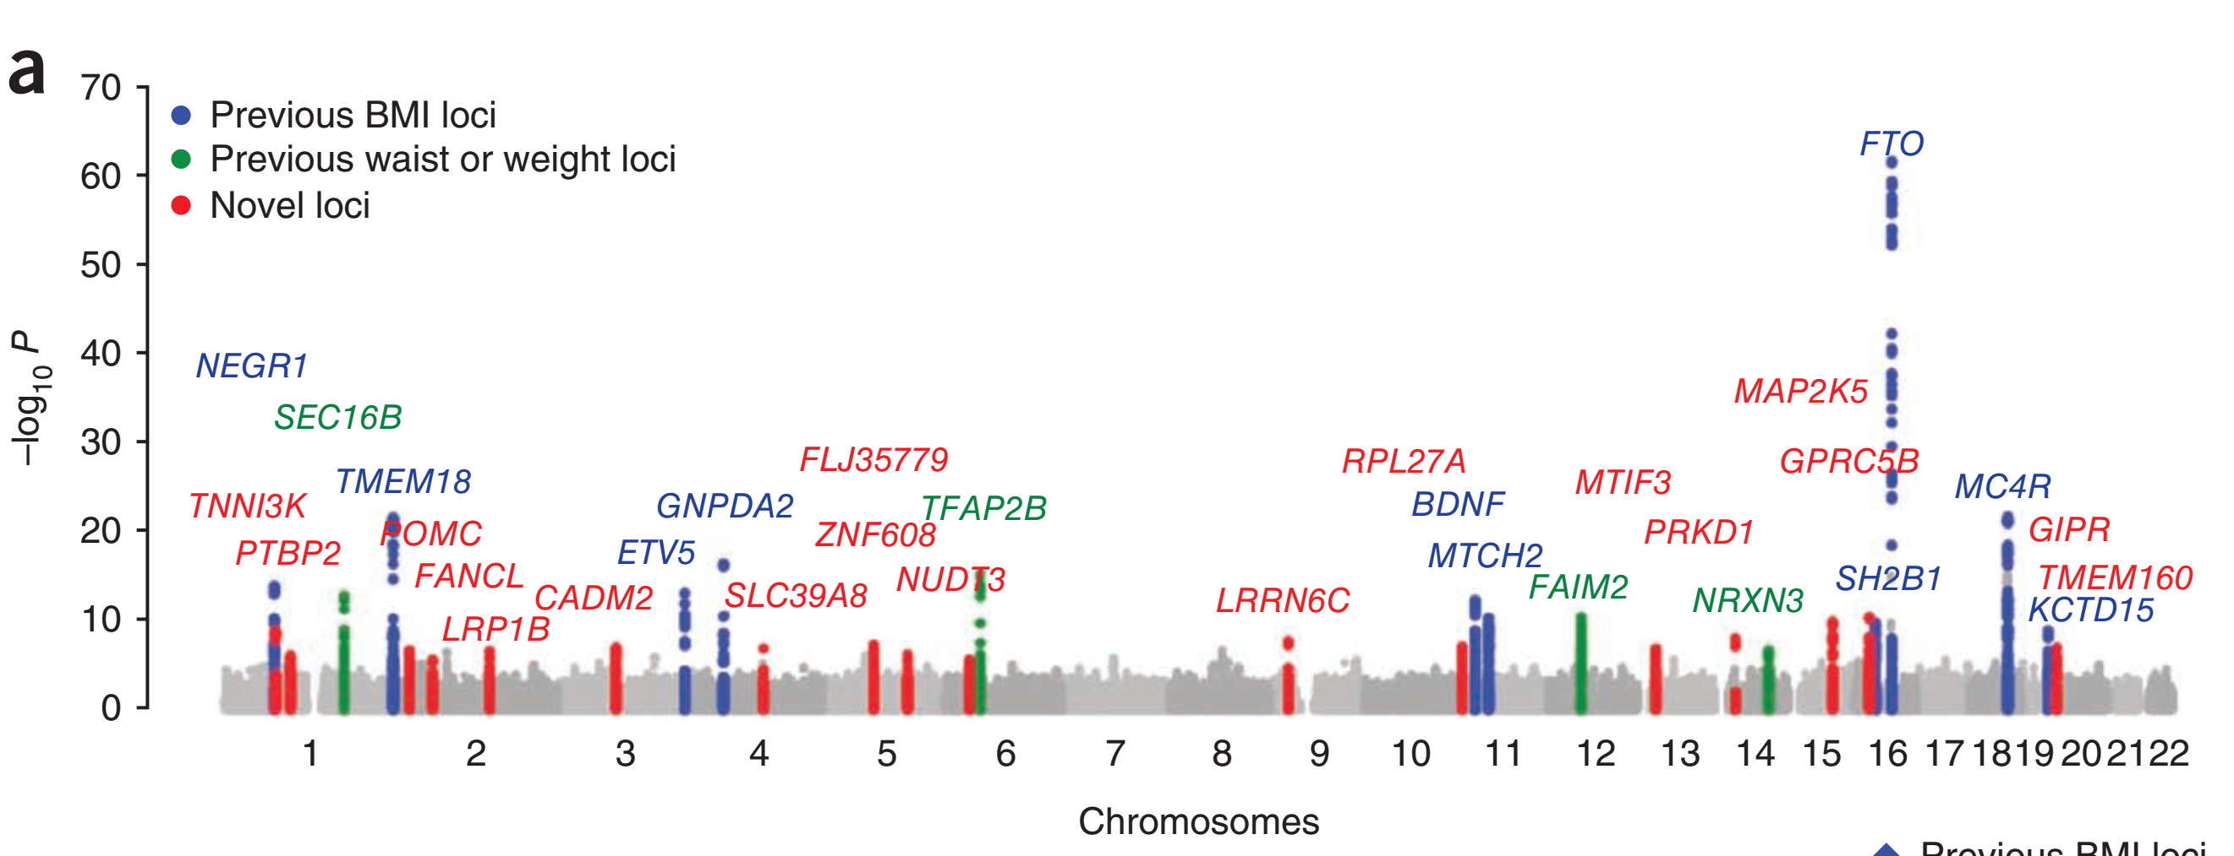
Nicotine Dependence:
Chromosome 15: nAChR Gene Cluster (Nicotinic Acetylcholine Receptor)
BMI:
More poligenic
Source: TAG Consortium., 2010
Source: Speliotes et al., 2010

