Slide 1
Null hypotheses
H1: Students who participated in the two control groups - scenarios without ITS and without training (Ctrl.A) , and scenarios without ITS but with training (Ctrl.B) - have the same math ability in both the pre-test and post-test.
H2: Students who participated in scenarios with our ITS and training (Exp) have the same math ability in both the pre-test and post-test.
H1 & H2

Slide 2
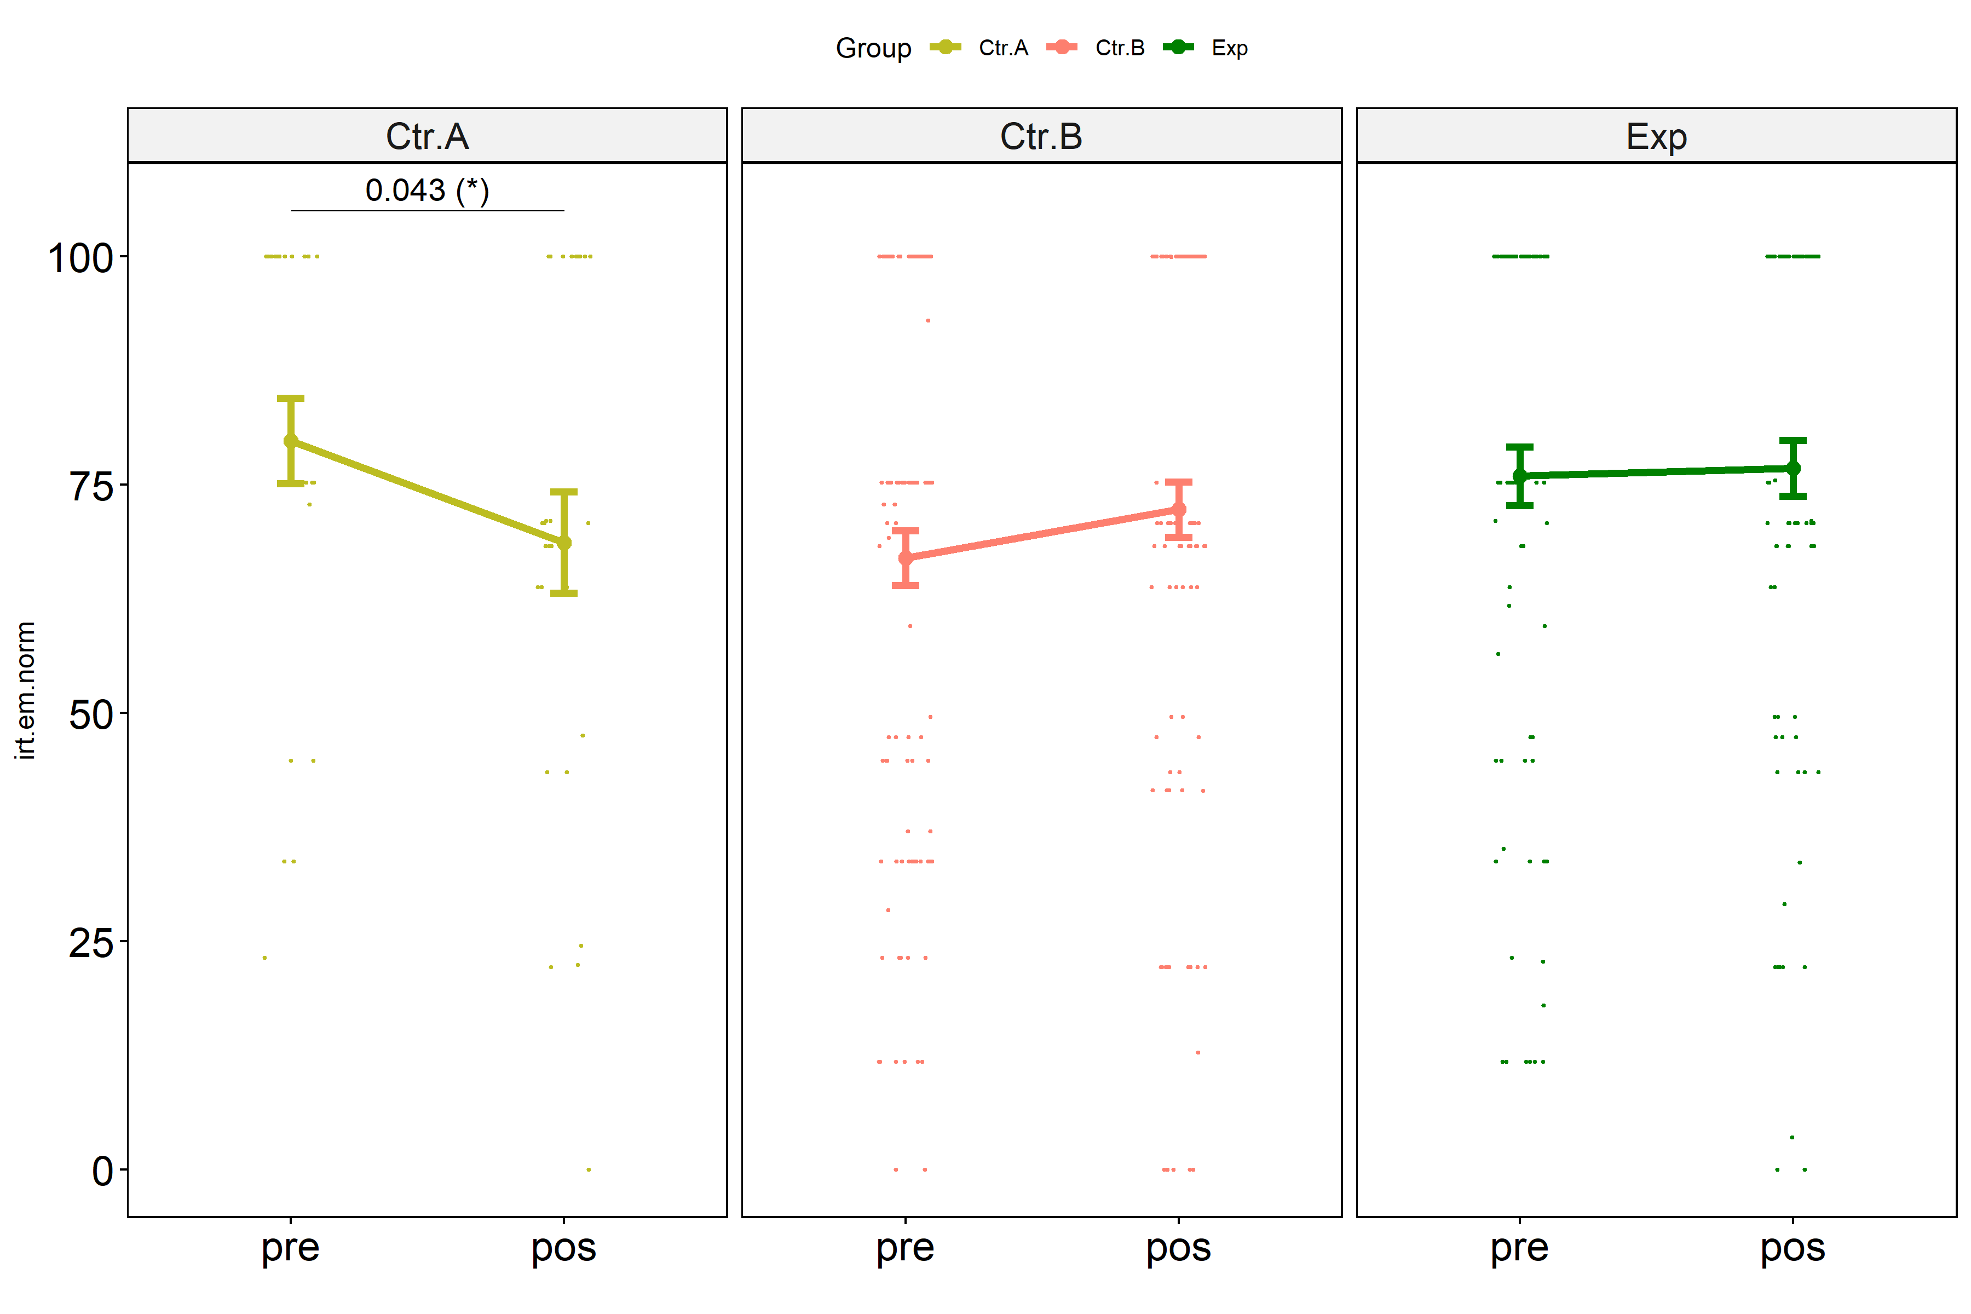

Slide 3
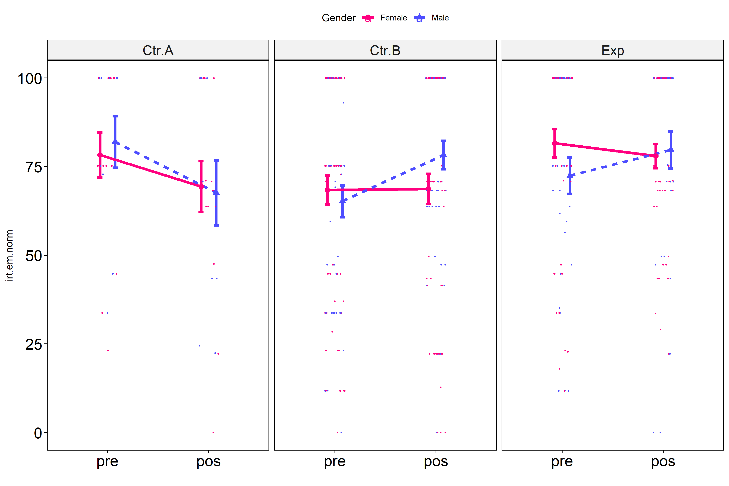

Slide 4
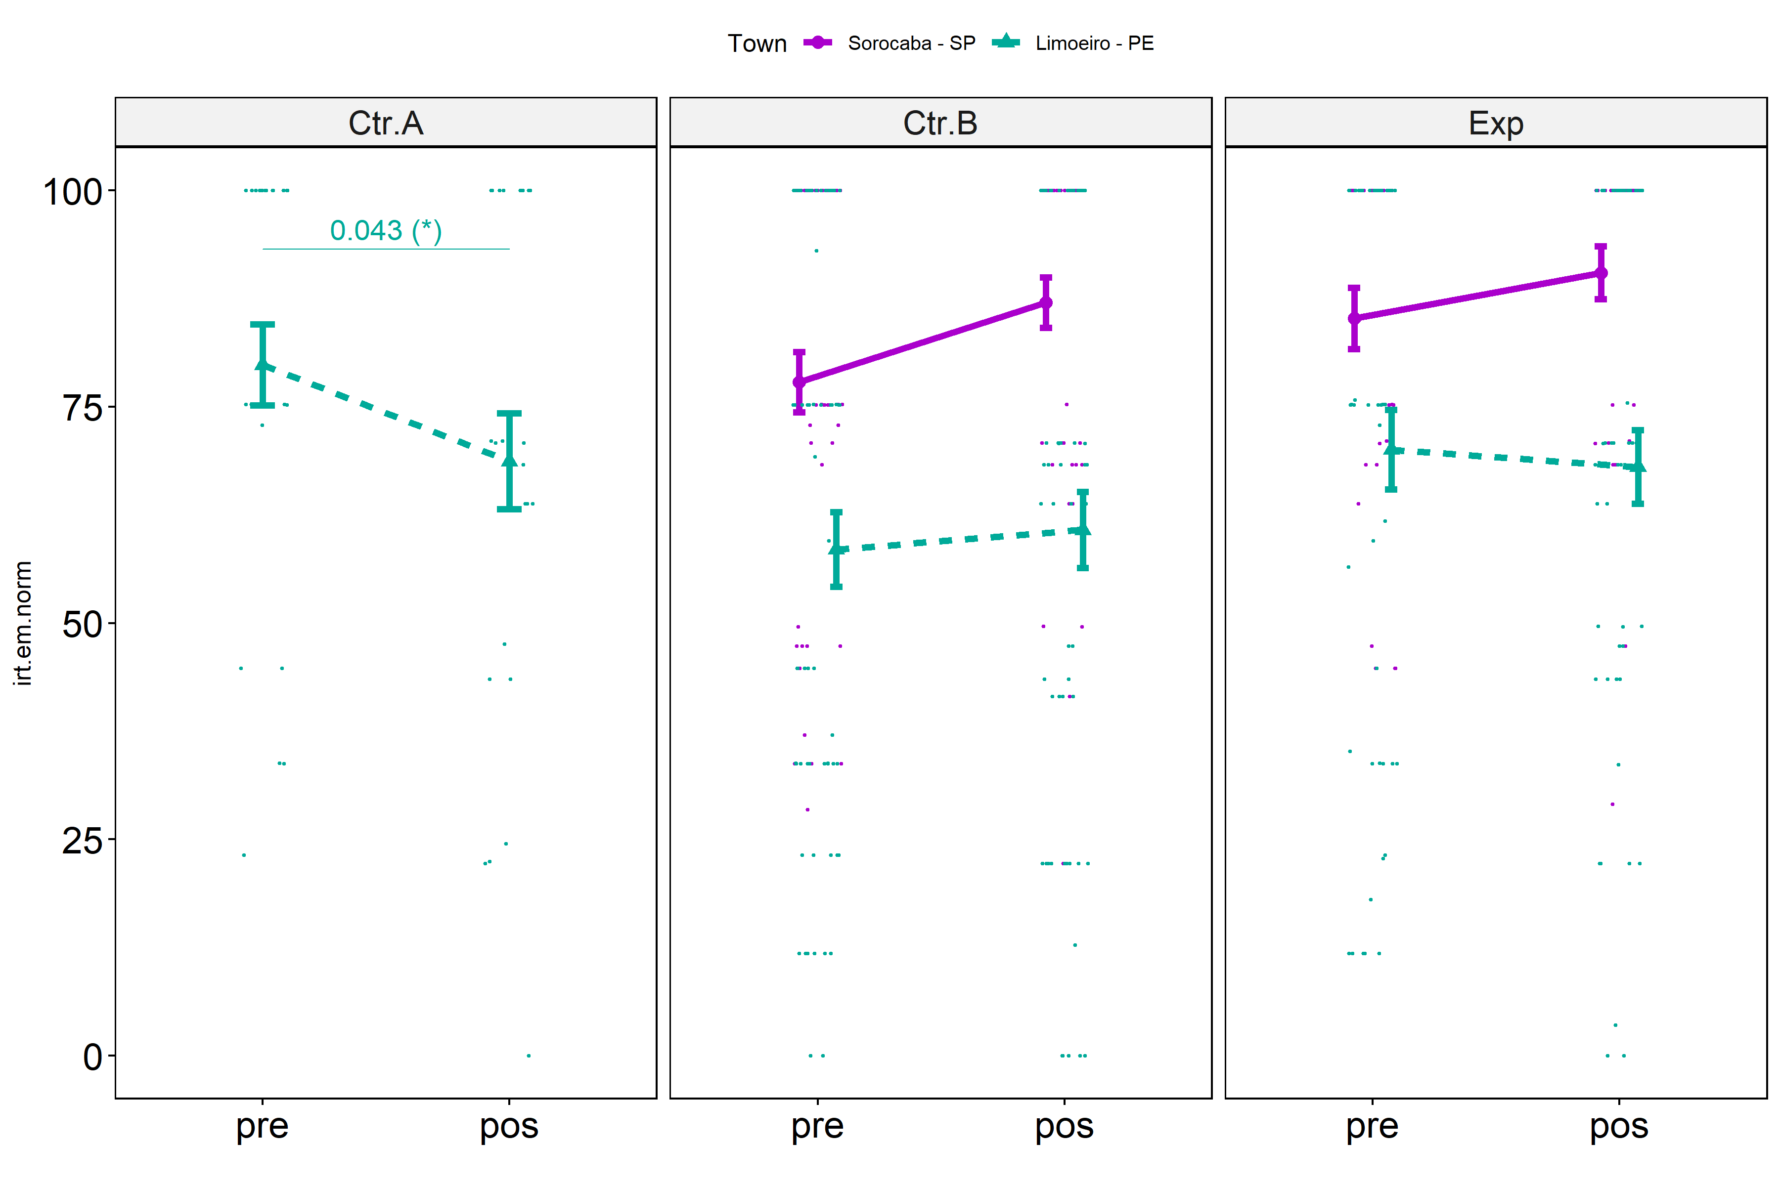

Slide 5
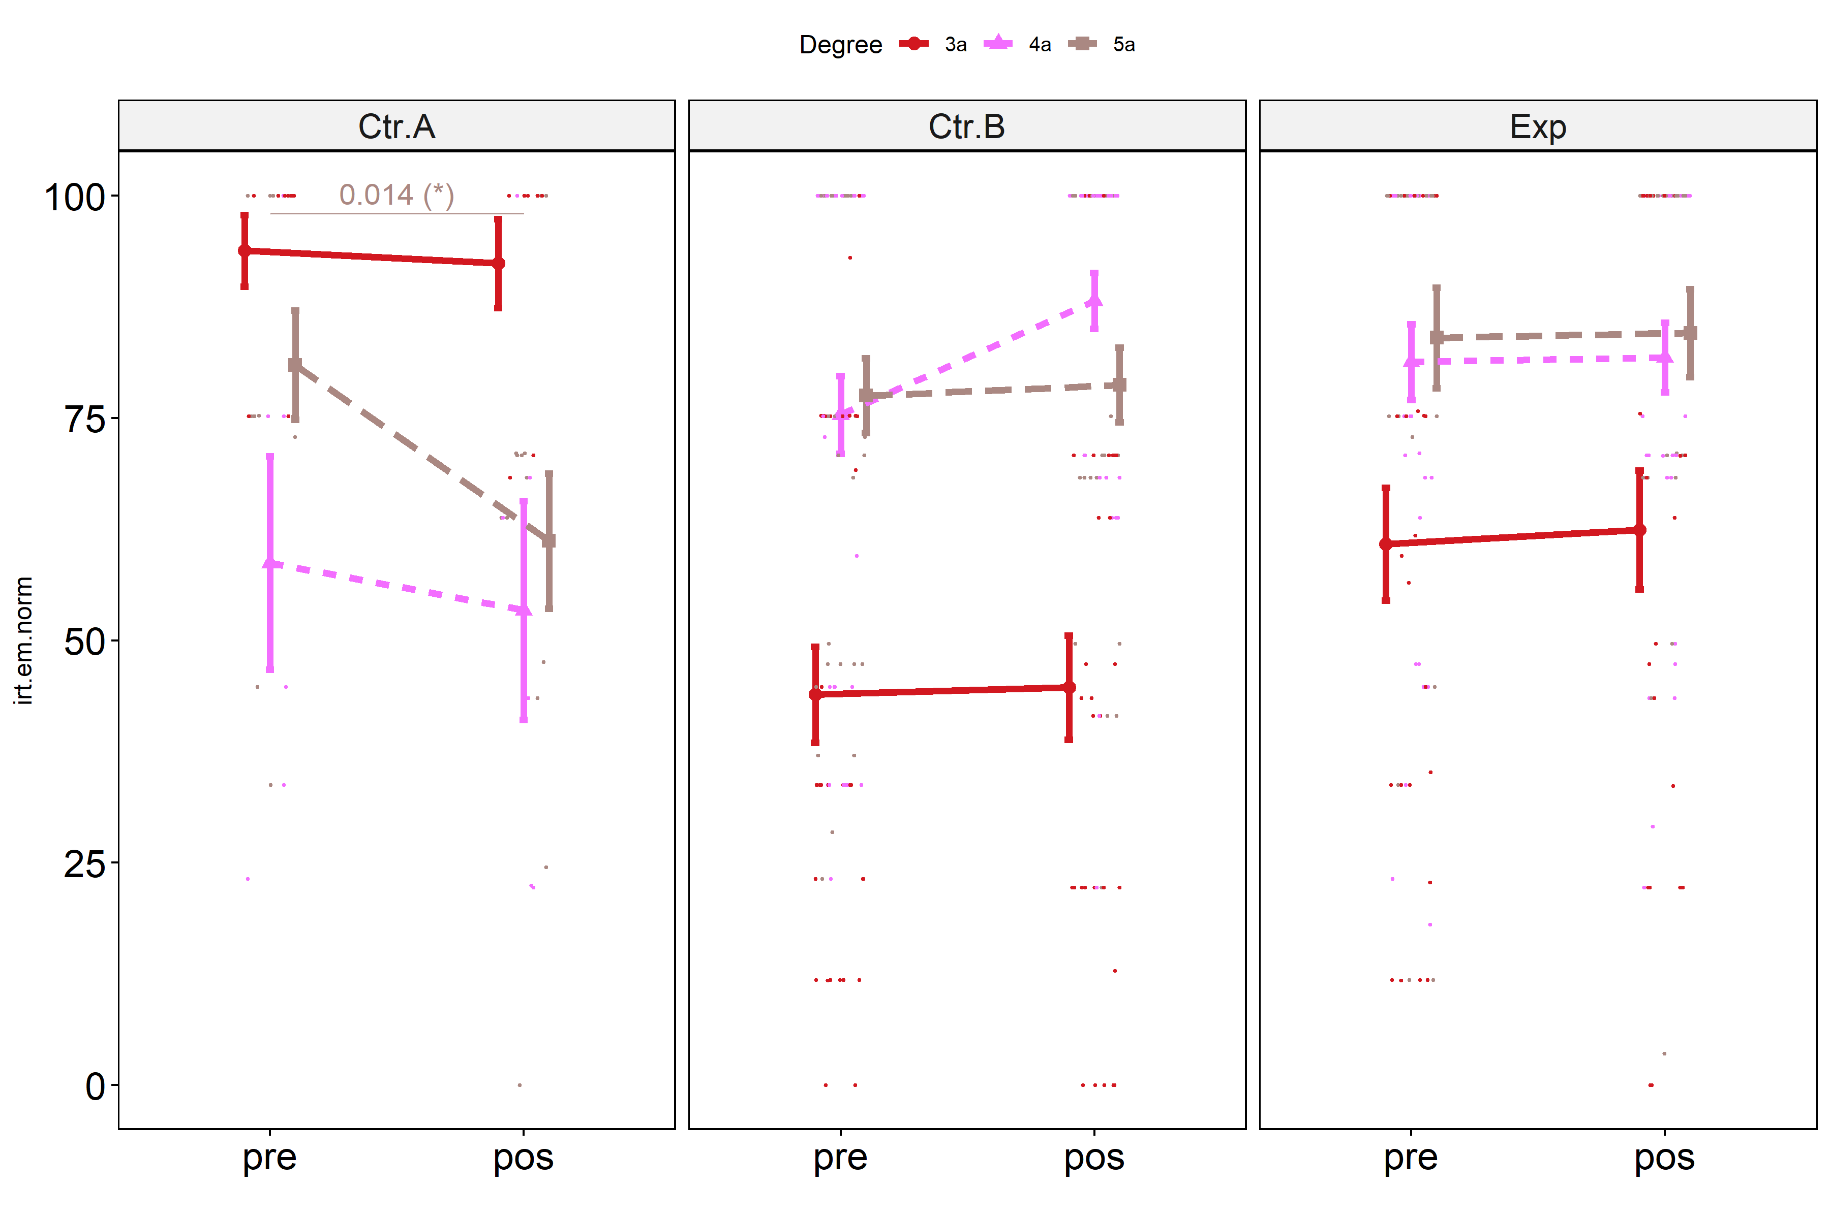

Slide 6
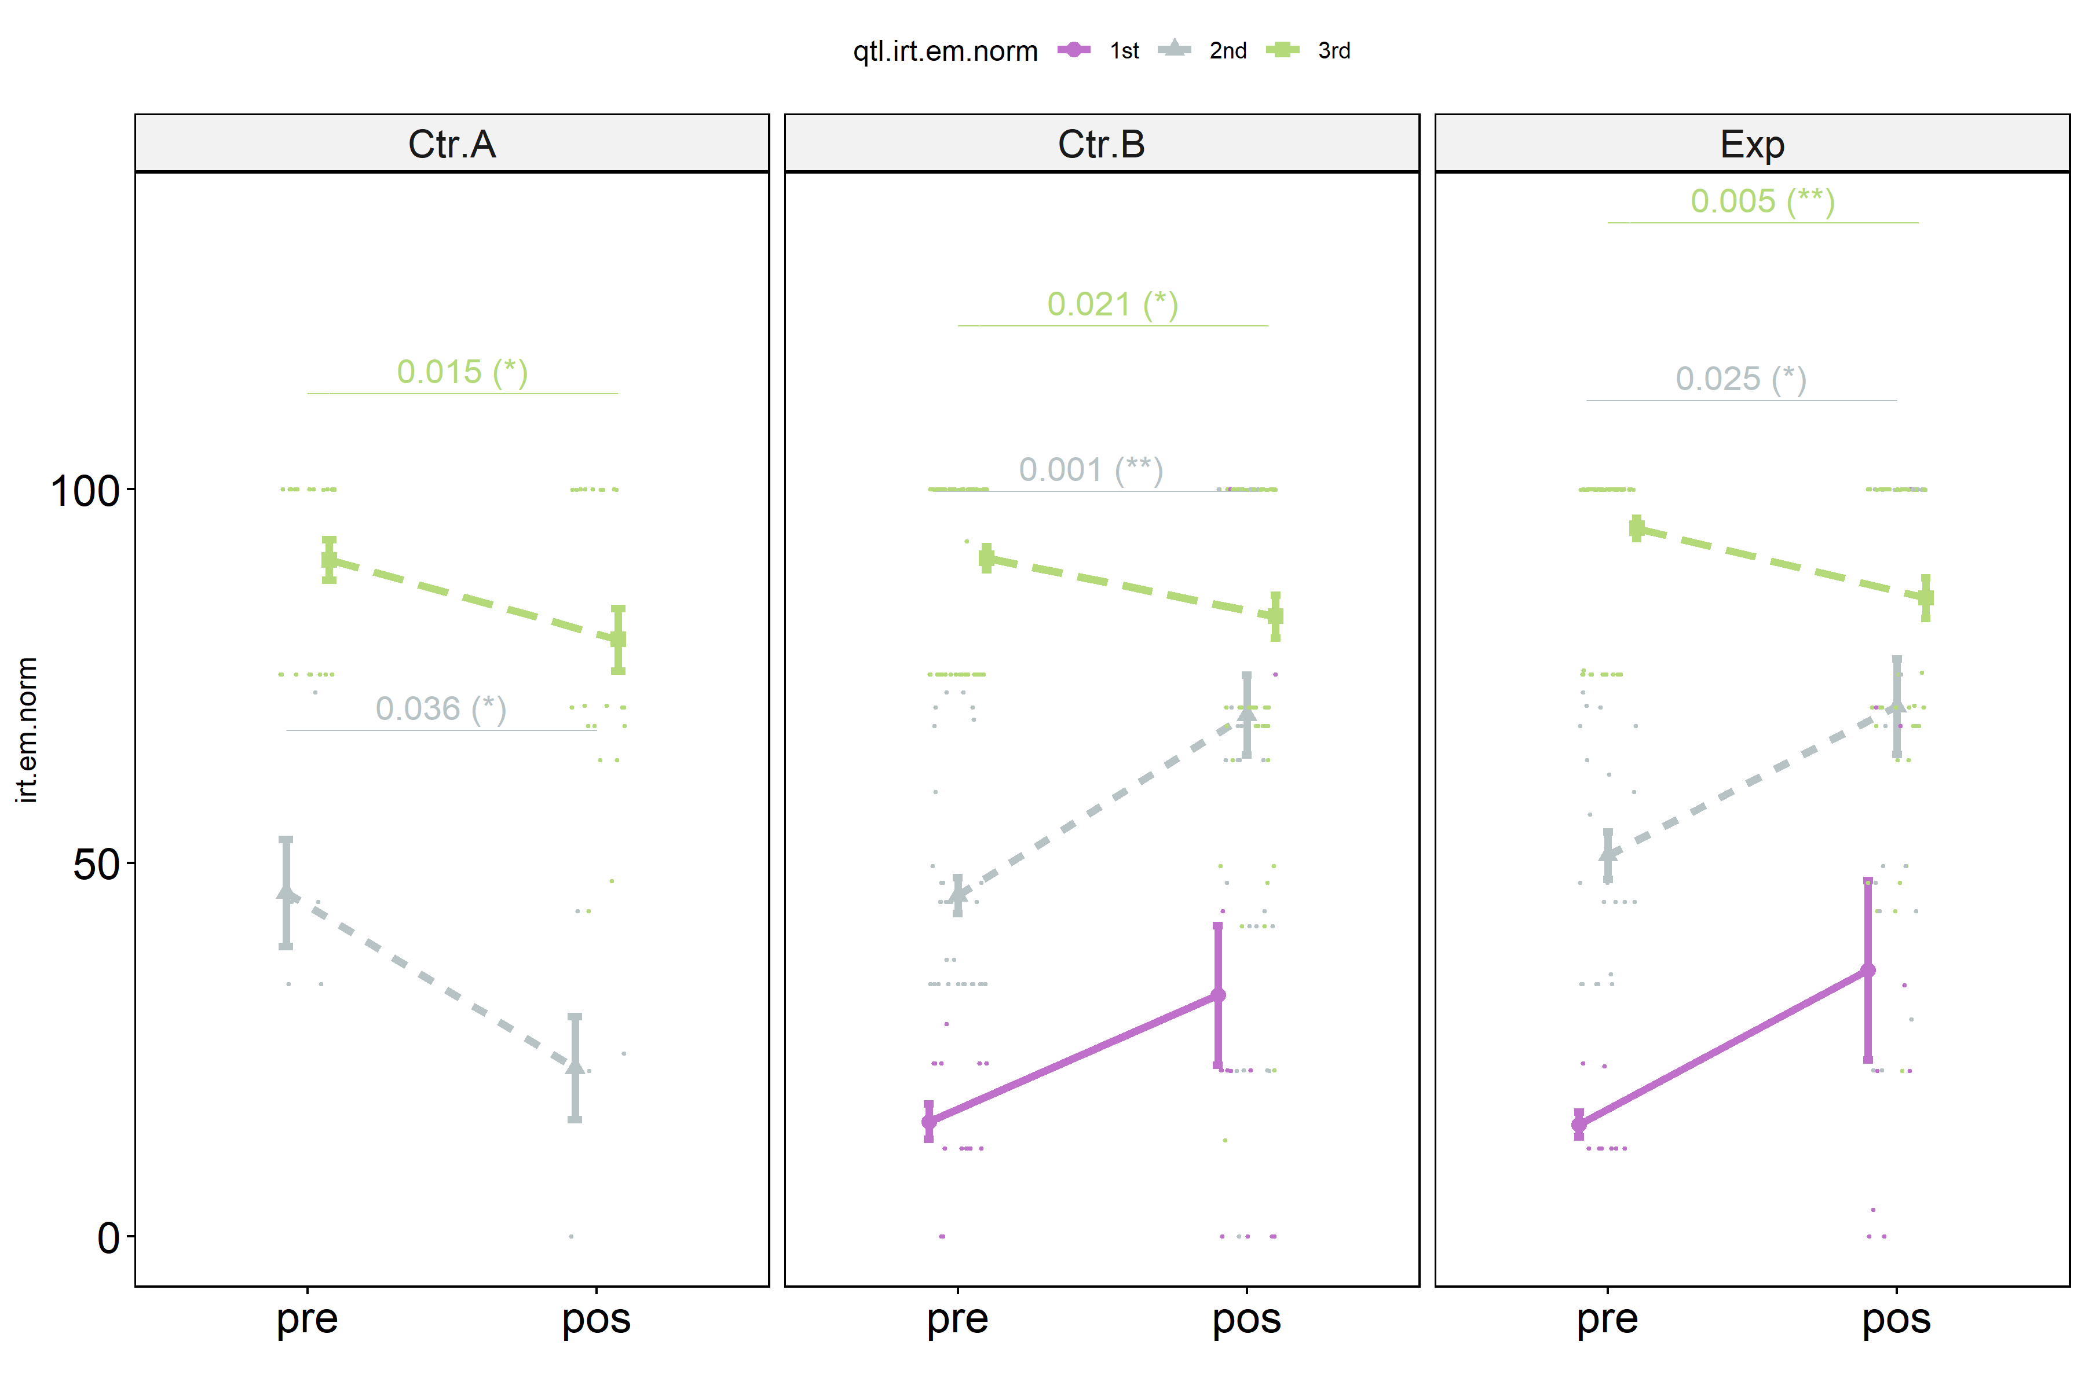

Slide 7
Null hypotheses
H3: Students who participated in scenarios with our proposed ITS and with training (Exp) have the same learning gain that students who participated in control groups (Ctrl.A - without training and without ITS & Ctrl.B - with training but without ITS).
H3

Slide 8
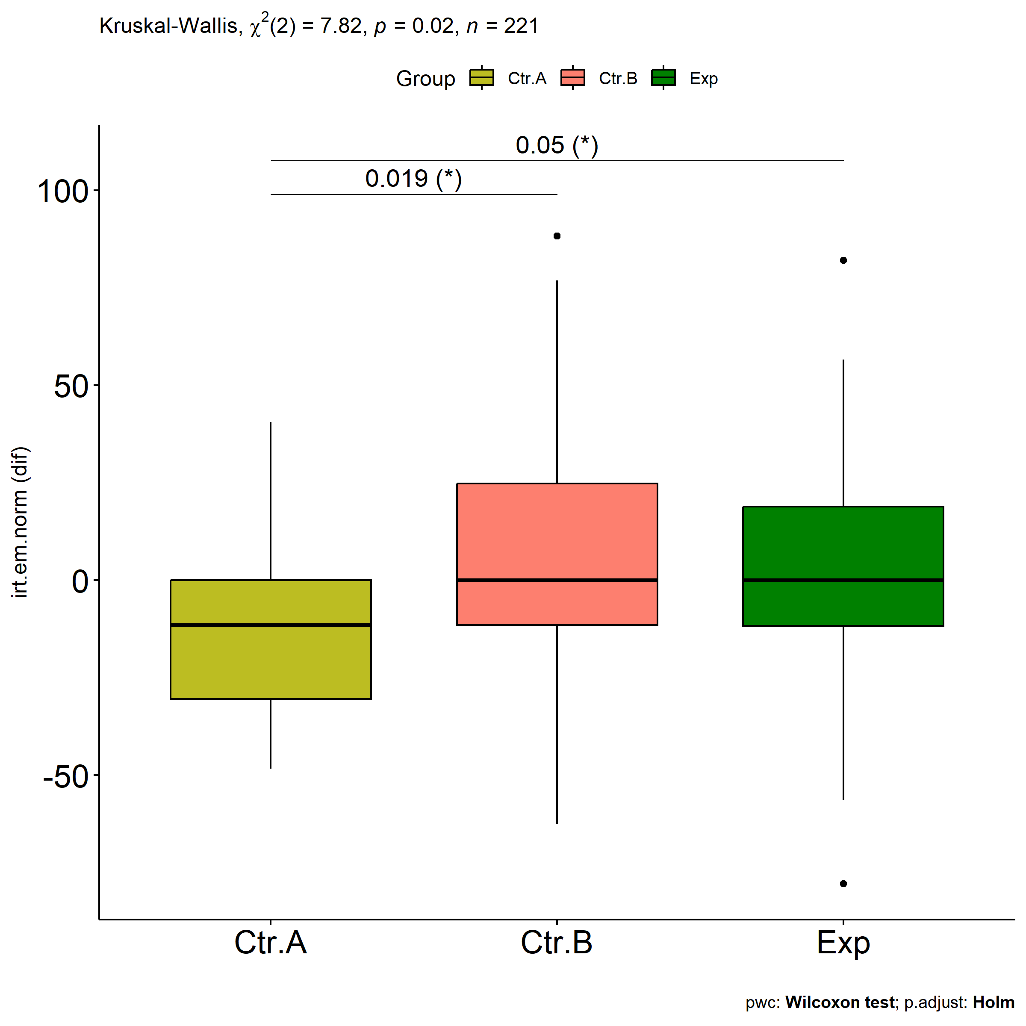

Slide 9
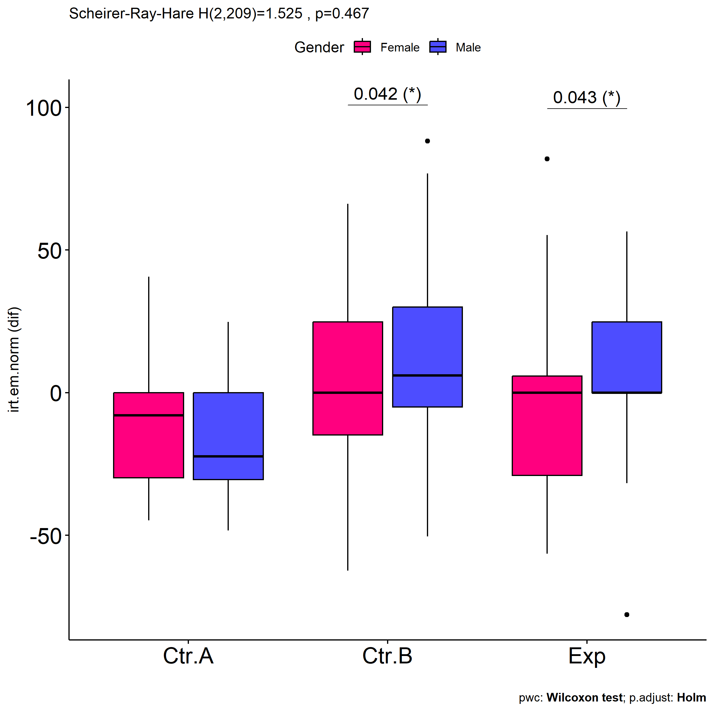
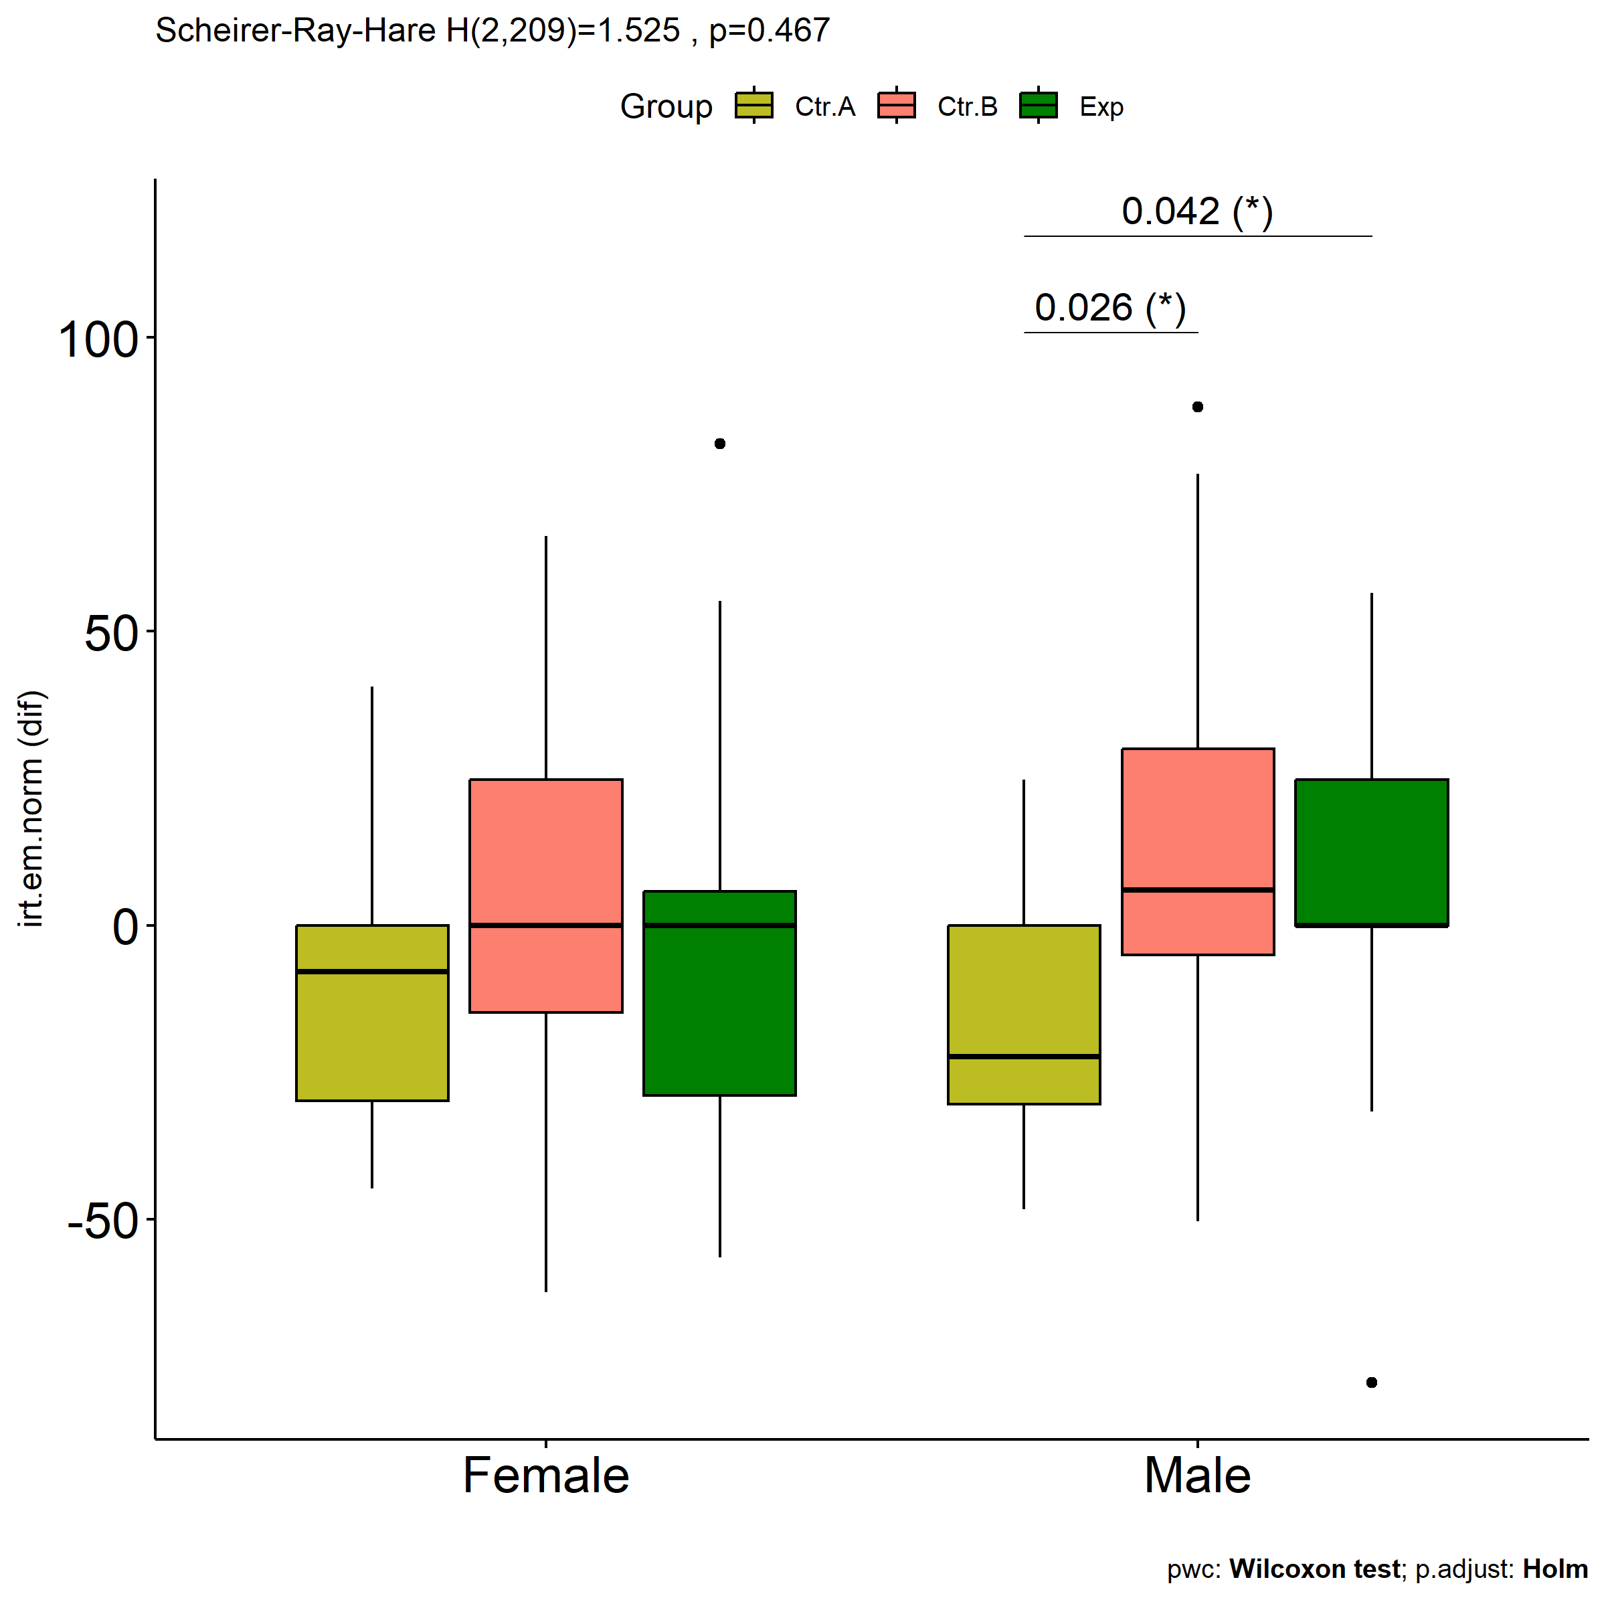

Slide 10
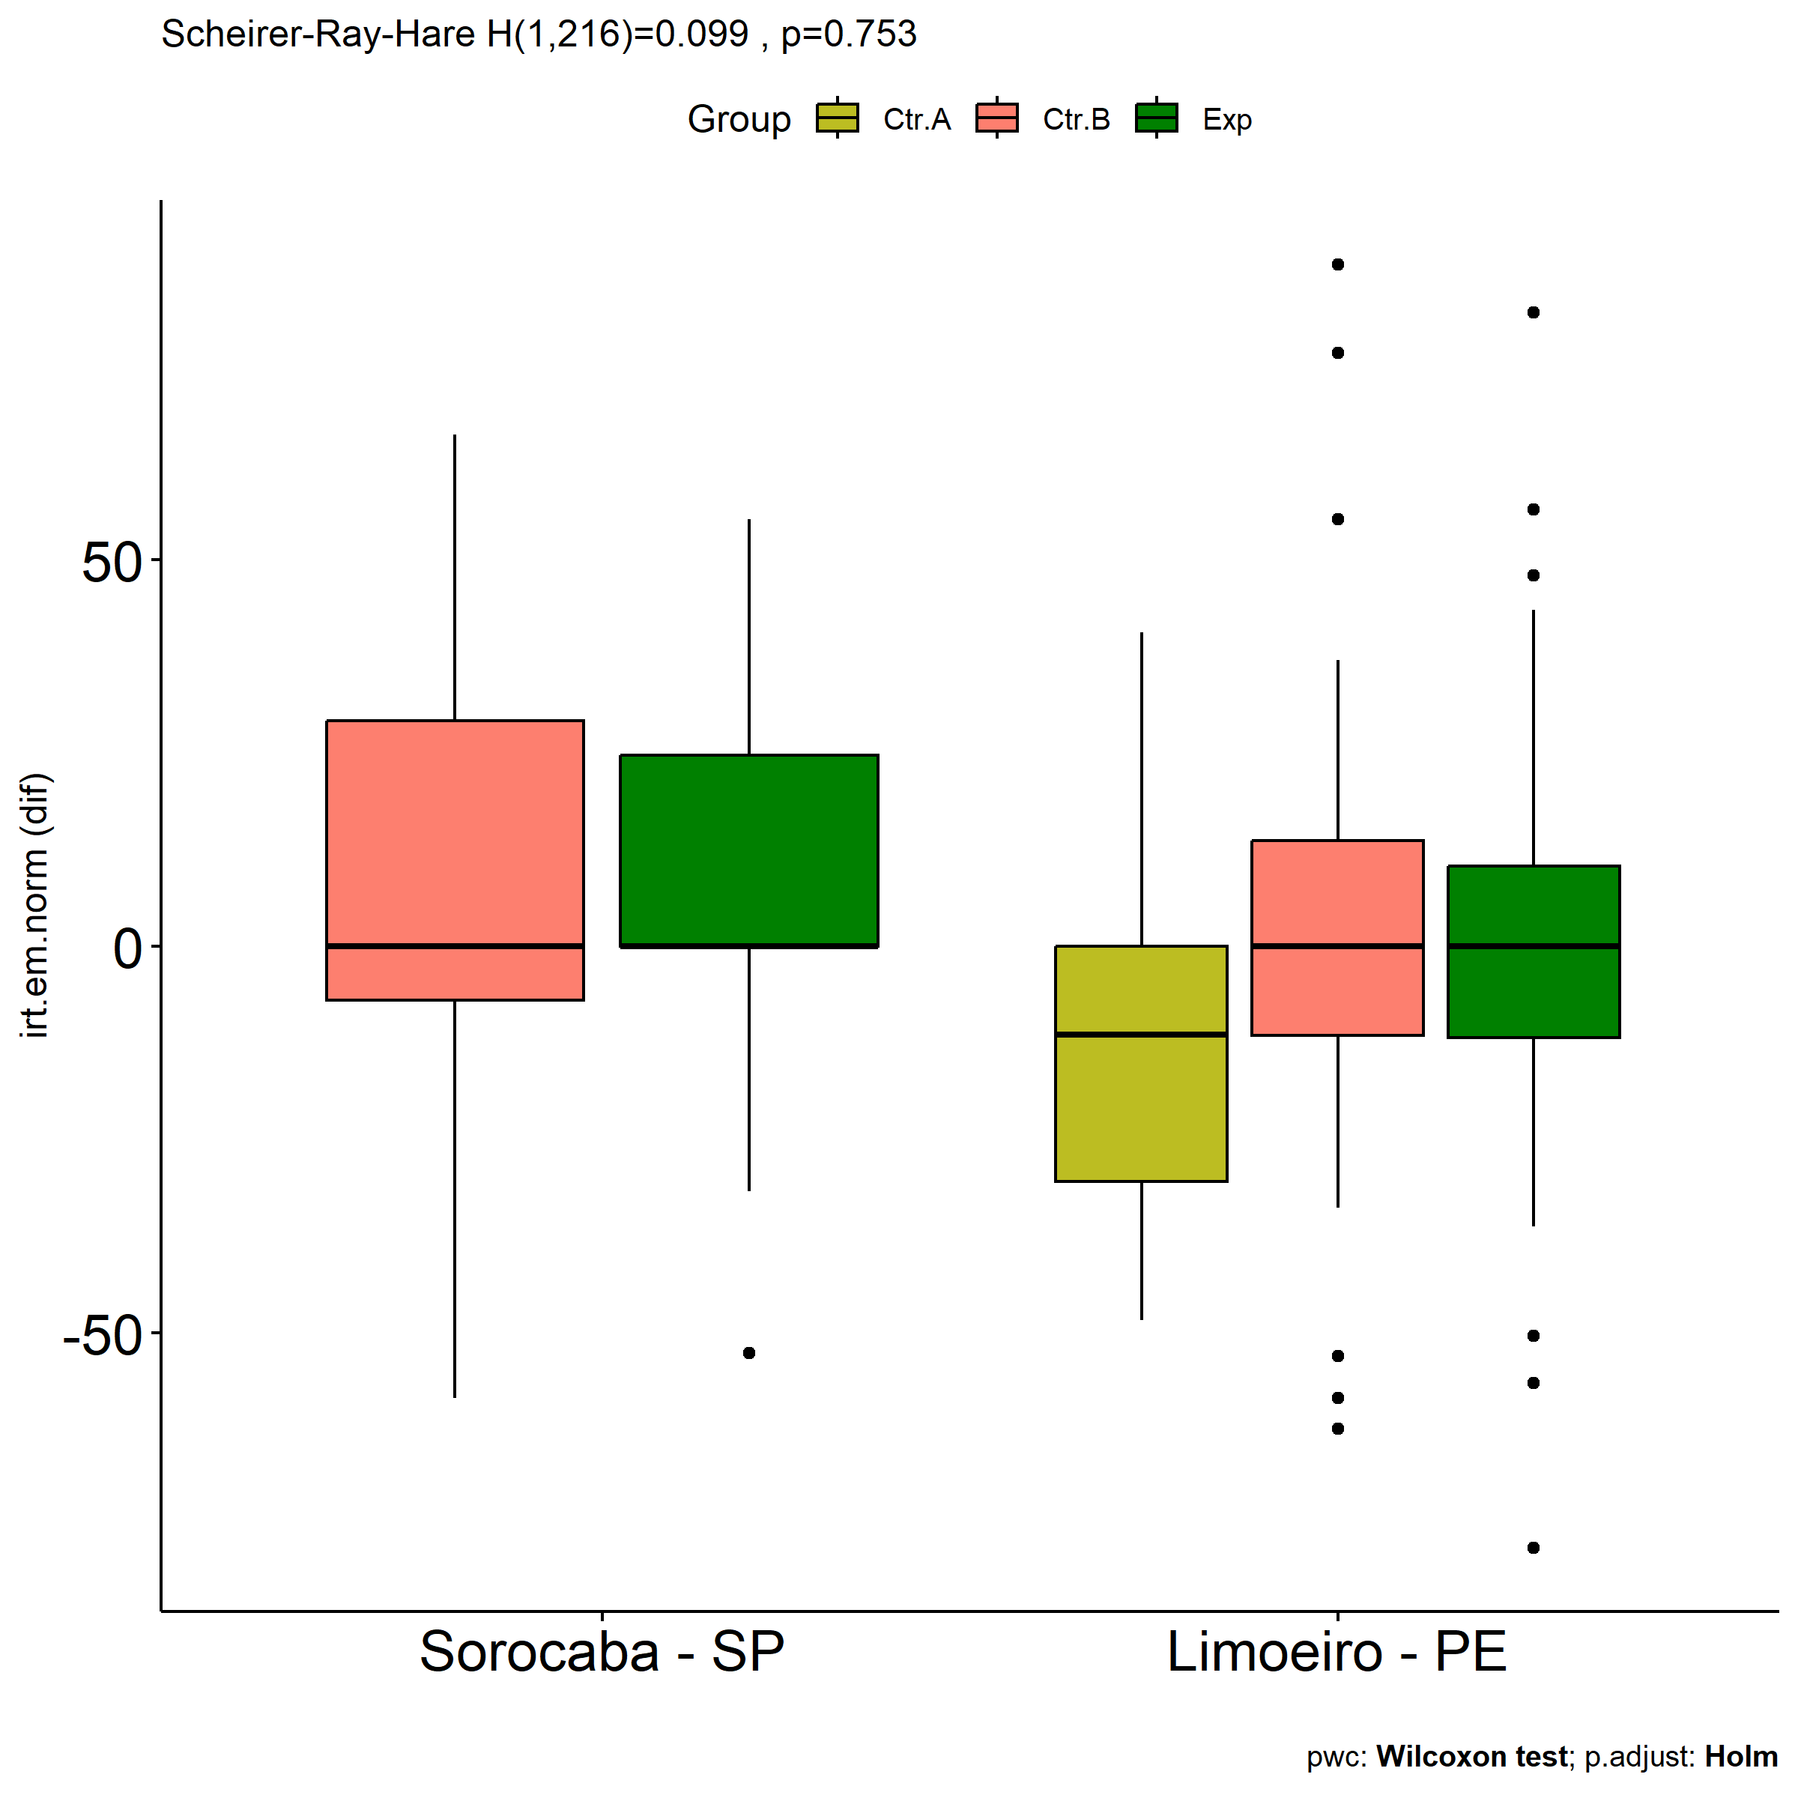

Slide 11
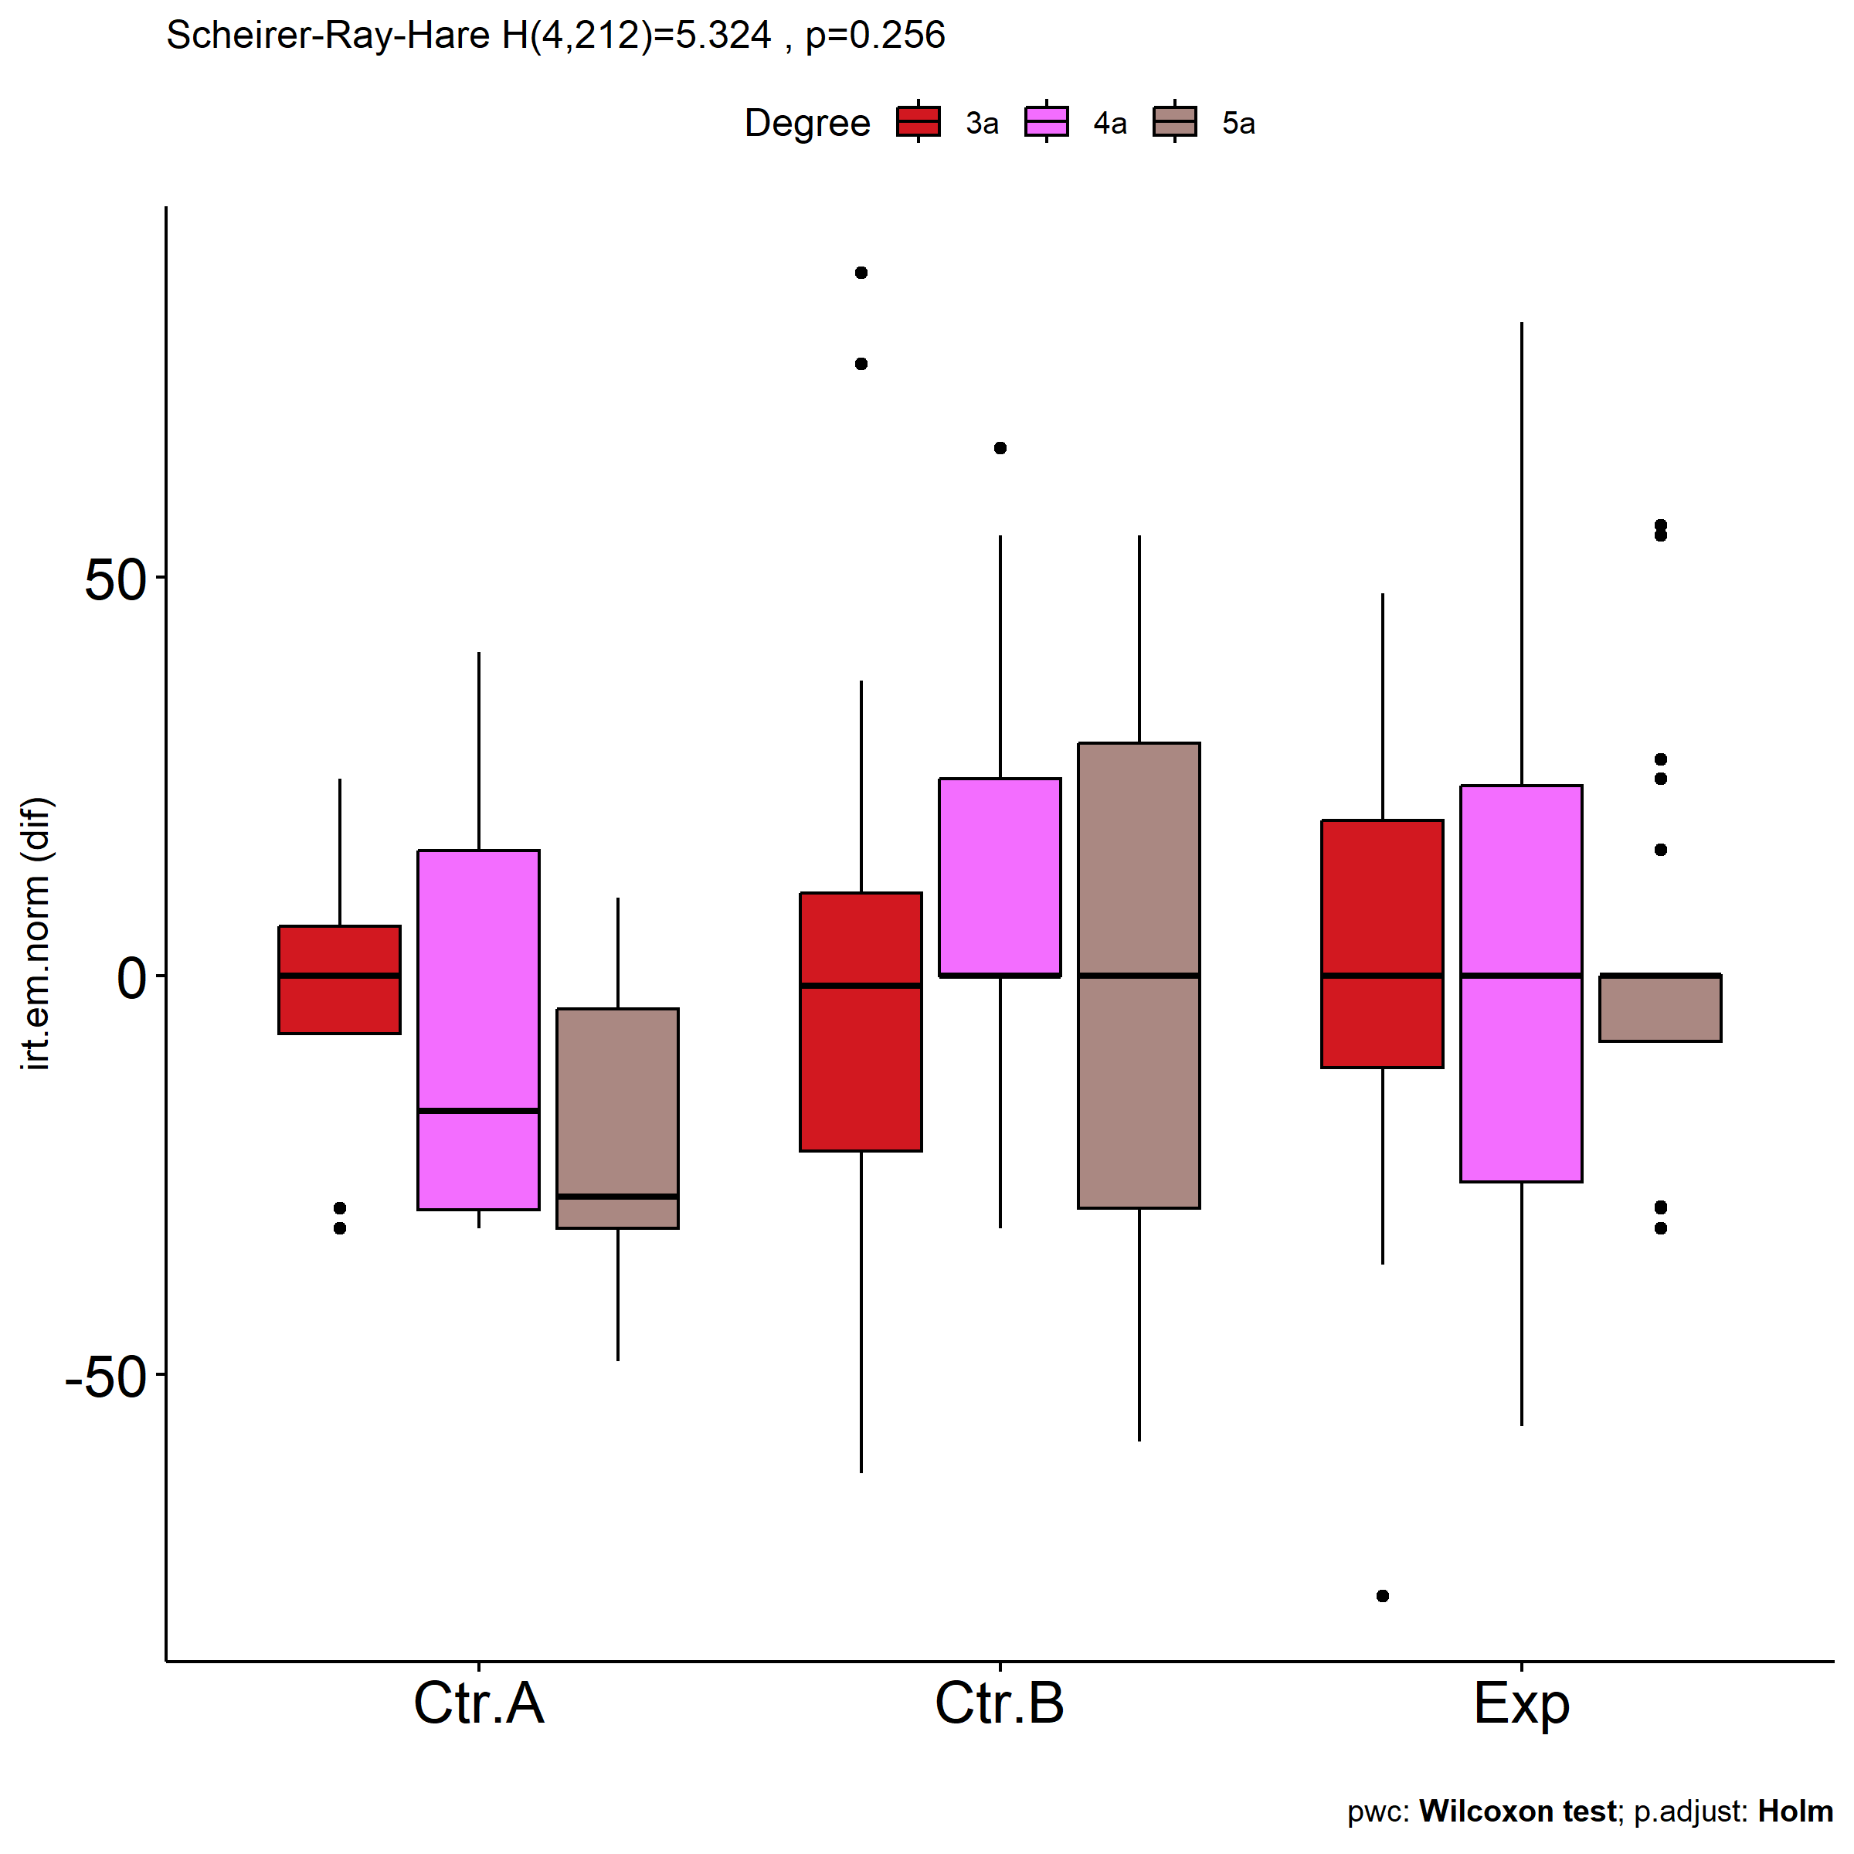
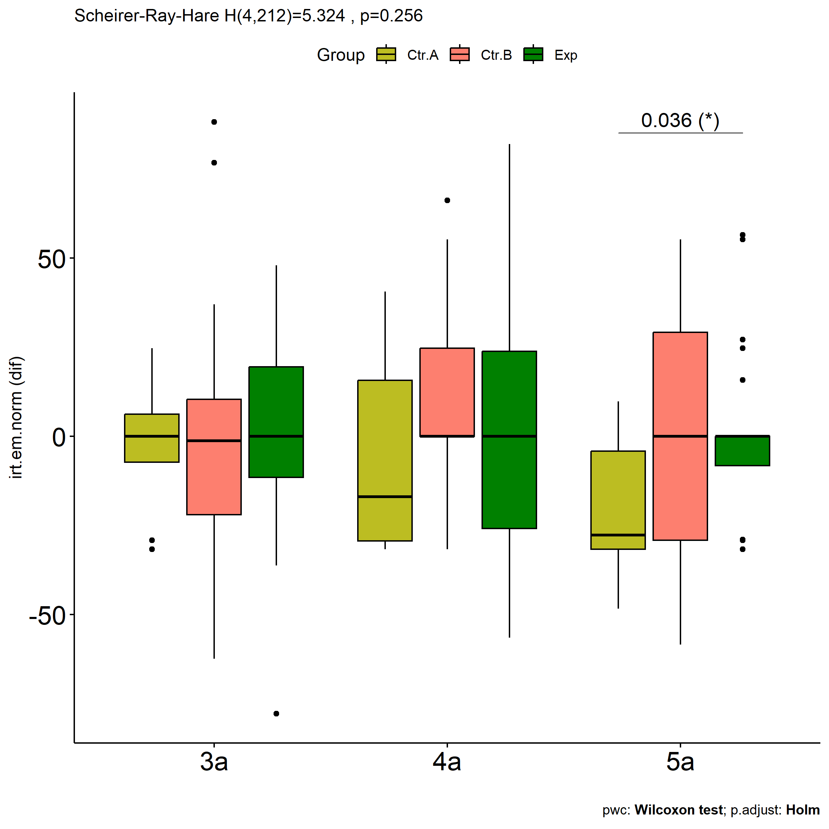

Slide 12
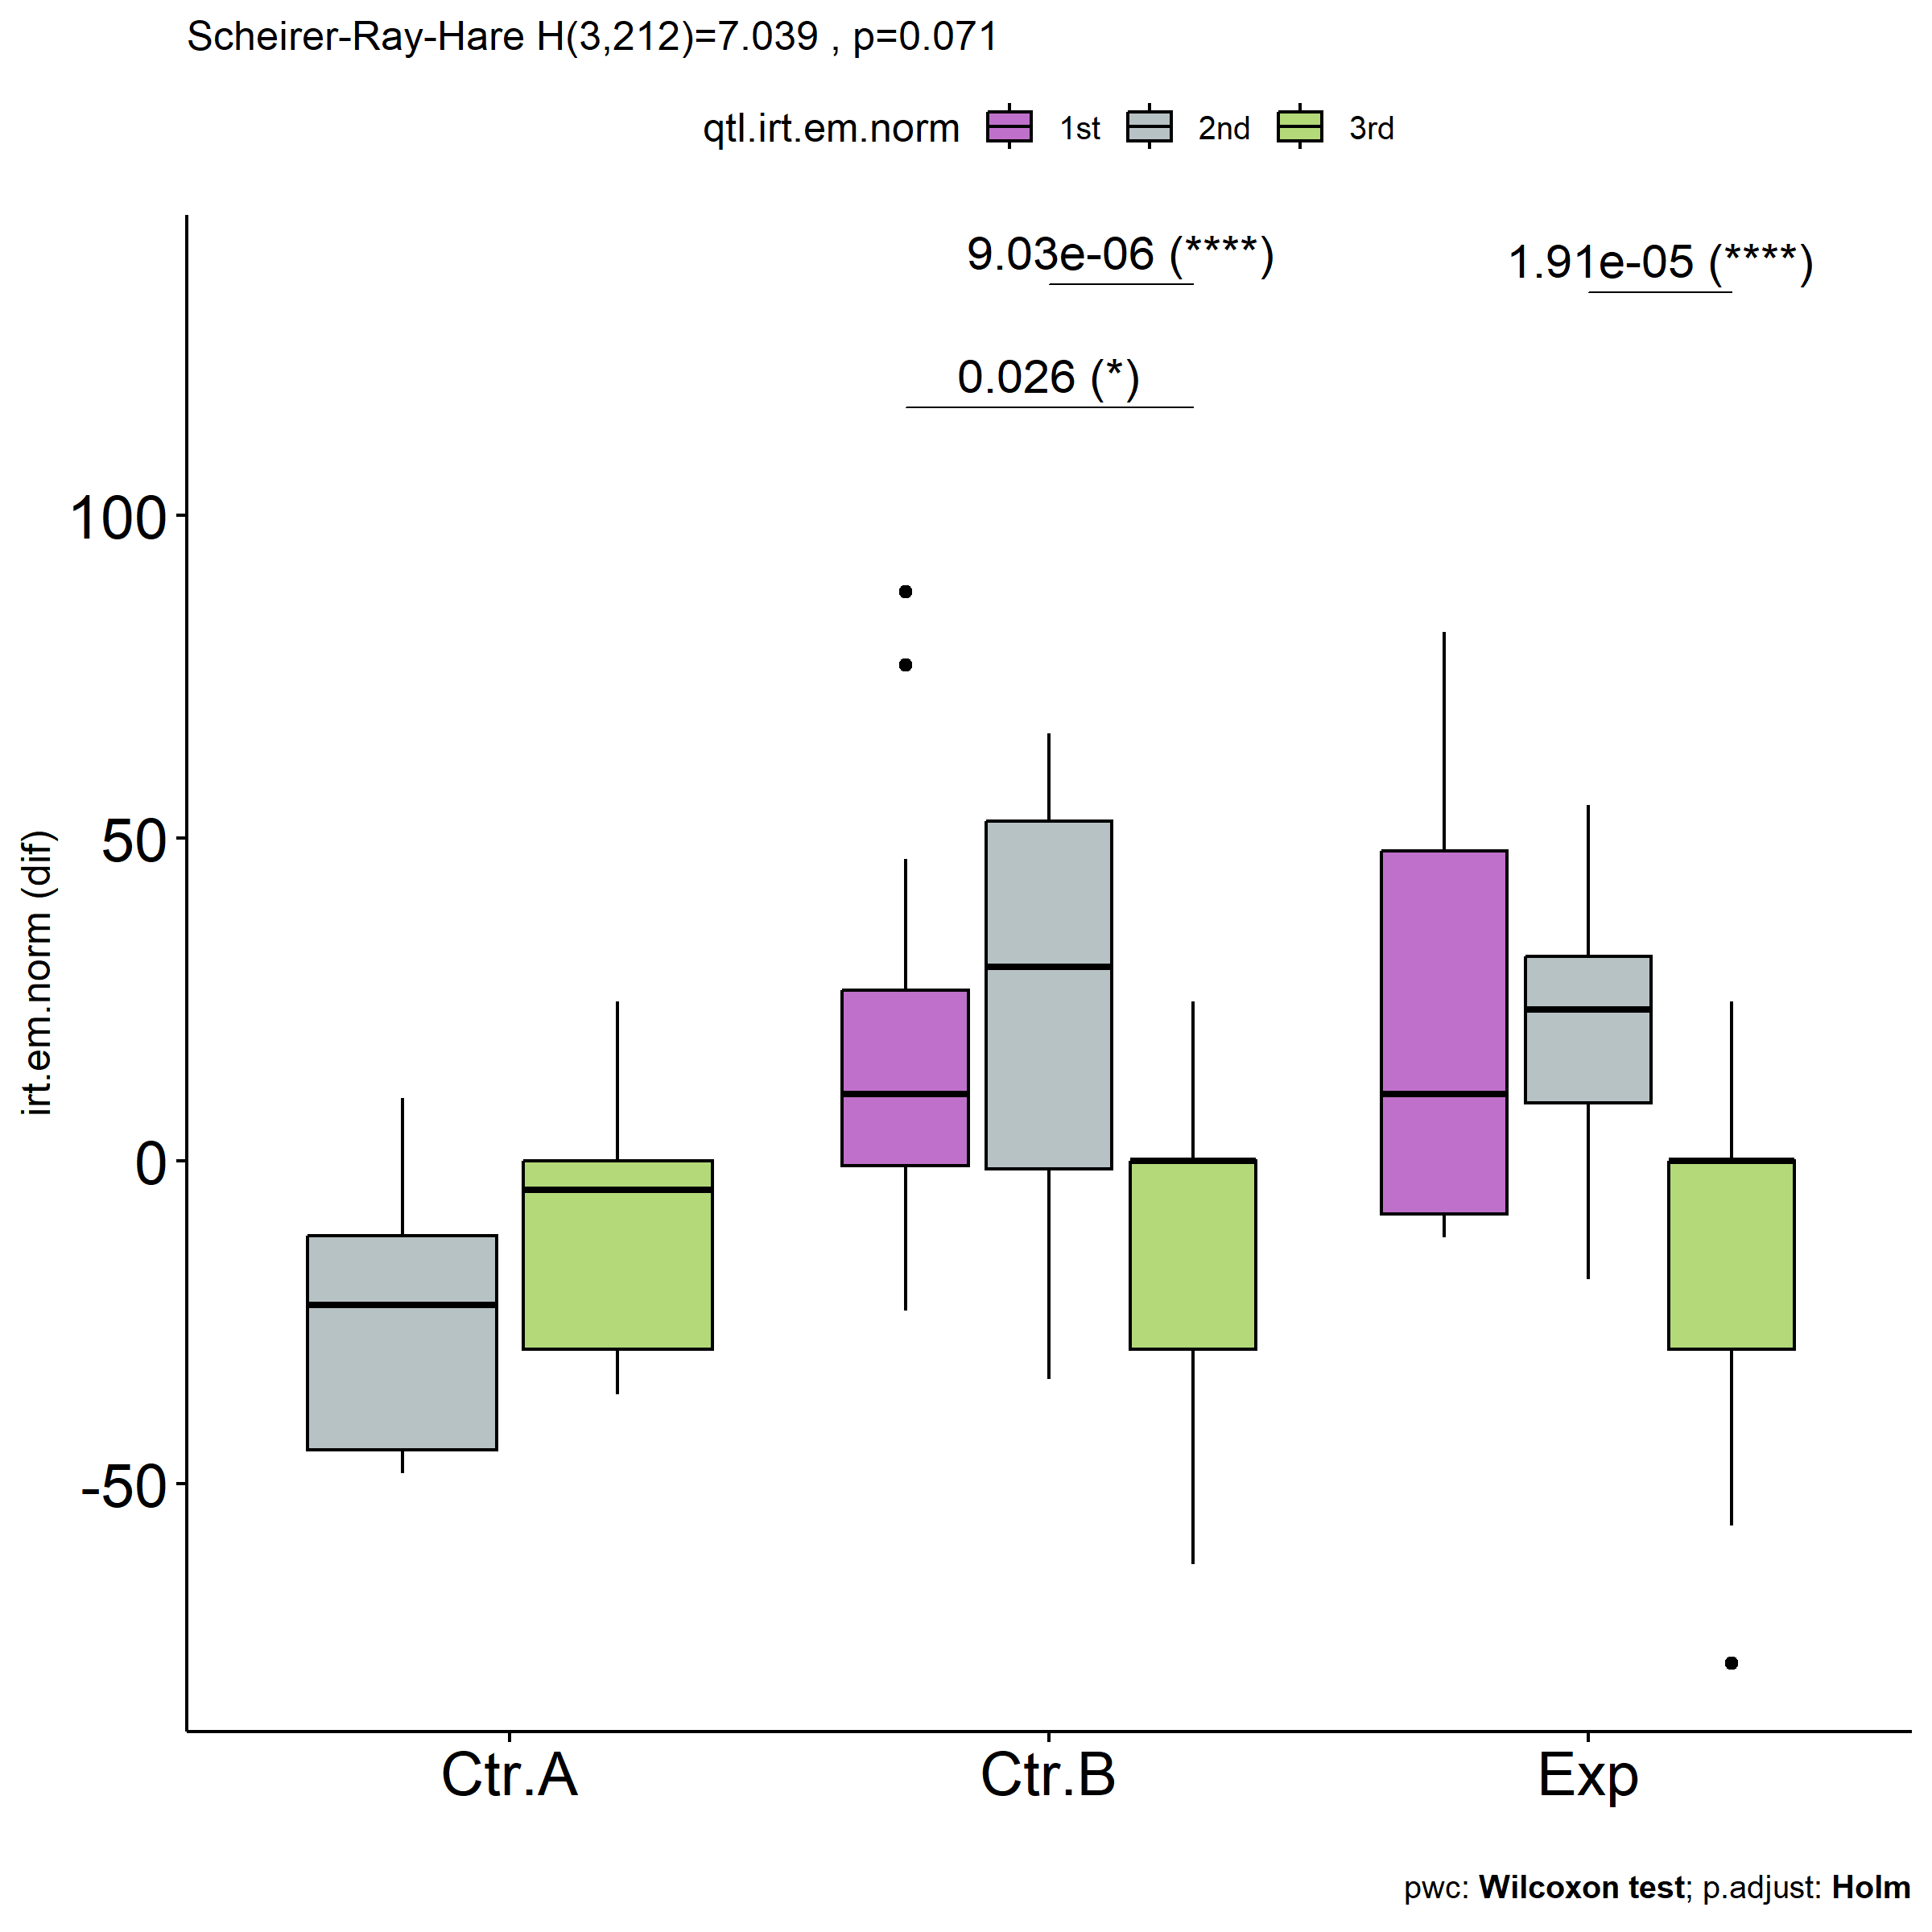
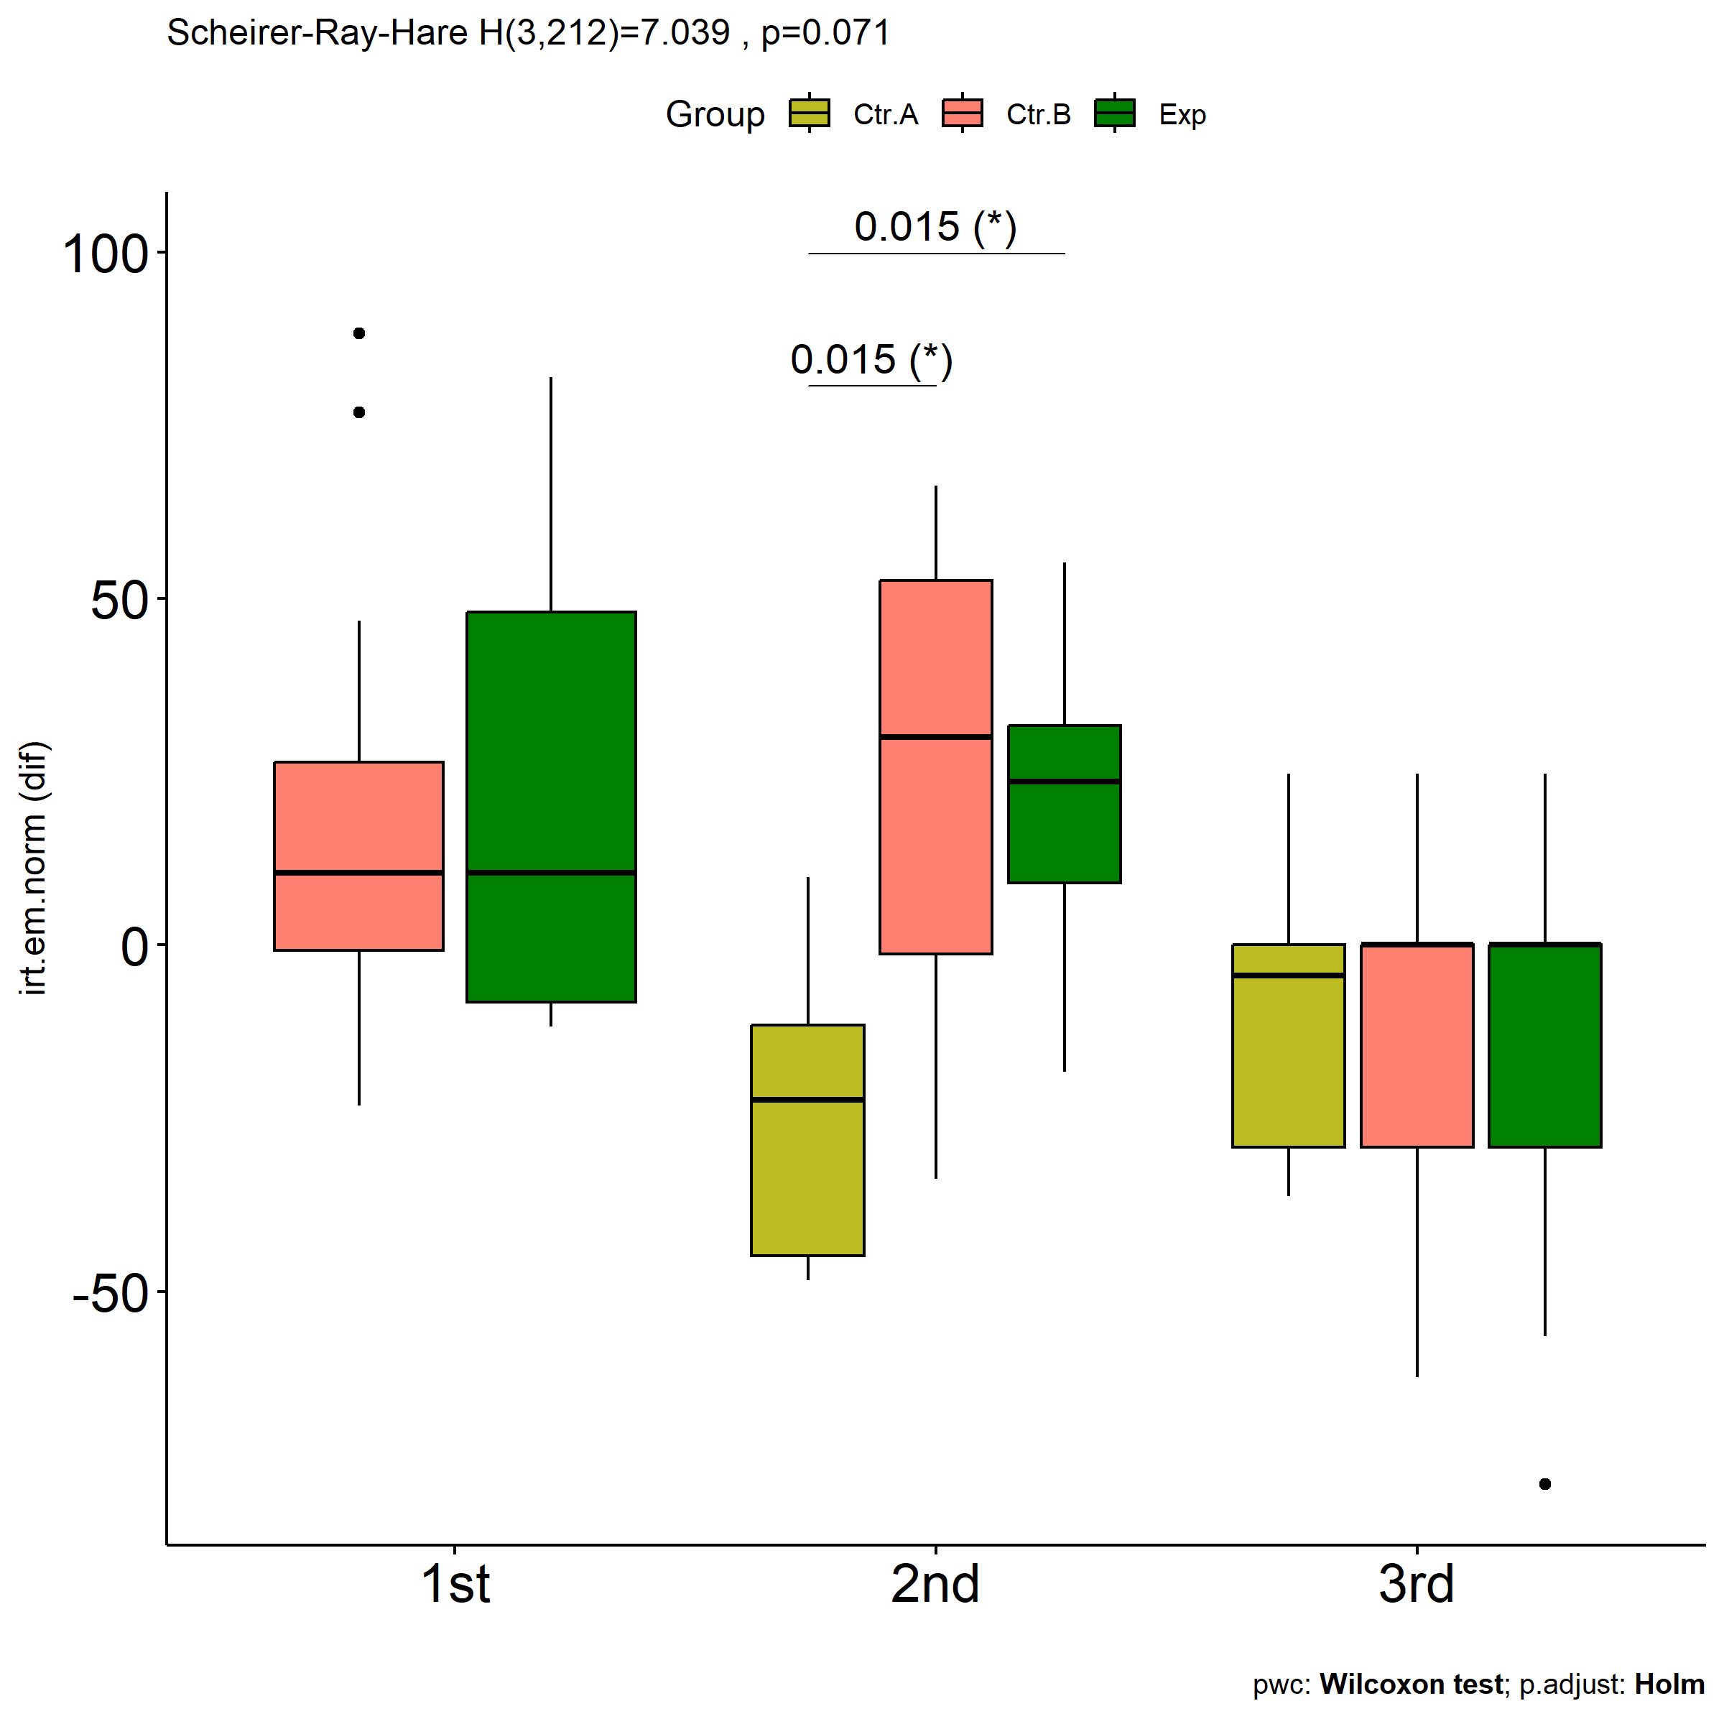

Slide 13
Null hypotheses
H4: Students who have something to learn* and who participated in scenarios with our proposed ITS and with training (Exp) have the same learning gain that students who participated in control groups (Ctrl.A - without training and without ITS & Ctrl.B - with training but without ITS).
H4
* Students who do not obtain maximum scores on the pre-test and post-test

Slide 14
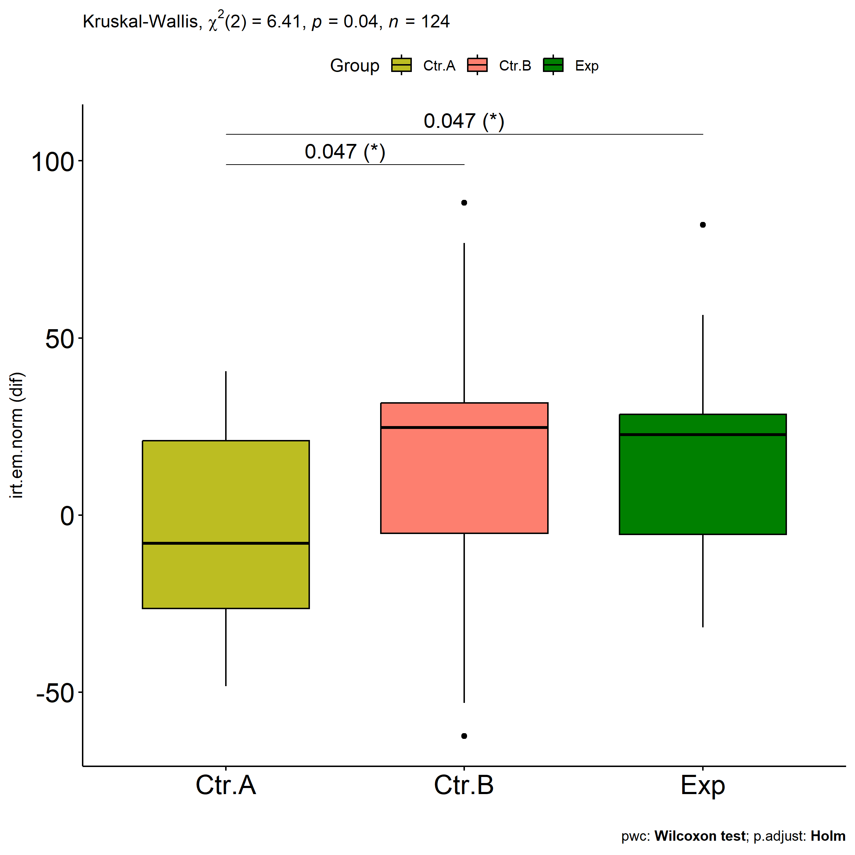

Slide 15
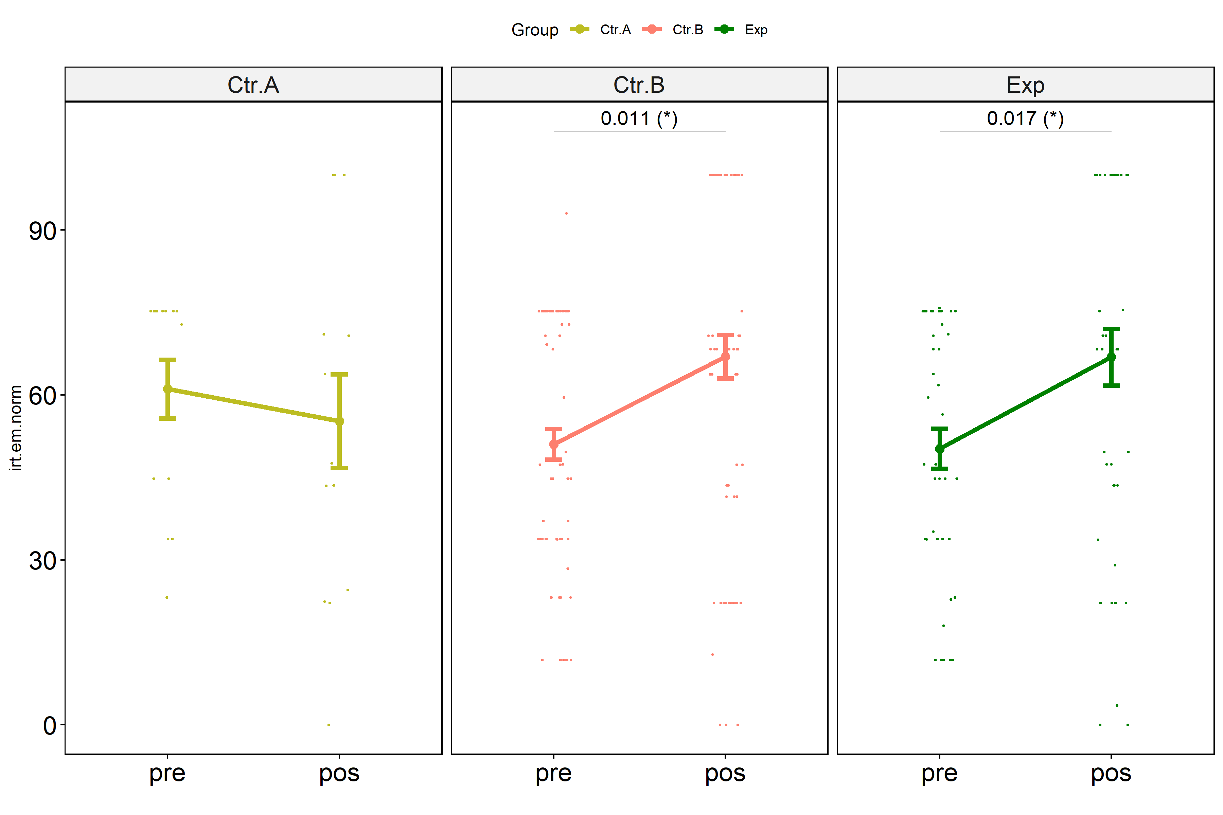

Slide 16
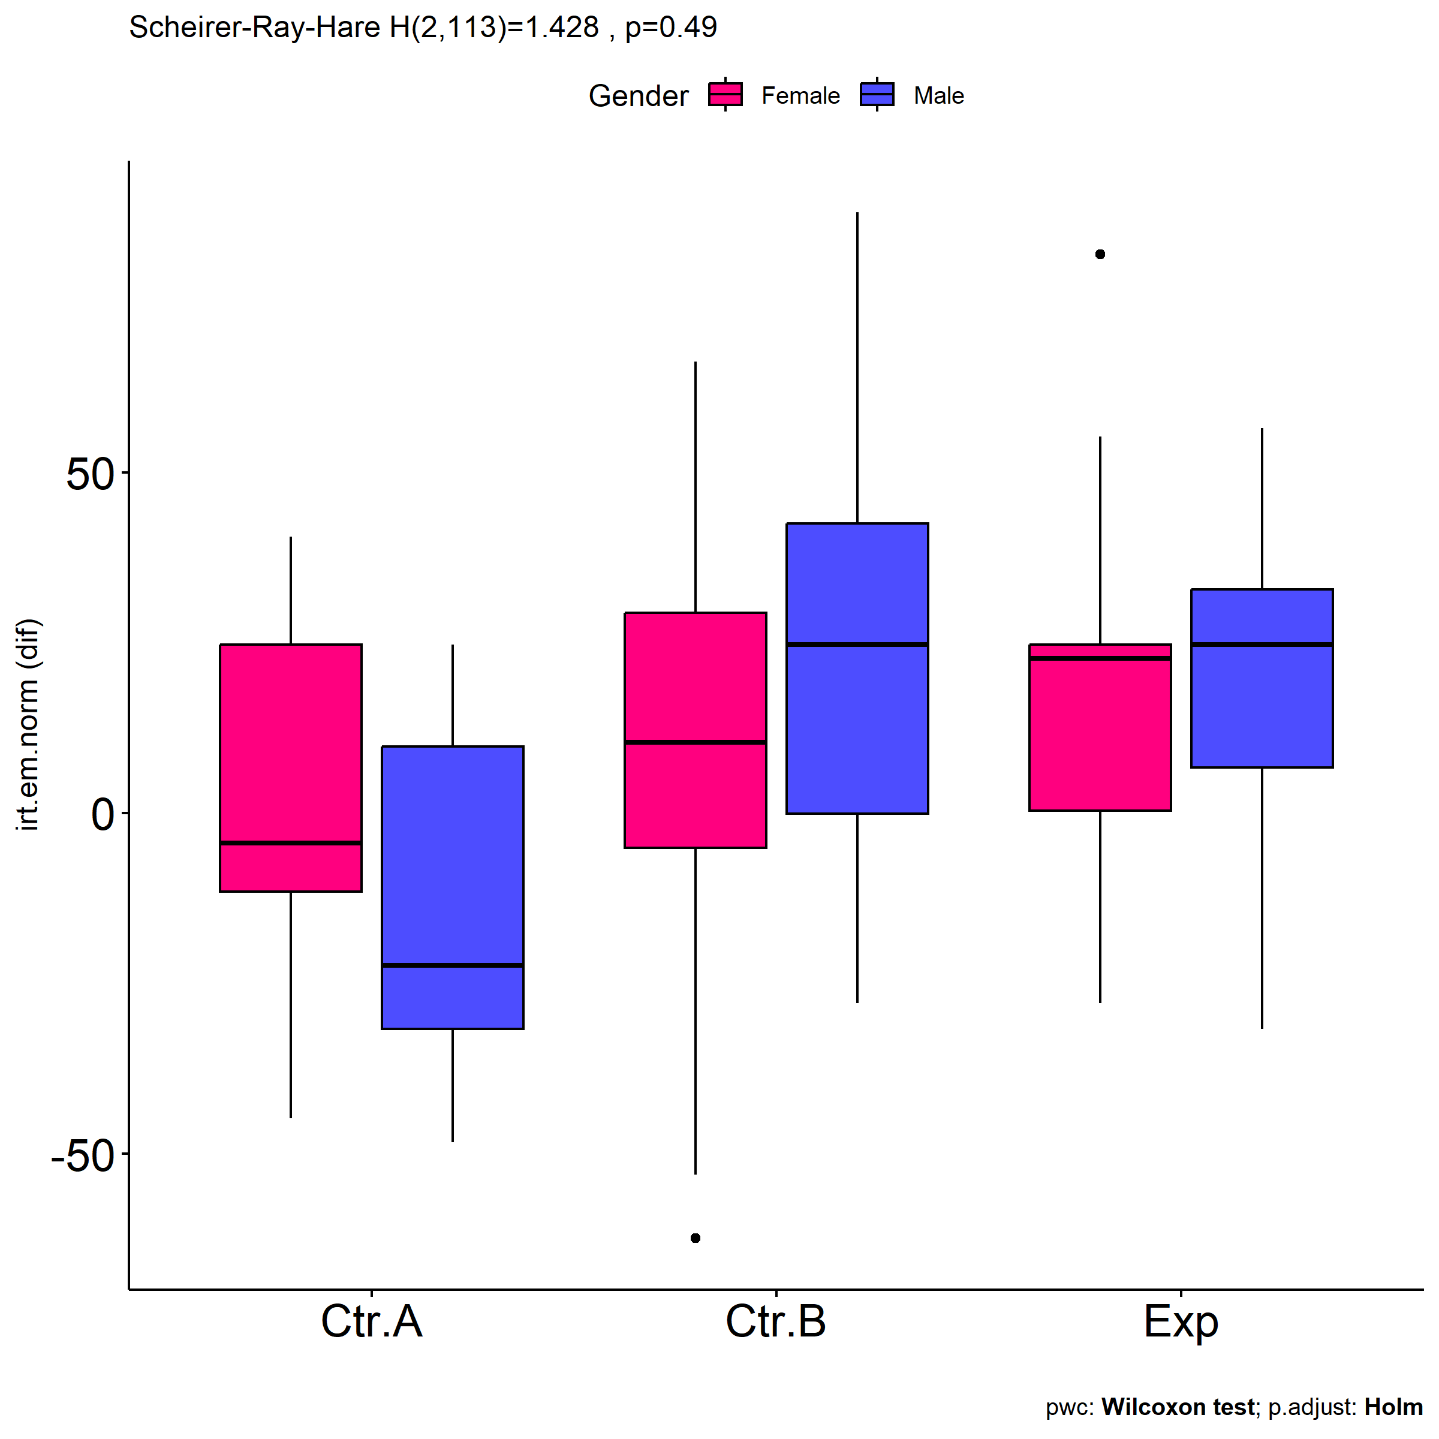
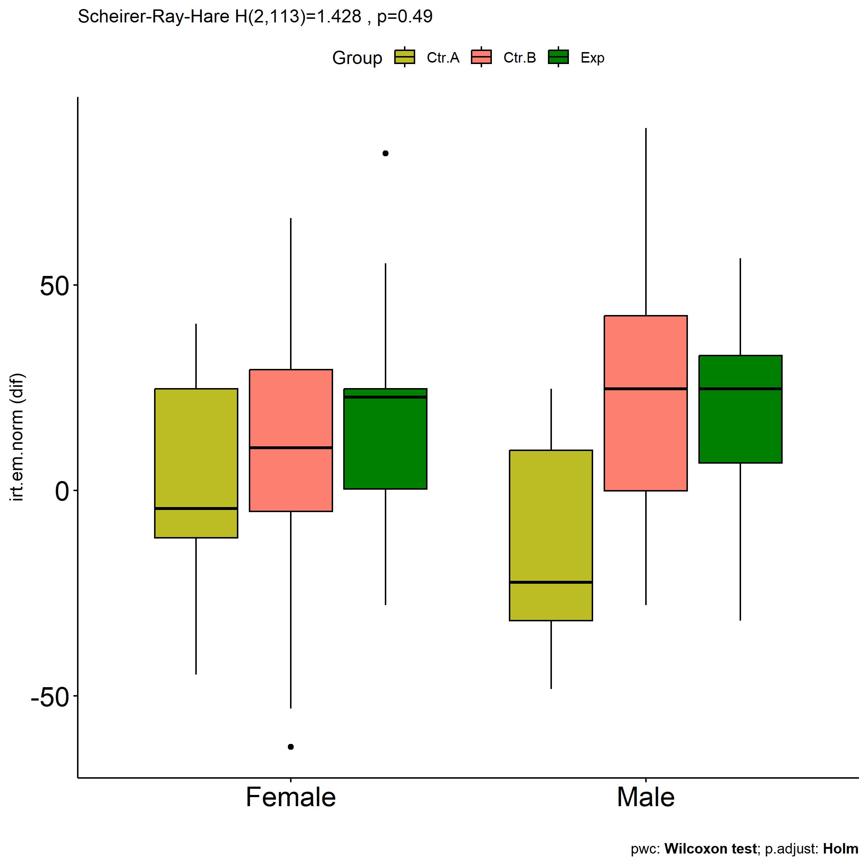

Slide 17
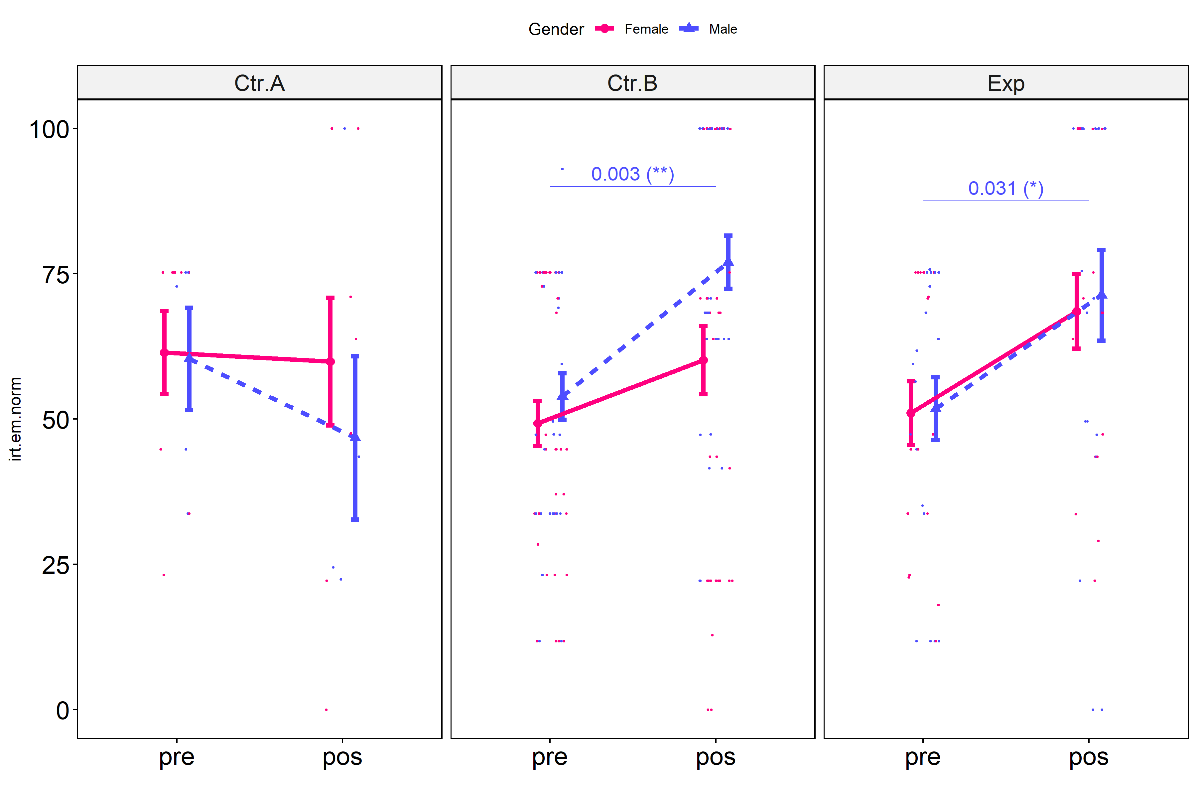

Slide 18
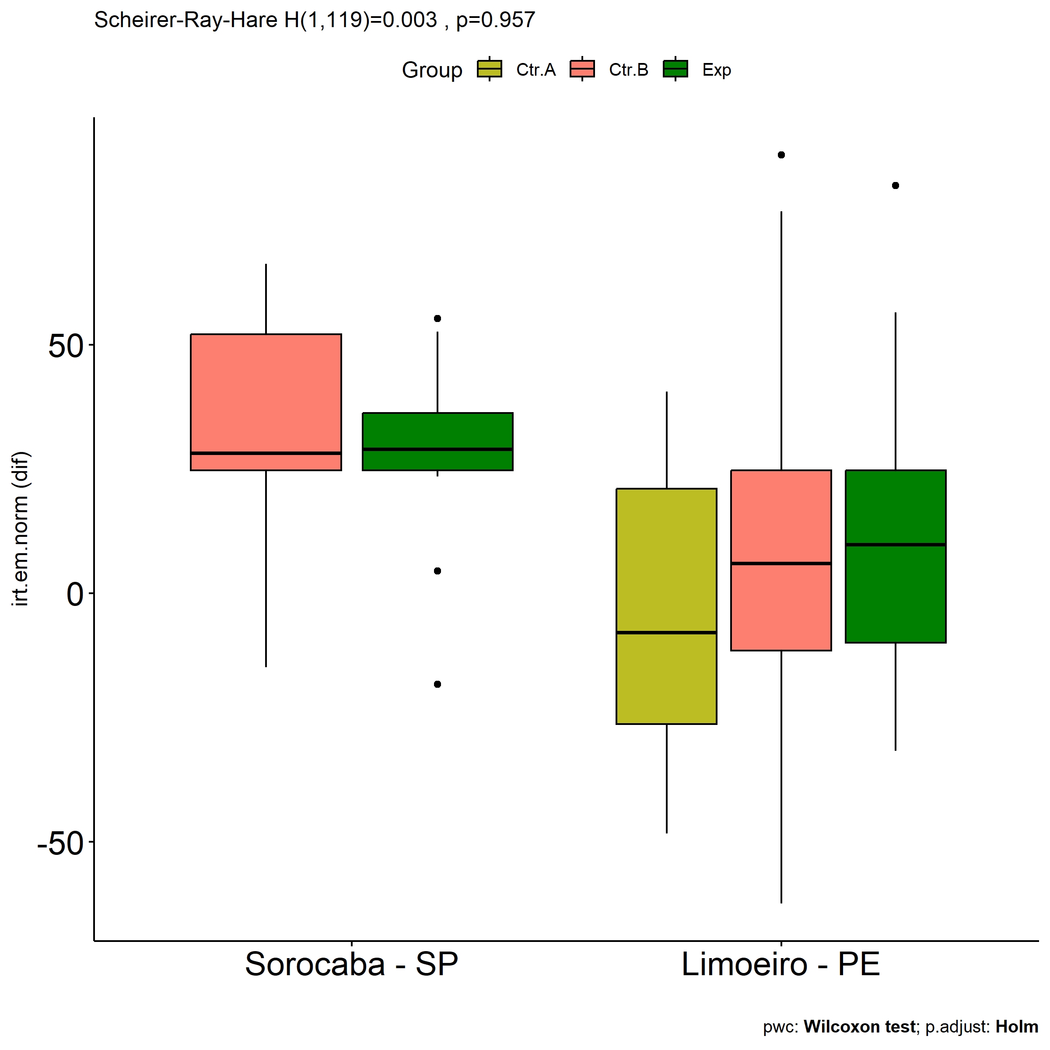

Slide 19
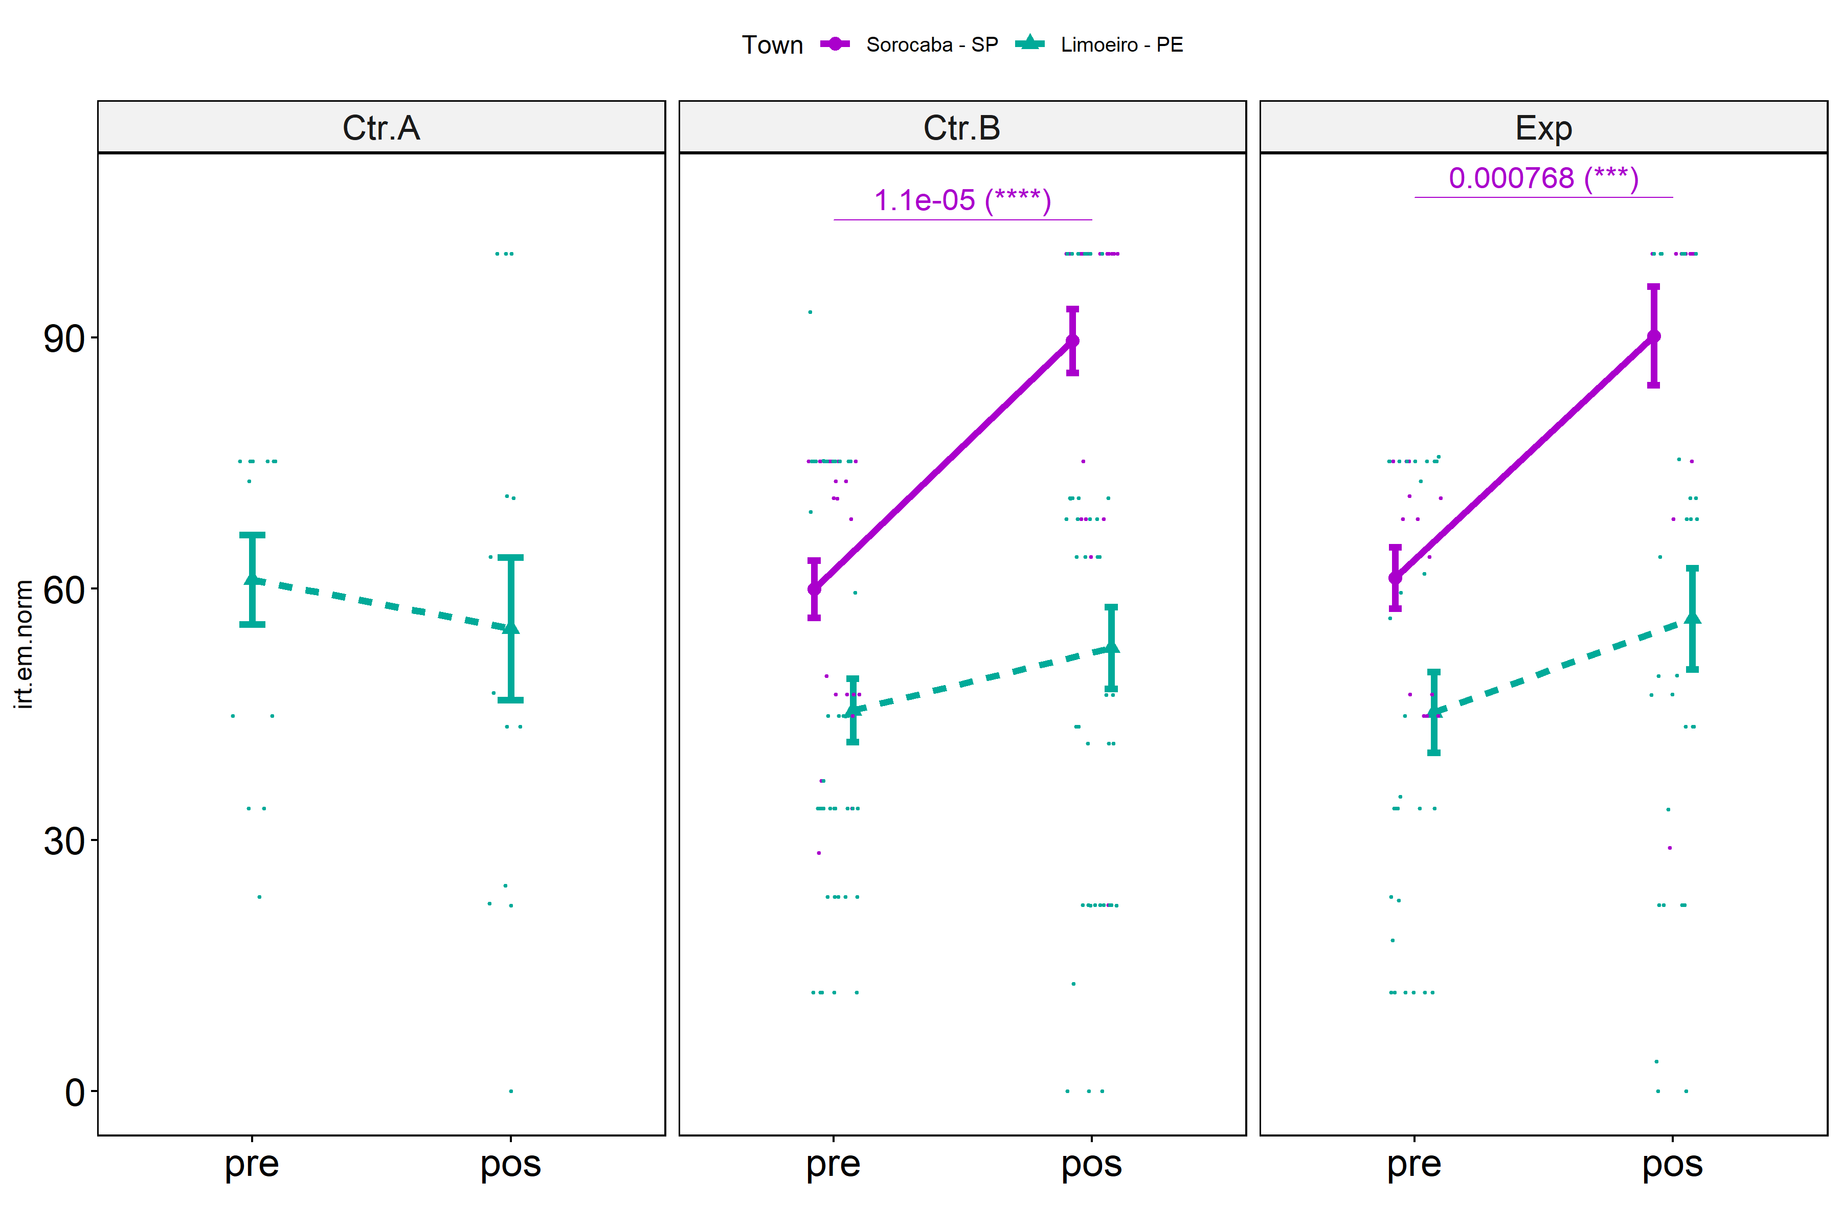

Slide 20
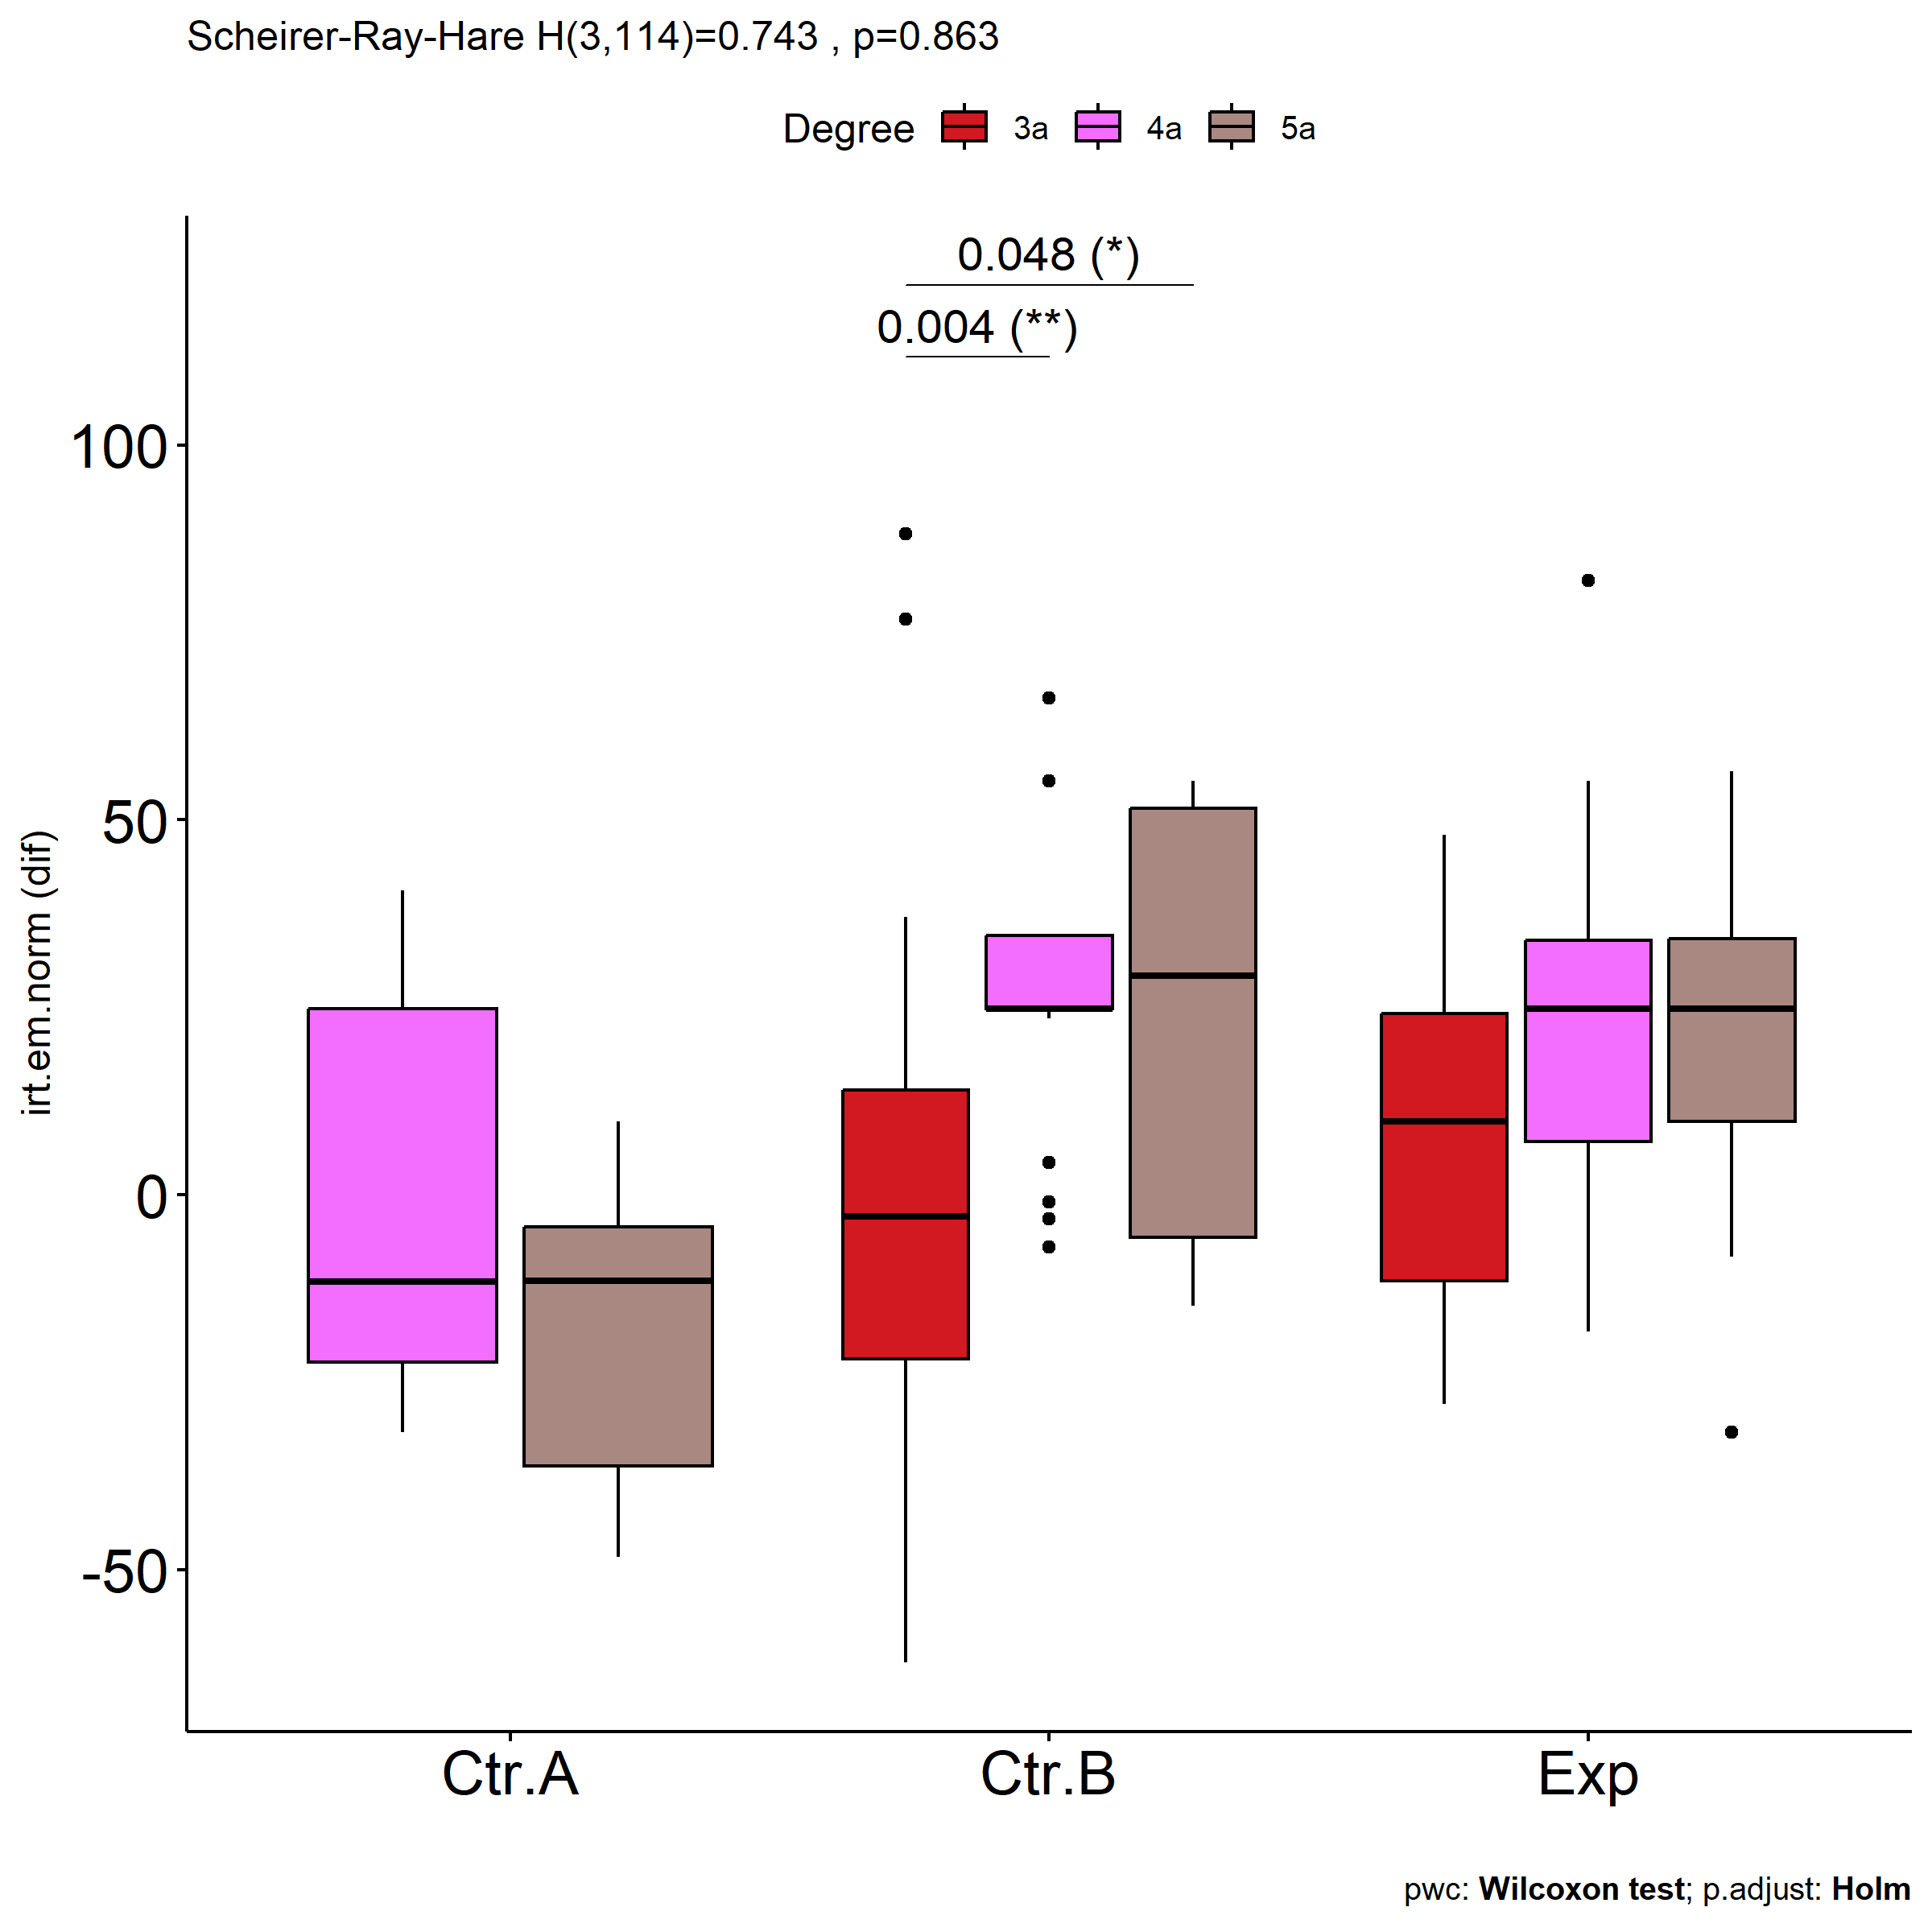
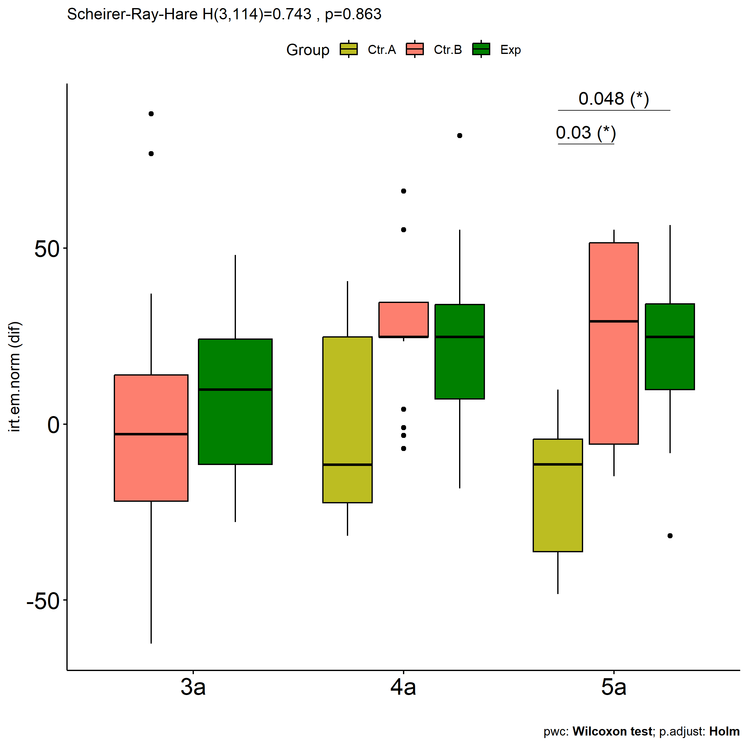

Slide 21
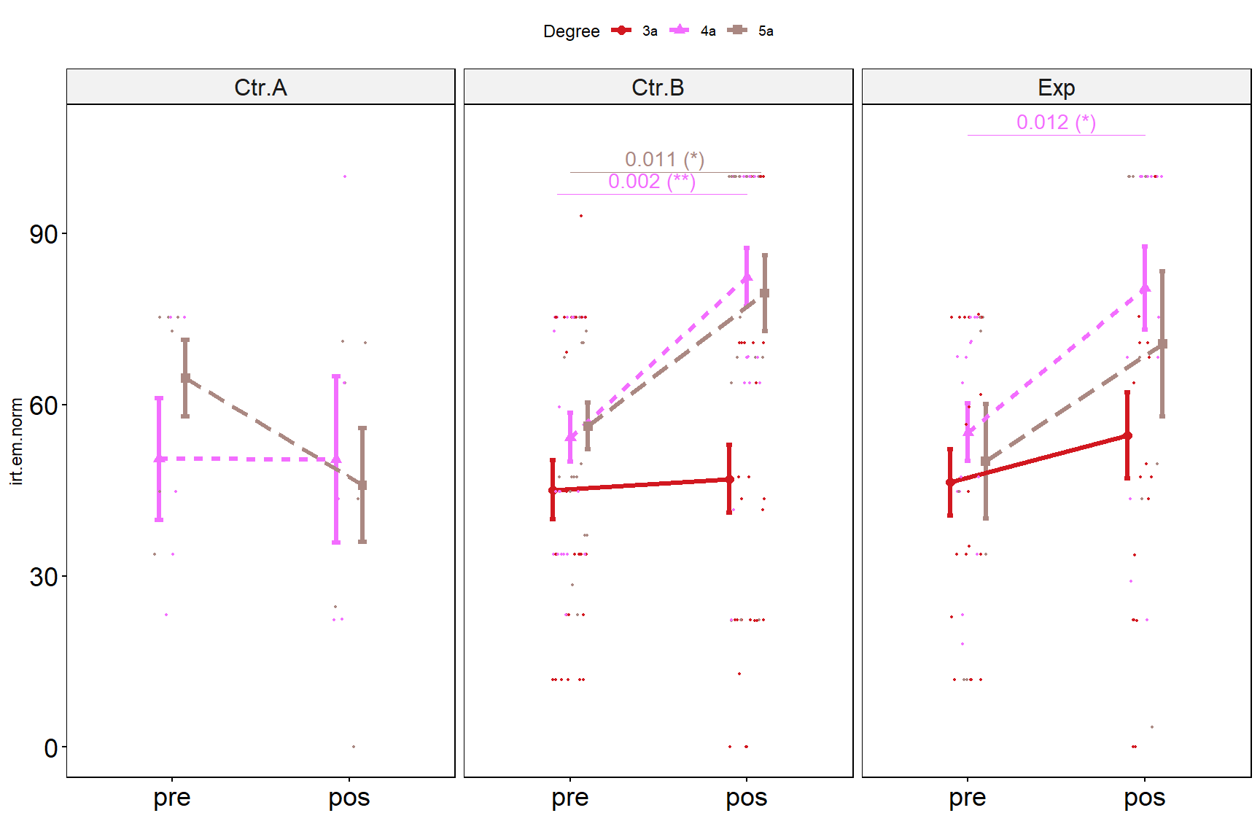

Slide 22
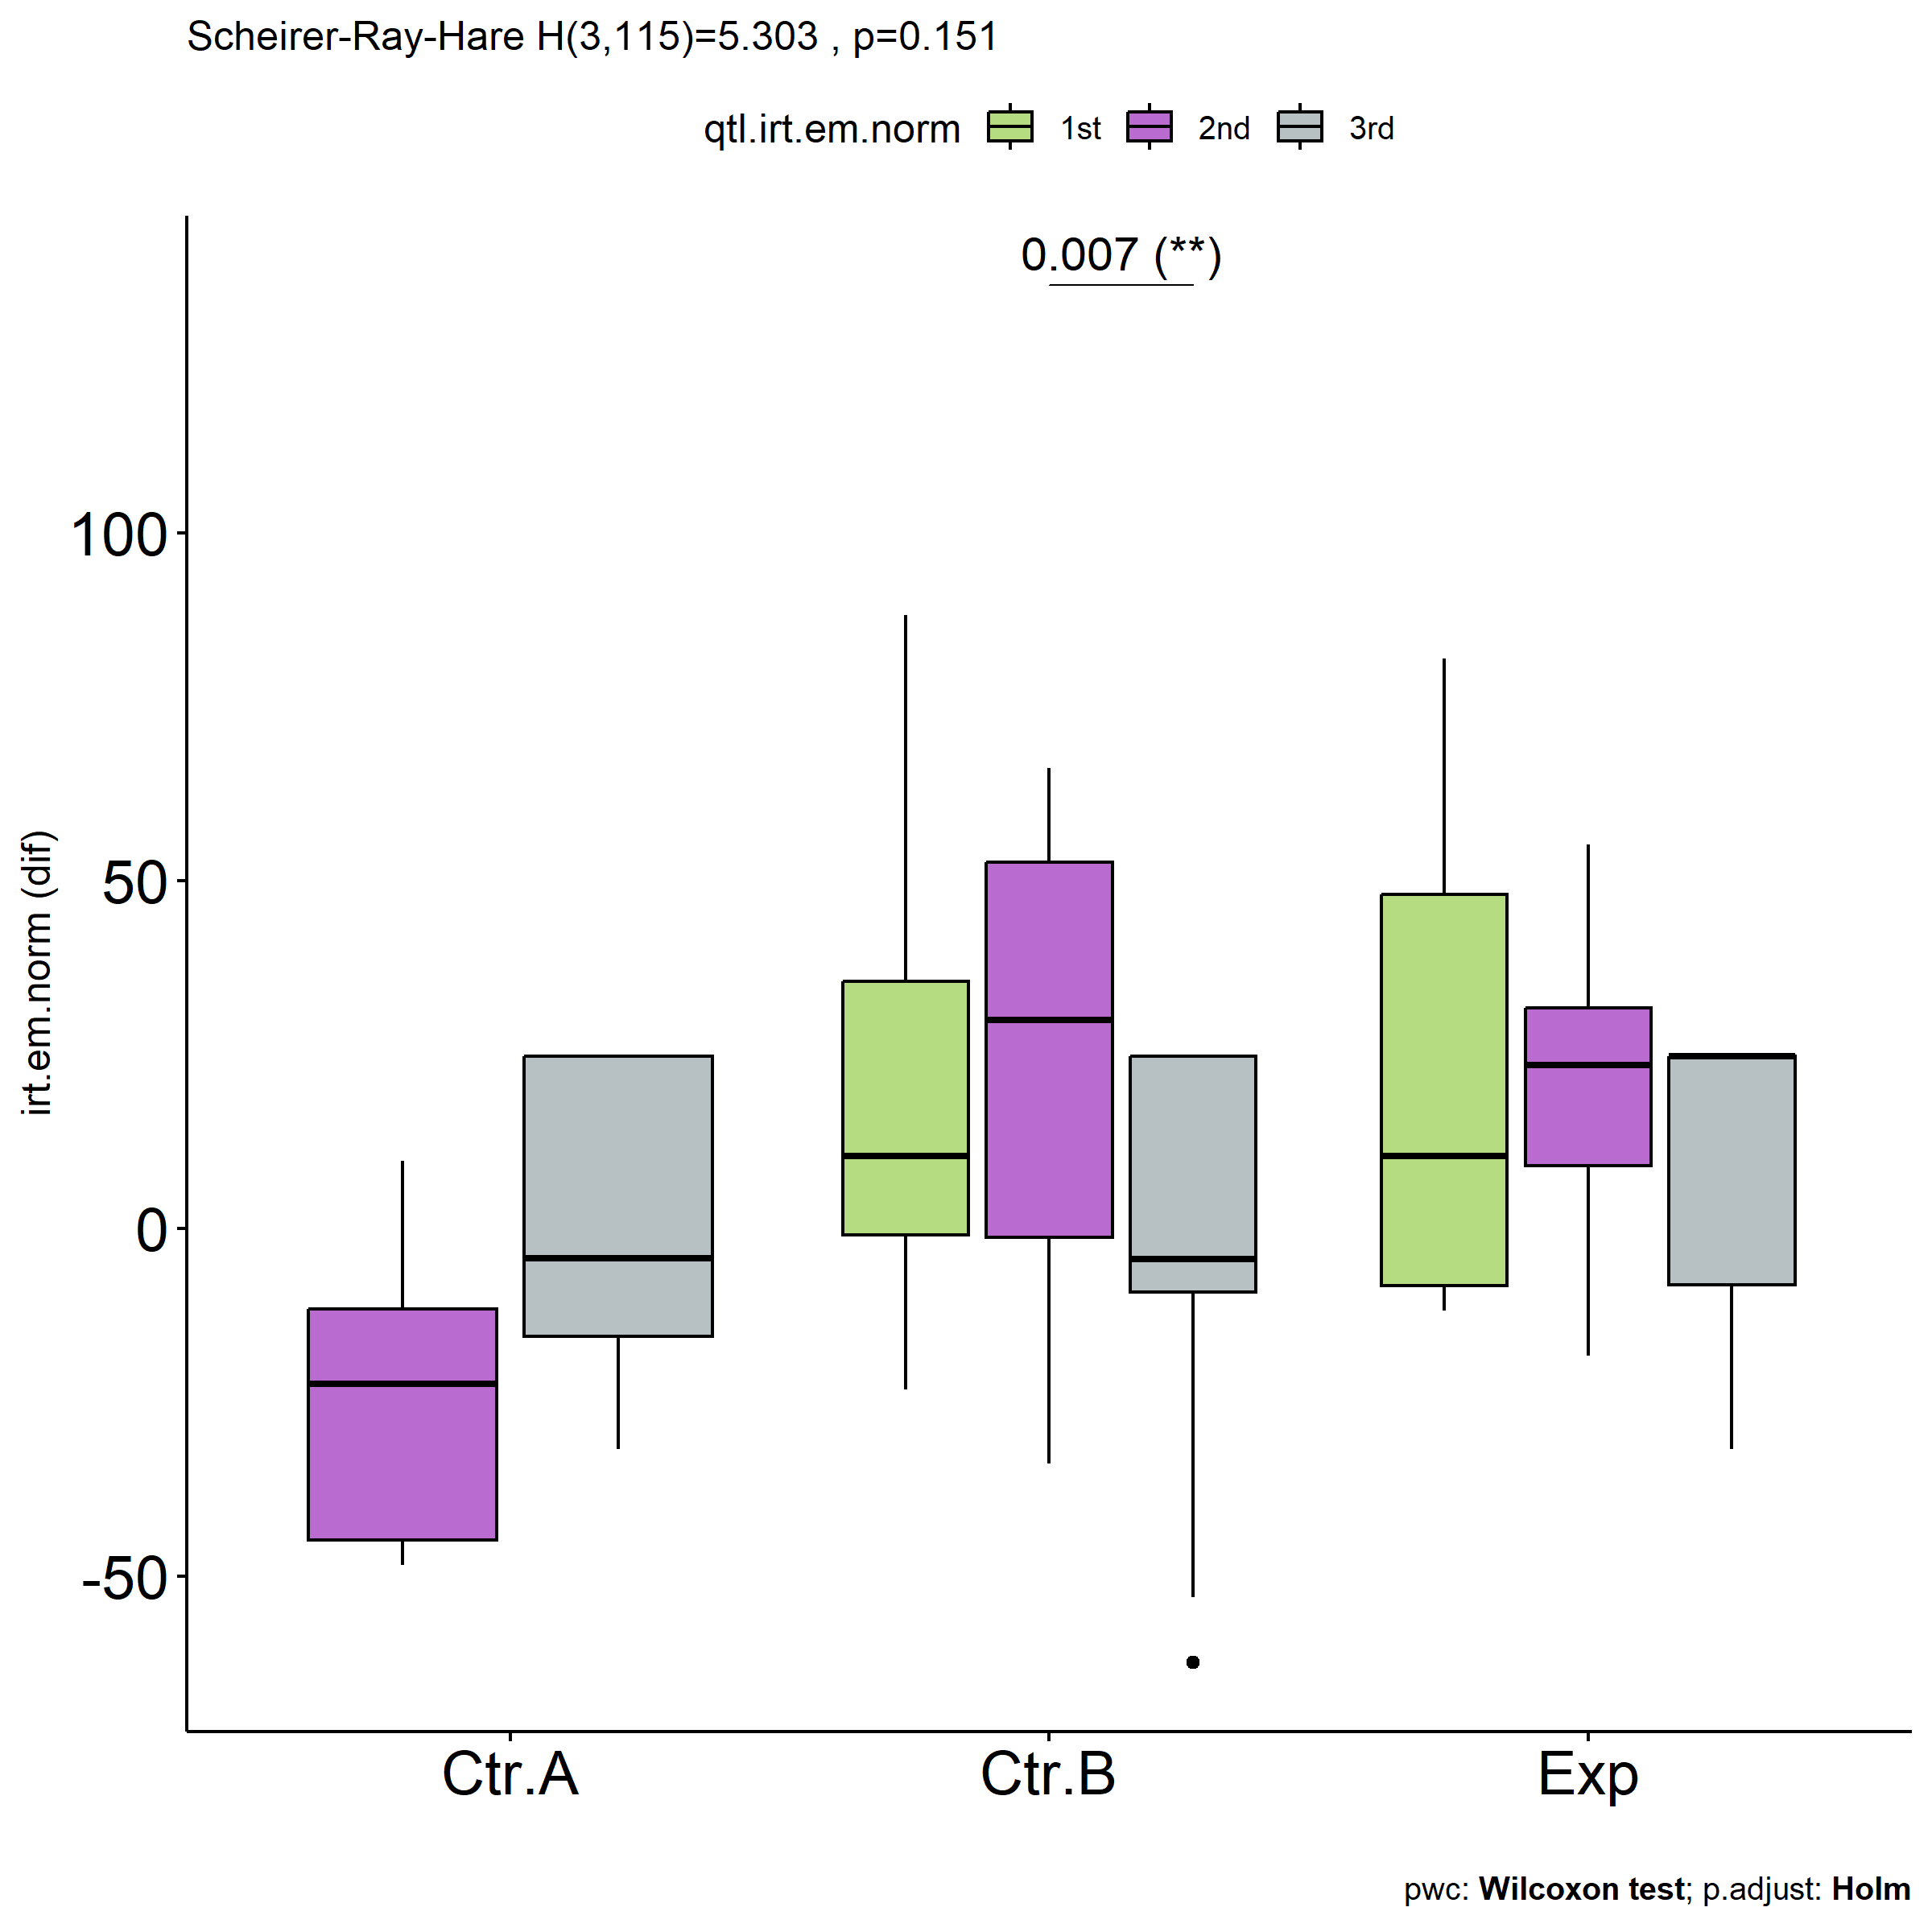
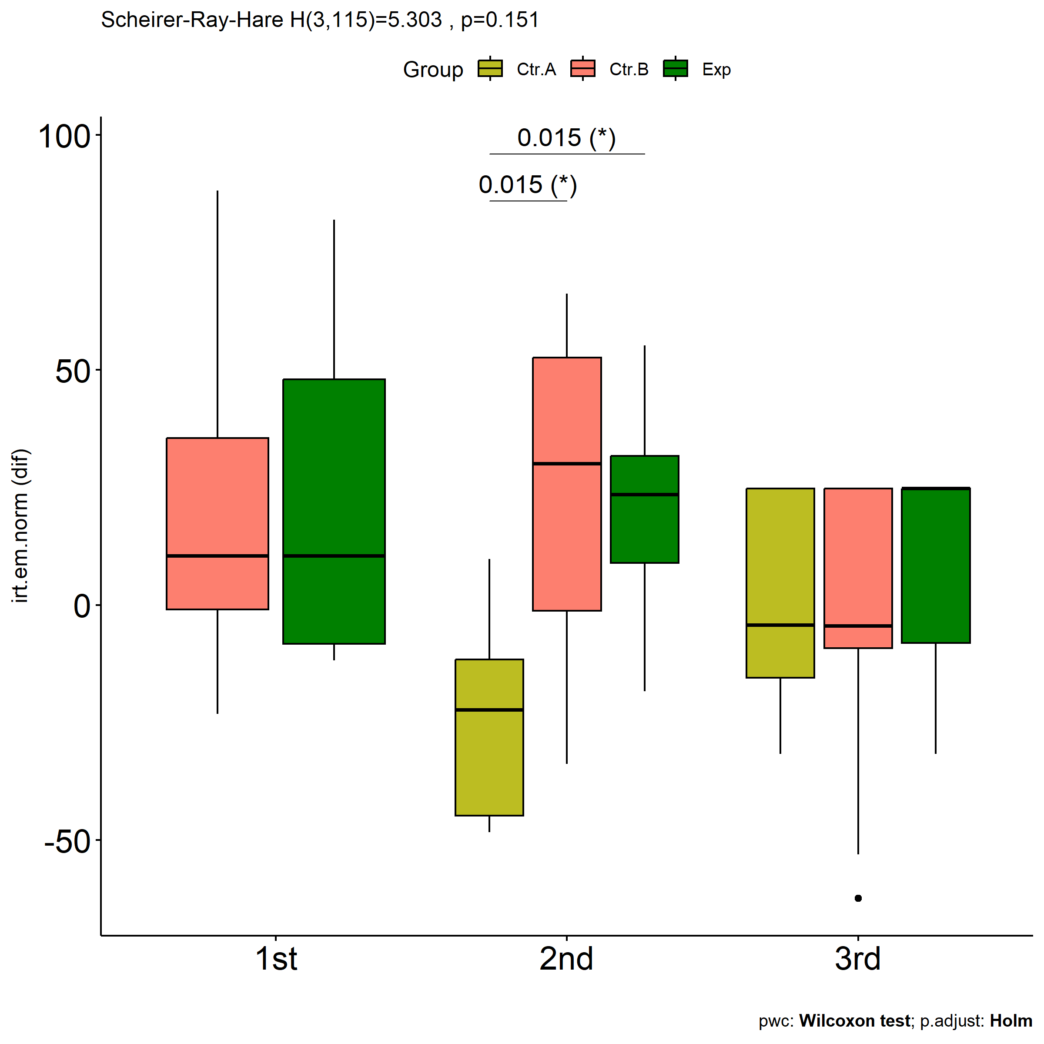

Slide 23
