Slide 1
S(0,0)
S(0,1)
S(2,0)
[Stages of Skill development]
S(1,0)
nothing (0)
S(0,2)
S(3,0)
rough cognitive stage (1)
S(1,1)
explanatory cognitive stage (2)
S(3,1)
associative stage (3)
S(2,1)
S(4,0)
autonomous stage (4)
S(0,3)
S(1,2)
S(2,2)
[Stages of Knowledge acquisition]
S(3,2)
nothing (0)
S(4,1)
accretion (1)
S(2,3)
tuning (2)
restructuring (3)
S(1,3)
S(3,3)
S(4,3)
S(4,2)

Slide 2
S(0,0)
S(2,0)
S(0,1)
S(1,0)
S(3,0)
S(3,0)
S(0,2)
S(1,1)
S(3,1)
S(3,1)
S(4,0)
S(2,1)
S(0,3)
S(2,2)
S(3,2)
S(1,2)
S(4,1)
S(3,2)
S(2,3)
S(1,3)
S(3,3)
S(4,3)
S(4,2)
(a) learning by apprenticeship
(b) learning by guiding

Slide 3
Anxiety
(too hard)
Challenge level
Flow
Boredom
(too easy)
Ability level

Slide 4
(1,5)
(2,5)
(3,5)
(4,5)
(5,5)
4:highest
s(3,y)→s(4,y) 4:highest
Anxiety
(2,4)
(3,4)
(4,4)
(5,4)
(1,4)
3:high
s(2,y)→s(3,y) 3:high
(1,3)
(2,3)
(3,3)
(4,3)
(5,3)
challenge level
s(1,y)→s(2,y) 2:medium
2:medium
s(2,y)→s(3,y) 2:medium
(1,2)
(2,2)
(3,2)
(4,2)
(5,2)
1:low
s(1,y)→s(2,y) 1:low
Boredom
(1,1)
(2,1)
(3,1)
(4,1)
(5,1)
0:lowest
s(0,y)→s(1,y) 0:lowest
s(0,y)→s(1,y)
s(1,y)→s(2,y)
s(2,y)→s(3,y)
s(3,y)→s(4,y)
transitions in skill development stages

Slide 5
(1,5)
(2,5)
(3,5)
(4,5)
(5,5)
4:highest
s(x,2)→s(x,3) 4:highest
Anxiety
(2,4)
(3,4)
(4,4)
(5,4)
(1,4)
3:high
s(x,1)→s(x,2) 3:high
challenge level
(1,3)
(2,3)
(3,3)
(4,3)
(5,3)
s(x,1)→s(x,2) 2:medium
2:medium
(1,2)
(2,2)
(3,2)
(4,2)
(5,2)
1:low
s(x,1)→s(x,2) 1:low
Boredom
(1,1)
(2,1)
(3,1)
(4,1)
(5,1)
0:lowest
s(x,0)→s(x,1) 0:lowest
s(x,0)→s(x,1)
s(x,1)→s(x,2)
s(x,1)→s(x,2)
s(x,1)→s(x,2)
s(x,2)→s(x,3)
transitions in knowledge acquisition stages

Slide 6
[Stages of Skill development]
S(0,0)
nothing (0)
S(0,1)
[0;0]
[0;2]
S(2,0)
rough cognitive stage (1)
[0;0]
explanatory cognitive stage (2)
S(1,0)
[1;2]
[2;3]
associative stage (3)
[1;3]
[0;0]
[0;0]
[0;3]
S(0,2)
[1;3]
S(3,0)
autonomous stage (4)
S(1,1)
[0;0]
[0;0]
[Stages of Knowledge acquisition]
[1;3]
[1;2]
S(3,1)
[4;4]
S(2,1)
[2;3]
S(4,0)
nothing (0)
[4;4]
[0;0]
[1;3]
accretion (1)
S(0,3)
S(2,2)
[4;4]
S(1,2)
[1;3]
[0;0]
tuning (2)
[1;2]
[2;3]
restructuring (3)
S(3,2)
[4;4]
S(4,1)
[0;0]
[4;4]
S(2,3)
[Levels of Challenge]
[1;2]
[4;4]
[4;4]
[1;3]
lowest (0)
[2;3]
low (1)
S(1,3)
[1;3]
[4;4]
[4;4]
medium (2)
S(3,3)
S(4,3)
S(4,2)
high (3)
highest (4)

Slide 7
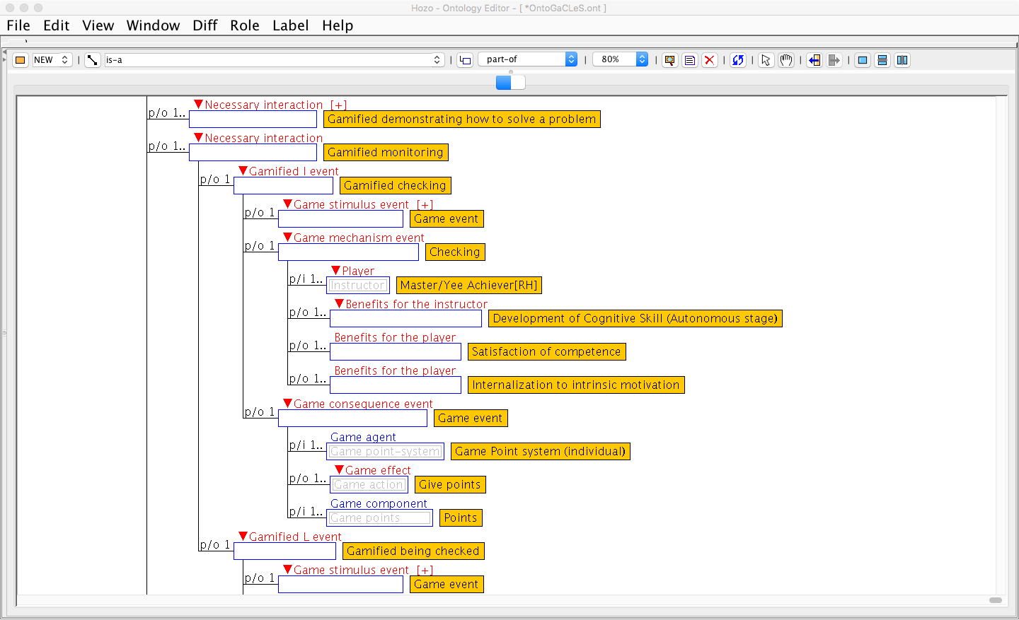
(Master/Yee Achiever) Learning by Guiding
S(3,1)
Initial stage
[4;4]
S(4,1)
Final stage
4:highest
s(3,y)→s(4,y) 4:highest
+1600 points
Anxiety
3:high
s(2,y)→s(3,y) 3:high
+800 points
challenge level
s(1,y)→s(2,y) 2:medium
2:medium
+400 points
s(2,y)→s(3,y) 2:medium
1:low
s(1,y)→s(2,y) 1:low
Boredom
+200 points
0:lowest
s(0,y)→s(1,y) 0:lowest
+100 points
s(0,y)→s(1,y)
s(1,y)→s(2,y)
s(2,y)→s(3,y)
s(3,y)→s(4,y)
transitions in skill development stages

Slide 8
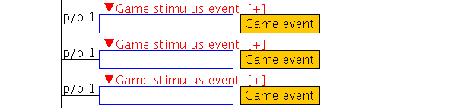
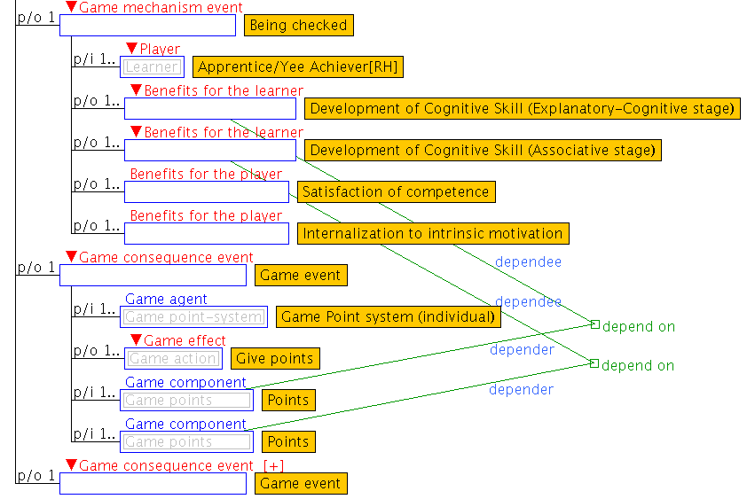
(Apprentice/Yee Achiever) Learning by Apprenticeship
S(0,0)
Initial stage
S(2,0)
[0;0]
[1;2]
[3;3]
S(3,0)
S(1,0)
Final stage
4:highest
s(3,y)→s(4,y) 4:highest
+1600 points
Anxiety
3:high
s(2,y)→s(3,y) 3:high
+800 points
challenge level
s(1,y)→s(2,y) 2:medium
2:medium
+400 points
s(2,y)→s(3,y) 2:medium
1:low
s(1,y)→s(2,y) 1:low
Boredom
+200 points
0:lowest
s(0,y)→s(1,y) 0:lowest
+100 points
s(0,y)→s(1,y)
s(1,y)→s(2,y)
s(2,y)→s(3,y)
s(3,y)→s(4,y)
transitions in skill development stages

