Slide 1

Life and Evolution of Cells
Functional Programming in Concurrent and Distributed Systems
Yevgeniy Gluhoy
Shaked Basa

Slide 2



About project
There are three main parts:
Board
Cells
Control plane

Slide 3

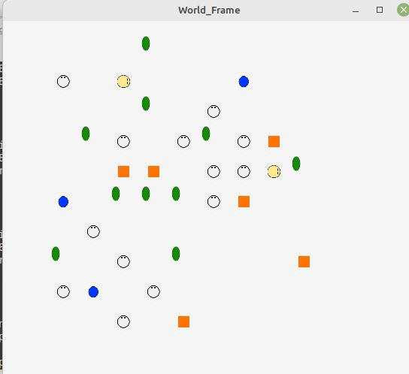
1. Board
Square with side size X – our world
Has 2 parameters: Energy and Organic.
High value of one of these parameters means – contamination of this part of a world.
World is ETS table with X*X entries

Slide 4
2. Cells
Each cell has parameters of organic and energy and die when energy==0; in addition, cells dies when they located in contaminated place; each cell has TTL parameter.
There are five type of cells.

Slide 5
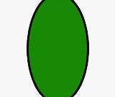

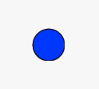


2. Cells (Cont.)
Leaf
General cell
Antena
Root
Seed
Description: uses photosynthesis to gain new energy.
Possible Actions: Move, Create new cell, Transform to new type of cell (more). Has no TTL.
Description: sleeping cell, has no TTL, becomes General Cell when it’s time come.
Description: absorbs energy from environment, can survive in places with energy contamination
Description: absorb organic from environment and transforms it into energy, can survive in places with organic contamination.

Slide 6
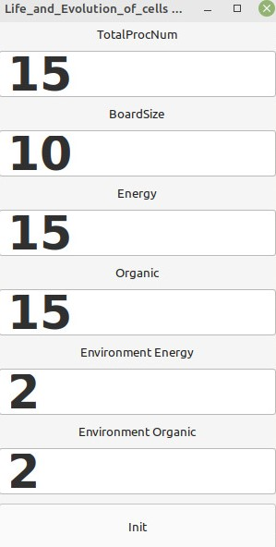
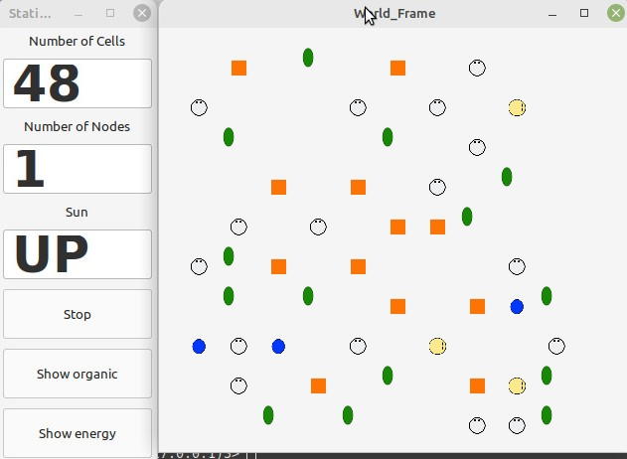
3. Control plane
Technical details
Requirements: minimum 2 Erlang nodes, “World size” always might be bigger or equal to number of cells
Control plane divided into two main parts “Simulation program” and “User interface”.
User interface created using wxWidjets
User interface contain “Control panels” and “World frame”

Slide 7
3. Control plane (Cont.)
Technical details
Graphic node
General node 1
General node 2
Simulation program has a main node – graphic node and general nodes (at least one).
Each node can communicate with each node.

Slide 8
3. Control plane (Cont.)
Main node
wxWidjets
Logger
Graphic node
Main data storage – contain all information about the world.
Recovery manager – restarts simulation from last save point when one of nodes was lost.
User interface
Simulation starer – launch servers on general nodes, divides world and cells between them.
Main node implemented using Erlang gen server
Outer world connection

Slide 9
3. Control plane (Cont.)
Outer world connection
General node
General node
Logger
Cells
Cell manager
Cell monitor
Additional Mailbox
Simulations happens here
Controls cells life cycles on it’s part of world
Periodically sends updates of a world to main node
General node and Cell manager implemented using Erlang gen server

Slide 10

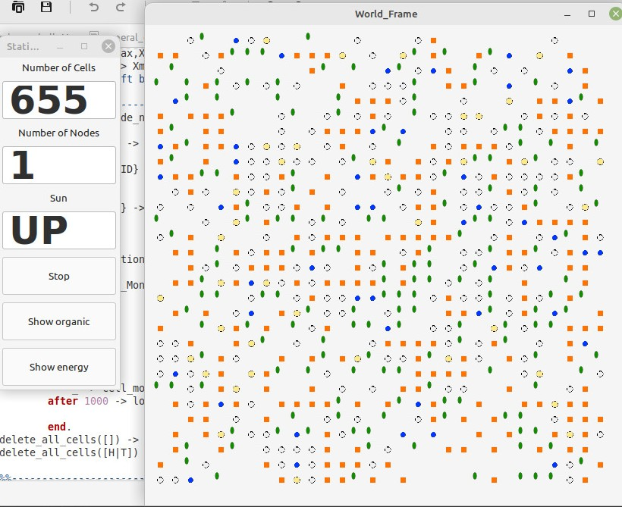
Simulation
Simulation starts from creating a given number (by user) of general cells. Each cell is different process which decides its action in next iteration according to environment. The simulation can complete in a few minutes, but usually the colony of cells self-sustaining and stable and can live forever.

Slide 11


Thank you for the attention!
Any additional information and statistics might be found on GitHub, including FSM for each type of cell and for the control plane
https://github.com/gekaizum/Functional_programming_project

