Slide 1
Load Forecasting Project
Team Members:
- Themistoklis Proko AEM: 03301
- Georgios Kapakos ΑΕΜ: 03165
- Eleni Athanailidi ΑΕΜ: 03453
Overview:
This project focuses on predicting the energy consumption of household appliances in a low-energy house using various basELINE, machine learning and deep learning models.

Slide 2
Data Preprocessing
1. Outlier Handling:
- Replaced outliers using the IQR method to improve data quality.
2. Missing Value Treatment:
- Handled missing values by replacing them with the mean of the respective columns.
These preprocessing steps ensured the dataset was clean and consistent for modeling.

Slide 3
Feature Engineering
1. Periodic Lags:
- Added lagged features based on daily cycles to capture recurring patterns.
2. Rolling Means:
- Computed moving averages to smooth the data and highlight trends.

Slide 4
Baseline Models
1. Naïve:
- Predicts the next value based on the most recent observation.
2. Moving Average:
- Uses the average of previous time steps to make predictions.
3. Seasonal Naïve:
- Incorporates seasonality by using the value from the same season in the past.

Slide 5
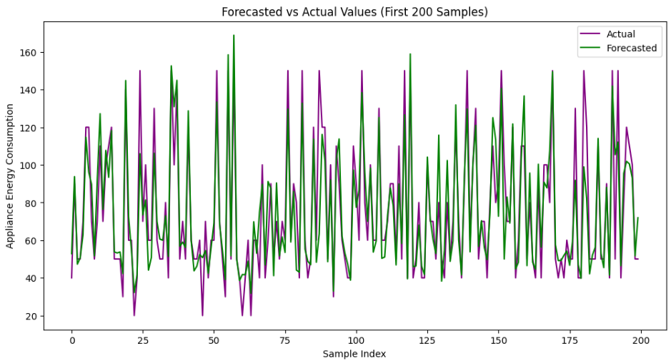
Machine Learning Models
XGBoost PLOT
1. Decision Trees:
- Splits data based on feature thresholds to make predictions.
2. XGBoost:
- Uses gradient boosting on decision trees for improved accuracy.
3. Random Forest:
- Combines multiple decision trees to reduce overfitting and enhance stability.

Slide 6
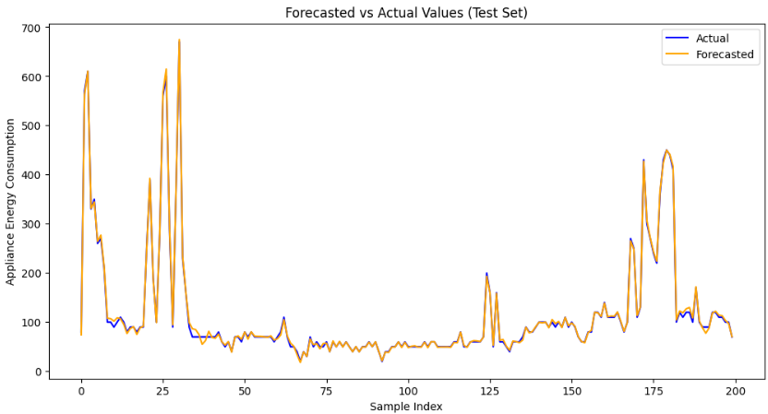
Deep Learning Models
LSTM PLOT
1. LSTM (Long Short-Term Memory):
- Captures long-term dependencies in time series data.
2. GRU (Gated Recurrent Unit):
- Similar to LSTM but with fewer parameters, making it computationally efficient.
3. TCN (Temporal Convolutional Networks):
- Leverages causal convolutions to handle sequential data effectively.

Slide 7
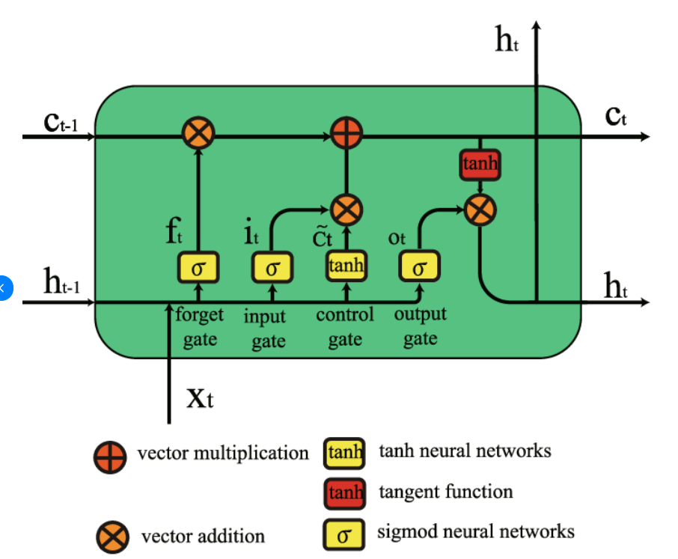
LSTM Architecture
The Long Short-Term Memory (LSTM) model is designed to handle sequential data effectively.
It is particularly well-suited for time series tasks due to its ability to capture long-term dependencies.
Key Components:
1. Input Layer: - Receives the sequential data with features representing energy consumption predictors.
2. LSTM Layers: - Includes multiple LSTM cells, each containing three gates (input, forget, and output gates) that regulate the flow of information.
- Maintains two states: hidden state (short-term memory) and cell state (long-term memory).
3. Fully Connected Layer: - Maps the output of the LSTM layers to the target prediction (energy consumption).
Advantages of LSTM:
- Captures temporal dependencies efficiently. - Handles vanishing gradient problems better than traditional RNNs.
- Suitable for tasks requiring context over long sequences."

Slide 8
Transformers: Overview
Transformers excel in handling sequential data like time series due to their attention mechanism, which enables the model to focus on relevant parts of the input sequence.
Key Components:
- Embedding Layer: Converts input features into dense vectors.
- Positional Encoding: Adds temporal information to the embeddings.
- Multi-Head Attention: Allows the model to learn relationships between different time steps.
- Feedforward Layers: Processes the attention outputs for prediction.

Slide 9
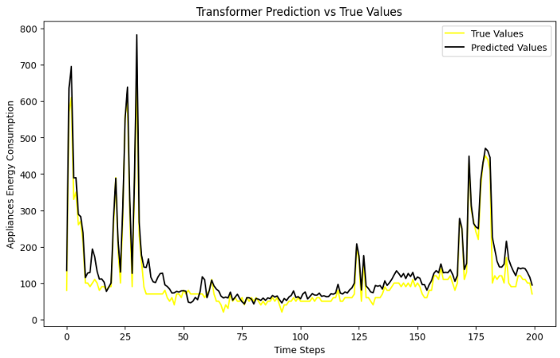
Transformers: Architecture
TRANSFORMERS PLOT
1. Embedding and Positional Encoding:
- The embedding layer transforms input features into high-dimensional vectors.
- Positional encoding adds sequence information to these vectors.
2. Multi-Head Attention:
- Computes attention scores to focus on relevant time steps.
- Multiple heads allow the model to capture diverse relationships.
3. Feedforward Network:
- Processes the outputs of the attention mechanism for final predictions.
Advantages:
- Handles long-term dependencies effectively.
- Parallel computation improves training speed.

Slide 10
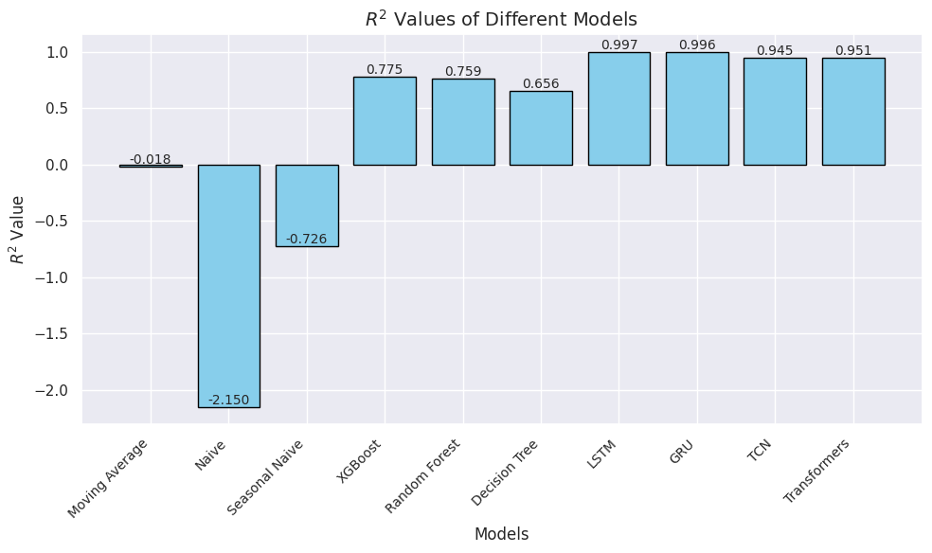
Model performance comparison

Slide 11
Thank you!!!

