Slide 1

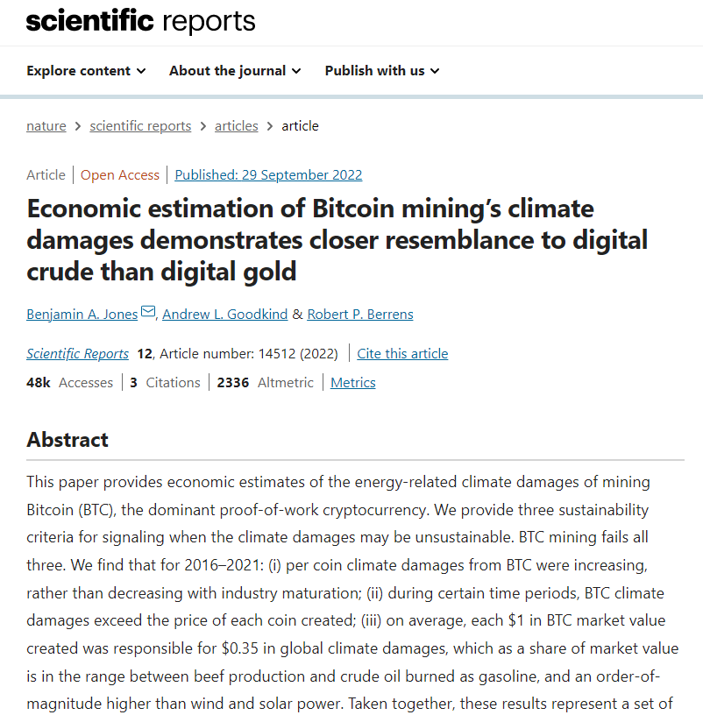
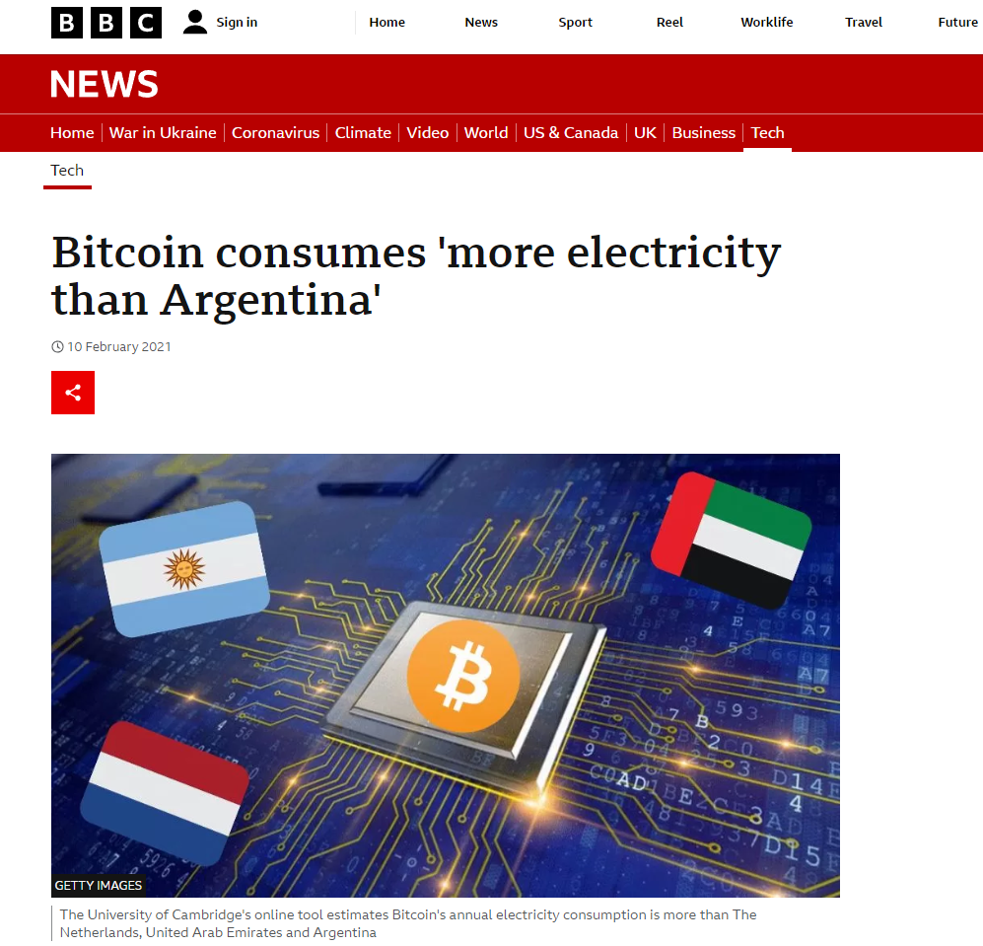
How to Address the energy consumption in cryptocurrency mining
Changyu Li 20513997
Judmayer et al. (2022). Blocks and Chains: Introduction to Bitcoin, Cryptocurrencies, and Their Consensus Mechanisms. Springer Nature | Jones, B.A., Goodkind, A.L. and Berrens, R.P., (2022). Economic estimation of Bitcoin mining’s climate damages demonstrates closer resemblance to digital crude than digital gold. Scientific Reports, 12(1), pp.1-10. | Criddle, C. (2021). Bitcoin consumes 'more electricity than Argentina’. [online] BBC News. Available at : https://www.bbc.com/news/technology-56012952 [Accessed 13 March 2023]
What is cryptocurrency? A type of digital currency that is secured by cryptography. How to get cryptocurrency? A complex process called “mining” is used, which requires advanced computer equipment to calculate math puzzles and cost energy. | Why is the energy consumption of mining is becoming an increasingly significant problem? With rapid price increases in bitcoin at the end of 2020, the energy consumption has significantly increased and caused more climate damages. 2021: Each bitcoin exhausts 113 tons of CO2. | How much energy is used in mining? About 6 GW of power(bitcoin only) similar as the energy consumption of Argentina. Why mining is a method that doesn’t work well? Mining doesn’t create real value. The energy consumption increases as more devices join.

