Slide 1
CROW
Framework for C++, by:
Gerardo Lazcano Aguilar
Jonathan Molinero Pérez

Slide 2
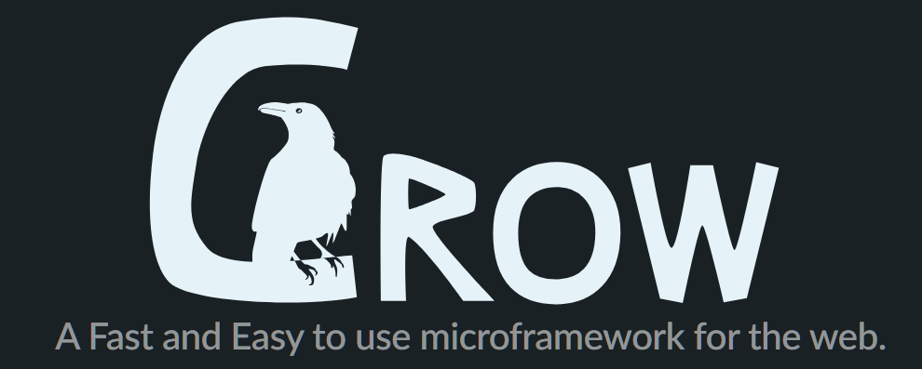
What is CROW?
Crow is a C++ framework for creating HTTP or WebSocket web services. It uses routing similar to Python's Flask which makes it easy to use. It is also extremely fast, beating multiple existing C++ frameworks as well as non C++ frameworks.

Slide 3
CHARACTERISTICS
Lightness: CROW is designed to be a lightweight and minimalist framework, meaning it is easy to understand and use, ideal for simpler projects or when you want close control over your web application.
Does not depend on external libraries: CROW has no external dependencies, making it easy to incorporate into projects without worrying about compatibilities or integration with other libraries.
Platform Independent: Despite its name, CROW is not limited to Windows and can be used on different operating systems. Although it was initially developed on Windows, it has been adapted and used on other platforms.

Slide 4
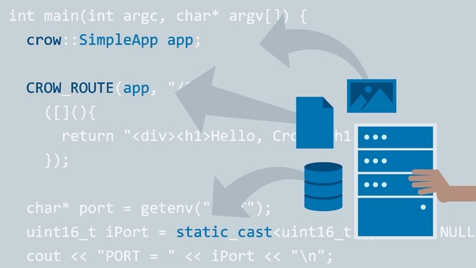
Advantages
Readability: Crow code is very readable, with a simple syntax that is easy to learn and understand. This makes it easy for programmers to collaborate on projects and to maintain code over time.
Conciseness: Crow code is also very concise, which can lead to smaller and faster programs. This is because Crow provides a number of features that allow programmers to express themselves more succinctly, such as pattern matching and functional programming constructs.
Efficiency: Crow is a compiled language, which means that Crow programs are converted into machine code before they are executed. This makes Crow programs very efficient, running at or near the speed of native code.
Versatility: Crow can be used to develop a wide variety of applications, including web applications, desktop applications, mobile applications, and embedded systems.

Slide 5

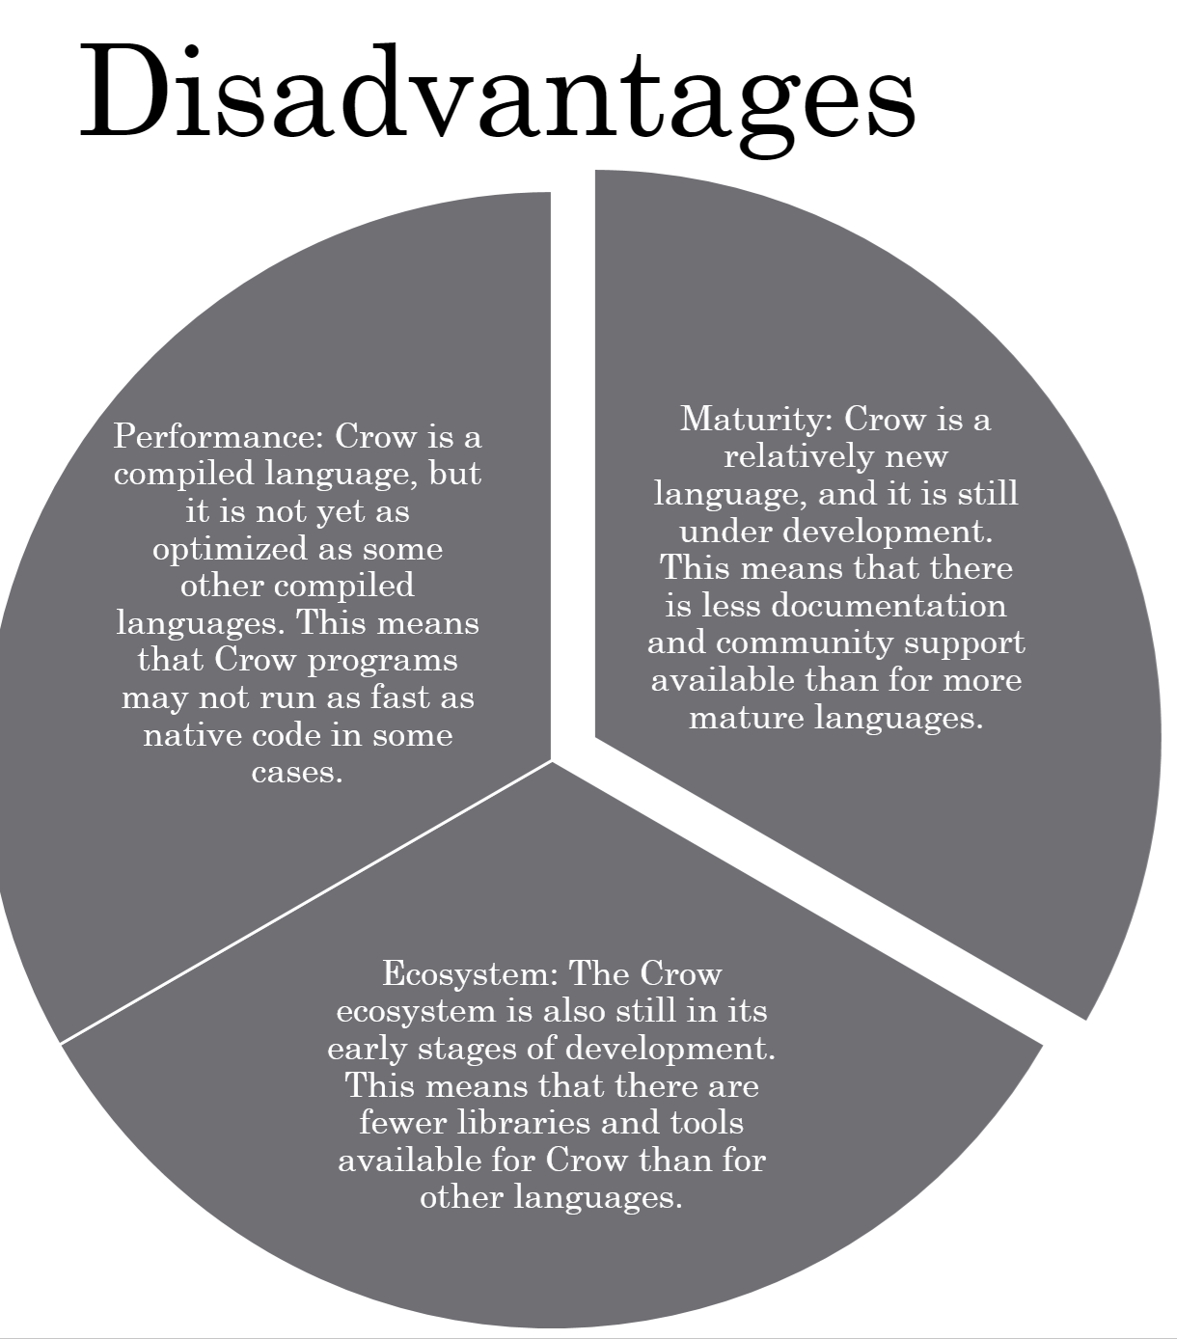

Disadvantages

Slide 6

How Work’s CROW?
The Crow framework works by listening for HTTP requests on a specific port. When a request is received, Crow matches the request path against a list of defined routes. If a match is found, Crow calls the corresponding handler function. The handler function can then generate a response and send it back to the client.
Here is a simplified overview of how Crow works:
Crow creates a server socket and binds it to a specific port.
Crow starts listening for incoming connections on the server socket.
When a connection is established, Crow accepts the connection and creates a new thread to handle it.
The new thread reads the incoming request and parses it into a crow::request object.
Crow matches the request path against a list of defined routes.
If a match is found, Crow calls the corresponding handler function.
The handler function generates a response and returns it to Crow.
Crow sends the response back to the client.
The new thread closes the connection.

Slide 7
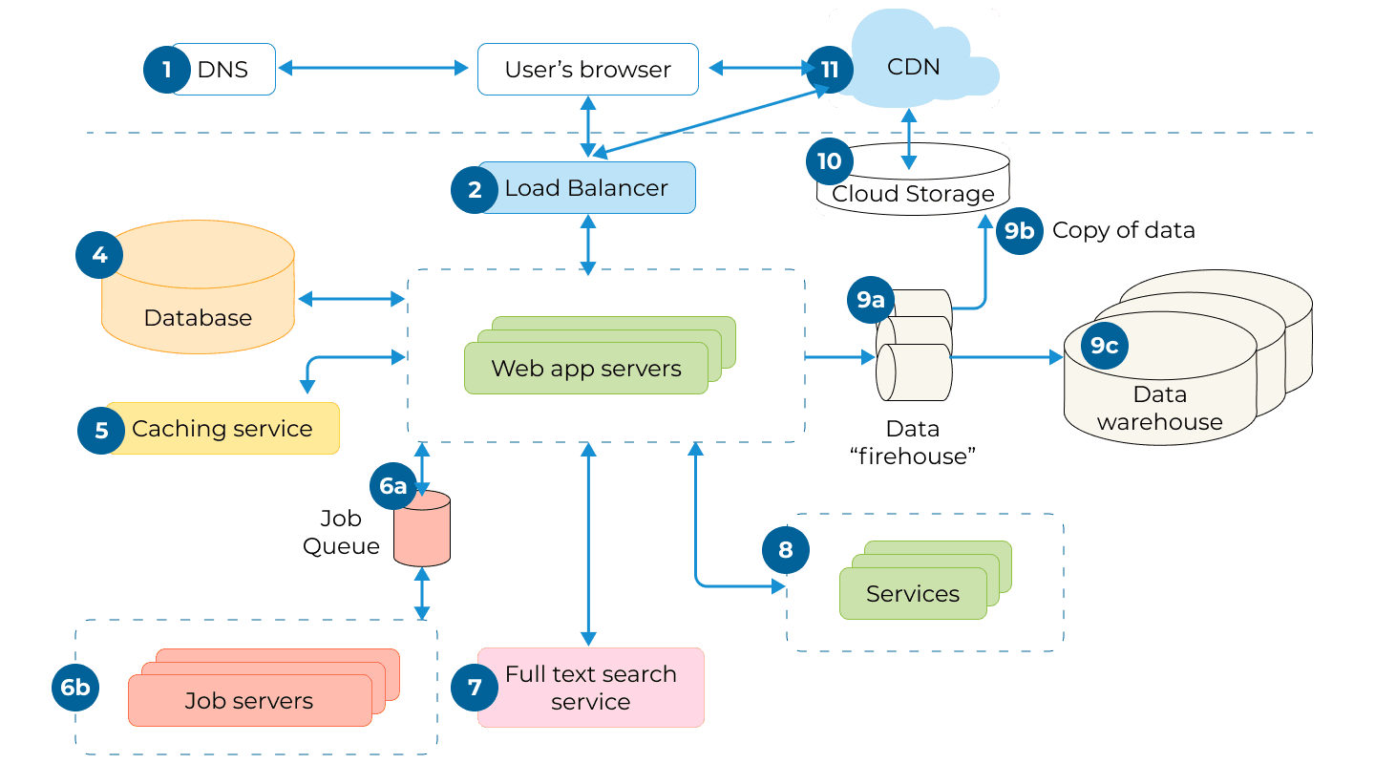
How its divided CROW?
Crow's core functionality is divided into several components:
Crow::App: The App class represents the Crow web application. It is responsible for creating and managing the server socket, listening for incoming connections, and routing requests to the appropriate handler functions.
Crow::Route: The Route class represents a route in a Crow web application. It is associated with a request path and a handler function.
Crow::Request: The Request class represents an HTTP request. It contains information about the request, such as the request path, the request method, and the request headers.
Crow::Response: The Response class represents an HTTP response. It contains the response body and the response headers.
Crow::Middleware: The Middleware class represents a middleware component. Middleware components can be used to intercept and modify requests and responses.
In addition to these core components, Crow also provides a number of other features, such as built-in JSON support, a Mustache templating library, and a logging system.

Slide 8
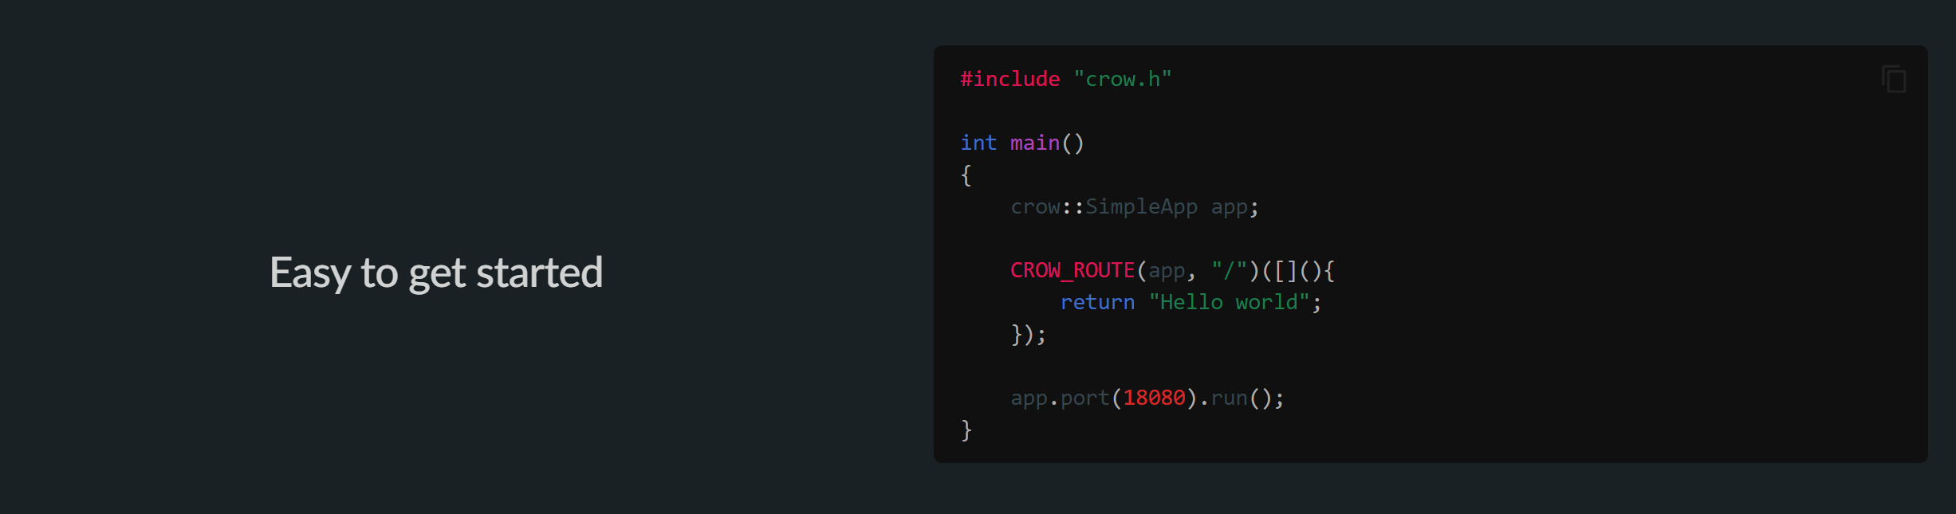
EXAMPLE

Slide 9
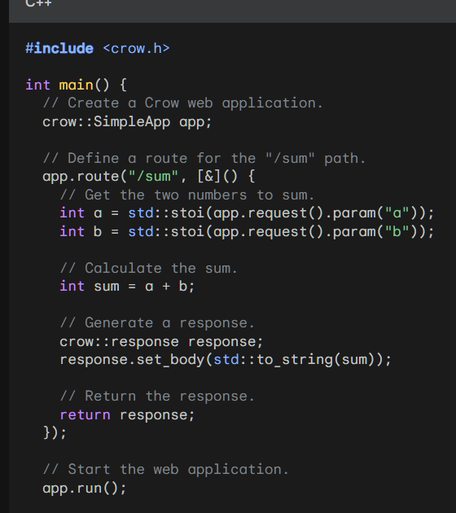
Example #2
This web application will return the sum of the two numbers a and b when a request is received for the "/sum" path. The two numbers can be specified in the request parameters.

