Slide 1


Enterprise AI Skills in Practice
Part II – AI is a Team Sport
Notes:
Title
Tonight is about what actually makes AI work inside a company.
Start with the Stanford evidence, then get practical.
Set the tone: honest, useful, no hype.

Slide 2
Ray’s Team Slide
Notes:
AI is a Team Sport
Ray: "AI is a team sport. The Stanford study and others point to the role of the sponsor in driving initiatives first-hand. But even with a strong leader, there can be concerns under the surface. How do we diagnose that?"

Slide 3
AI IS A TEAM SPORT
F A K T S
FEAR
AGENCY
KNOWLEDGE
TRUST
SELF- INTEREST
Notes:
FAKTS
Arman: Building a high-performance team means understanding what people are worried about and working through it with them.
That is where performance comes from — coaching the team, not managing or appeasing it.
Five things to track: FAKTS. Fear is what you see.
The other four are why: Agency, Knowledge, Trust, Self-Interest.
The first three you can resolve. The last you can only name.

Slide 4
Leadership
ROI
Fear
Managers
CONTROL
Staff
LIABILITY
Frontline
LAYOFFS
Notes:
Fear
Ray: "Let's start with Fear. Different roles fear different things. Leadership fears unproven return. Middle management fears being bypassed. Legal, HR, Risk fear the blame. Frontline fears layoffs. How do we address fear?"

Slide 5
AI IS A TEAM SPORT
Agency
Knowledge
Fear
Trust
Self Interest
Notes:
Fear
Arman:
Arman: Fear is the presenting symptom. When someone resists, what you see is fear — of blame, of losing control, of being made redundant.
But fear has different roots:
Agency — "I have no say" → loss of control.
Knowledge — "I don't understand it" → the unknown.
Trust — "I don't believe it works" → being let down.
Self-Interest — a purely selfish motive. The one root with no response.

Slide 6
AI IS A TEAM SPORT
Agency
CO-CREATION
Notes:
Agency
Ray: "People accept change they can't avoid, but acceptance isn't agreement — the resentment stays under the surface. How do we deal with that?"
Arman: People want a voice, and to understand why.
That is dignity. The response is co-creation: a hand in shaping the new way, with their expertise setting the rules.

Slide 7
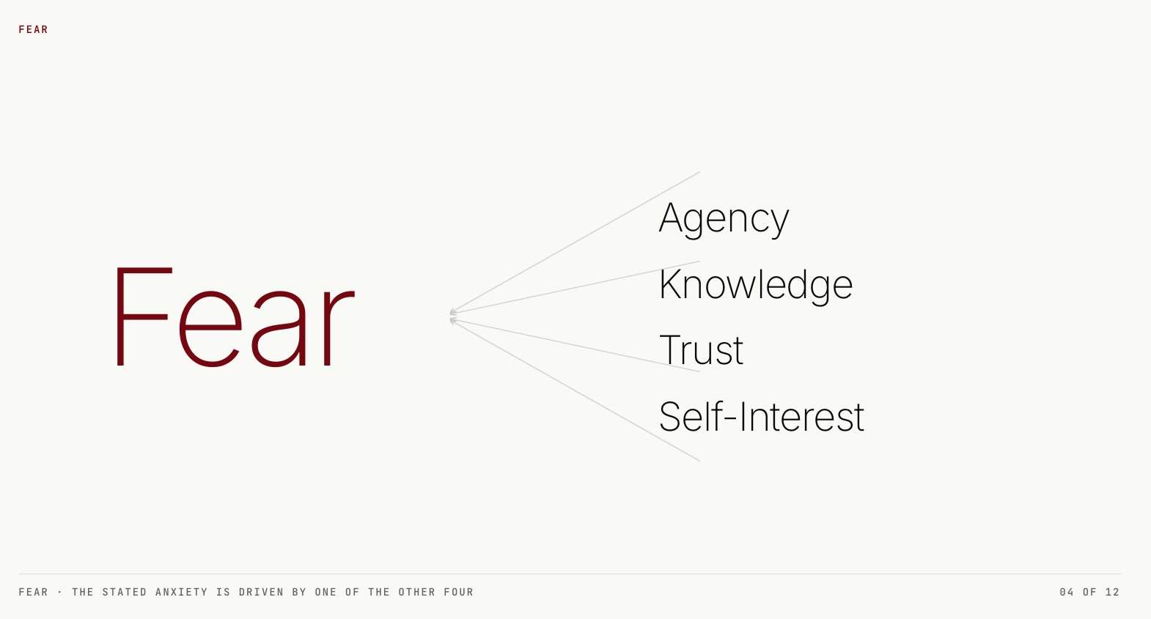
AI IS A TEAM SPORT
Knowledge
TRAINING
Notes:
Knowledge
Ray: "This one seems the most fixable of the four."
Arman:
BCG: about 69% of people build skill fastest from capable colleagues.
Training works best hands-on, in your own workflow — learning what the tool does well and where it fails.
It is the floor, and Trust stands directly on top of it.

Slide 8
AI IS A TEAM SPORT
Trust
CALIBRATION
Notes:
Trust
Ray:
And from the research — what actually builds trust in these tools?
Arman:
Trust is earned one way: by showing it works, in real work, again and again.
Not by telling people it's reliable — by letting them watch it perform and check it.
Stanford: every successful deployment was built iteratively. That is calibration.

Slide 9
AI IS A TEAM SPORT
Self-Interest
?
Notes:
Self-Interest
Arman: Self-Interest is the one root we can't resolve. The others are about the seat — anyone in it would feel the same.
Self-Interest is personal, and it would vanish if someone else held the seat. You can't co-create or train it away. You name it, and you stop.

Slide 10
AI IS A TEAM SPORT
Agency
Knowledge
Fear
Trust
Self Interest
Notes:
RECAP
Ray: So although addressing people’s fears is the hardest problem, there appears to be a systematic process to identify the sources of concern.
Arman: Yes. It all manifests in different types of fears. To understand the source we need to explore if the fear is driven by Agency, Knowledge, Trust, or Self Interest. The process is actually not hard, but it does take time to understand and address peoples fears.

Slide 11
AI IS A TEAM SPORT
AI IMPLEMENTATION INTERVIEW GUIDE SKILL EXAMPLE (PAGE 1/2)
Approve
Build
Run
Use
Data-egress
INFO SECURITY
Model-validation
MODEL RISK
Conduct & fair-lending
COMPLIANCE
Liability & disclosures
LEGAL
Residual-risk acceptance
ENTERPRISE RISK
Go/no-go
SPONSOR
Build the data-protection architecture
ENGINEERING
Escalation & fallback to a human
OPERATIONS
Real Adoption AGENTS &
CUSTOMERS
Notes:
Skill
Ray: ”Can AI help with diagnosing people issues?”
Arman: We have developed a skill to map the gates — who holds a checkpoint over the deployment. Not by rank, but by role: who approves, builds, runs, uses. Watch "staff functions" become six distinct gates, each with its own risk and its own conversation. For each gate, Claude gives you what's at stake, the open questions to ask, and a private key for reading the root. You walk in prepared. The reading stays yours.

Slide 12
AI IS A TEAM SPORT
AI IMPLEMENTATION INTERVIEW GUIDE SKILL EXAMPLE (PAGE 2/2)
Information Security Example
WHAT'S AT STAKE
KEY QUESTIONS
A cloud assistant moves customer data across the firewall, and a breach on that path lands on this seat. Under consent orders, the tolerance is near zero.
Listen for what’s driving Fear: Agency, Knowledge, Trust, Self-interest
Notes:
Skill
Ray: ”Can AI help with diagnosing people issues?”
Arman: We have developed a skill to map the gates — who holds a checkpoint over the deployment. Not by rank, but by role: who approves, builds, runs, uses. Watch "staff functions" become six distinct gates, each with its own risk and its own conversation. For each gate, Claude gives you what's at stake, the open questions to ask, and a private key for reading the root. You walk in prepared. The reading stays yours.

