Slide 1


Design and Implementation of Mobile Applications
prof. Luciano Baresi
COVTRACK
Marco Gelli
901470
Notes:
Hi everyone I’m Marco Gelli and my project is called CovTrack.

Slide 2

Goal
Support regional and state authorities in the fight against the spread of the Covid-19 virus through the voluntary monitoring of citizens’ movements
Notes:
CovTrack is a cross-platform mobile application whose main goal is to…
… and help these last ones in the trip management process during the lockdown.

Slide 3
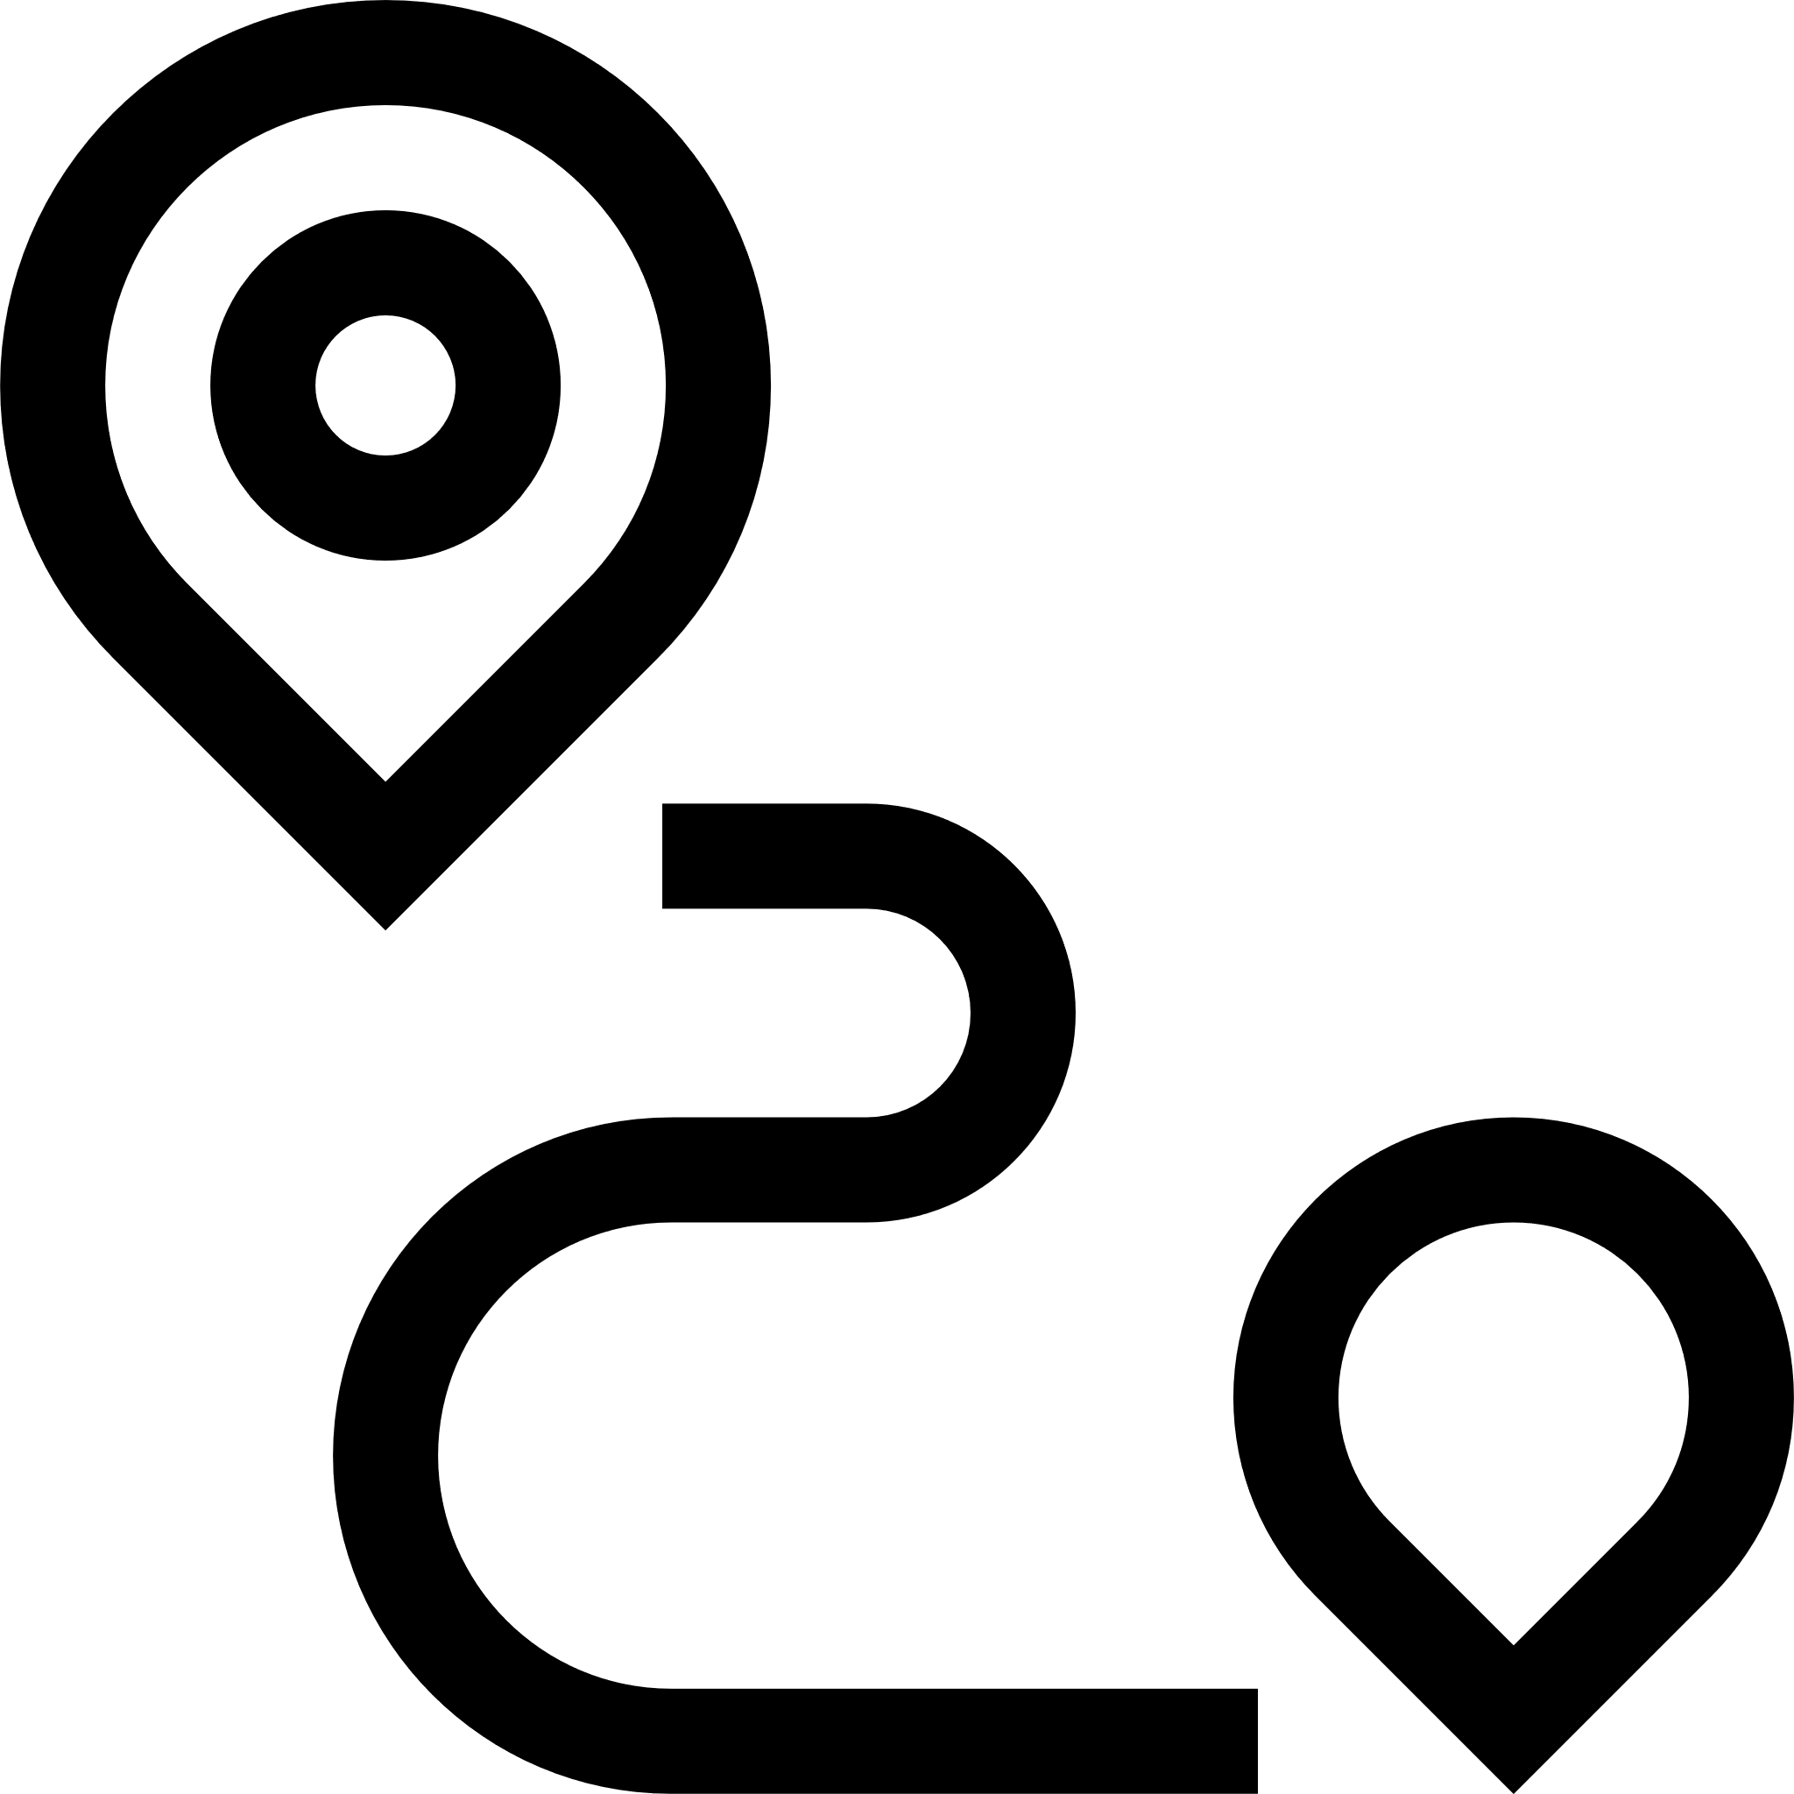
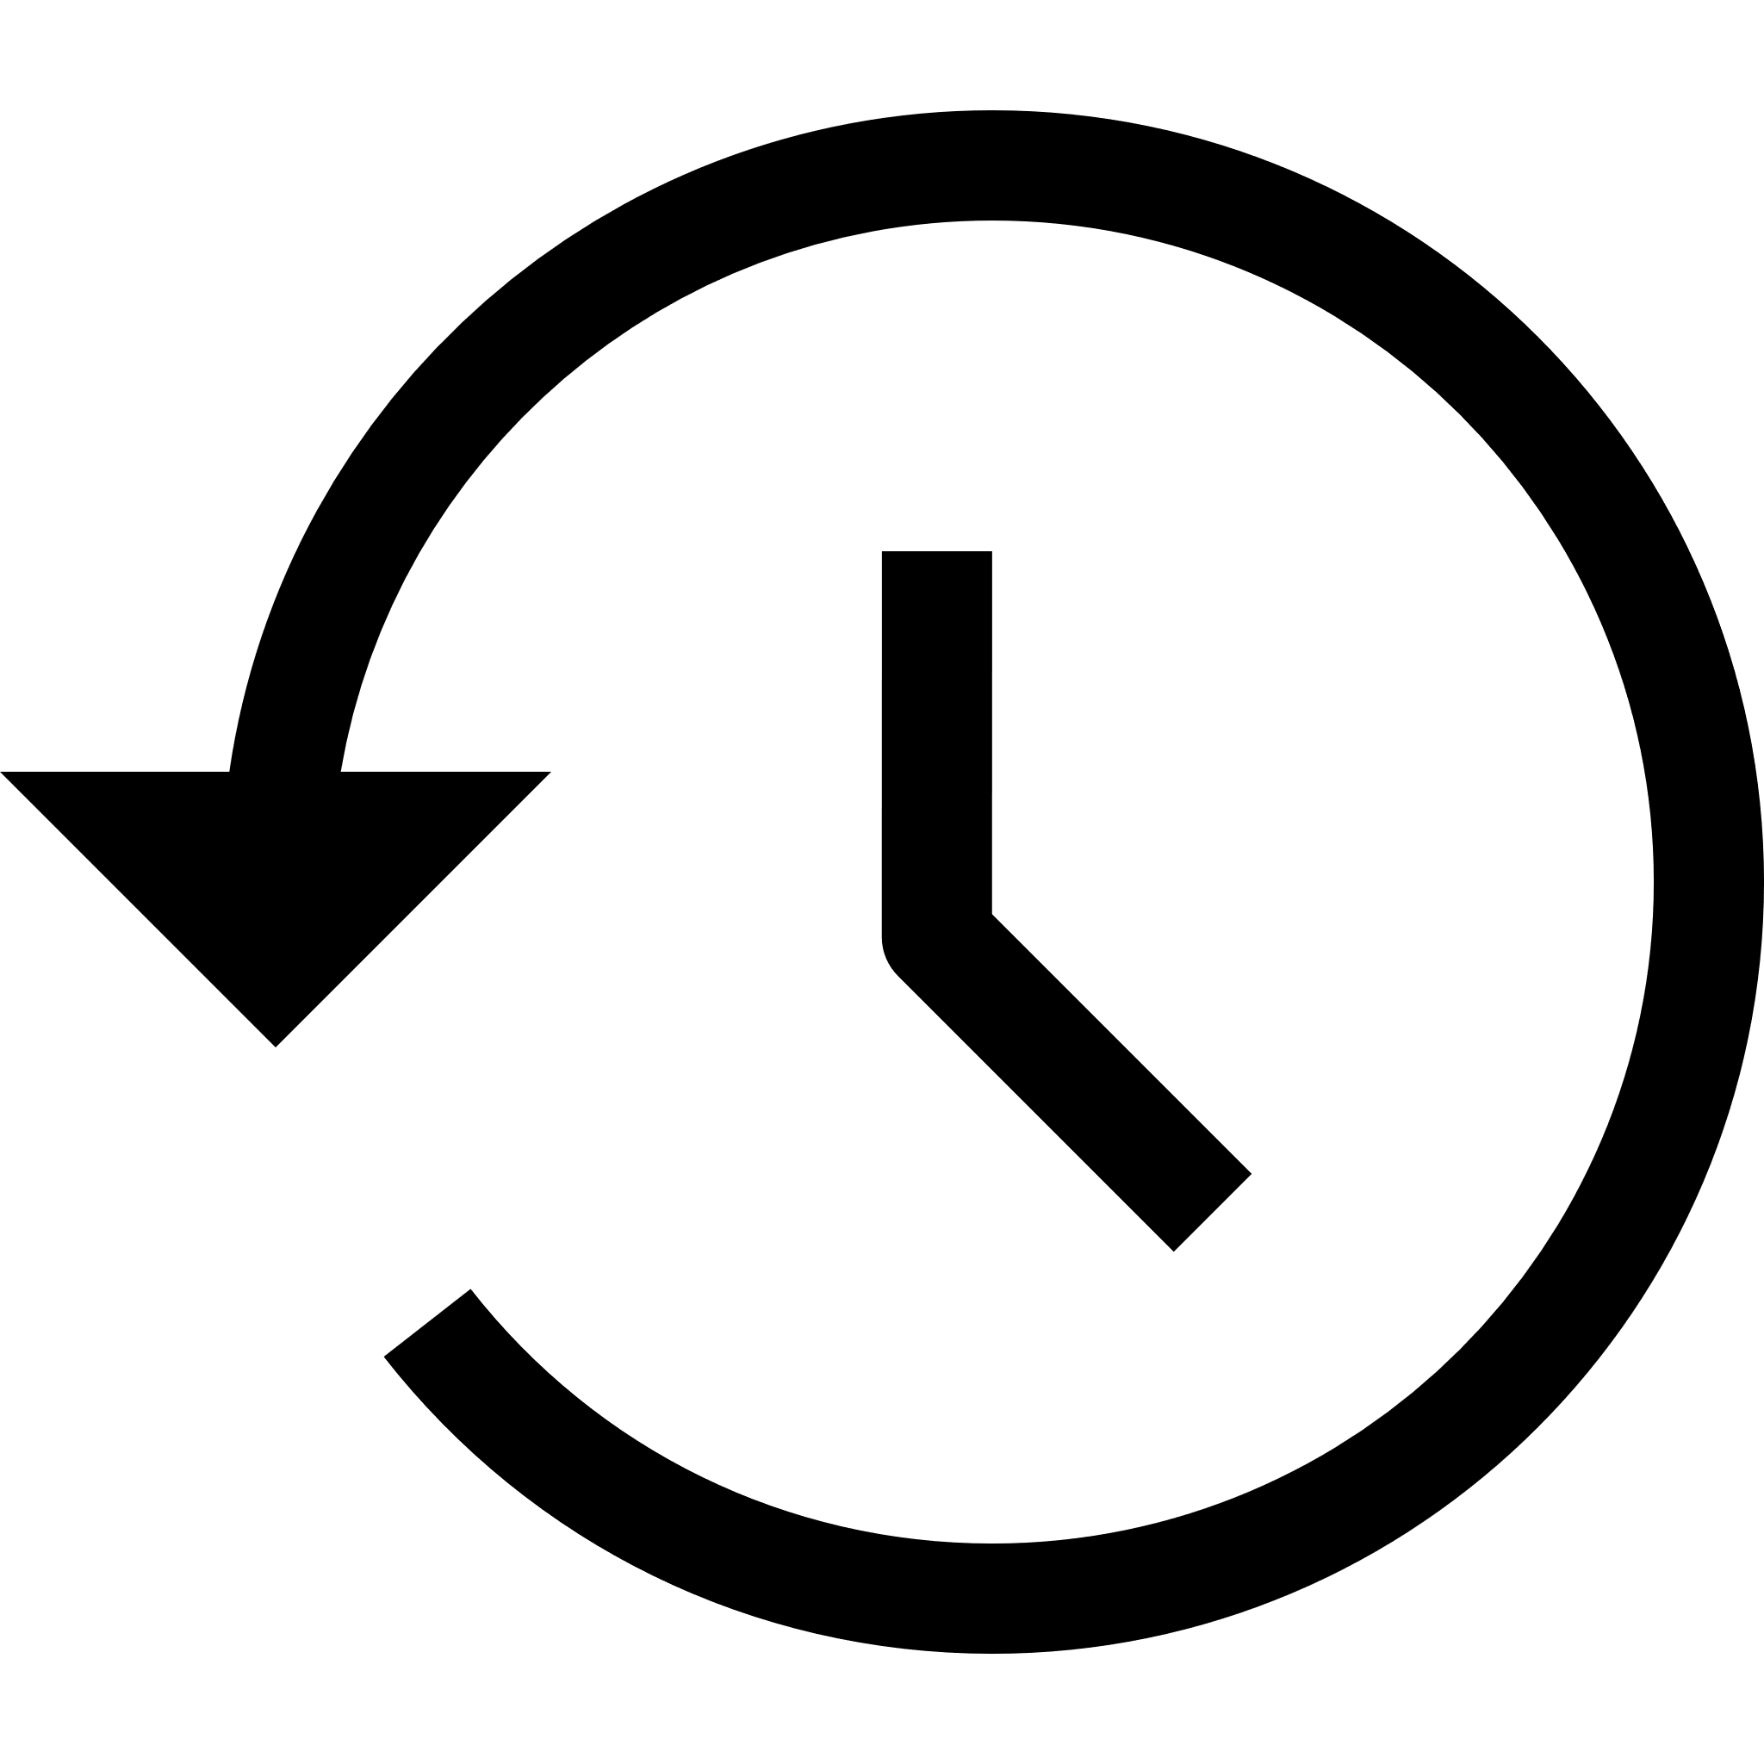

Core Features (1/2)
Easy trip management
Guided creation process
Pick the destination using a search bar or an interactive map
Easily stop the active trip or start the return one
Old destinations browsing
Browse a list of all the destinations reached in the past
Start a new trip with the same destination
Fine-grained control
During an active trip, every time the user stops, the application saves the coordinates of the geographical point
Notes:
The main features of my application are the following ones. At first…
…Secondly…
…Moreover…

Slide 4


Core Features (2/2)
News
Statistics on the evolution of the pandemic
Local news
Global news
Settings
Change app color theme (light / dark)
Change account password
Delete account (and all the saved data)
Notes:
Besides the features regarding the trips management, CovTrack provides the user with statistics on the evolution of the pandemic.
Finally the user

Slide 5






Secondary Features
Easy authentication
Login / register with e-mail and password
Login with Google account
Internationalization
Multi-language support (English & Italian for now)
Onboarding
The first time the user launches the application, the main features are explained

Slide 6



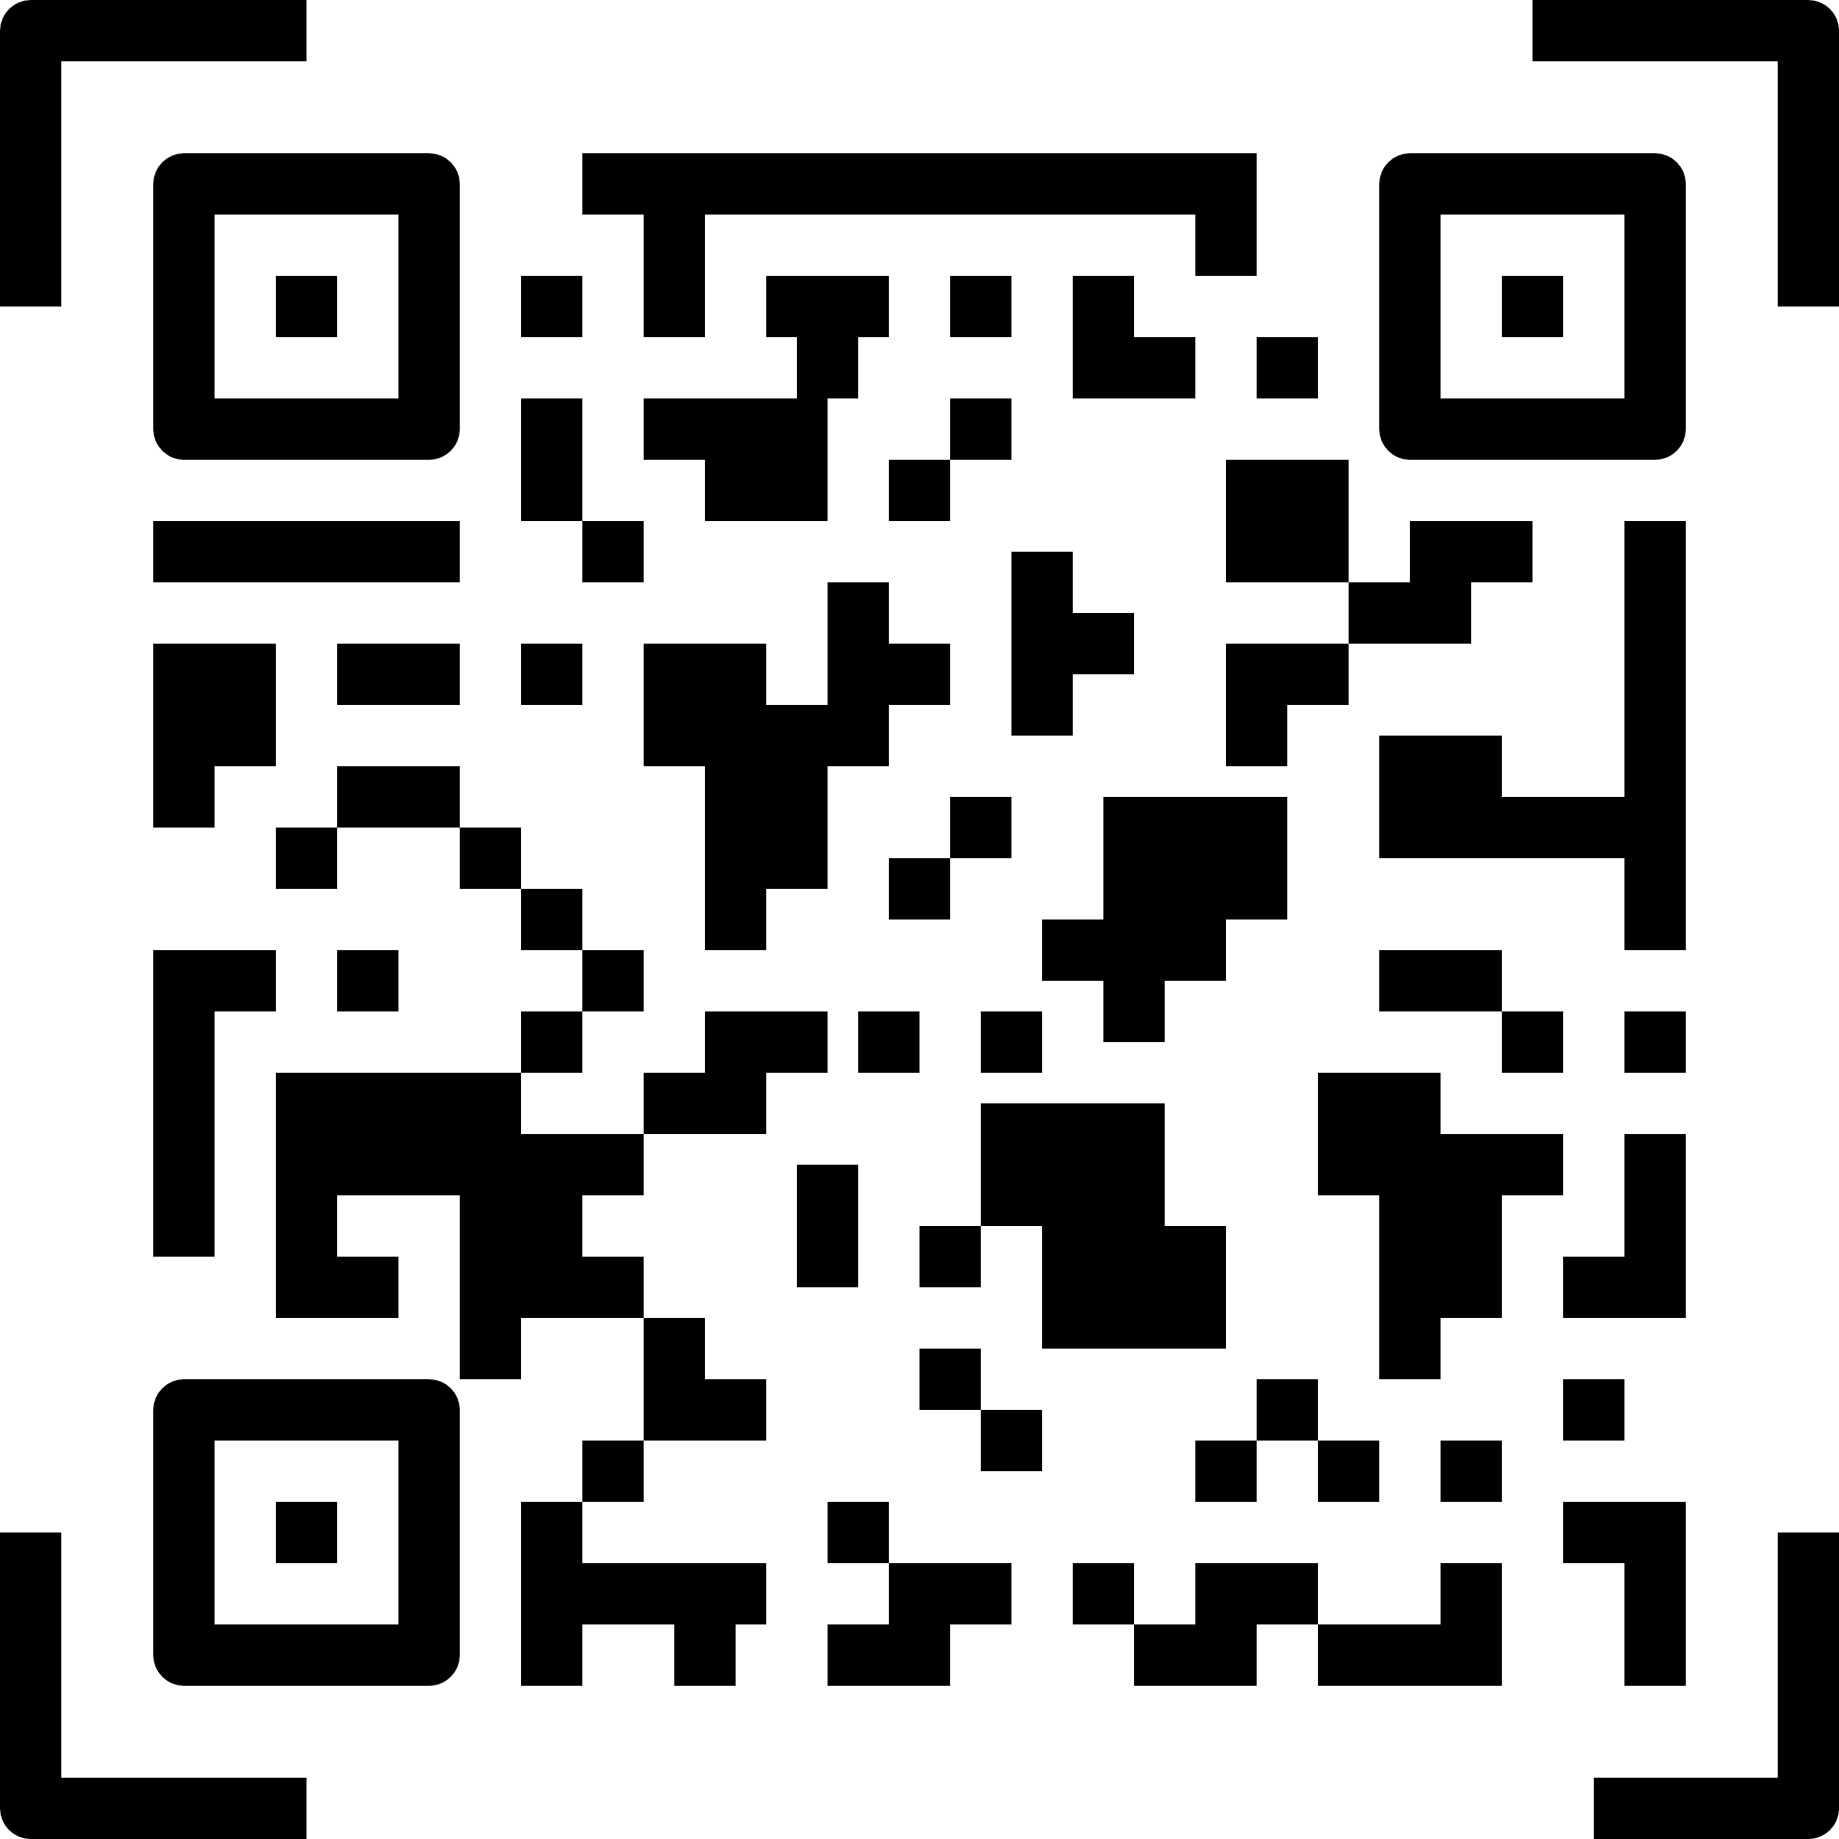

Advantages
Digital self-certification form
The application completely replaces the paper version of the self-certification form
Control phase speed-up
Authorities can scan citizens’ movements faster by simply scanning a QR Code
Data collection
Trips data saved in a remote database: statistics, analysis and data processing
If a user is found positive, it will be possible to trace his previous movements and meetings

Slide 7
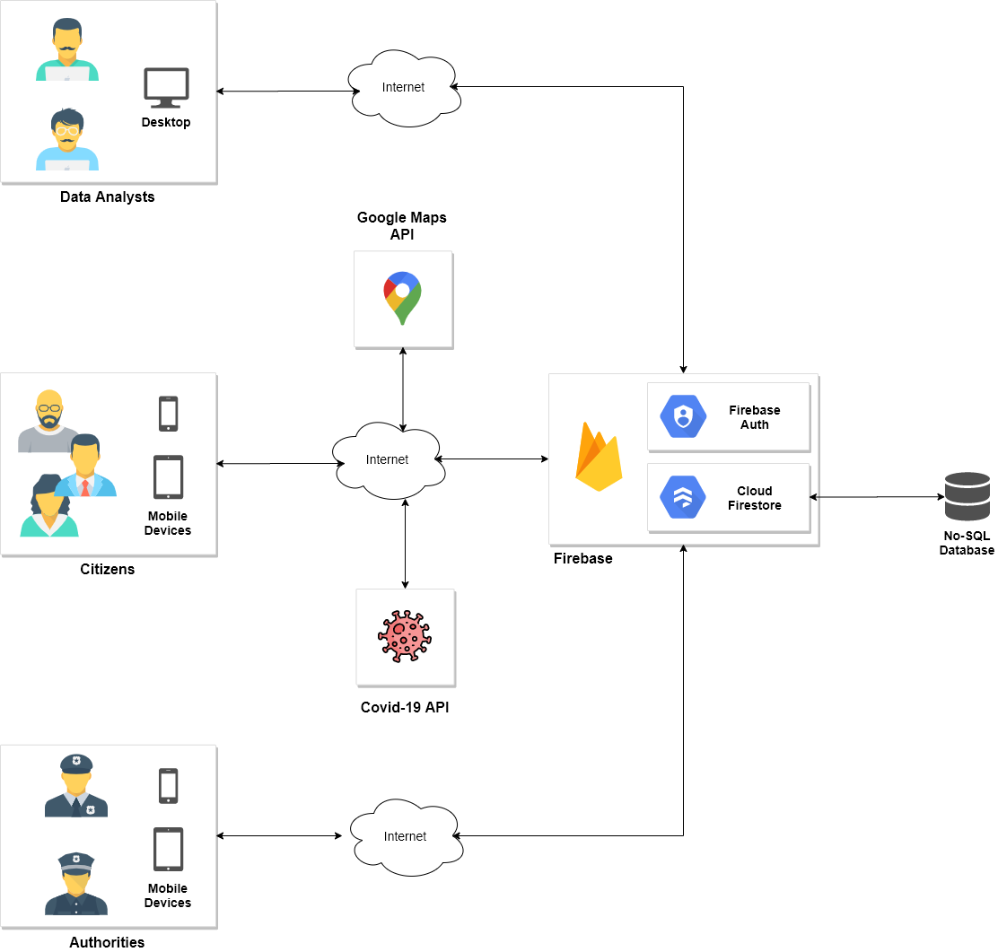
Architecture (1/4)
System Architecture
Front-End
Back-End
External Services
Notes:
Let’s talk about the application from an architectural point of view. For the purpose of the course I focused my attention on the development of the front-end mobile application used by the citizens, but CovTrack can be seen as a whole system that can be divided into three separate sub-systems:
Front-End: set of applications including a desktop application used by the data analysts to have insights on the evolution of the pandemic by studying trips data generated from citizens, CovTrack, the mobile-application used by the citizens and a mobile application used by the authorities to scan the QR Codes of users’ trips
Back-End: the system relies on Firebase, an external platform provided by Google which provides some services (authentication, no-sql database, cloud storage, …). To use these services you have to simply select the desired ones and configure them.
External Services: finally the system relies on two main external services: Google Maps API and Covid-19 API. I will explain these in detail later on.

Slide 8


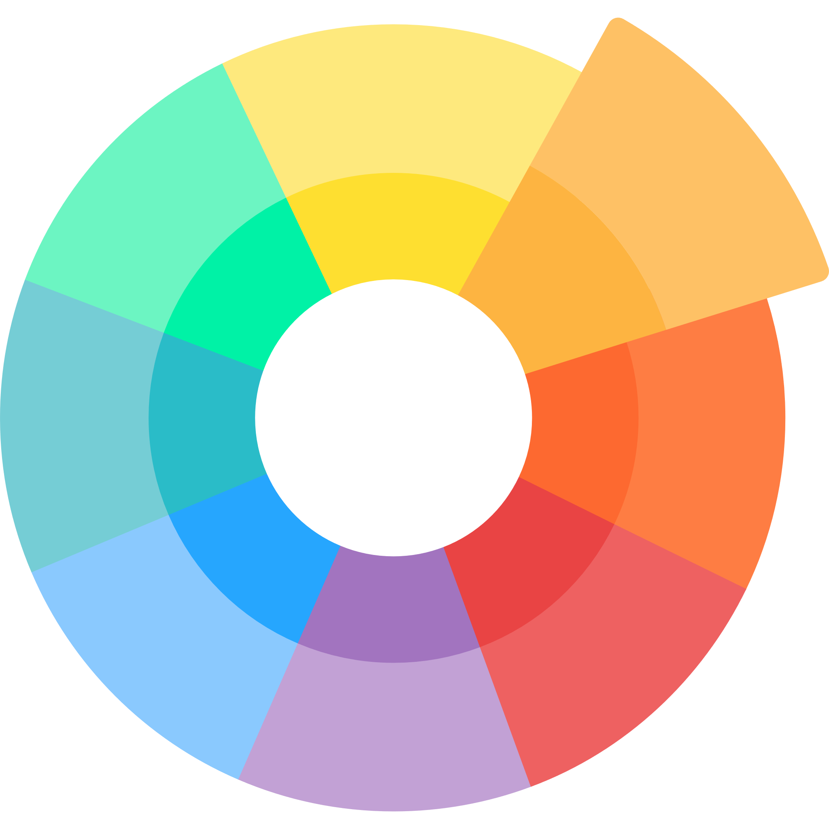
Architecture (2/4)
Front-End
Development Framework
One codebase, two markets reached
Fast-growing framework
Maintained by Google
Design
Intuitive UI & UX
Material Design guidelines

Slide 9
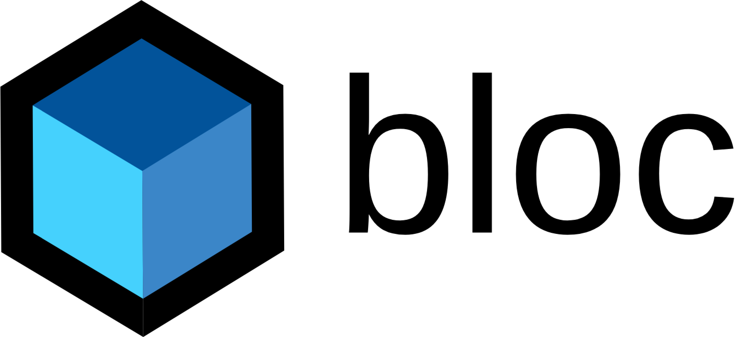
Architecture (3/4)
Front-End
State Management
States
Async Request
UI
BLoC
Data
Easy to separate presentation from business logic
Events
Async Response
Code modularity and re-usability
Presentation Layer
Business Layer
Data Layer
Screens & Widgets
BLoCs
Providers & Repositories
Easily testable
Handle user input and application lifecycle events
Render itself based on one or more BLoC states
Map events coming from the UI (generated by user input) with new states
Communicates with repository in order to build a new state for the UI to consume
Providers: provide raw data to the app
Repository: wrapper around one or more providers used by the BLoCs
Very well documented libraries

Slide 10


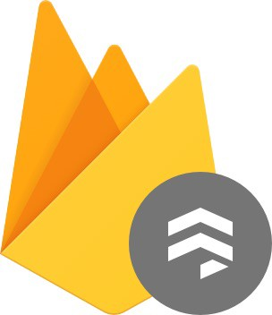
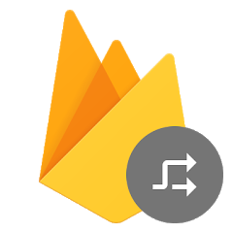
Architecture (4/4)
Back-End
Authentication
Cloud Firestore
Remote Config
Email-password authentication
Google account authentication
Change password
Delete account
CRUD operations on users’ trips data
CRUD operations on users’ reached destinations data
Store application API Keys and other settings
Notes:
As I said before the Back-End is completely managed using Firebase. In particular, the modules I decided to include in my project are the following:
Authentication
Cloud Firestore
Remote Config

Slide 11


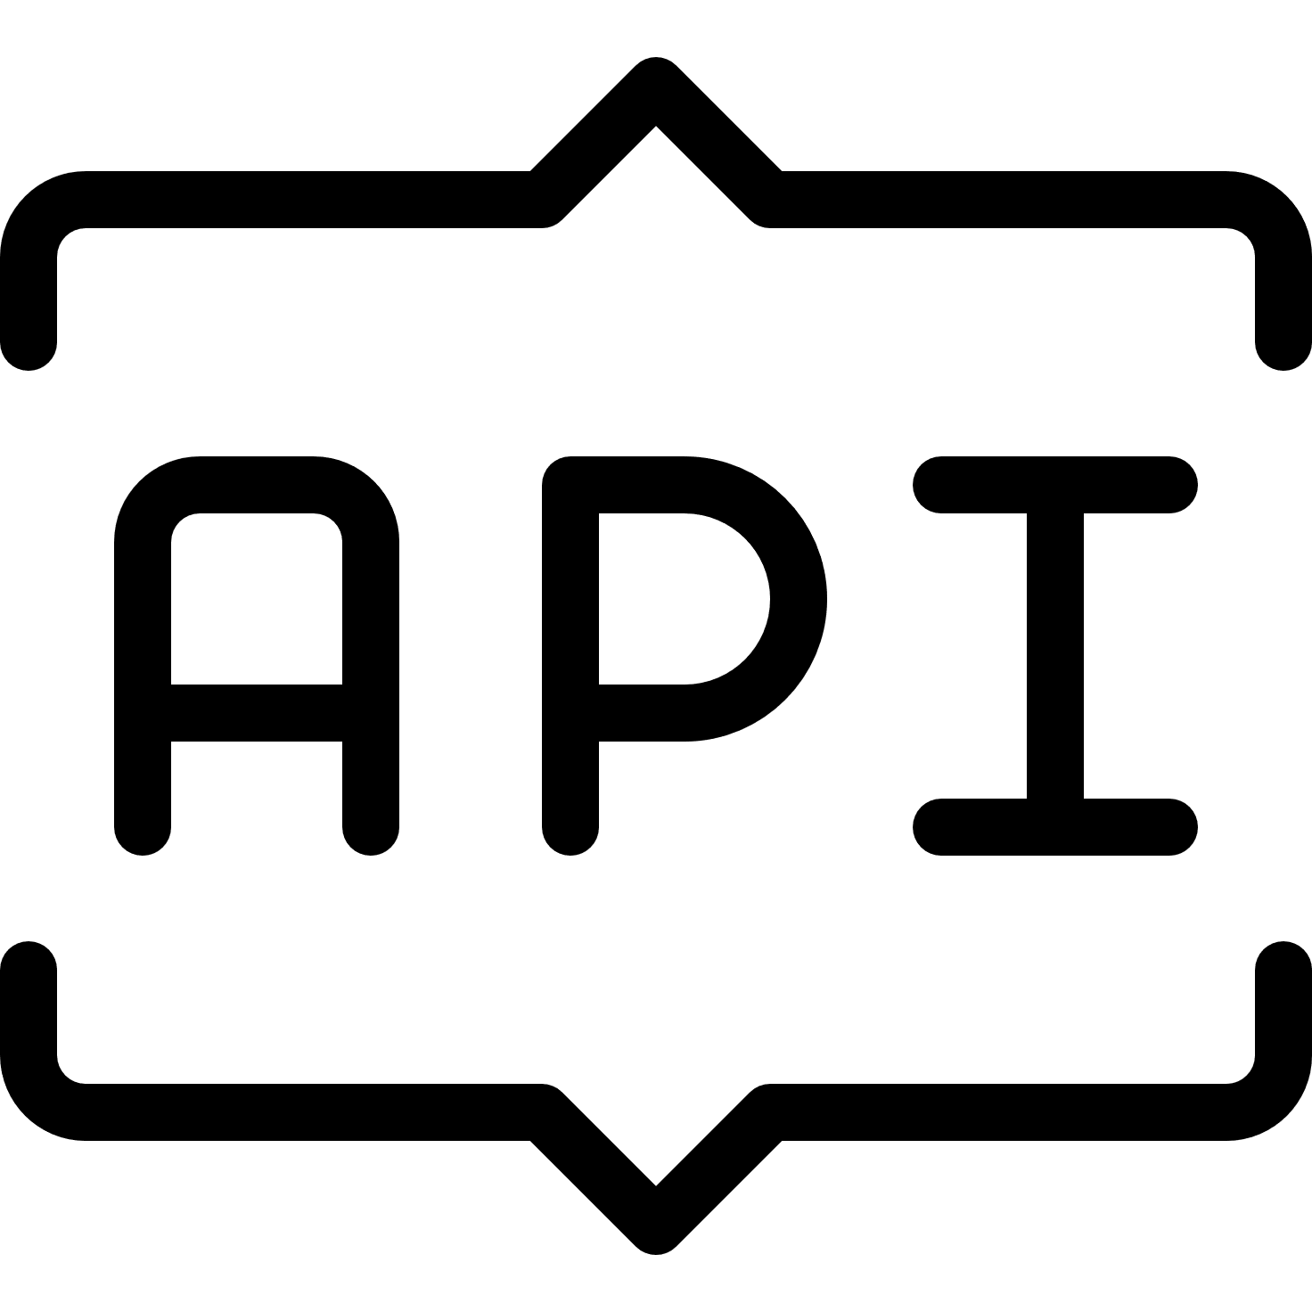
External Services
Covid-19 API
Google Maps APIs
News on the evolution of the sanitary situation in user's country and around the world
Places Autocomplete API
Place Details API
Reverse Geocoding API

Slide 12

Testing
114 tests in total
Under test:
Business Layer
Data Layer
Some utility classes

Slide 13

Challenges
Data modeling
Model the data managed by the application in order to be easily stored and retrieved to the remote database and later presented on screen
Declarative programming & state management
Being used to an imperative promming style, Flutter was completely new for me
Choose a state management solution between the many available ones
Testing BLoCs
Testing all the BLoCs of the application was not easy since there were many dependencies I had to learn how to mock them

Slide 14
Thank you for your attention and stay safe!

