Slide 1
CRP_Contracts
SOOMPAY_KOREA_CRP
개발 2팀
강 상 연

Slide 2
Contracts ○ Token Contract ○ CrowdSale Contract ○ Escrow Contract ○ Revenue Sharing Contract

Slide 3
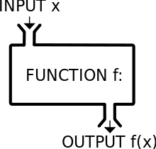
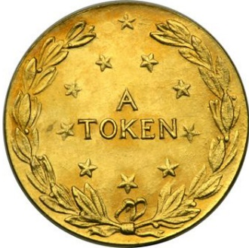
Token Contract
Input
Decimal
Supply
Owner
Name
Symbol
Function
- Token Transfer
- Token burn
- check balance
- Related Administrator
- Related lock
Create Token
Under CRP

Slide 4
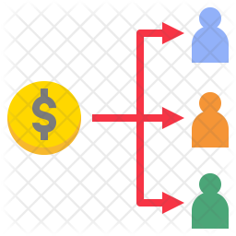

Crowd Sale Contract
Input
Expires
Token Address
CRP Wallet Address
Function
- Save Buyer Info
- Exchange Ratio
According to period
- Sale Status
- Transfer Token
- Related lock

Slide 5
Escrow Contract
Production team
Input
Token
Volume
TotalStep
Function
- Vote For Next Step
- Roadmap Settings
- Step State
- Transfer Token
- Payback from a vote
Permission
Crowd sale CRP Coin

Slide 6

Revenue Sharing Contract
Input
Date
Token.info
Revenue .info
Function
- Distribution According To Holding
Distribute to
Holder’s Wallet

