Slide 1
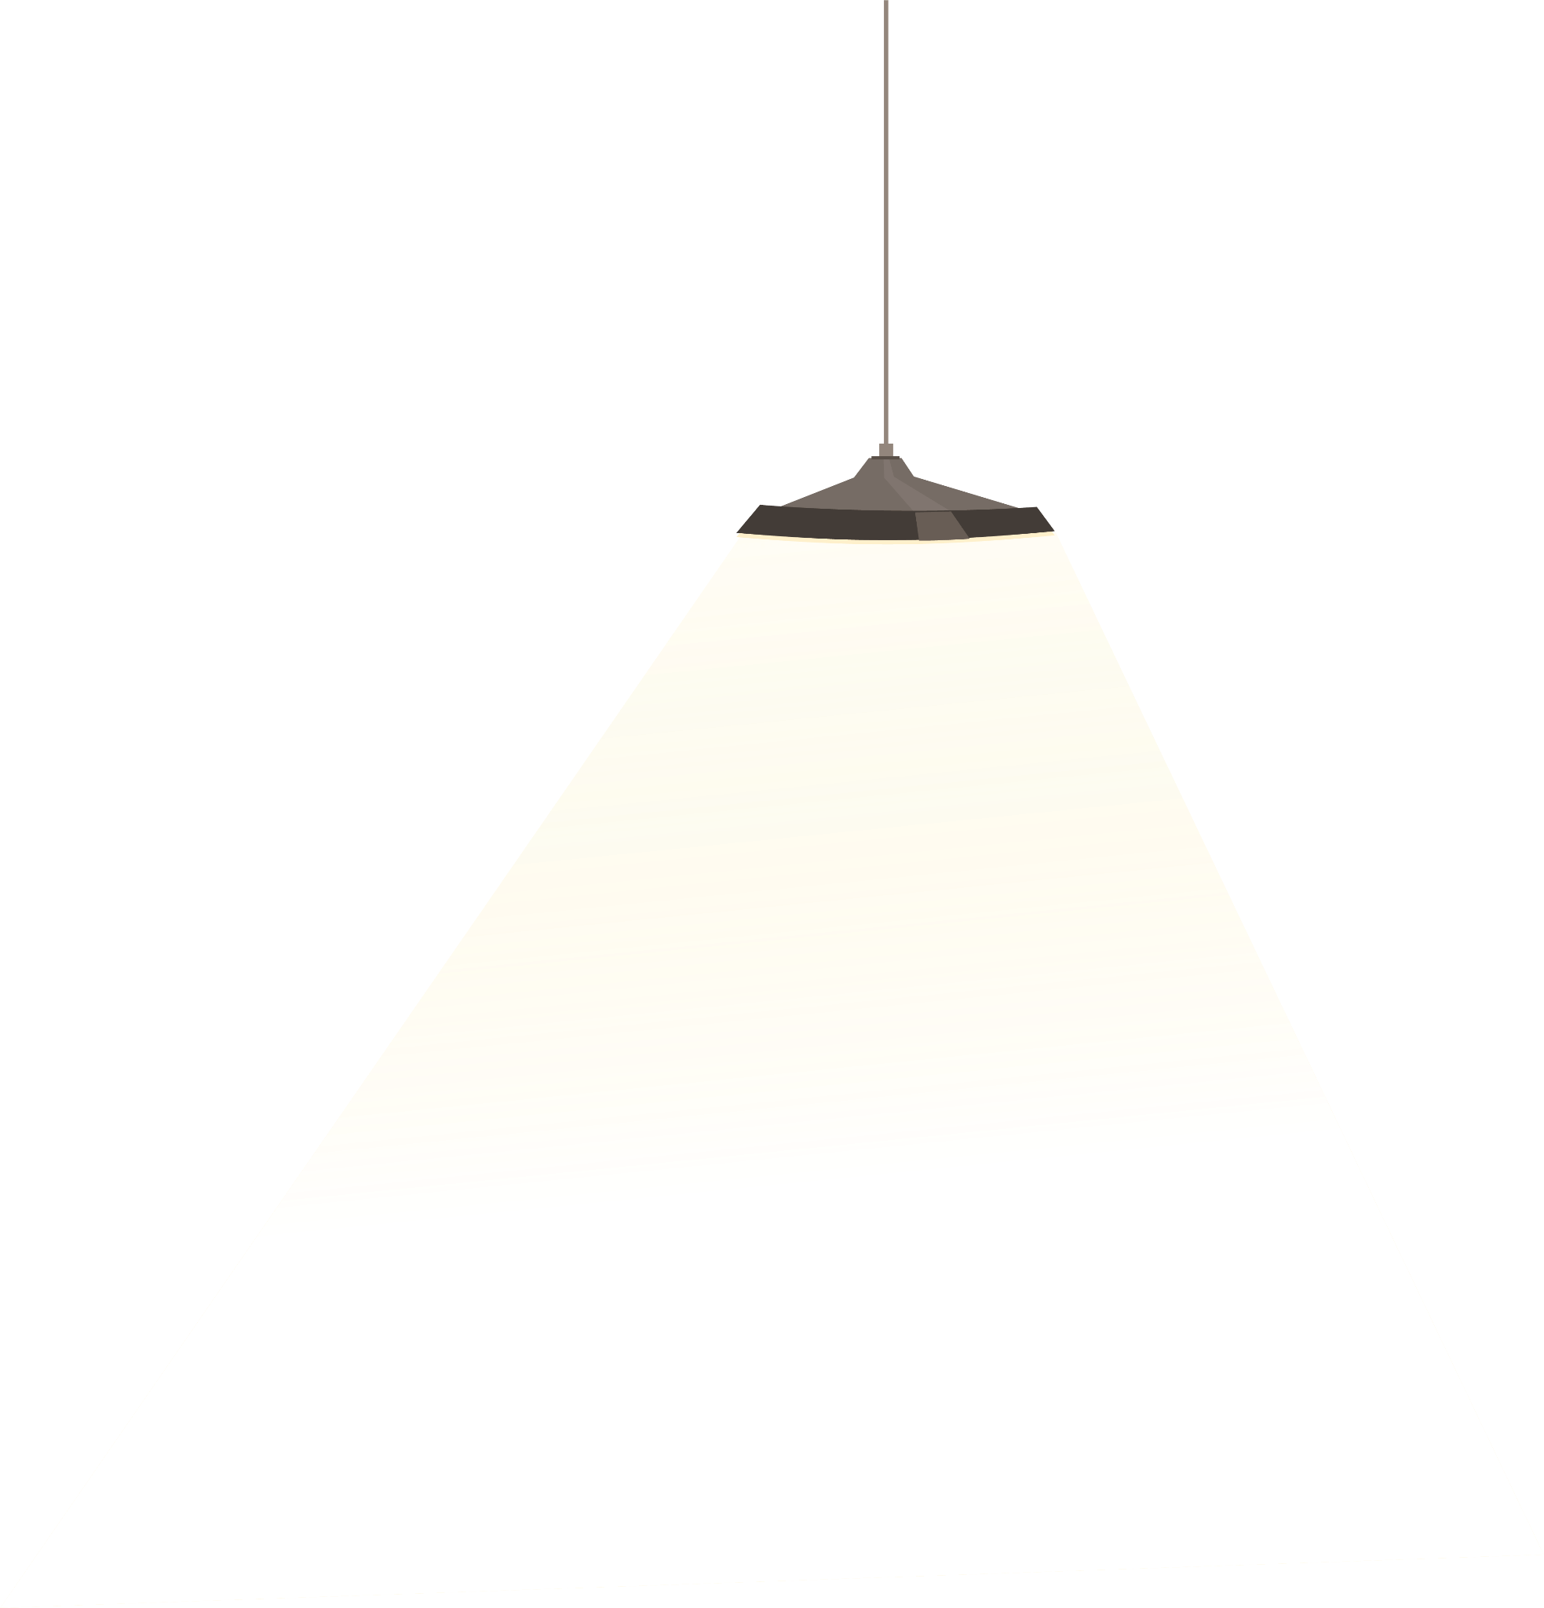

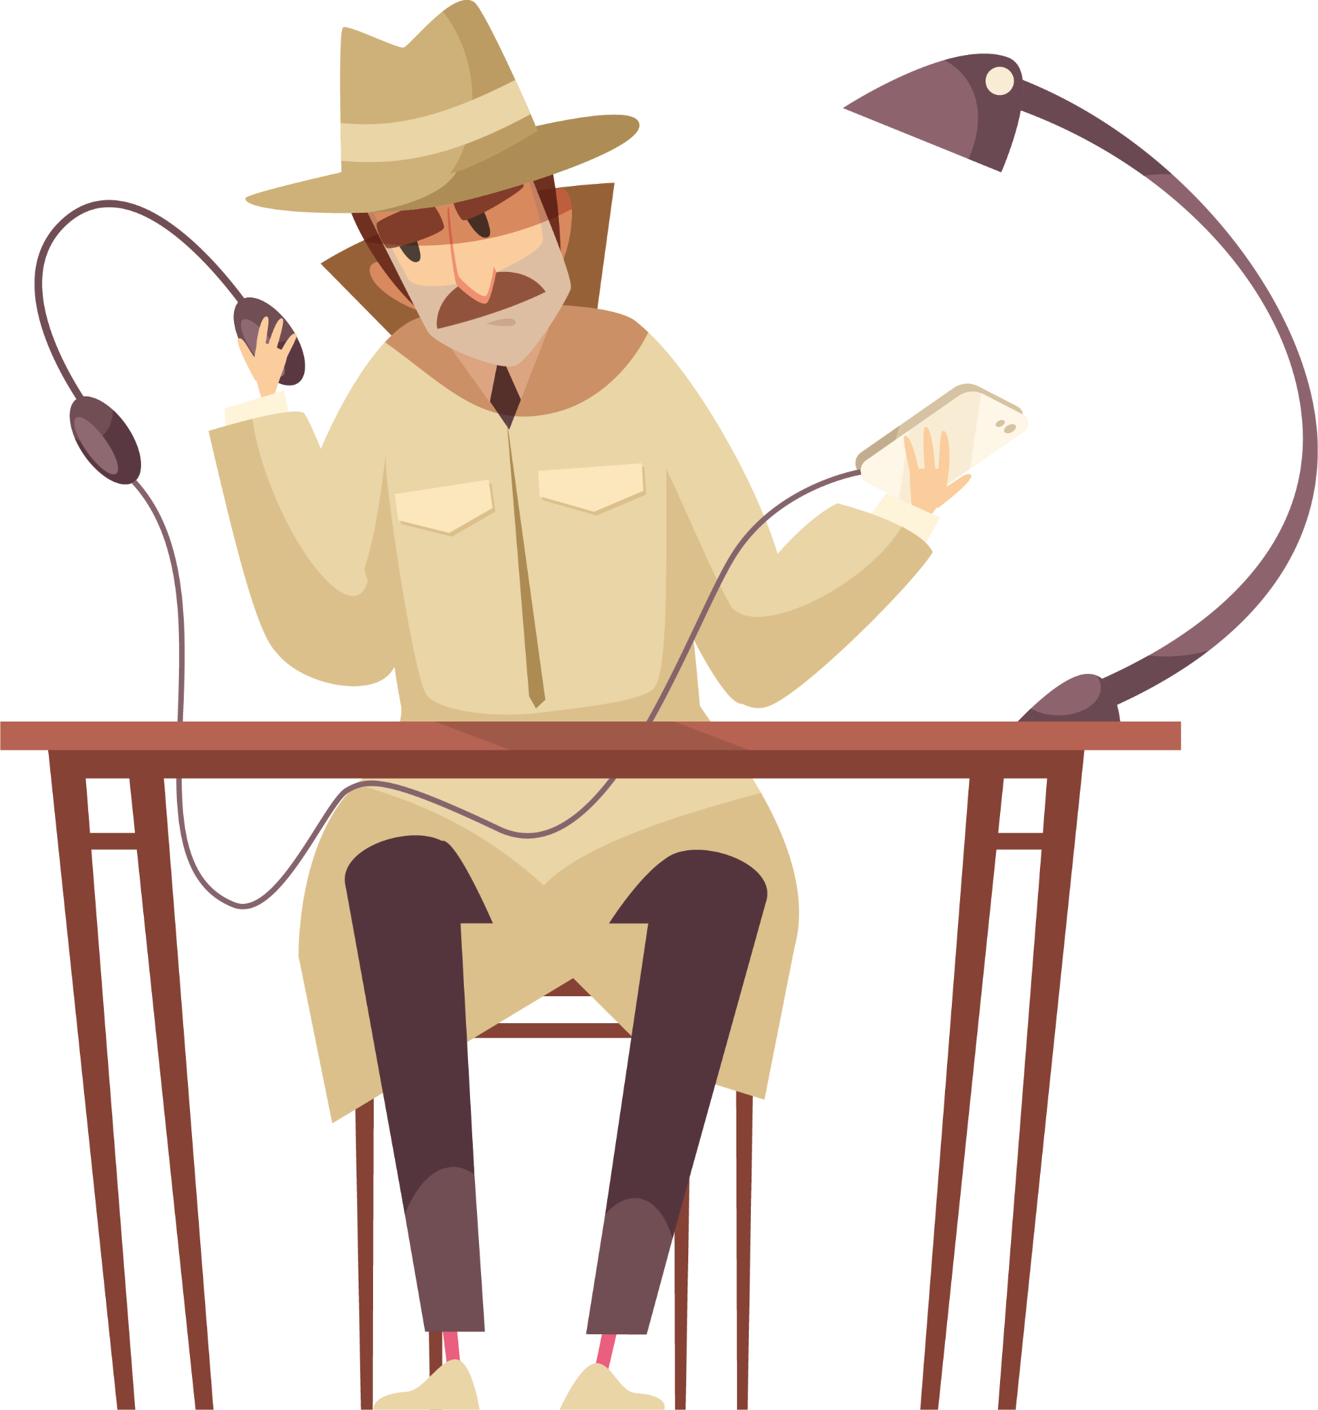
CRyptography
Sensei Glen | Code Ninjas

Slide 2
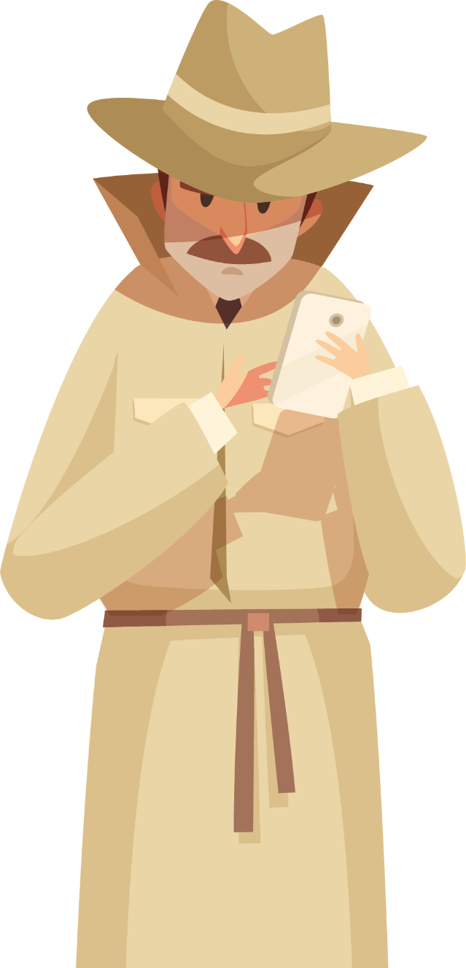
Ice-breaker
Do you like Detectives?
What is your favourite Detective/Crime Thriller movie?

Slide 3

TABLE OF CONTENTS
01
02
03
04
05
06
Crypto? Graphy?
How does it Work?
GOALS & STRATEGY
You can describe the topic of the section here
You can describe the topic of the section here
You can describe the topic of the section here
CONTENT PLAN
BUDGET
KPI OVERVIEW
You can describe the topic of the section here
You can describe the topic of the section here
You can describe the topic of the section here

Slide 4
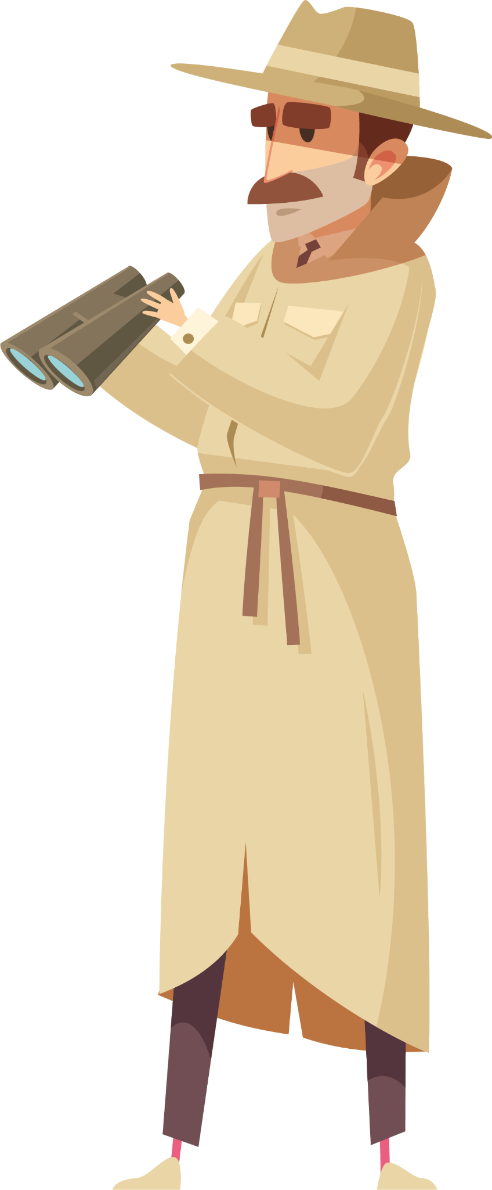
01
Crypto? Graphy?

Slide 5

RSA CRyptography
Cryptography is how we hide messages so only the right people can read them.
Why do we use it?
To keep secrets safe.
To stop others from changing information.
To prove who a message really came from.
How does it work?
We turn normal text into code (Encryption).
Only someone with the key can turn it back to the original text (Decryption).

Slide 6
Some examples of where Cryptography is used
Cryptography has a lot of applications. It is used in
Messaging (Whatsapp)
Online Banking
Video Game Accounts
Wi-Fi Passwords
And many more!
This is a screenshot from Whatsapp, indicating that communication is end-to-end encrypted.

Slide 7
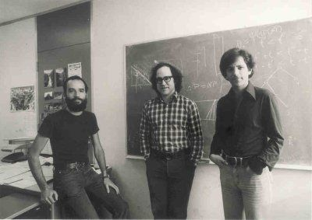
How did it start?
In the 1970s, people needed a safer way to send secret messages, especially as computers started talking to each other.
Three researchers at MIT – Ron Rivest, Adi Shamir, and Leonard Adleman came up with a breakthrough idea in 1977.
They created a system where you can lock a message with one key and unlock it with a different key. This became RSA, the first letters of their last names.
Today, the RSA Cryptosystem has massive usage, from banking to emails – keeping information safe and secure.

Slide 8
Some examples of where Cryptography is used
Cryptography has a lot of applications. It is used in
Messaging (Whatsapp)
Online Banking
Video Game Accounts
Wi-Fi Passwords
And many more!
This is a screenshot from Whatsapp, indicating that communication is end-to-end encrypted.

Slide 9

John Perry Barlow
“When Cryptography is outlawed,
bayl bhgynjf jvyy unir cevinpl.
(Only Outlaws will have privacy – in ROT13)”

Slide 10

02
How Does It Work?

Slide 11
Locks And Keys
Public Key = Padlock Private Key = ONLY key that opens the Padlock
Anyone can use your padlock (Public Key)
Only YOU have the private key.
You don’t share the private key with anyone, except with people you want to see the message.

Slide 12
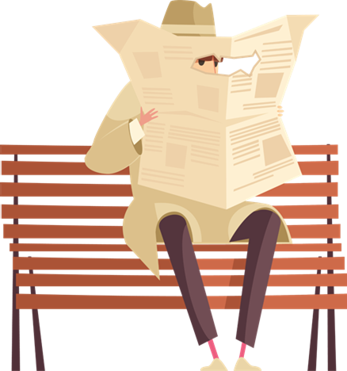
Prime Numbers
RSA uses Prime numbers to encrypt your messages!
Prime Numbers are numbers that are fully divisible by ONLY 1 and the number itself.
Example: 13 is only divisible by 13 and 1
23 is only divisible by 23 and 1
2,3,5,7,13,15,17,19,23,29,31,37… and so on, are ALL prime numbers!

Slide 13
The Math Behind it All!
Pick two LARGE prime numbers.
Mix them in a special math formula.
This creates two keys:
  Public Key (lock)
  Private Key (key)
To encrypt: raise a number to power e, mod n.
To decrypt: raise to power d, mod n.

Slide 14
Why Does It Work?
Why does this mathematically work?
Because…
Factoring HUGE numbers is extremely hard
With primes hundreds of digits long
Even supercomputers struggle!
It is like trying to find two needles in a stack full of
needles!

Slide 15
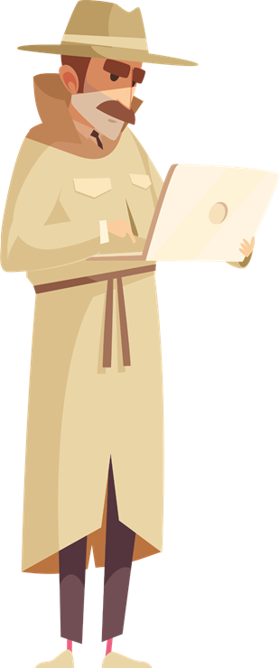
03
Hands On!

Slide 16
04
Conclusion

Slide 17
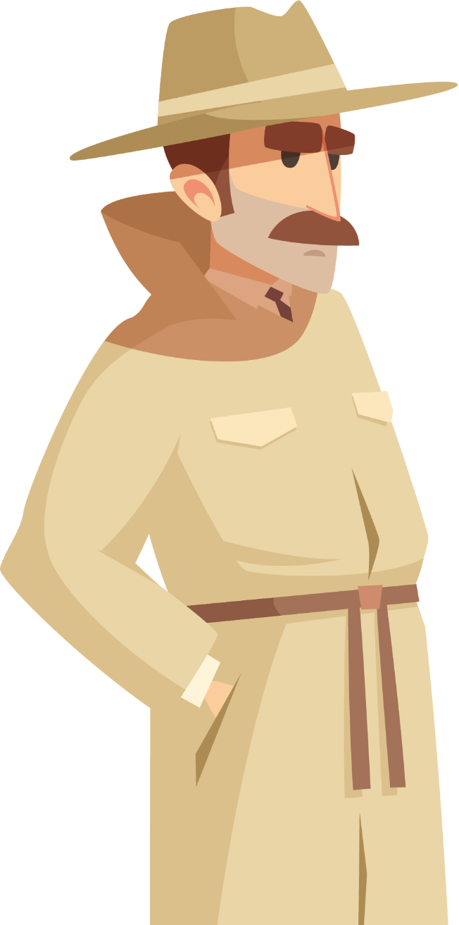
THANKS
Do you have any questions?
addyouremail@freepik.com
+91 620 421 838
yourwebsite.com
Please keep this slide as attribution

Slide 18

RESOURCES
1. Rivest-Shamir-Adleman Photo

