Slide 1



Cryptography - 2
Sensei Glen | Code Ninjas

Slide 2
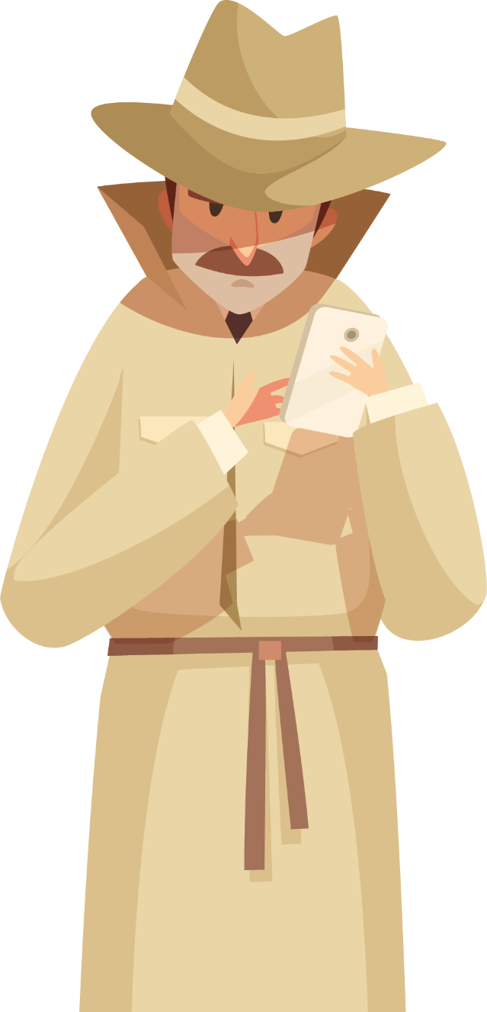
So Far..
We’ve learnt about:
Private Keys
Public Keys
How encrypting and decrypting works
How to GENERATE our own Keys!
Decrypting each others’ names

Slide 3
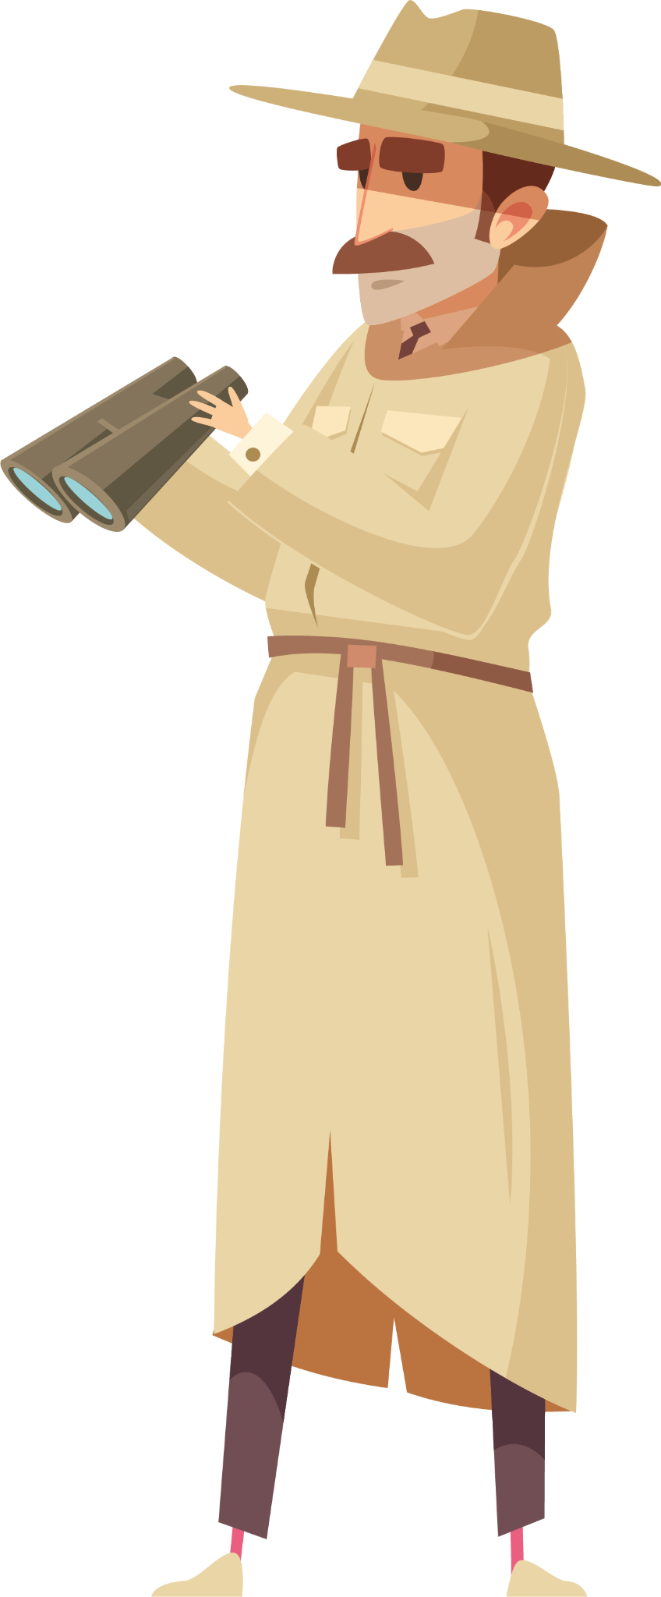
01
What About some Real Life Examples?

Slide 4
Checking Our Browser’s Cryptography in Action
Everyday websites use cryptography to ensure hackers don’t get your information easily, and to help internet users surf websites without worrying about data leakages.
One such example is Google (but you can go to any website, really) which shows you your encryption key, but smartly keeps the private key hidden!
Google uses an SHA-256 encryption which works with a hash function.

Slide 5
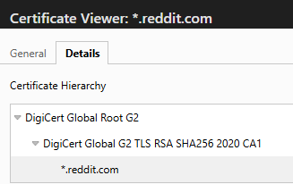
A Few More Examples
Even though Google uses SHA-256, a lot of websites use different methods of encryption, depending on user needs.
One such example is Reddit, which uses a combination of RSA, TLS (Transport Layer Security) and SHA-256 (Secure Hash Algorithm) to ensure extra safe browsing on the platform!

Slide 6
Activity!
I want all of you to:
Go to your favourite website
Try and spot the Encryption (Public) key, and what kind of cryptosystem is in use for the same.
After this, find at least 2 websites using either RSA, TLC, or SHA-256.
Let a Sensei know once you’re done!

Slide 7

Awesome Work!
We see that Cryptography has large scale applications in the real world, especially to keep our information safe.

Slide 8

02
Signatures!

Slide 9
How Do We Know who the Sender Is?
So we’ve figured out how to encrypt messages. However, how do we Verify if it is actually sent by the right person?
This is where RSA Signatures come in.
Encryption keeps messages secret, but Signatures prove people are real.
If I sign something with my private key,
Anyone can check the signature with my public key
But only I could’ve created it..
It proves that the message is authentic and is actually sent by me.

Slide 10
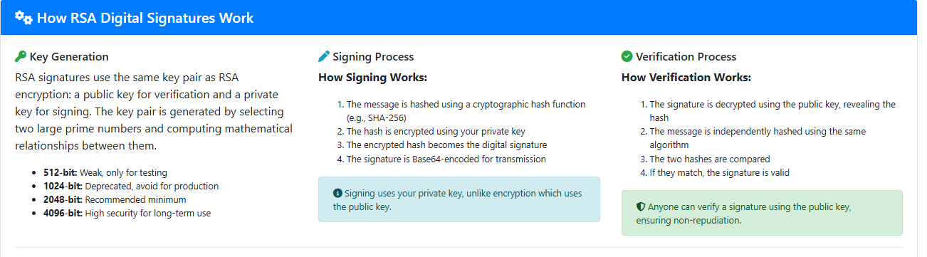
Let’s Learn with an Activity
Look to your Python Notebook, there are a few links for activities!
The first one leads you to the Signature Verifying website, where all of us can play around with exchanging messages.

Slide 11
Signatures Protect you From:
Fake Websites
Malware Pretending to be apps
Tampered Files
Impersonation
Inaccurate Information

Slide 12

03
Steganography

Slide 13

Steganography – What is it?
Steganography is the practice of hiding a message inside of something that looks normal.
We’re not scrambling the message, that would be encryption.
We’re simply hiding it into, say for example, an image!

Slide 14
Steganography – What is it?
You could hide text inside of:
images
audios
a PDF
and the file would look the exact same to the human eye.

Slide 15
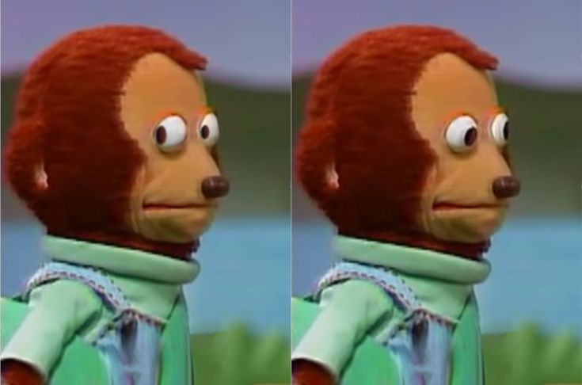
But….
If you knew how to extract the data somehow…
The secret message appears!

Slide 16

SteganoGraphy Activity
Let’s now look to our Python Notebook and follow the Sensei’s instructions on what to do with this peculiar image…….

Slide 17

04
Conclusion

Slide 18
So, What did we Learn Today..
Did a recap from last week on the RSA Cryptosystem
from last week on Python.
Explored a bunch of websites using different
Encryptions.
Discovered the idea of Verification and
Signatures!
Exchanged messages with Signing them!
Uncovering hidden messages in images through
Steganography!

Slide 19

THANK you
It has been an absolute pleasure teaching all of you!!
glenissac392@gmail.com
+1 (639) 554-5833
github.com/gelnerr
Please keep this slide as attribution

Slide 20

RESOURCES
Rivest-Shamir-Adleman Photo
Lebron James you are my Sunshine
Monkey looking away template

