Slide 1

Layout Testing using Galen

Slide 2
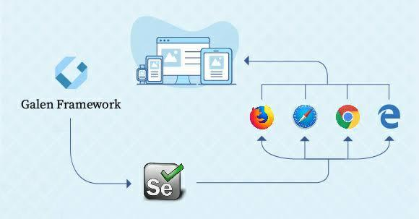
Galen Framework
Page specifications writing for multiple screen sizes
Visual testing with image comparison
JavaScript tests and structured reporting

Slide 3
Key Features
Galen a tool for cross-browser layout testing
Based on Selenium
Inbuilt HTML Error Reporting with screenshots for Pass and Fail
Multiple browser support for testing on various platforms
Supports functional testing
Can be integrated with Browser Stack, and Sauce labs
Has rich JavaScript API that gives you a chance to work with WebDriver specifically

Slide 4

Galen Specs
Easy to learn, read and write spec language to write layout test
Checks whether the element visible or not
Checks visible text displayed correctly
Checks alignment of the elements with respect to other elements as well as viewport
Image Comparison
Different tests can be made for each screen size.
Custom and complex test can be made

Slide 5

All checks
absent
near
above
below
inside
aligned
centered
color scheme
component
visible
text
on
width
height
contains
image

Slide 6
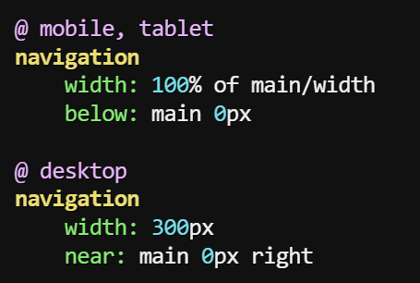
Example
Navigation panel should stretch on mobile and tablet devices and be located under main section. But on desktop it should have static width of 300px and be on the right side of a screen near a main section

Slide 7
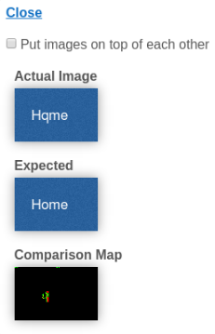
Image Comparison
Even if its Hqme instead of Home
Galen will catch it

Slide 8
Advantages and Disadvantages of Galen
Advantages
Inbuilt HTML Error Reporting with screenshots for Pass and Fail
Multiple browser support for testing on various platforms
Supports functional testing
Can be integrated with Browser Stack, and Sauce labs
Has rich JavaScript API that gives you a chance to work with WebDriver specifically
Disadvantages
Writing Spec sheets take a lot of time
Code maintenance is costly when there are lot of UI changes

Slide 9
What value will the POC add?
Galen makes Layout testing feasible so that we can test any break in Layout beforehand
Layout of a web page can be tested for different screen sizes

Slide 10

Thank You!

