Slide 1


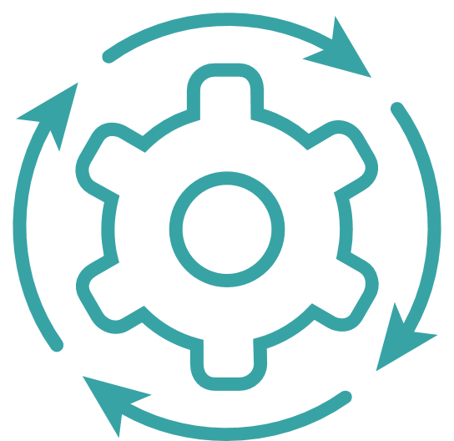
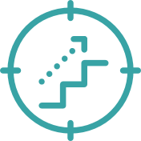



Speech & Text Translation across MENA languages
The model used is SeamlessM4T Model. This Model supports Speech to Speech, Text to Text, Speech to Text, Text to Speech and Automatic speech recognition.
Overview
Implementation
Results
Often while translation the literal meaning, and expression of the context is lost.
Fine tuning the model to give more accurate translation for MENA languages like Urdu, Persian, Turkish, Hebrew etc.
Model takes speech or text from a language as source language and translate to other language as target language.
Developed a model utilizing pre-trained LLM (Large Language Model) models that supports translation using speech and text as input in more than 100 languages and also for MENA languages like Urdu, Persian, Turkish, Hebrew etc.
Tech stack used are follow:
seamless_communication: A package/module for inference tasks related to translation.
Python,PyTorch,Torchaudio,Numpy
Gradio- for creating User Interface (UI)
Model accuracy of seamless model measured in terms of BLEU Score = 0.75 for the MENA languages, which can be further improved by training on application-specific dataset.
Use of current machine translation tools like Google Translate which are based on neural models with a transformer architecture might fail to translate the meaning when provided with long statements in a specialized business context.

