Slide 1

Trevor Lund
Engineer Extraordinaire

Slide 2
Education
High School Degree
  Dowling Catholic High School
  GPA: 4.17
  August 2006 – May 2010
Bachelor’s in Software Engineering
  Iowa State University
  GPA: 3.83
  August 2010 – May 2014

Slide 3
Experiences
Freshman Honors Program Leader
  Fall 2011
  Leadership, Event Planning, Organizational/Communication Skills
House President
  Fall 2011 – Spring 2012
  Leadership, Communication Skills

Slide 4
Technical
Languages
  Java
  C/C++
  VBA
Software
  Mac OSX, Windows
  Eclipse, Dev-C++

Slide 5
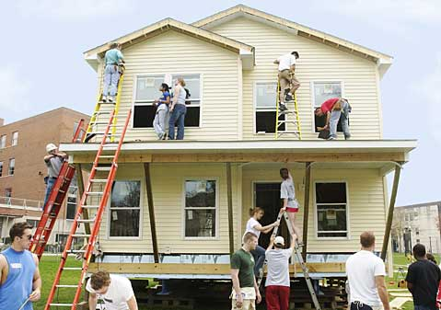
Other Activities and Awards
Habitat for Humanity
  Fall 2010 – Current
  Build houses for those in need
Eagle Scout
Service Cord

