Slide 1
IS for : Health Informatics application
Digital dentistry

Slide 2
abstract
This project aims to develop a tooth fracture detection app that can be used by dental professionals and patients. The app uses image processing and machine learning algorithms to identify fractures in teeth. The app also provides a user-friendly interface for dentists and patients to interact and share information about the detected fracture.
This project aims to improve dental diagnosis accuracy and facilitate the communication between dental professionals and patients.

Slide 3
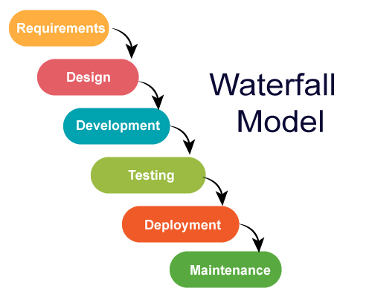
Methodology
Waterfall

Slide 4
Tools used
AI Model
1- Collab Notebooks
2- TensorFlow
3- Dataset of fractured teeth
Backend
1- ASP. Net core 6
Application
1- Flutter
2- Visual studio code
3- Android Studio
4- Dart

Slide 5
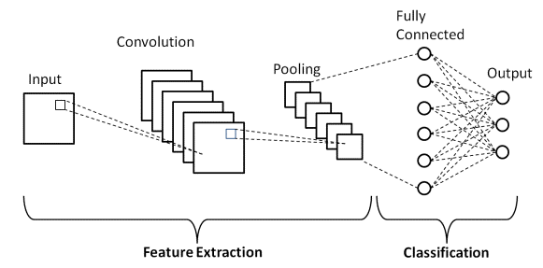
Algorithm
Neural network
CNN

Slide 6
Expected outcomes
An AI model that can detect root fracture
A flutter application that’ll be integrated with the ai model to help doctors

Slide 7
Implementation of algorithms

Slide 8
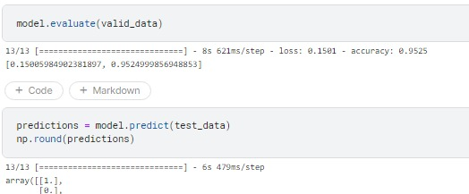
Results
The Trained model has scored an accuracy of 95% by using a dataset of more than 4000 images

Slide 9
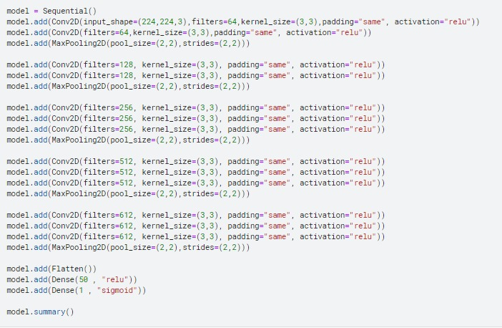
Building the model

Slide 10
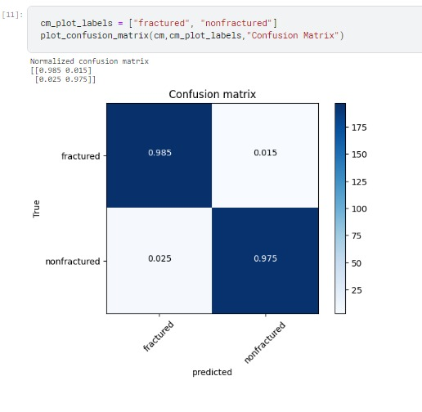
results cont.

Slide 11
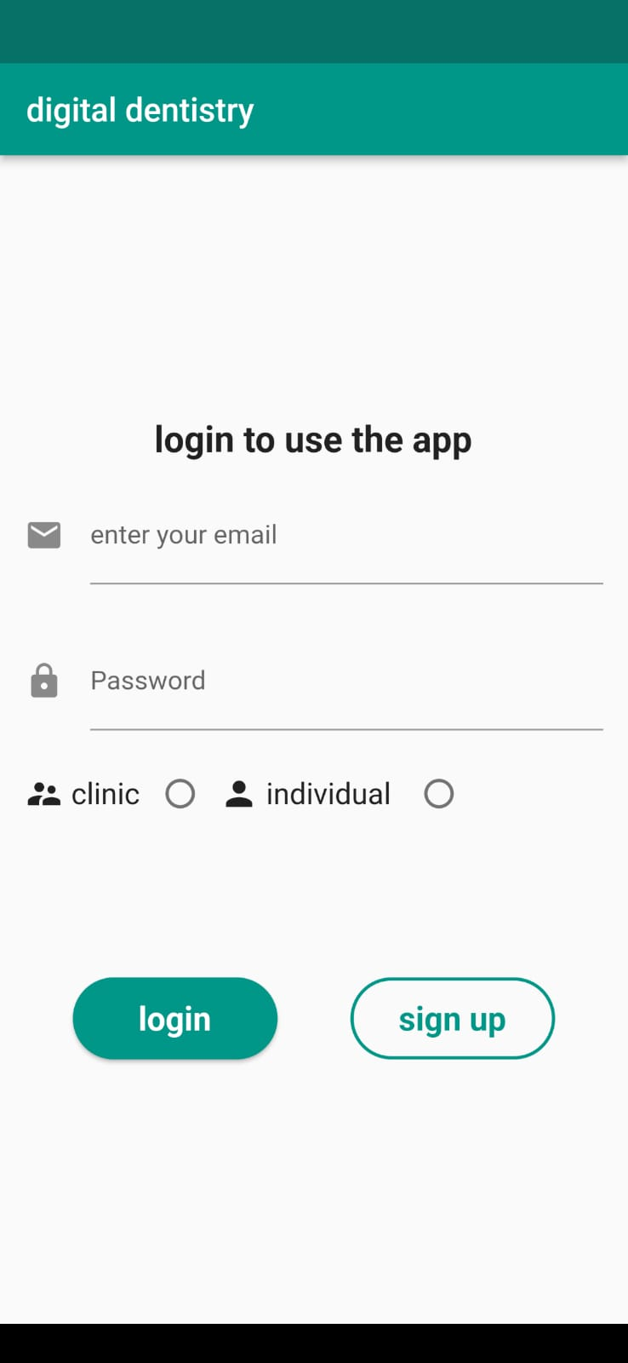
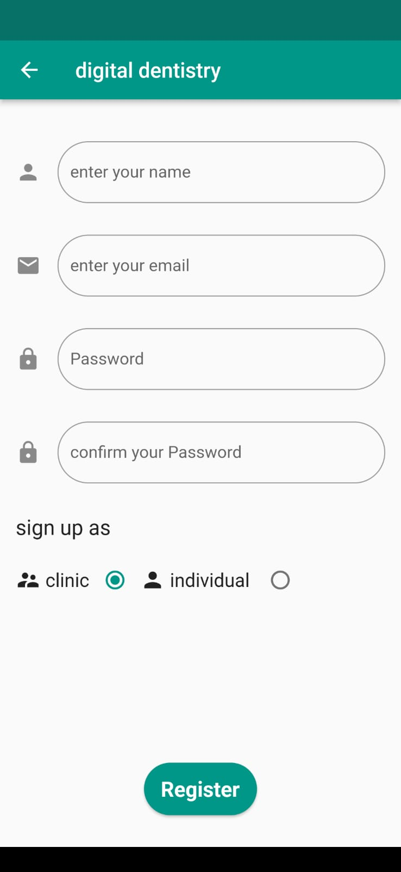
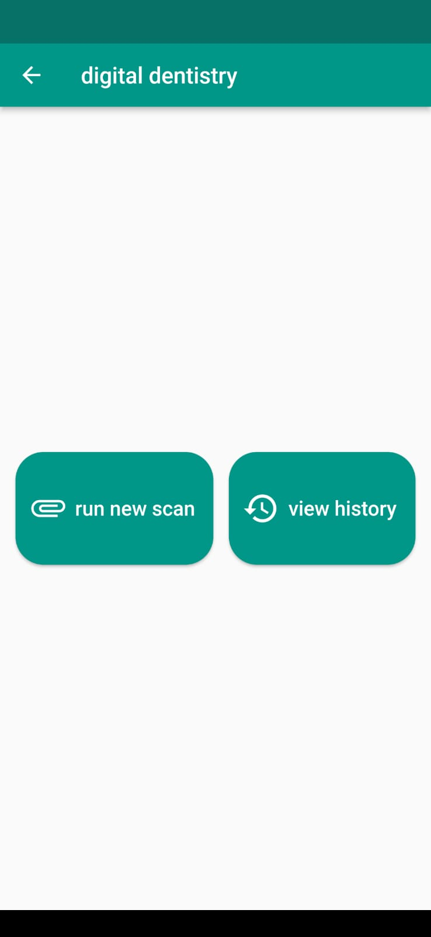
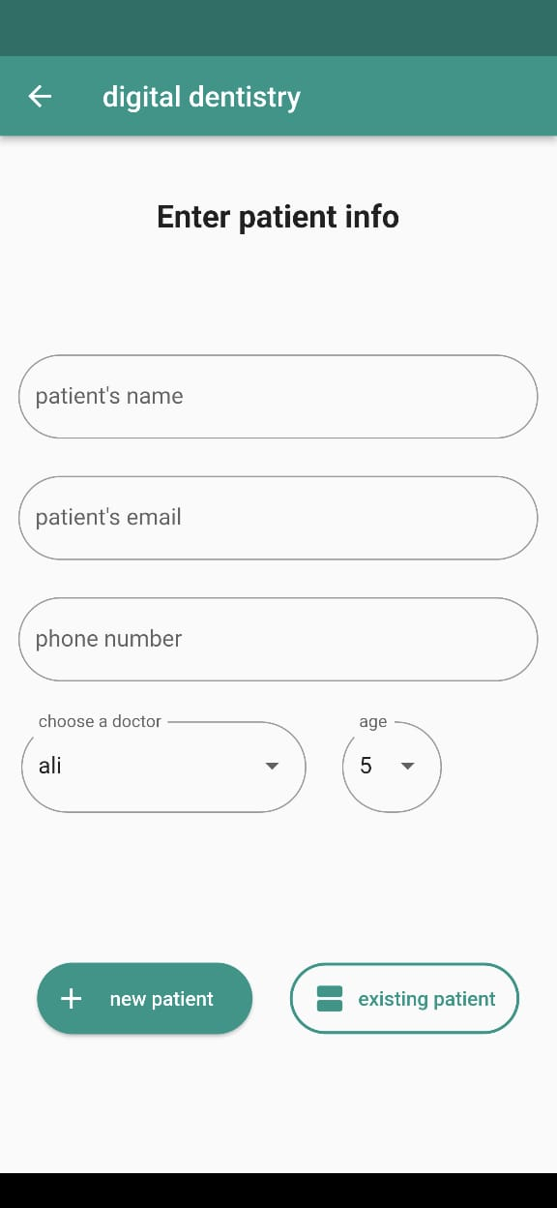
Flutter application

Slide 12
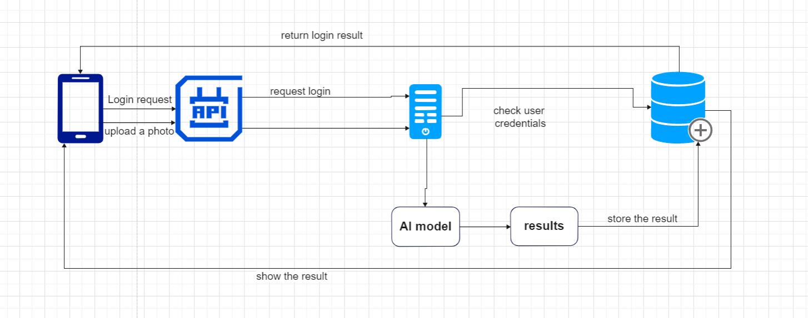
System arc
System architecture

Slide 13
Comparative
We’ve compared our model with a model from Github by SerdarHelli
Model name | Digital model (our model)
Accuracy | 95.4%
dataset | 4000 images

Slide 14
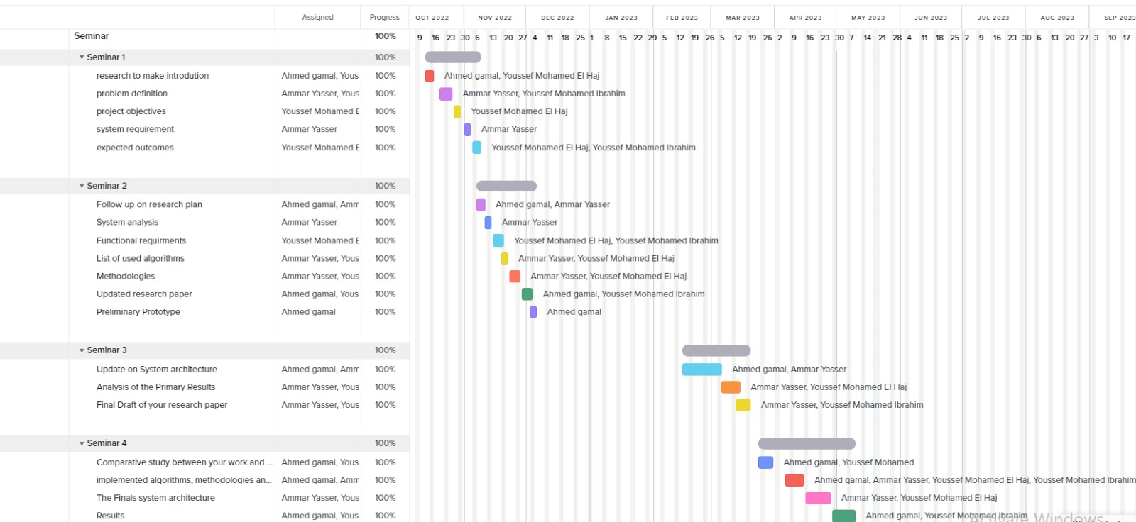
“
Gannt chart

Slide 15
THANK YOU
Any questions?

