Slide 1
Custom Preference
(implementation 'androidx.preference:preference:1.1.0')

Slide 2
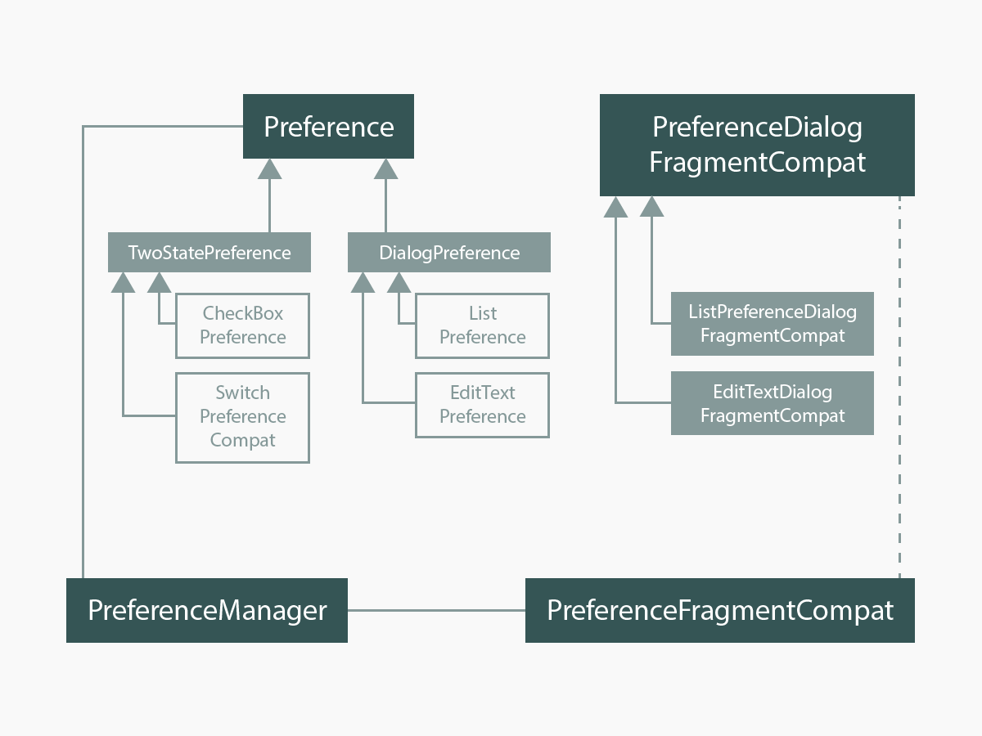
How the Library Is Structured

Slide 3
Structure of preference`s layout
title
Widget
layout
summary
<LinearLayout ...>
<FrameLayout
android:id="@+id/icon_frame"
... >
<androidx.preference.internal.PreferenceImageView
android:id="@android:id/icon"
.../>
</FrameLayout>
<RelativeLayout
...>
<TextView android:id="@android:id/title"
... />
<TextView android:id="@android:id/summary"
.../>
</RelativeLayout>
<!-- Preference should place its actual preference widget here. -->
<LinearLayout android:id="@android:id/widget_frame"
.../>
</LinearLayout>

Slide 4
Setting up different layouts
1. Setting up a widget`s layout
setWidgetLayoutResource(layoutId: Int) // Java
widgetLayoutResource = R.layout.«layout_name» // Kotlin
app:widgetLayout = «...» // in XML
2. Setting up a preference`s layout
setLayoutResource(layoutId: Int)
layoutResource = R.layout.«layout_name» // Kotlin
app:layout = «» // in XML
3. Setting up a dialog`s layout
setDialogLayoutResource(layoutId: Int) // Java
dialogLayoutResource = R.layout.«layout_name» // Kotlin
app:dialogLayout = «» // in XML

Slide 5
Existing attributes
Title → android:id="@android:id/title" → setDialogTitle()
Message → android:id="@android:id/message" → setDialogMessage()
Icon → android:id="@android:id/icon" → setDialogIcon()
PositiveButton → setPositiveButton()
NegativeButton → setNegativeButton()

Slide 6
What needs to write own preference
1. Class that exteds Preference:
class MyPreference(
context: Context,
attrs: AttributeSet = null,
defStyleAttr: Int = 0,
defStyleRes: Int = 0
): Preference(context, attrs, defStyleAttr, defStyleRes) { ... }
2. Set widgetLayout in init-block: init { widgetLayoutResource = ... }
3. Override methods:
- onSetInitialValue(…) - reads an initial value from SharedPreferences or set a default value
- onGetDefaultValue(…) - read the default value if it exists
* - setSummary(…) - write a current value as summary info
* - onBindViewHolder(…) - binds layout views

Slide 7
What needs to write own dialog preference
1. Class that extends DialogPreference:
- class MyDialogPreference(…): DialogPreference(…) { …}
2. Methods from from previous slide, point 3. You can to set the layout here:
init { dialogLayoutResource = ... }
or override onCreateDialogView() in the class of the next step
3. All preference dialogs inherit from one abstract class called PreferenceDialogFragmentCompat:
class MyPreferenceDialogFragmentCompat :
PreferenceDialogFragmentCompat() {…}
4. Override at least two methods:
- onBindDialogView(view: View)
- onDialogClosed(positiveResult: Boolean)

Slide 8
Class for saving a preference state
private class SavedState : BaseSavedState {
internal var value: String? = null
constructor(superState: Parcelable) : super(superState)
constructor(source: Parcel) : super(source) {
value = source.readString()
}
override fun writeToParcel(dest: Parcel, flags: Int) {
super.writeToParcel(dest, flags)
dest.writeString(value)
}
companion object {
@JvmField
val CREATOR: Parcelable.Creator<SavedState> =
object : Parcelable.Creator<SavedState> {
override fun createFromParcel(`in`: Parcel): SavedState {
return SavedState(`in`)
}
override fun newArray(size: Int): Array<SavedState?> {
return arrayOfNulls(size)
}
}
}
}

Slide 9
SummaryProvider
object SimpleSummaryProvider: SummaryProvider<AutoCompletePreference> {
override fun provideSummary(preference: AutoCompletePreference): CharSequence? {
return if (TextUtils.isEmpty(preference.text)) {
preference.context.getString(R.string.not_setted)
} else {
preference.text
}
}
}

Slide 10
Using a custom data store
class DataStore : PreferenceDataStore() {
override fun putString(key: String, value: String?) {
// Save the value somewhere
}
override fun getString(key: String, defValue: String?): String? {
// Retrieve the value
}
}
Enable the data store
override fun onCreatePreferences(){
// to enable a custom data store for a specific Preference
val preference: Preference? = findPreference("key")
preference?.preferenceDataStore = dataStore
// to enable a custom data store for all preferences
val preferenceManager = preferenceManager
preferenceManager.preferenceDataStore = dataStore
}

