Slide 1
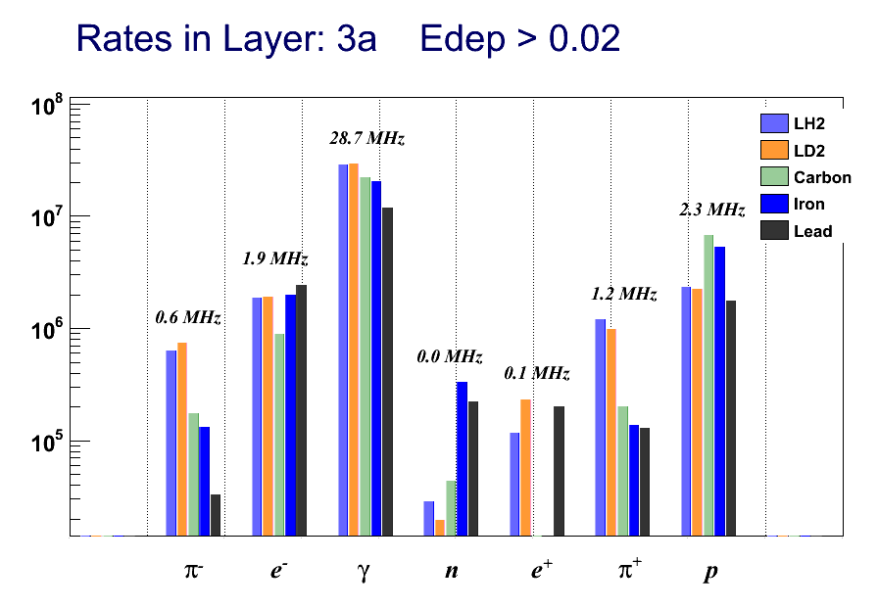
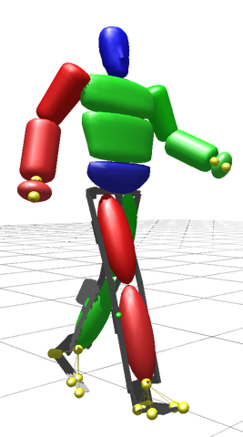
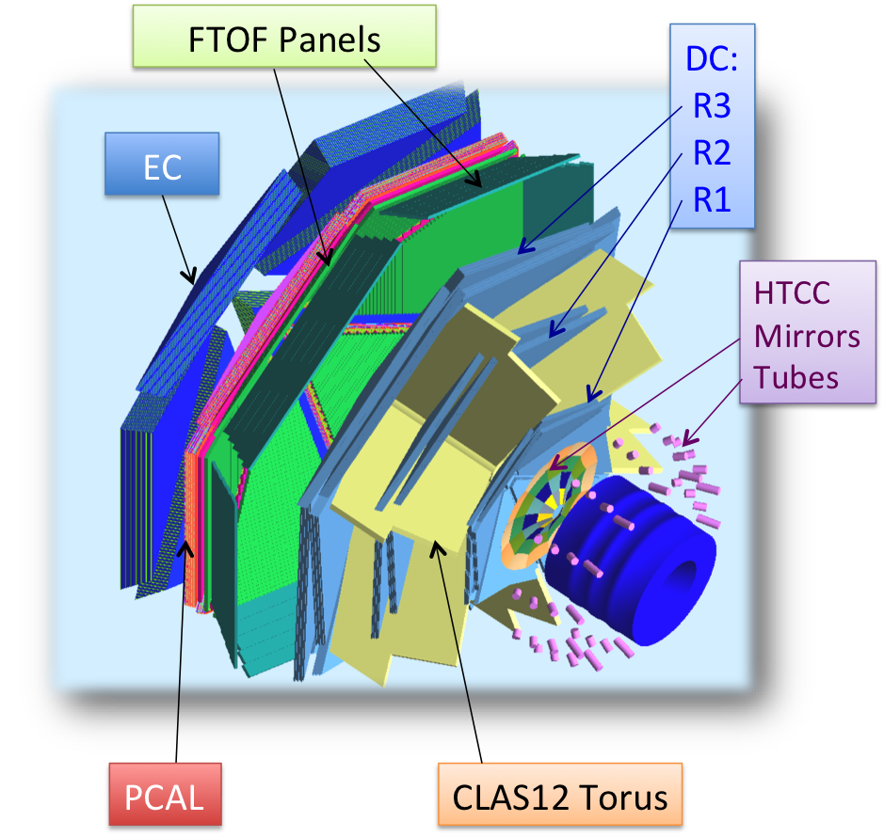
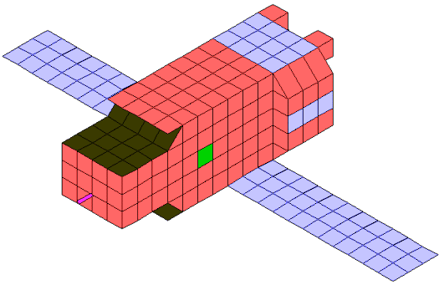
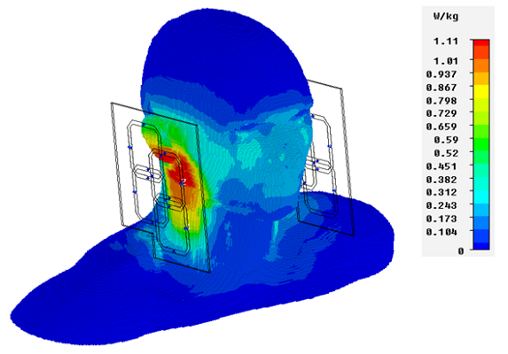
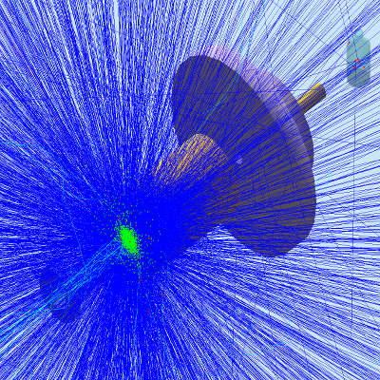
Run options: tilts, displacement, calibration, inefficiencies
Geometry and Physics Modeling
Transport Calculation
Energy loss
Secondaries
Results
Digitization
Hit definition
Sensitivity
Output
Bank defs
File format
Nuclear Physics Cross Sections
Electromagnetic Fields
The architecture of gemc

