Slide 1


Addis Ababa Science and Technology University College of Electrical and Mechanical Engineering Department of Software Engineering
Dire Hotel Management System
Group members ID
Duresa Feyisa ETS-0388/13
Etsubdenk Hayelom ETS-0448/13
F/Silassie Kelemework ETS-0504/13
Habte-Yesus Tadesse ETS-0566/13
Gemechis Elias ETS-0539/13

Slide 2
Overview
Introduction
System Requiremet Specification
Requirement Analysis and Modeling
System Design & Architecture

Slide 3
PHASE I
Introduction

Slide 4
1.1 Background
Dire Hotel is a four-star hotel located in Adama, Ethiopia. It is one of the finest properties in the region, offering world-class amenities and services to its guests. The hotel features a wide range of accommodation options for all types of travelers, ranging from luxury guest rooms to suites and villas.
Dire Hotel does not have an online web-application or any sort of technological advancement that makes it possible to book reservations online.
This project is a critical process that helps in developing a web-application for Dire Hotel. It allows the development team to thoroughly understand the scope and purpose of the web- application and determine all the necessary components that are needed to successfully create an online platform.

Slide 5
1.2 Motivation
This project title helps us to learn new things about Web application development requirement analysis. And web applications are a great motivator for us to learn new skills, stay updated on trends in the industry, create a network of contacts, and work collaboratively with other web developers

Slide 6
1.3 Statement of the Problem
As Dire Hotel booking is having currently manual booking system, they are facing some problems issuing booking requests of customers. All the necessary booking stuffs are being done in hard copy. So, it become much difficult for staffs to keep the records updated all the time. As for example, if the customers need to change the check in date it become difficult for them to find out the customers booking details for updating as there are so many customers booking records.
Because of without an online system presence, a hotel management system is severely hampered in terms of reach and availability. Dire Hotel fails to appeal to the modern travel customer who typically searches for hotels online.

Slide 7
1.4 Objectives
This project is a Web-based application that provides a user-friendly and simple interface to let users easily book hotel rooms and perform booking activities via Internet. The records are shared with not only Web users but also, with administrators to the site.

Slide 8
1.5 Methods
The Iterative Model is a great choice for web-application development for Dire Hotel. This model makes it easier to adjust designs and features based on user feedback, and also allows the programmers to prioritize features that are seen as most important. It is a great fit because it can be completed in smaller sections, which should lead to earlier successes and results, while providing fewer risks.
The testing phase of each iteration helps ensure the project is going in the right direction and fix any problems before they become major obstacles. By identifying customer requirements early on in the process, this model works well for web development projects like Dire Hotel’s web-application.
Additionally, the iterative nature of the process will also allow for different customer feedback or changes in market conditions. As components or iterations are successfully implemented improvement suggestions from end users can be incorporated into subsequent efforts with an assurance

Slide 9
1. 6 Scope and Limitations
Financial Limitations: Developing a website-application requires funds for hiring developers and purchasing the necessary software, hardware, and other resources. If funds are limited, it may not be possible to create the application desired in the time allotted.
Time Constraints: The development of any application usually comes down to the amount of time available. If the project deadline is set too close then there will be fewer creative possibilities that can be implemented without having to make sacrifices elsewhere.
Software Limitations: Different web applications require different software or platforms and if these are not available or compatible with each other than developing an optimal solution may be impossible.

Slide 10
PHASE II
System Requirement Specification

Slide 11
2.1 Functional Requirements
Public Home Page
Facility Management System
User Authentication
Login Page
Booking System
Customer Profile Maintenance.
Payment System
Rates & Tariffs Calculation
Check-in status tracking
Room Reservation & Check-ins/Check-outs
Cancellation
Room Billing & Tax Management
Module
Admin Accounts

Slide 12
2.2 Non Functional Requiments
Availability: The System must be available 24x7 throughout the year unless it is down due to scheduled maintenance work done by System administrators.
Scalability: The System must scale up automatically when operating loads increase without reducing performance levels considerably.
Performance: The System must guarantee response times better than 2 seconds for any operation on website that does not involve data backed generation tasks like reports etc.
Maintenance: System must be able to undertake capacity planning in order make sure no components within the application are over loaded leading malfunction of some parts due congestion
Data storage requirements: This application must have proper data storage facilities which are reliable and secure for storing customer information, tax calculations, financial transactions etc.
Security requirements: The application shall provide strong security features like encrypted passwords, role-based rights etc., which will ensure protection against unauthorized access as well as data integrity is maintained properly.
Usability requirements

Slide 13
PHASE III
Requirement Analysis and Modeling

Slide 14
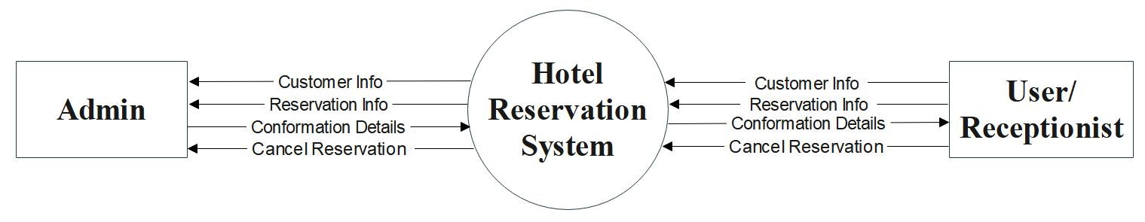
3.1 Data Flow Diagrams
Figure 1: Context Diagram

Slide 15
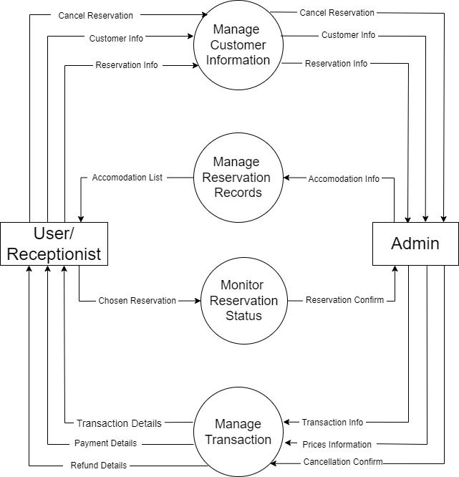
3.2 Data Flow Diagrams
Figure 2: Level 1 DFD

Slide 16
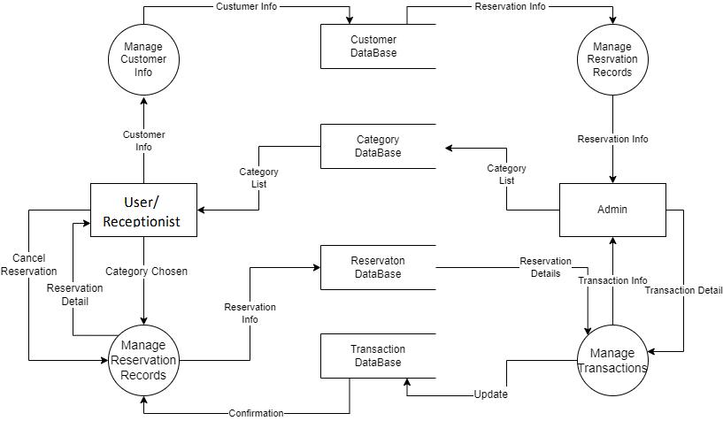
3.3 Data Flow Diagrams
Figure 3: Level 2 DFD

Slide 17
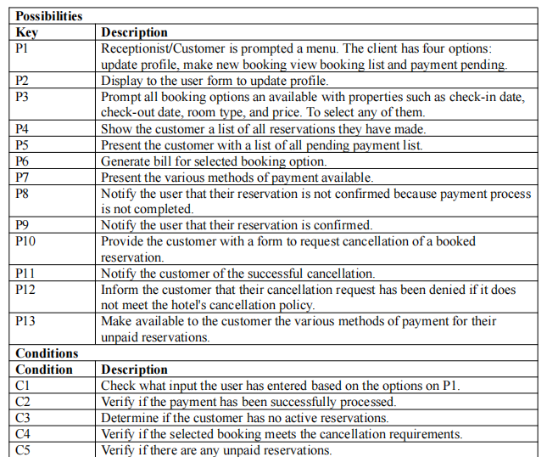
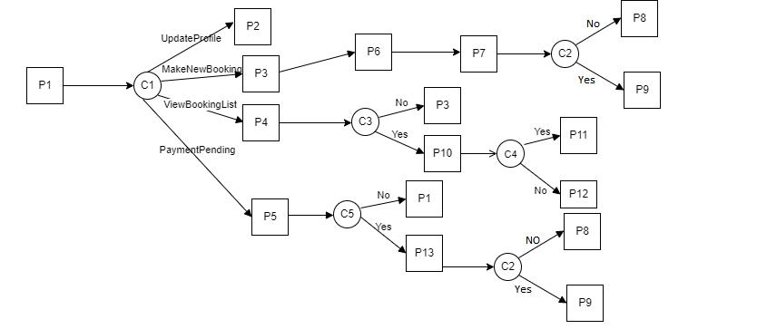
3.4 Decision Tree for a Customer and Receptionist.

Slide 18
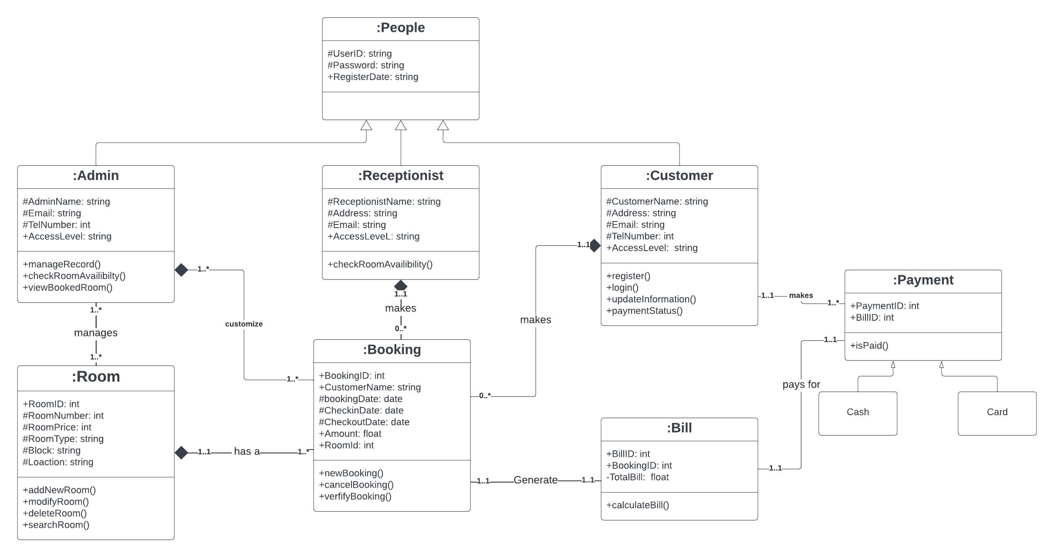
3.5 Class Diagram
Figure 3: Level 2 DFD
Figure 6: Class diagram

Slide 19
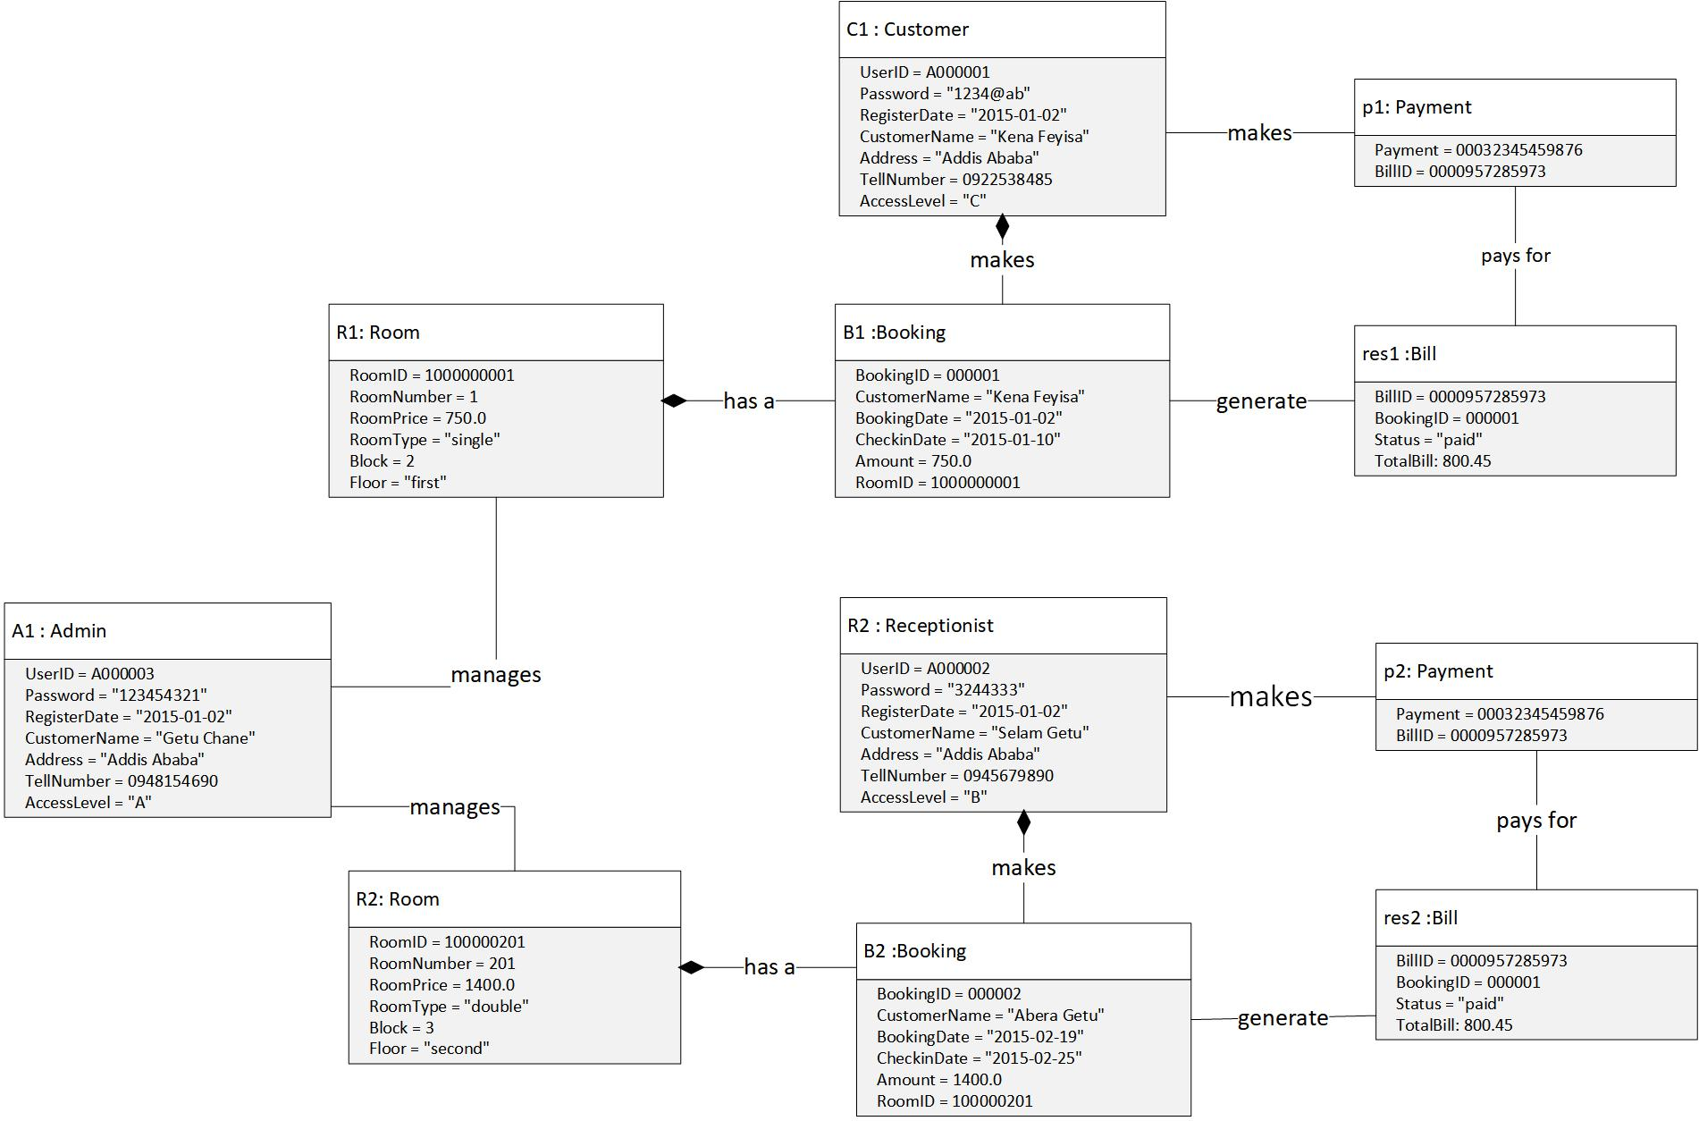
3.6 Object Diagram
Figure 3: Level 2 DFD
Figure 7: Object Diagram

Slide 20
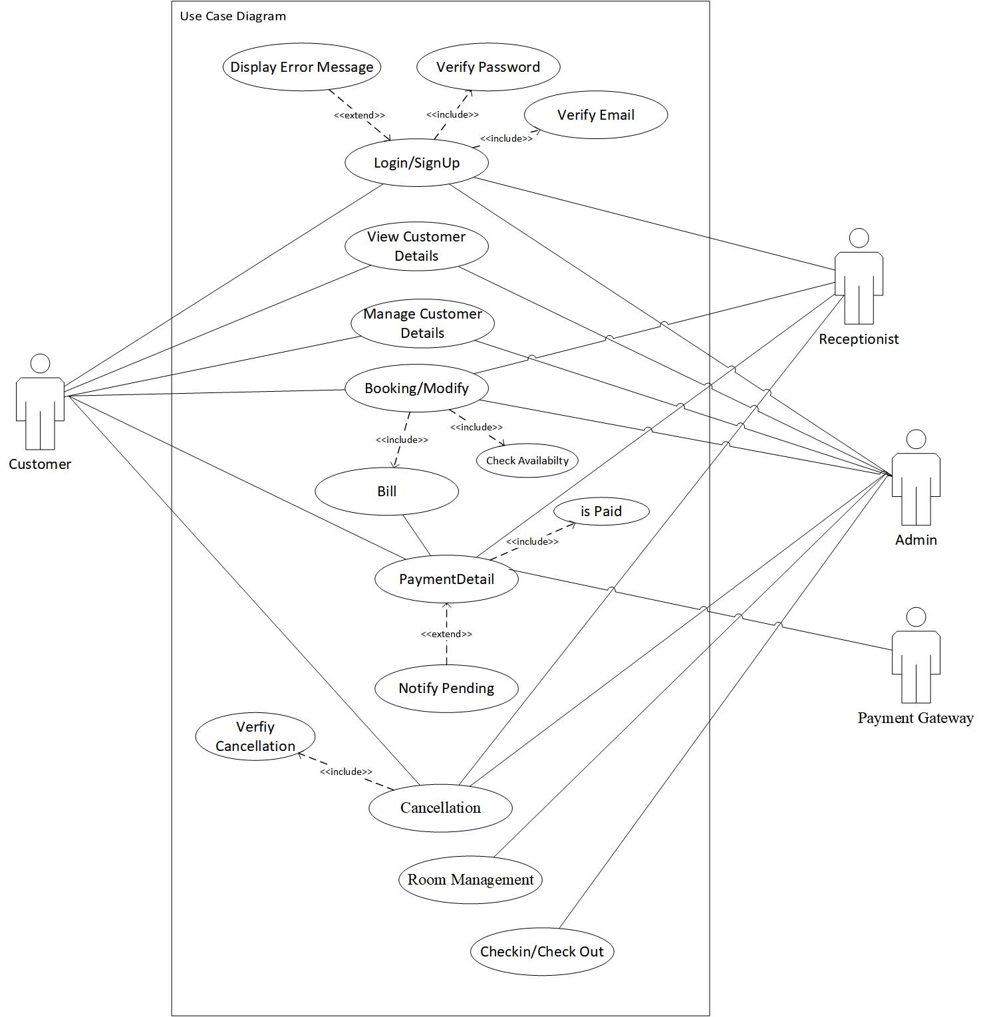
3.7 Use Case Diagram
Figure 8: Use Case

Slide 21
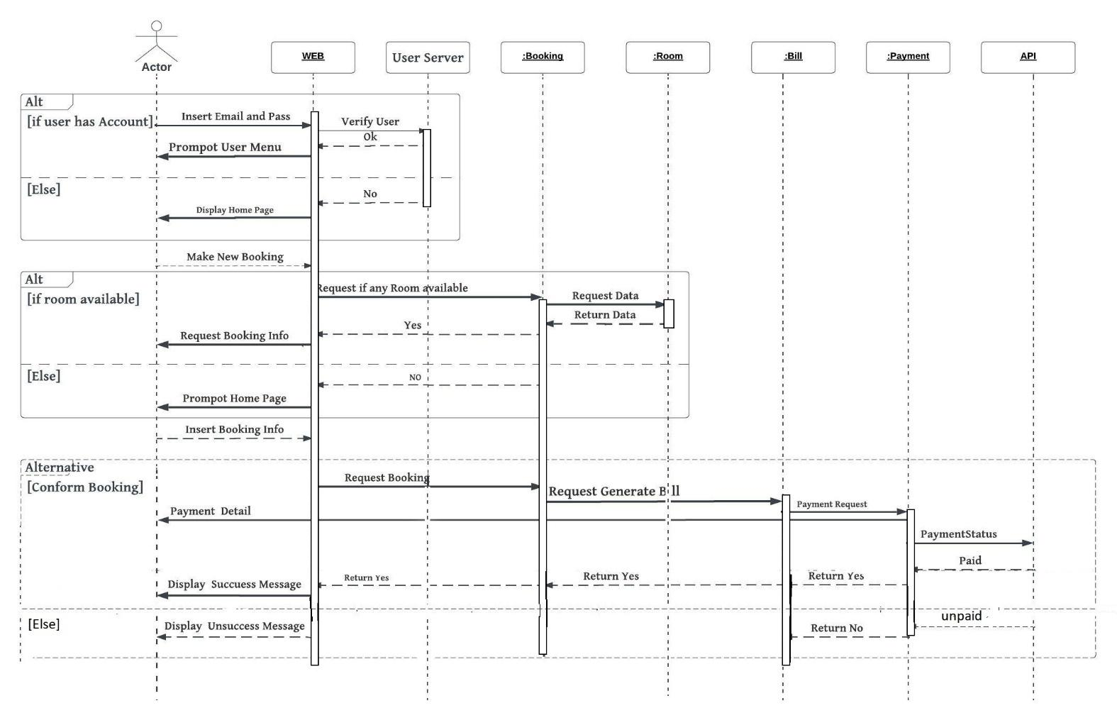
3.8 Sequence Diagram
Figure 9: Use Case

Slide 22
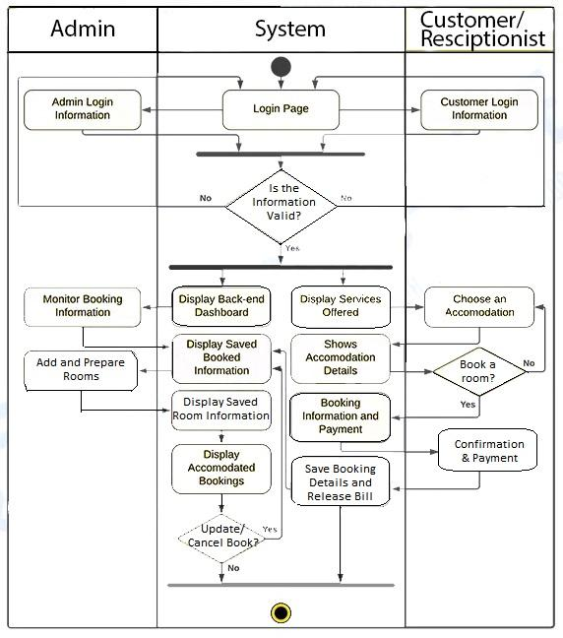
3.9 Activity Diagram
Figure 10: Activity Diagram

Slide 23
PHASE IV
System Design & Architecture

Slide 24
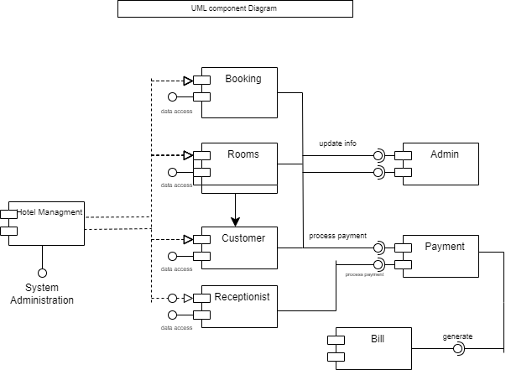
4.1 Component Diagram
Figure 11: Component Diagram

Slide 25
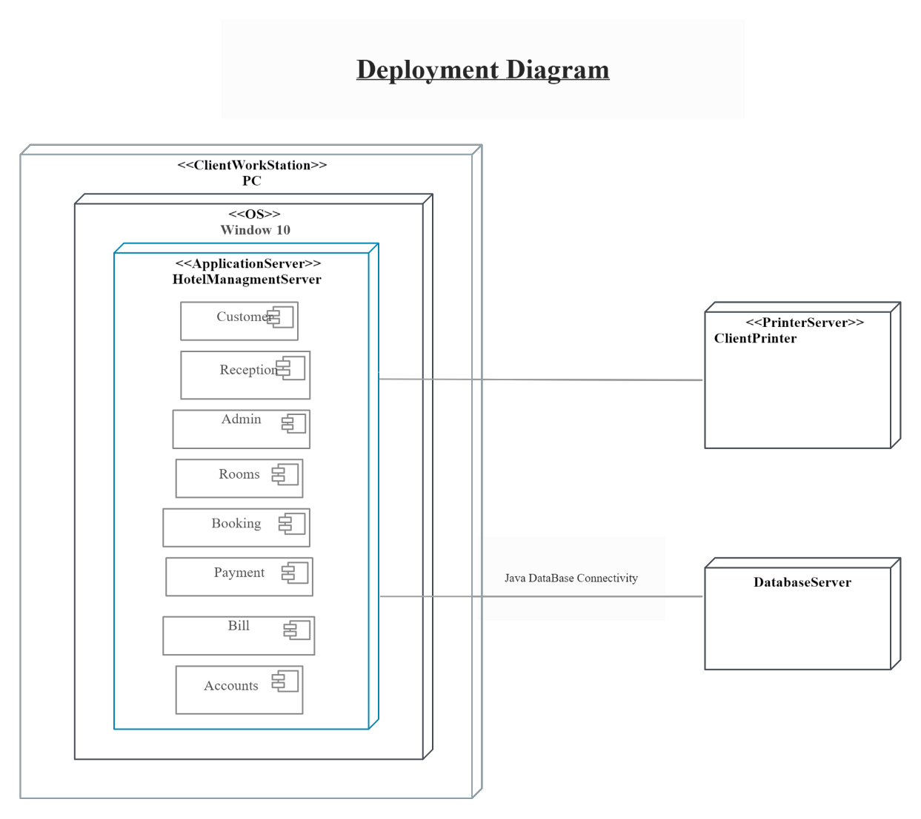
4.2 Deployment Diagram
Figure 12: Activity Diagram

Slide 26
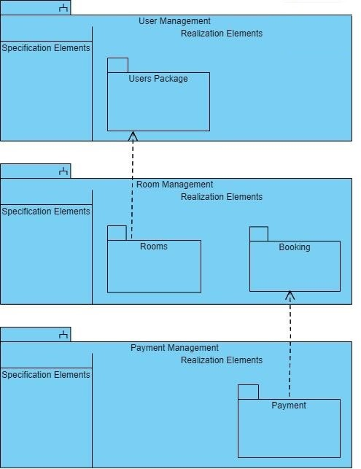
4.3 Package Diagram
Figure 13: Package Diagram

Slide 27
Thank You!

