Slide 1
Magnetic Properties of Solids
Magnets are very common items in the workplace and household. Uses of magnets range from holding pictures on the refrigerator to causing torque in electric motors. Most people are familiar with the general properties of magnets but are less familiar with the source of magnetism. The traditional concept of magnetism centers around the magnetic field and what is known as a dipole. The term "magnetic field" simply describes a volume of space where there is a change in energy within that volume. This change in energy can be detected and measured. The location where a magnetic field can be detected exiting or entering a material is called a magnetic pole. Magnetic poles have never been detected in isolation but always occur in pairs, hence the name dipole. Therefore, a dipole is an object that has a magnetic pole on one end and a second, equal but opposite, magnetic pole on the other.

Slide 2
All matter is composed of atoms, and atoms are composed of protons, neutrons and electrons. The protons and neutrons are located in the atom's nucleus and the electrons are in constant motion around the nucleus. Electrons carry a negative electrical charge and produce a magnetic field as they move through space. A magnetic field is produced whenever an electrical charge is in motion. The strength of this field is called the magnetic moment.

Slide 3
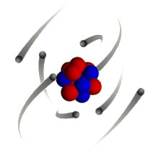
This may be hard to visualize on a subatomic scale but consider electric current flowing through a conductor. When the electrons (electric current) are flowing through the conductor, a magnetic field forms around the conductor. The magnetic field can be detected using a compass. The magnetic field will place a force on the compass needle, which is another example of a dipole.
Since all matter is comprised of atoms, all materials are affected in some way by a magnetic field. However, not all materials react the same way.

Slide 4
What is magnetism?
Force of attraction or repulsion due to electron arrangement
Magnetic forces are the strongest at the poles
Magnets have two poles: North and South

Slide 5
Magnetic poles and fields
Magnets always have two poles
If a magnet is cut it will still have two poles
Like magnetic poles repel
Unlike magnetic poles attract
A magnetic field is the area in which magnetic forces act

Slide 6
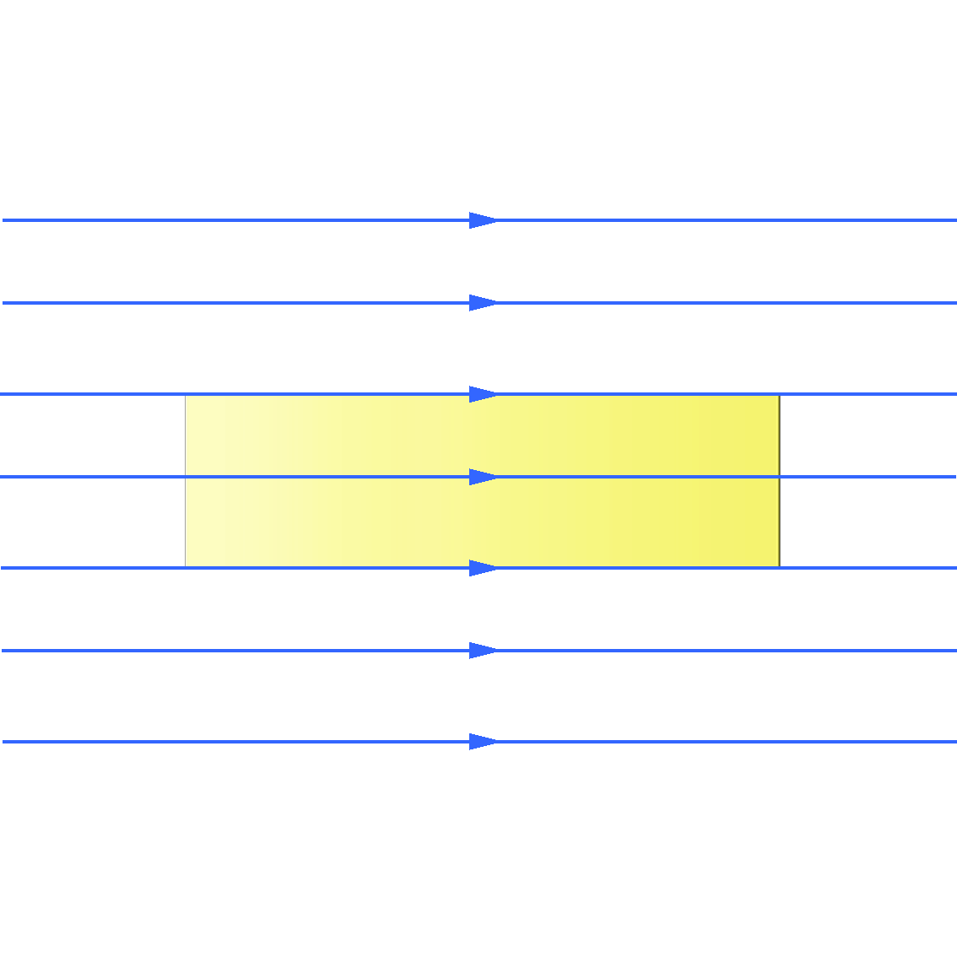
Specimen in magnetic field
If specimen has no magnetic response, flux lines are not perturbed

Slide 7
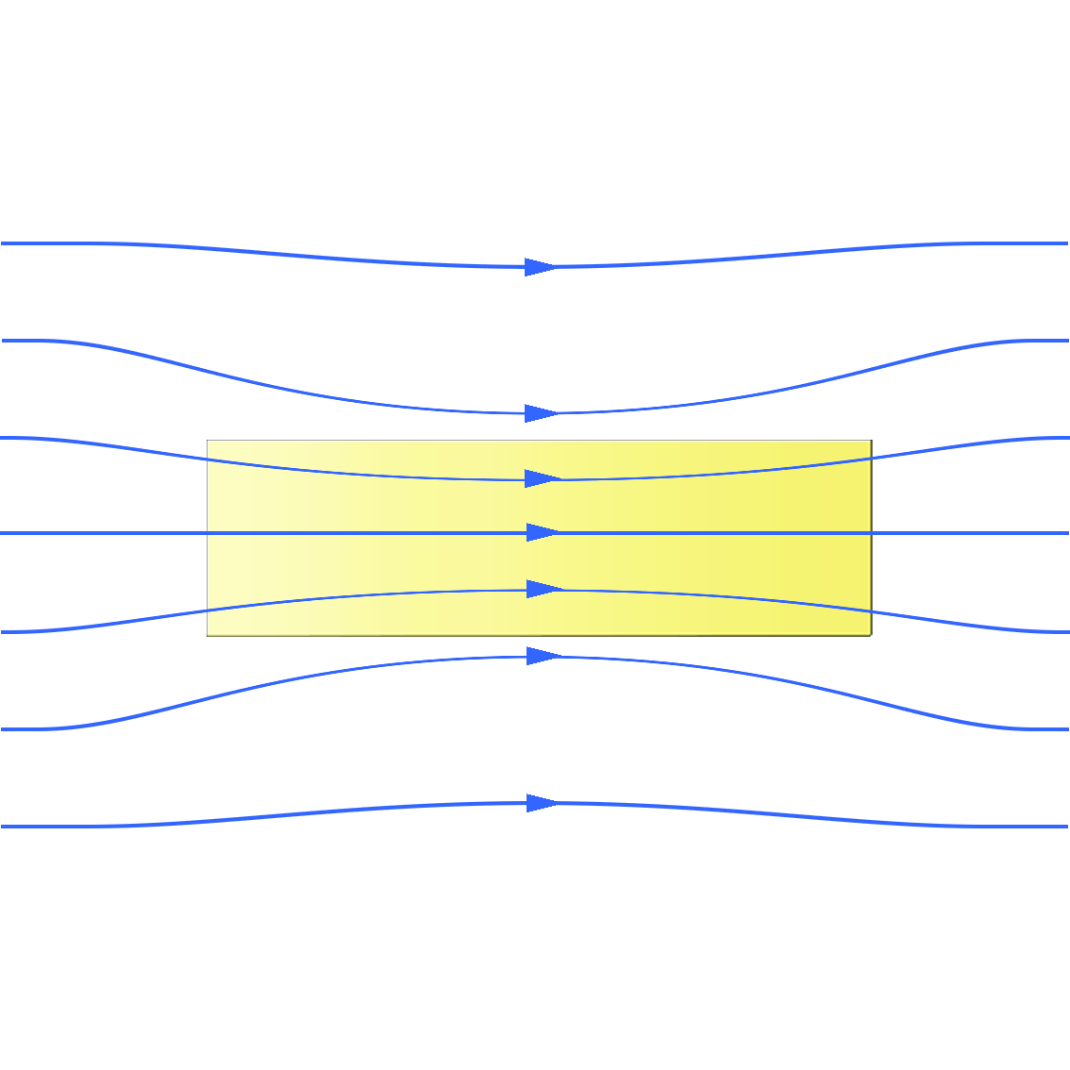
“Magnetic” materials
“magnetic” materials tend to concentrate flux lines
Examples: materials containing high concentrations of magnetic atoms such as iron, cobalt

Slide 8
Materials respond differently to the force of a magnetic field.
There are three main classifications of magnetic materials.
Ferromagnetic Materials
A magnet will strongly attract ferromagnetic materials.
Paramagnetic Materials
weakly attract paramagnetic materials.
Diamagnetic Materials
Weakly repel diamagnetic materials.

Slide 9
Diamagnetic materials
Diamagnetism is the property of an object which causes it to create a magnetic field in opposition to an externally applied magnetic field, thus causing a repulsive effect. The substances which tend to move from stronger to weaker region of the magnetic field are called diamagnetic substances. These are weakly repelled by a strong magnet. In these substances, there are equal numbers of electrons spinning and orbiting in opposite directions so that the electrons of an atom remain paired in such away that their net magnetic moment is zero in the absence of any external magnetic field.
Examples: Antimony, bismuth, copper, gold, lead,
mercury, silver etc…

Slide 10
Properties
1. The relative permeability is less than unity
2. The susceptibility is negative
3. The susceptibility does not vary with temperature.
In electromagnetism, permeability is the measure of the ability of a material to support the formation of a magnetic field within itself. In other words, it is the degree of magnetization that a material obtains in response to an applied magnetic field.
In electromagnetism, the magnetic susceptibility is the degree of magnetization of a material in response to an applied magnetic field.

Slide 11
Ferromagnetic materials
The substances which are strongly attracted by a magnet are called ferromagnetic substances. These are the permanent magnets which exhibit Hysterisis. It arises due to the self alignment of groups of atoms carrying permanent magnetic moment in the same direction. The magnetic moment is an account of spin of the electrons. Ferromagnetic materials are characterized by curie temperature above which they become paramagnetic materials.

Slide 12
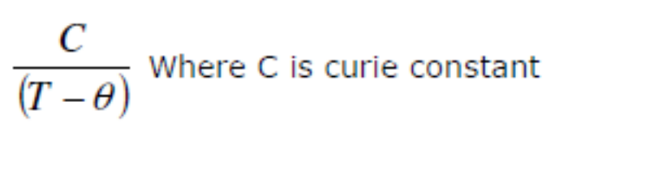
Properties
1. The relative permeability is very high
2. The susceptibility is very high and it depends on the temperature.
3. They exhibit magnetostriction and hysteresis
Ferromagnetic susceptibility

Slide 13
Paramagnetic materials
The substances which tend to move from weaker to stronger regions of magnetic field are called paramagnetic substances. These are feebly attracted by a strong magnet. In these substances, the atoms or molecules with one or more unpaired electrons possess a permanent magnetic moment. But they are oriented randomly in the absence of an external magnetic field.
Examples: Aluminium, chromium, manganese,
platinum, sodium etc…

Slide 14
Properties
Low magnetization, low susceptibility
Susceptibility is small, positive and varies
inversely with temperature
3. Permeability is greater than one

Slide 15
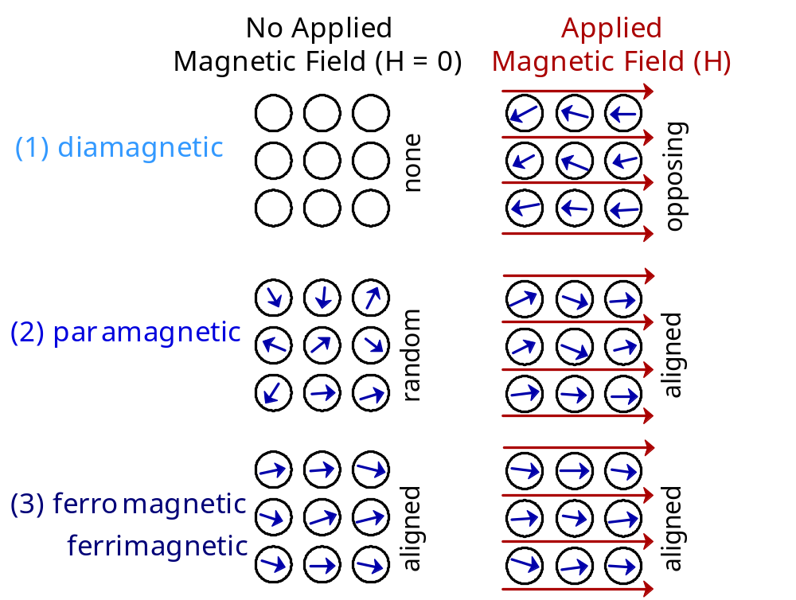
MAGNETIC MOMENTS FOR 3 TYPES
The magnetic moment (or magnetic dipole moment) of an object is a measure of the object's tendency to align with a magnetic field.

Slide 16
Magnetic Induction or Magnetic flux Density (B)
The Magnetic induction in any material is the number of lines of magnetic force passing through unit area perpendicularly. Units: wb/m² or Tesla.
Magnetic field intensity (H)
The Magnetic field intensity at any point in the magnetic field is the force experienced by an unit north pole placed at that point.
Units : A/m

Slide 17
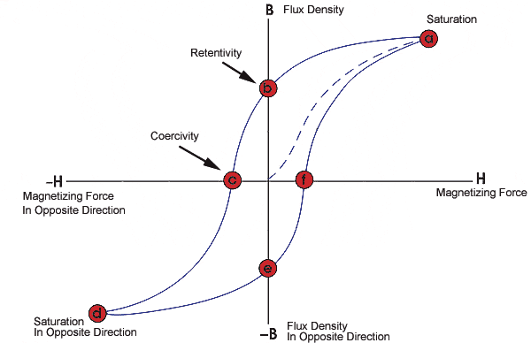
B H Curve (Hysteresis)
A great deal of information can be learnt about the magnetic properties of a material by studying its hysteresis loop. A hysteresis loop shows the relationship between the induced magnetic flux density (B) and the magnetizing force (H). It is often referred to as the B-H loop. An example hysteresis loop is as shown.

Slide 18
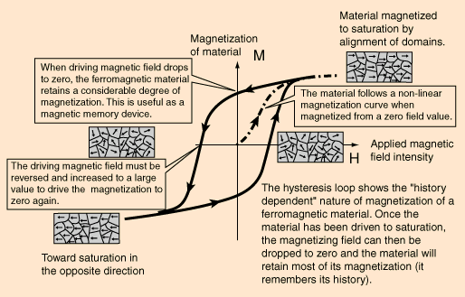

Slide 19
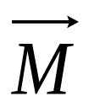
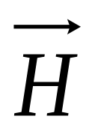
Saturation
Magnetization
P
M_{s}
Residual
Magnetization
Q
M_{r}
-H_{s}
R
H_{c}
o
H_{s}
Coercivity
S
-M_{s}
Ferro Magnetic Material

Slide 20
If we start with no Magnetized specimen
(M= 0) with the increasing values of magnetizing field H.
The Magnetization of the specimen increases from zero to higher values and attains its maximum value at a point P, at this point the Magnetization referred as Saturation Magnetization..

Slide 21
When we increase Magnetic field H there is no further increment in Magnetic moment.
When we decrease Magnetic field H to Zero, the Magnetization M attains point Q.
At this point Magnetization referred as residual Magnetization M_{r.}

Slide 22
Further if we increase the Magnetic field from zero to negative values, the Magnetization of material becomes zero at a point R, at that point the Magnetic field H_{c} is referred as Coercivity of the specimen.
If we increase Magnetic field H in reverse direction Magnetization of material reaches its peak value at a points S.

Slide 23
On reversing the polarities of Magnetic field and increasing its strength the Magnetization slowly decreases first to residual value then to zero and finally increases to saturation state and touches the original saturation curve.
The area of loop indicates the amount of energy wasted in one cycle of operation.

Slide 24
A ferromagnetic solid can be assumed to be comprised of small number of small regions called domains each of which is spontaneously magnetized. The magnetic moments of all the exams are all aligned in a particular direction. However the different domains are so oriented as to make the net magnetization zero.
The process of magnetization consists in rotating the different domains in the direction of applied field so that the specimen exhibits net magnetization.
When a magnetic field is applied on a ferromagnetic material, the domains nearly parallel to H can grow in size at the expense of antiparallel domains and gradually all the domains align along the applied field at which the material is said to be saturated.

Slide 25
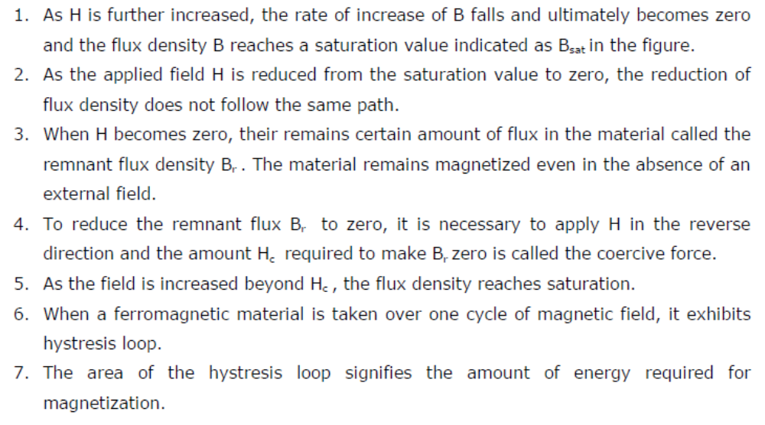
The hysteresis can be explained as follows.

Slide 26
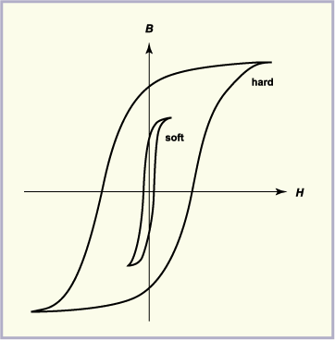
Based on the Hysteresis property, Magnetic materials can be classified into two types.
Hard Magnetic Materials
Soft magnetic Materials

Slide 27
Hard magnetic materials:
Magnetic materials that have large energy product (BH) and high coercivity are called hard magnetic materials.
Properties
1. Large hysteresis loop
2. High coercivity
3. High remanant magnetization
4. High permeability
5. High hysteresis energy loss
6. High saturation flux density
Eg: Carbon, tungsten-steel alloy, alloy steel, alloys of aluminium

Slide 28
Uses
The permanent magnets are used in instruments like
galvanometers, ammeters, voltmeters, speedometers and recorders.
2. Tungsten steel are used in chucks and latches, tool holders, magnetic bearings and mixers.
3. They are used in electronic devices such as telephones and tape recorders, loud speakers and hearing aids.

Slide 29
Soft magnetic materials
Magnetic materials that have high permeability and low coercive force are called soft magnetic materials. These are temporary magnets which can retain magnetism for a short interval of time. They possess small hysteresis loss.
Properties
1. Low remnant magnetism
2. High permeability
3. High susceptibility
4. Low coercivity
5. Low hysteresis energy loss
6. Thin hysteresis loop
7. Low eddy current loss
Ex: Soft iron, mild Steel, alloys, pure nickel…

Slide 30
Uses
1. They are used in the construction of cores of transformers.
2. Relatively pure iron is frequently used as the magnetic core
for direct current applications.
3. The magnetic mild steel is used for relays, reed switches and
pole pieces for electromagnets.
4. Iron-nickel alloys are used for audio frequency applications.

