Slide 1
Bullying and its Effect on Academic Performance
Hannah Duncan
Geoffrey Johnston
Vineet Sikri
Melody Yu

Slide 2
Background
Bullying is a major social problem affecting school aged children and adolescents nationwide.
Researchers on school bullying have defined it as “a systematic abuse of power”. The defining features of bullying which distinguish it from other forms of aggressive behavior are that it is (a) repeated and (b) intent to hurt, and (c) there is an imbalance of power between the bully and the victim, with the victim in a weaker and more vulnerable position.
There are four main types of bullying which are most prevalent in school, including physical bullying, verbal bullying, social or relational bullying, and cyberbullying.

Slide 3
Background
Bullying can negatively impact youths’ overall well-being and has been linked to multiple adverse outcomes, including both externalizing and internalizing difficulties. One of the major consequences associated with being the target of aggressive behavior is lower academic performance.
For this project, we as data analyst in the field of education, will be looking at national bullying statistics and determining if there is a correlation between bullying and academic performance.

Slide 4
Research questions
Is there a statistically significant correlation between bullying and academic performance?
In the United States of America:
H₀ – Bullying has no effect on academic performance
H_{A} – Bullying has an adverse effect on academic performance
What demographic factors can lead to higher instances of bullying? (Socioeconomic, Age, Ethnicity, Location, etc.)
Can we predict instances of bullying in the future based on history?

Slide 5
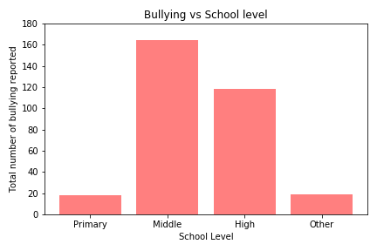
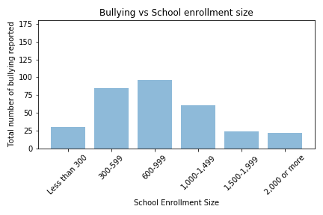
results
Prevalence of bullying (2015)
Total number of bullying reported

Slide 6
results
Prevalence of bullying (2015)
Total number of bullying reported

Slide 7
results

Slide 8
results

Slide 9
Limitations
Population and ethnicity data are only based on reported census data.
Data does not take social or economic conditions into account.
Bullying data contain only instances of alleged bullying and does not include cyberbullying.
Graduation rates, dropout counts, and test scores are not the only measures of student success.
Assessments given to students are standardized by state; they are not nationally standardized.

Slide 10
Resources and reference
https://educationdata.urban.org/documentation/
https://nces.ed.gov/programs/crime/student_data.asp
https://usedgov.github.io/
https://www.census.gov/acs/www/data/data-tables-and-tools/data-profiles/2015/
https://educationdata.urban.org/documentation/#how_to_use
Alhajji, M., Bass, S., & Dai, T. (2019). Cyberbullying, Mental Health, and Violence in Adolescents and Associations With Sex and Race: Data From the 2015 Youth Risk Behavior Survey. Global Pediatric Health, 6.

Slide 11
Thank you!

