Slide 1
Unit 01 Getting Started with Antigravity
Setup and your first web page
Install, build a web page and make a playable mini-game, all by chatting in plain language
Video: movies/01-antigravity.en.mp4 (Chinese: youtu.be/PQEkjWiNC5o)
Notes:
In this first unit we use Google Antigravity IDE and its built-in AI Agent, chatting in plain language the whole way: first set up the environment, then ask the AI to build a web page, and finally build a Memory Match game you can actually play. No coding experience is needed.

Slide 2
Four parts
1–3
Install & set up
Install Antigravity
Sign in
Adjust layout
4
AI installs tools
Install in one sentence
Check versions
5
Warm-up
First web page
hello.html
6
Game example
Memory Match
Vite + JS
Classroom PCs
Antigravity and all tools are pre-installed: skip Step 1; in Step 4 only check the tools
Notes:
Today has four parts. Steps 1 to 3 install Antigravity, sign in and adjust the layout. In Step 4 we ask the AI to install and check the tools. Step 5 is a warm-up: build a first web page to confirm the AI can create files and run commands on the computer. Step 6 is the main example, a Memory Match game. Classroom computers already have Antigravity and the tools installed, so skip Step 1 and in Step 4 only do the final tool check; the install steps are for reference on your own computer at home.

Slide 3
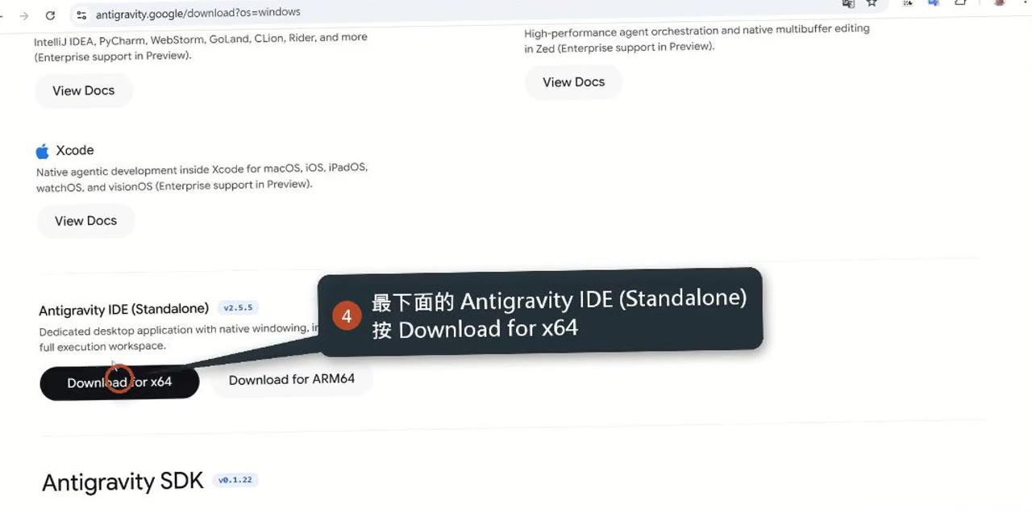
Step 1: Download Antigravity IDE
Official download page
antigravity.google/download
Pick the right version
Not the Antigravity app or CLI at the top
Scroll down to Antigravity IDE (Standalone)
Notes:
Open the official download page, antigravity.google/download. As the clip shows, the top of the page has the Antigravity app and the Antigravity CLI; neither is what we want. Keep scrolling down to the Antigravity IDE (Standalone) section, then download for your operating system. This is the easiest place to go wrong: pick the wrong one and the interface won't match the course at all. (The clip's callouts are in Chinese.)

Slide 4
Choose the right build, install with defaults
Windows 10 / 11
Which build
Mostly x64; ARM laptops: ARM64
How to check
Settings → System → About, see “System type”
Install
Run the .exe and click Next through the defaults
macOS
Which build
Apple Silicon (M1 / M2 / M3 / M4)
How to check
Apple menu → “About This Mac”, see the chip
Install
Drag Antigravity IDE into Applications
Notes:
On Windows 10 or 11, most computers need x64; only laptops with an ARM processor need ARM64. If unsure, check “System type” under Settings, System, About. Run the downloaded .exe and click Next through the defaults. On macOS choose Apple Silicon, the M1 to M4 chips; you can confirm it in “About This Mac” from the Apple menu. Open the download and drag Antigravity IDE into the Applications folder, and you're done.

Slide 5
Step 2: Sign in with Google
①
Open and sign in
Open Antigravity
Sign in with your Google account
②
Built-in AI Agent
In the chat panel on the right
Nothing extra to install
No API key needed
!
Can't sign in?
Work or school accounts may be restricted by admins
Use a personal Gmail account
Notes:
Open Antigravity and sign in with your Google account. The chat panel on the right is the built-in AI Agent: nothing extra to install and no API key needed. Note that for work or school Google accounts, an administrator may have restricted this feature. If you can't sign in or can't use the agent, switch to a personal Gmail account.

Slide 6
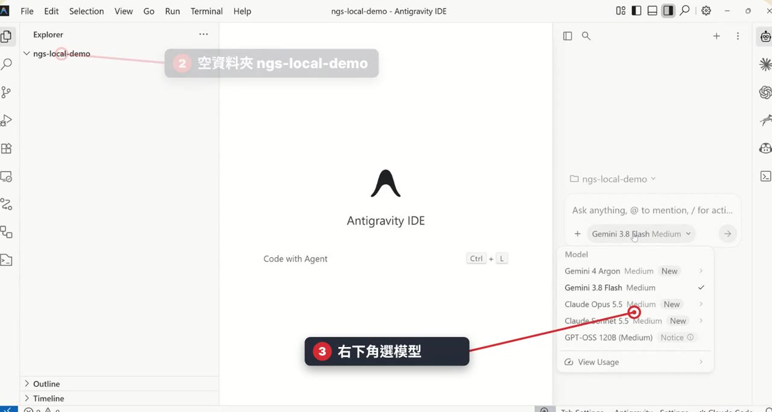
Step 3: Open a project folder
The AI only works in the folder you open
One new folder per project
How to open
1. Click the blue Open Folder
2. Create one in Documents
my-first-project
3. Select it, click Select folder
Next time: open from Workspaces
Notes:
The AI Agent only reads and writes files inside the folder you open, so open a new folder for each project. Click the blue Open Folder button in the middle, or File, Open Folder from the menu, create an empty folder in Documents, for example my-first-project, select it and click Select folder. The second half of the clip also shows choosing the model and thinking level in the bottom right. Folders you've opened are listed under Workspaces, so next time one click reopens them. (The clip's callouts are in Chinese.)

Slide 7
The layout: files left, preview middle, chat right
Left
Explorer
All files and folders in the project
Middle
Preview / editor
Click a file on the left to show it here
Right
Agent chat panel
Chat with the AI
Pick a model below
Low / Medium / High thinking
Far right
Agent icon bar
Switch between agents
Notes:
The layout has four areas from left to right. On the far left is the Explorer, with every file and folder in the project. In the middle is the preview and editing area: click a file on the left and its contents appear here. On the right is the agent chat panel, where we mostly talk to the AI; below it you can pick the model and one of three thinking levels, Low, Medium or High. The column on the far right is the agent icon bar for switching between agents.

Slide 8
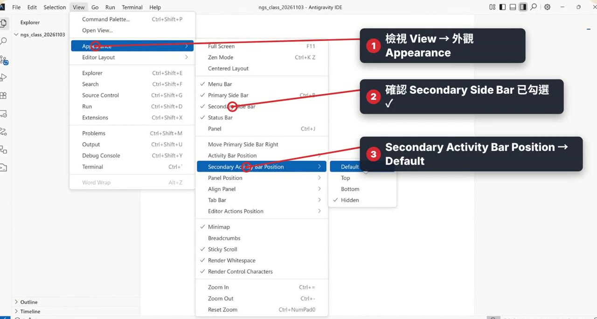
Put the AI chat panel on the right
① Chat panel
View → Appearance
View → Appearance
Check Secondary Side Bar
② Terminal (optional)
Right-click the terminal tab header
Move → Secondary Side Bar
Notes:
If you don't see the chat panel on the right, open View, Appearance from the top menu and check Secondary Side Bar. The clip shows the whole procedure. Once checked, a column of agent icons appears on the right; click one to switch. If you also want the terminal on the right, right-click the terminal tab header and choose Move, Secondary Side Bar. (The clip's callouts are in Chinese.)

Slide 9
Step 4: Ask the AI to install these tools
Git
Required
Records every version of your work
Node.js (with npm)
Required
Runs web apps, installs skills
uv
Required
Runs Python programs
GitHub CLI (gh)
Recommended
GitHub sign-in, saving work (not used in this course)
LibreOffice
Recommended
Office files; turns slides into images for the AI to check
ffmpeg
Recommended
Video and audio processing
Notes:
There are six tools to install. Three are required: Git records every version of your work; Node.js with npm runs web apps and installs skills; uv runs Python programs. Three are recommended: GitHub CLI signs in to GitHub and saves your work, which this course doesn't use; LibreOffice handles Word, Excel and presentation files and can turn slides into images for the AI to check the layout; ffmpeg handles video and audio. You don't need to look up how to install them; the AI works out whether you're on Windows or macOS.

Slide 10
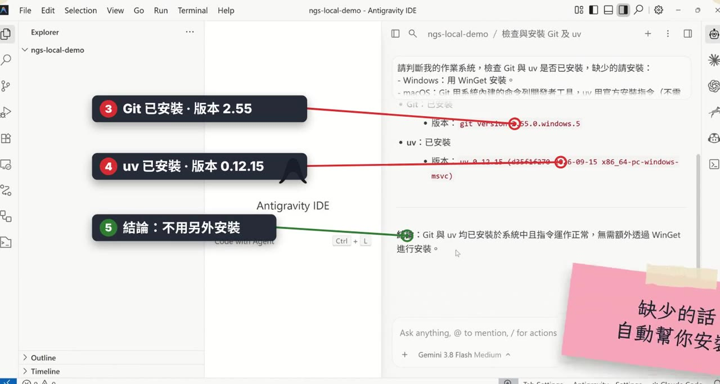
The AI detects the OS, checks, reports versions
The AI asks permission
Click Accept / Run: it isn't stuck
A system dialog pops up
Click “Yes” or “Install”
macOS asks for Password
Type your login password (no characters show)
Notes:
The clip shows what really happens after the AI gets the install instruction: it detects the operating system, writes its own commands to check Git and uv, and reports the versions, skipping anything already installed. Whenever the AI wants to run a command it asks permission first; click Accept or Run. That's a normal safety check, not the AI getting stuck. If a system dialog pops up, such as User Account Control on Windows or the command-line developer tools on macOS, click Yes or Install. When the macOS terminal shows Password, type your computer's login password and press Enter; no characters appear while you type, which is also normal. (The prompt in the clip was typed in Chinese.)

Slide 11
Prompts 1 & 2: install tools in one sentence
Prompt 1 Required tools
Please help me install Git, uv, and Node.js. Skip any that are already installed, tell me the reason if any fail, and finally list the version of each tool.
Restart Antigravity afterwards
New tools are only found after a restart
otherwise: “npm / git not found”
Prompt 2 Recommended tools
Please help me install GitHub CLI, LibreOffice, and ffmpeg. Skip any that are already installed, tell me the reason if any fail, and finally list the version of each tool.
LibreOffice is ~300–400 MB, so the download takes a while
No need to install project packages
The AI installs React, Vite and Python packages into the project with npm and uv
Notes:
Prompt 1 installs the required tools, Git, uv and Node.js: skip what's installed, explain failures, and list versions at the end. Afterwards you must quit and reopen Antigravity: newly installed tools are only found after a restart, otherwise you'll later see “npm not found” or “git not found”. Prompt 2 installs the recommended tools, GitHub CLI, LibreOffice and ffmpeg; the LibreOffice installer is about 300 to 400 MB, so it takes a while. You don't install React, Vite or Python packages yourself; the AI installs them into the project folder when it builds a project.

Slide 12
Classroom PCs: just check the tools
Check the tools
Please tell me the installed versions of git, gh, uv, node, npm, ffmpeg, and LibreOffice (soffice) on this computer.
List any that cannot be found, and do not install them yet.
✓
Done when
Every tool shows a version number
“Do not install them yet”
The AI only lists versions and missing tools; it installs nothing
Notes:
Classroom computers are already set up, so just paste this checking prompt. Note the last sentence, “do not install them yet”: the AI only lists versions and anything missing, and installs nothing. When every tool has a version number, Step 4 is done.

Slide 13
Step 5: Warm-up, your first web page
Prompt 3 First web page
Create a hello.html in this folder that displays "Hello Antigravity" and today's date in large text, then open it in the browser for me.
What success looks like
hello.html appears in the Explorer
The browser opens the page
Hello Antigravity
2026/11/09
Meaning
The AI can create files and run commands
Notes:
This step just confirms the AI works. Paste Prompt 3 into the chat panel on the right: create a hello.html that shows Hello Antigravity and today's date in large text, then open it in the browser. Success looks like two things: hello.html appears in the Explorer on the left, and the browser opens the page. That means the AI can create files and run commands on your computer, and your environment is ready. You don't need to keep my-first-project.

Slide 14
Step 6: Game example, Memory Match
Prompt 4 Memory Match game
In this folder, help me build a "Memory Match" card game using the simplest Vite + JS setup:
16 cards arranged randomly; flip two matching cards to clear them, and show move count and timer at the top.
When all cards are cleared, display "Congratulations!" and a "Play Again" button.
Once finished, start the web server directly and give me the URL so I can click and play.
Open a new folder first
my-second-project
Open it with Open Folder
What the AI does
Creates the project, installs packages
Starts the dev server
localhost:5173
Notes:
The main example: create another empty folder in Documents, my-second-project, open it with Open Folder, and paste Prompt 4. Notice the prompt spells out four things: what to build it with, Vite plus JS; the rules, sixteen cards, matching pairs clear, with moves and a timer; the end screen, Congratulations and Play Again; and what to do when finished, start the page and give me the URL. The AI creates the project, installs packages and starts a dev server, usually at localhost:5173. (In class the prompt was typed in Chinese and also asked for a Traditional Chinese interface.)

Slide 15
Play a round to check it's done
✓
Flip & match
✓
Moves & timer
✓
“Congratulations!”
Keep the game
Unit 02: install the frontend-design skill
Build it again with almost the same prompt
Compare the two
Windows firewall, server
Firewall dialog → click “Allow”
Keep the dev server running while the page is open
Done playing → tell the AI “stop the dev server”
Notes:
Open the URL the AI gives you and play a round: if flipping, matching, the move count and the timer all work, and Congratulations appears when every card is cleared, you're done. On Windows, if a firewall dialog appears, click Allow. While the page is open, keep the dev server running in the terminal; when you're done, just tell the AI “stop the dev server”. Keep this game: in Unit 02, after installing the frontend-design skill, we build it again with almost the same prompt so you can compare the two.

Slide 16
Ask the AI for changes in one sentence
“Make the cards fruit pictures”
“Add a best record”
“Use 20 cards”
After the change
Refresh the page to see it
One clear sentence
What to do, where, and what happens after
Notes:
Want more? Just tell the AI in one sentence what to change and how, for example make the cards fruit pictures, add a best record, or use 20 cards. Refresh the page after the change to see it. The trick to a good prompt is one clear sentence: what to do, where, and what should happen when it's done.

Slide 17
Mini glossary
Prompt
The instruction text you paste to the AI
Accept / Run
The AI asks before changing files or running commands
Terminal
A window for typed commands; the AI's commands show up here
Dev server
Runs the web app on your computer for now; keep it on to see your work
localhost:5173
Door (port) 5173 on this computer; only you can see it
Notes:
A few terms you'll hear all day. A prompt is the instruction text you paste to the AI. Accept or Run is the button the AI shows to ask your permission before it changes files or runs commands. The terminal is a window for typed commands, and every command the AI runs shows up there. A dev server is a program that runs the web app on your computer for now; the browser only shows your work while it is running. localhost:5173 is door number 5173 on this computer, and only your computer can see it.

Slide 18
When something goes wrong
Universal fix
Paste the whole error message to the AI and let it handle it
node / npm / git not found
Close and reopen Antigravity
Windows firewall dialog
Click “Allow”
“Running scripts is disabled”
Paste the error to the AI
URL won't open, port in use
Ask the AI to restart on another port
The AI keeps asking permission
Check, then click Accept / Run
Work or school account can't sign in
Use a personal Gmail
Notes:
Most problems are solved by pasting the whole error message to the AI and letting it handle it. A few common cases: node, npm or git not found, so close and reopen Antigravity. A Windows firewall dialog appears, so click Allow. PowerShell says running scripts is disabled, so paste the error to the AI. The URL won't open or the port is in use, so ask the AI to restart on another port. The AI keeps asking permission, so check what it wants and click Accept or Run. A work or school account can't sign in, so use a personal Gmail.

Slide 19
Appendix: other tools (optional)
pandoc
Markdown to Word
ripgrep, jq
Search files, process JSON
Install optional tools
Please help me install pandoc, ripgrep, jq, and ImageMagick, and then install yt-dlp using uv.
Skip any that are already installed, tell me the reason if any fail, and finally list the version of each tool.
ImageMagick
Image processing
yt-dlp
Download videos
Notes:
The appendix lists optional tools. You don't need them now; ask the AI to install them later when you do. pandoc converts Markdown to Word; ripgrep and jq search file contents and process JSON; ImageMagick handles images; yt-dlp downloads videos. The prompt on the right installs them all at once, with yt-dlp installed via uv.

