Slide 1
Unit 02 Frontend Design
frontend-design skill: a brand landing page and a Memory Match game
Video: movies/02-frontend-design.en.mp4 (Chinese: youtu.be/qVPdYf5CD2A)
Notes:
In this unit we use Anthropic's official frontend-design skill to build two things: a one-page website for a tea brand, and a Memory Match card game. We already built the card game once in Unit 01; this time we build it again with the skill installed and compare the two side by side. Before we start, let's spend a few minutes on what a skill is, where it lives, and how to install it.

Slide 2
What is a skill?
An operating manual for the AI
How to do a type of task
Which rules to follow
Which tools or scripts to use
The AI doesn't start from scratch each time
A folder
SKILL.md
Required: the workflow and rules
Optional: scripts, data, references
Triggers automatically
The AI reads the description at the top of SKILL.md to decide when to load it
Just describe the task
To force it: /skill-name or "Please use the xxx skill"
Notes:
Think of a skill as an operating manual written for an AI Agent. First card: it tells the AI how to do a type of task, which rules to follow, and which tools it can use, so the AI doesn't have to figure things out from scratch every time. Second card: physically it is just a folder; at its core is SKILL.md, and next to it you can put scripts, data or reference documents. Third card: you usually don't have to name it. The AI reads the description at the top of SKILL.md to decide whether the task needs it; if you really want to force it, type a slash and the skill name, or just say "Please use the such-and-such skill."

Slide 3
Where skills are installed
Project directory
.claude/skills/
.agents/skills/
Applies to this project only (this unit installs here)
User directory
~/.claude/skills/
Global skills: active in every project
Note
Global skills on your computer also show up in workshop projects and may compete with this unit's skills to trigger
Notes:
Skills can be installed in two places. The project directory, such as .claude/skills or .agents/skills, applies only to that project, and that's where this unit installs. The user directory, such as .claude/skills in your home folder, is global: every project can use it. One reminder: if your computer already has global skills, they also show up in this workshop project and may compete with this unit's skills to trigger. If the AI picks the wrong skill, check here first.

Slide 4
Installation syntax
Command format
npx skills add <github-owner>/<repo>[@skill-name] -a antigravity -a claude-code --copy -y
owner/repo[@name]
Without @: install every skill in the repo
With @name: install just that one
-a
Choose the AI Agent
Writes to .agents/skills/ and .claude/skills/
--copy
Copy files instead of symlinks
More reliable on Windows
-y
Skip confirmation prompts
Notes:
This is the full syntax of npx skills add. Look at the whole line first, then each parameter. owner/repo installs every skill in the repo; add @ and a name to install just one. -a picks which AI Agent to install for; we install for both Antigravity and Claude Code, so it writes to both .agents/skills and .claude/skills. --copy copies the files instead of creating links, which is more reliable on Windows. -y skips the confirmation prompt.

Slide 5
Manage skills, then restart the chat
Search
npx skills find <keyword>
Update
npx skills update
Update all installed skills
Version record
skills-lock.json
Appears in the project root after installing
Start a new chat
After installing a skill, start a new AI Agent chat so it takes effect
Notes:
Two common management commands: npx skills find plus a keyword searches for skills, and npx skills update updates every installed skill. After installing, a skills-lock.json file appears in the project root, recording which versions are installed. The most important card is the last one: always start a new AI Agent chat, or the skill won't take effect. Many people install and then keep typing in the old chat, and the skill never loads.

Slide 6
Install frontend-design
Open the right folder first
Antigravity → Open Folder
Open 02-ai-workshop-frontend-design
Not the outer ai-workshop-research
Run in the terminal
npx skills add anthropics/skills@frontend-design -a antigravity -a claude-code --copy -y
Like a design director
Finds colors, fonts and layout in the subject itself
Avoids the AI-template look
Purple gradient + big numbers + cards
Notes:
Before you start, check that Antigravity's Open Folder opened 02-ai-workshop-frontend-design, not the outer ai-workshop-research, or the skill will be installed in the wrong place. Then run this command in the terminal. frontend-design is Anthropic's official skill: it makes the AI work like the design director of a studio, finding colors, fonts and layout in the subject itself. What it specifically avoids is the AI-template look we all know: purple gradients, big numbers, a row of cards. Remember to start a new chat after installing.

Slide 7
Three key concepts
1
Clarify first, then style
Subject, audience, the page's main goal
Only then choose an aesthetic direction
2
An iconic hero
Put the most representative thing about the subject there
3
Type is design
Choose fonts deliberately
Build a clear type scale
Notes:
frontend-design follows three principles. First, clarify the subject, the audience and the page's main goal before choosing an aesthetic direction, instead of picking colors right away. Second, the hero section, the first screen, should show the most representative thing about the subject. Third, fonts are chosen deliberately, with a clear type scale; typography itself is part of the design. When we look at the AI's output in a moment, compare it against these three points.

Slide 8
Example 1: a product page with character
Task prompt
In the directory output/case01/, build a single-page official website (HTML + CSS) for a Taiwanese artisanal tea brand called "Shanlan Tea Research Institute (山嵐茶研所)", saving the main page as output/case01/index.html.
The target audience is 30–50 year-old consumers who value origin and craftsmanship.
Required sections: Brand Story, Introduction to Three Teas, Tea Origin Map, and Order Button.
Do not use a generic SaaS template style—please propose 2 aesthetic directions for me to choose from first.
Expected behavior
Proposes 2 directions first, e.g. "Xuan Paper & Ink Wash + serif type" or "High-Mountain Morning Mist + generous whitespace"
Builds only after you choose
Verify the trigger
Ask: Which Skills did you use in this case?
Notes:
Example one: a one-page website for a Taiwanese artisanal tea brand, Shanlan Tea Research Institute. Notice the last line of the prompt: no SaaS template style, and propose two aesthetic directions for me to choose from first. So the AI won't start coding right away; it gives you directions first, such as Xuan paper and ink wash with serif type, or high-mountain morning mist with generous whitespace, and builds only after you choose. When it's done, ask "Which Skills did you use in this case?" to confirm it really loaded frontend-design. In the demo the prompt was typed in Chinese.

Slide 9
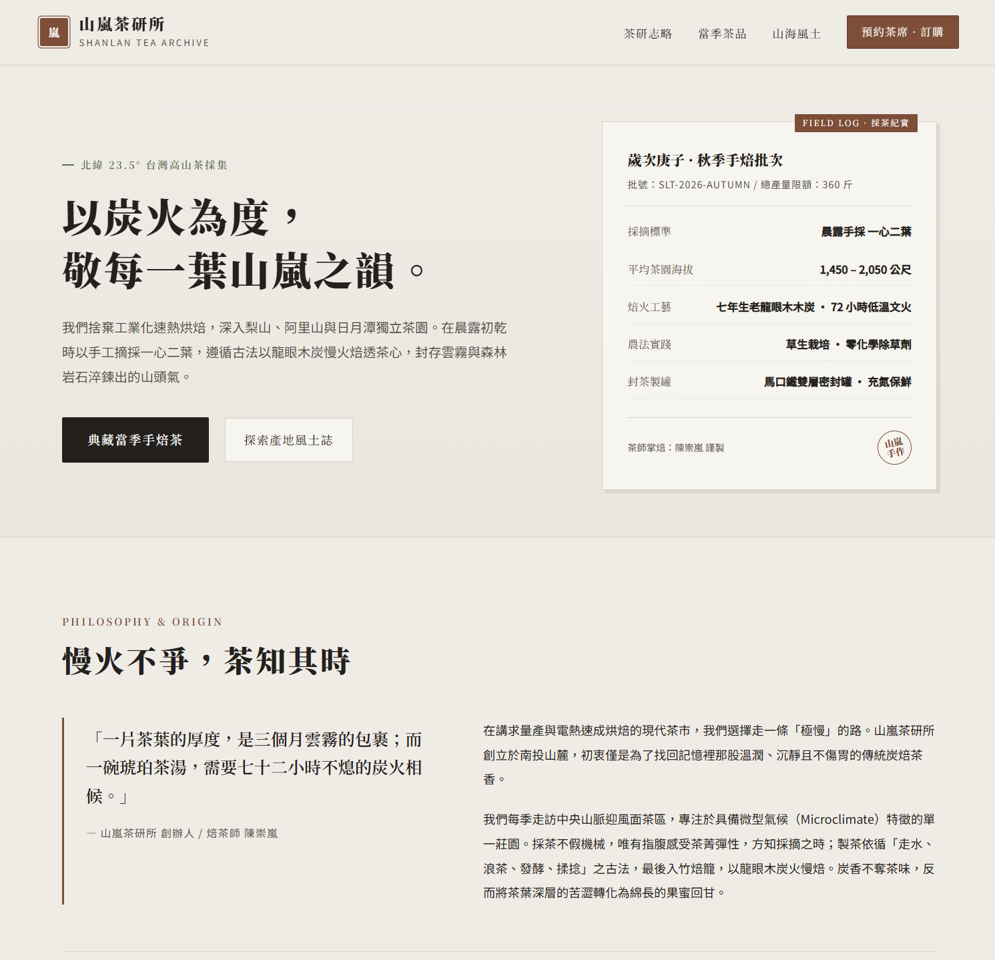
Example 1 result: Shanlan Tea Research Institute
Colors and fonts
Off-white background, tea-brown accents, serif headline
An iconic hero
A "harvest record" batch card: altitude, roasting craft, farming method
No template look
No gradients or icon cards: like a tea field notebook
Notes:
This is the home page Example 1 actually produced; the page itself is in Chinese. First the colors and fonts: an off-white background with tea-brown accents and a serif headline, a bit like rice paper and brush writing. Then the hero: on the right is not a product photo but a harvest-record batch card listing altitude, roasting craft and farming method; that is the subject's most representative thing placed on the first screen. The whole page has no gradients and no row of icon cards; it reads like a tea field notebook rather than a SaaS template.

Slide 10
Example 2: Memory Match vs Unit 01
Expected behavior
Creates a Vite + JS project with shuffle and match logic
Starts the server in the background and gives a URL (e.g. localhost:5173)
Task prompt
In the directory output/case02/, help me build a "Memory Match" card game using the simplest Vite + JS setup:
16 cards arranged randomly; flip two matching cards to clear them, and show move count and timer at the top.
When all cards are cleared, display "Congratulations!" and a "Play Again" button.
Once finished, start the web server directly and give me the URL so I can click and play.
Compare side by side
Compare colors, fonts and layout with the Unit 01 version
Notes:
The prompt for Example 2 is almost the same as Unit 01 step 6; the only difference is that frontend-design is now installed. The AI creates a lightweight Vite project, writes the shuffle and match logic, starts the server in the background, and gives you a URL like localhost:5173 to click and play. When it's done, open both versions side by side and compare colors, fonts and layout. Again, ask which skills it used. In the demo the prompt was typed in Chinese and also asked for a Traditional Chinese interface.

Slide 11
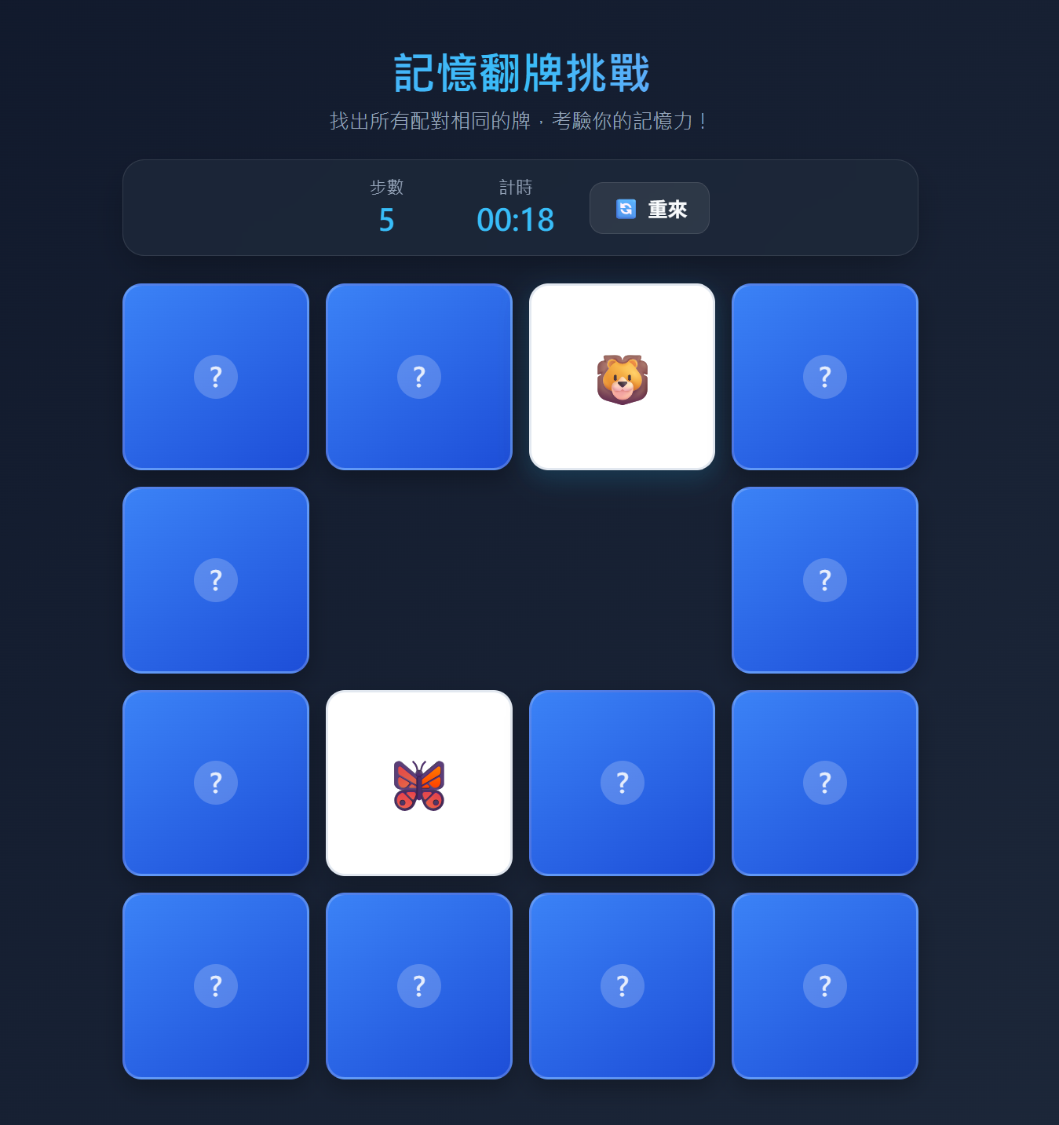
Example 2 result: Memory Match (UI in Chinese)
Layout
Moves, timer and restart in a top panel; a 4×4 board below
Interaction
Flipped cards turn white to show the picture; matched pairs disappear
Side by side with Unit 01
How do the colors, fonts and layout differ?
Notes:
This is the game Example 2 produced; its interface is in Chinese. The title, move count, timer and restart button sit in a top panel, with a 4 by 4 board below. A flipped card turns white to show its picture, and a matched pair disappears, leaving an empty space. Now open the version you built in Unit 01 next to it, compare the colors, fonts and layout, and think about where the skill made a difference.

Slide 12
The workflow
5
Ask
Which Skills did you use in this case?
4
Give the prompt
Ex 1 product page, Ex 2 card game
3
Start a new chat
so the skill takes effect
2
Install the skill
Install frontend-design in the terminal
1
Open the folder
Open Folder: 02-ai-workshop-frontend-design
Notes:
Finally, let's put the whole flow together: open the right folder, install the skill, start a new chat, give the prompt, and ask which skills it used. The first three steps are where mistakes happen, especially forgetting to start a new chat. Now please start on Example 1.

