Slide 1
Unit 00 Cloud vs. Local
One paper, two ways to use AI
ChatGPT on the web → Claude Code in the editor → Gemini cross-check
Notes:
This unit opens the workshop. We take the same paper and the same three questions and give them to ChatGPT on the web in the cloud, and to an AI editor on your own computer, to see how the two approaches differ. We show the result first; the following units teach you how to do it step by step. Note: the live demo was run in Chinese, so the screenshots show Chinese prompts and answers; the slides give the English versions.

Slide 2
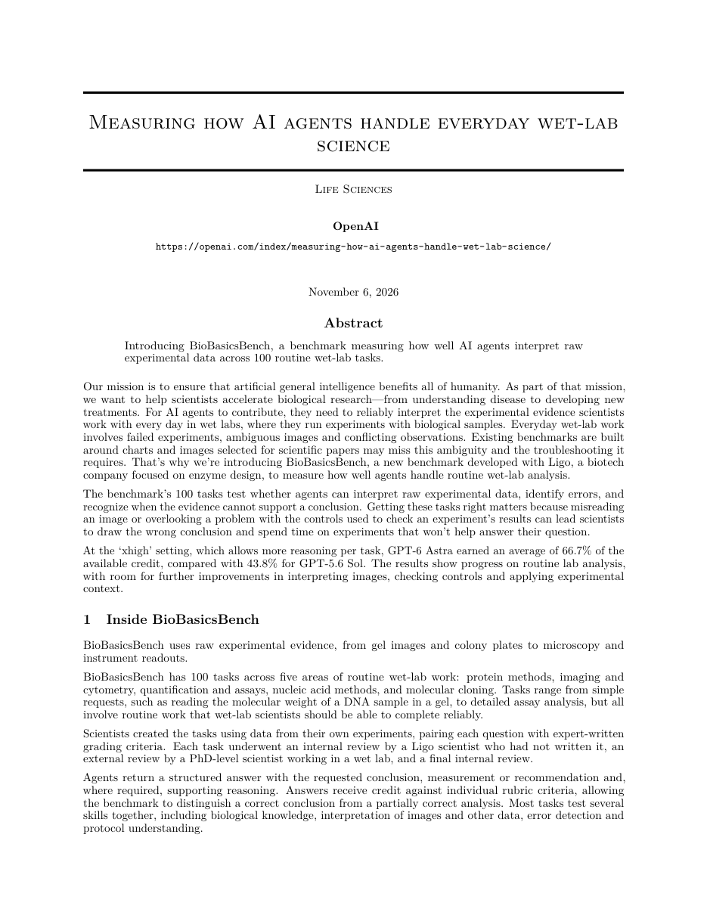
The demo paper: can AI read wet-lab data?
measuring-how-ai-agents-….pdf
BioBasicsBench: 100 everyday wet-lab questions
OpenAI × biotech company Ligo (November 6, 2026)
From scientists' own data: gels, blots, microscopy images, instrument exports
Five domains (questions)
Protein Methods 25
Imaging & Flow Cytometry 23
Quantification & Assays 19
Nucleic Acid Methods 17
Molecular Cloning 16
Notes:
The demo uses OpenAI's "Measuring how AI agents handle everyday wet-lab science", published November 6, 2026, which we typeset as a paper-style PDF. OpenAI partnered with the biotech company Ligo to build BioBasicsBench, which tests AI Agents on 100 everyday wet-lab questions. The questions come from scientists' own experimental data, such as gels, blots, microscopy images and instrument exports, across five domains.

Slide 3
The same three questions, cloud and local
Prompt ① Concept
What does "wet-lab science" in the title of this paper mean? Why would AI be used to handle laboratory work?
Prompt ② Make a table
The paper says AI was tested on 100 lab questions—what kind of questions were they? Multiple-choice or image-reading questions? Please summarize them in a simple table for me.
Prompt ③ Practical use
I am a new graduate student who just joined a biology lab. How can I safely use AI to help check my experimental data without being misled by it?
Notes:
Both the cloud and the local approach get the same three questions. Question one asks what wet-lab science means and why AI would handle lab work. Question two asks what the 100 questions test and requests a table. Question three takes the view of a new graduate student and asks how to safely use AI to check experimental data. In the demo these were typed in Chinese; these are the English versions.

Slide 4
Three more: save as Word, cross-check with Gemini
Prompt ④ Save as a Word report
Please organize the discussion questions and answers above and save them as a Word report named report.docx
Typed in the cloud demo: "Save this result as a Word report"
Prompt ⑤ Cross-check with Gemini
report.docx contains questions and answers generated by an AI agent based on measuring-how-ai-agents-handle-wet-lab-science.pdf. Please verify whether the content is accurate.
Prompt ⑥ Revise and save
Please revise the report according to your suggestions and save it under a new filename.
Notes:
After the three questions, one sentence asks for a Word report. In the cloud demo, the shorter request actually typed was "Save this result as a Word report". For cross-checking on the local side, we switch to Gemini and say two more things: check the report against the PDF, then revise it as suggested and save it under a new name.

Slide 5
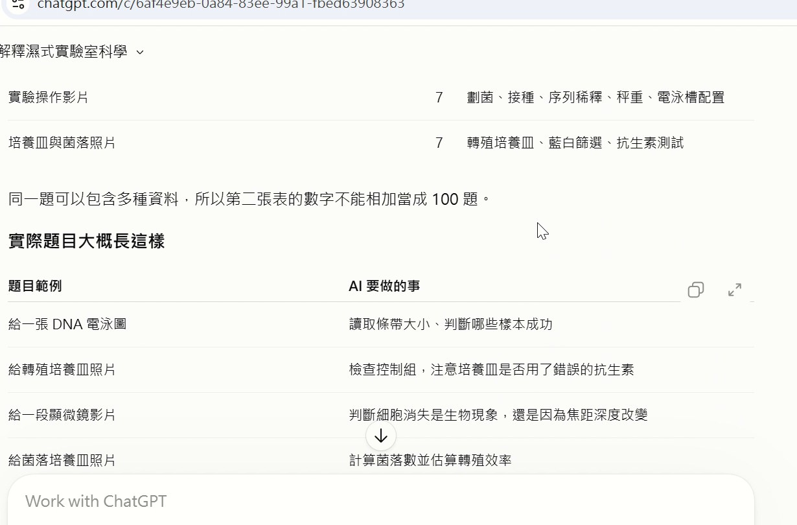
Cloud: upload the PDF, ask one at a time
ChatGPT web · answer to Q2 (in Chinese)
1
Upload the PDF
Pick the file and send it to the site
2
Ask each question
Three questions in turn
3
Answers cite sources
Thorough, with references to the paper
Notes:
The cloud approach: open ChatGPT on the web, upload the PDF, then ask the three questions one at a time. The answers are thorough; the screenshot shows the answer to question two, which cites the paper. The demo was in Chinese, so the screen is in Chinese.

Slide 6
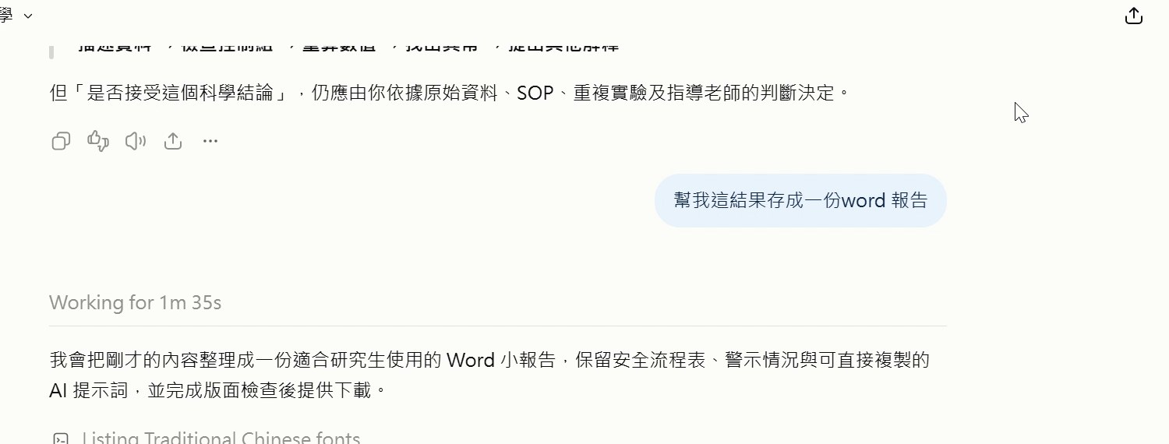
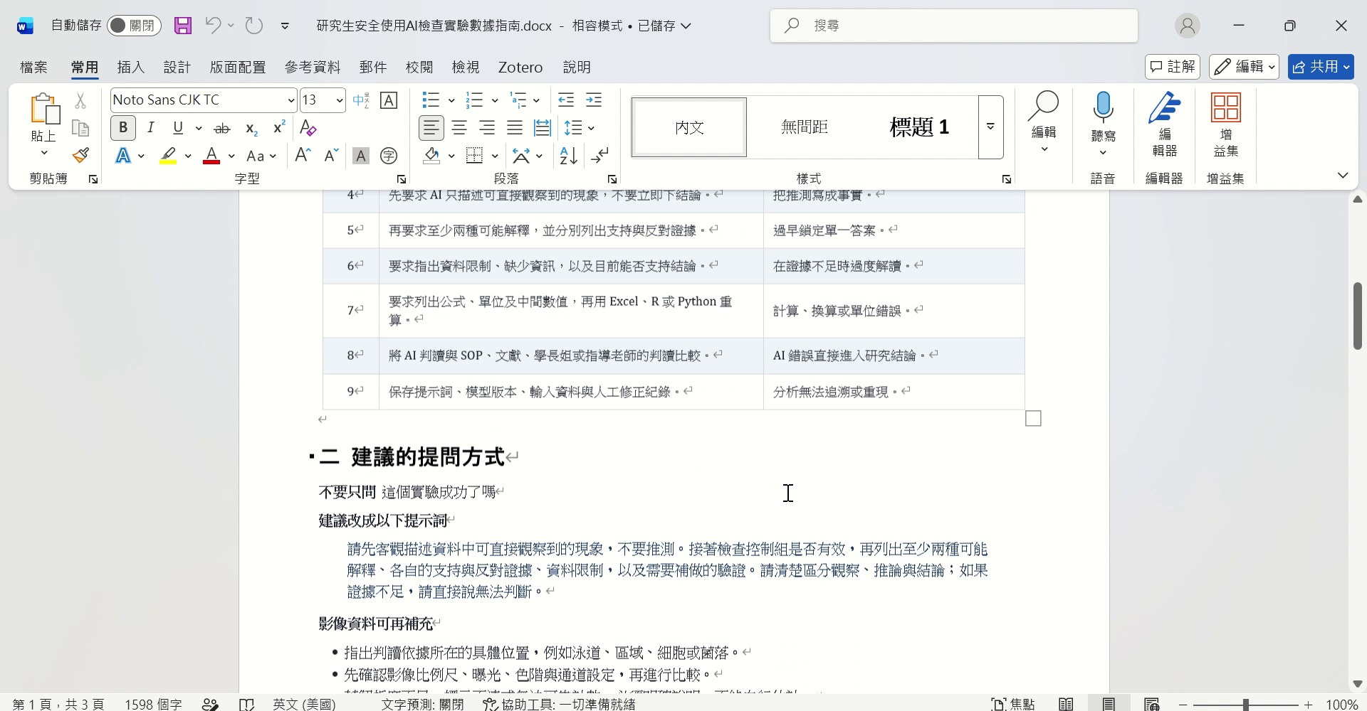
Cloud: a Word file you still have to download
"Save this result as a Word report" → Working for 1m 35s
Downloaded, then opened in Word
You wait, and you move the files
Upload PDF → wait over a minute → download → open in Word
Notes:
Finally we ask ChatGPT for a Word report. It works for over a minute; the screen shows Working for 1m 35s. When it's done, you still have to download it yourself and open it in Word. Moving files between the site and your folder is up to you.

Slide 7
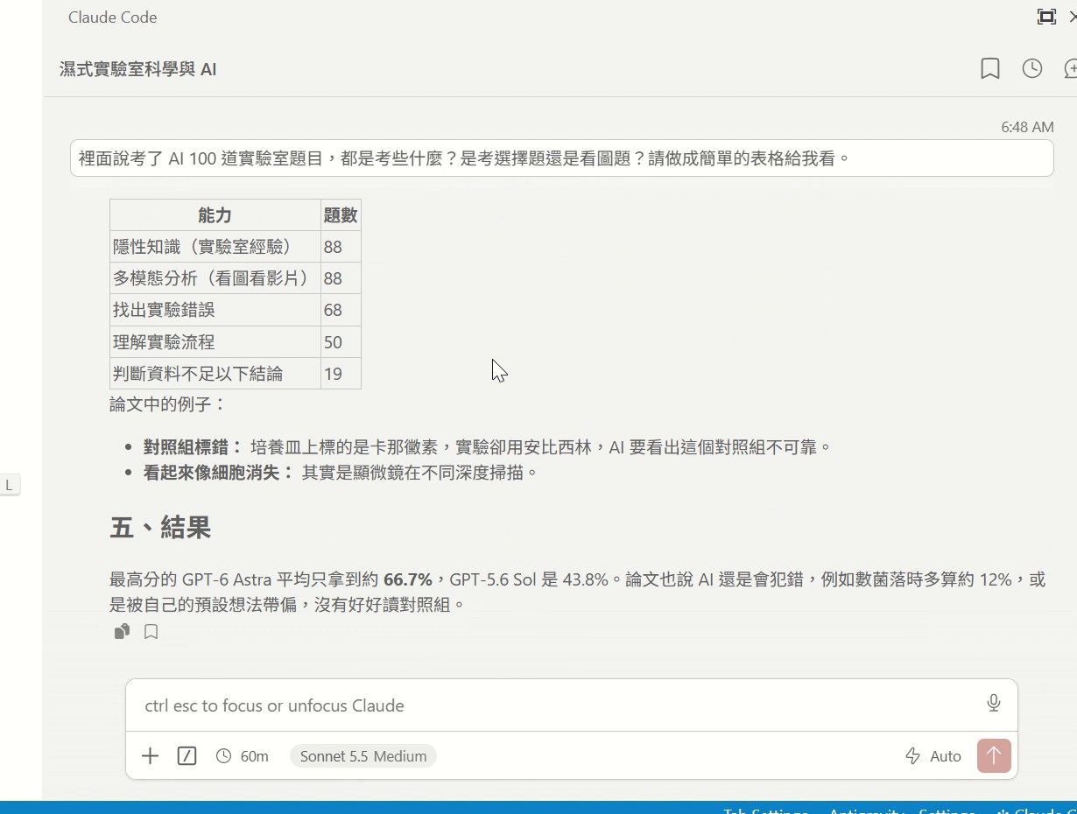
Local: the paper is already in your folder
Claude Code · Q2 as a table (in Chinese)
1
Paper in your folder
No upload needed
2
Finds and reads the file
Claude Code locates the PDF, then answers
3
Makes a table
Q2: the 100 questions in a table
Notes:
The local approach: the paper sits in a folder on your own computer. Open Claude Code in the Antigravity editor and ask the same three questions. It finds the PDF in the folder by itself and reads it before answering. For question two, it organizes the 100 questions into a table.

Slide 8
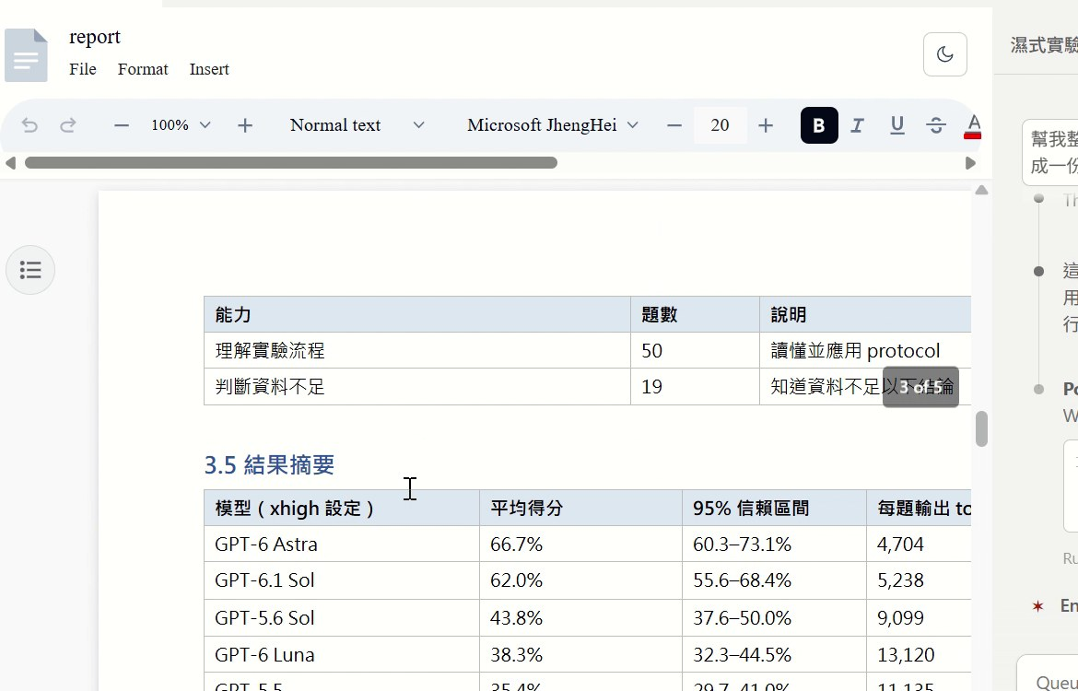
One sentence: it writes code to build the Word file
Prompt ④
Please organize the discussion questions and answers above and save them as a Word report named report.docx
report.docx opened in the editor
1 Loads the docx skill
Taught in Unit 03
2 Writes code to build the file
Then checks the layout as PDF
3 report.docx in the same folder
No download, no moving files
Notes:
Then one sentence: save it as a Word report. Claude Code loads the docx skill, writes code to generate the file, and converts it to PDF to check the layout. report.docx appears in the same folder, and you open it in the editor to check it. Installing and using the docx skill is covered in Unit 03.

Slide 9
What's inside report.docx
AI and Wet-Lab Science
Paper Reading and Discussion Report (written in Chinese)
1. About this report
2. Q1: What is wet-lab science? Why would AI handle lab work?
3. Q2: Which 100 questions was AI tested on?
4. Q3: How can a new grad student check data safely with AI?
5. Summary
Question 1
Wet lab vs dry lab comparison table
Why AI would handle lab work
Question 2
Counts per domain: 25 / 23 / 19 / 17 / 16
Data given to AI: gels & blots, protocols & notes, tables & instrument exports…
Notes:
report.docx is titled "AI and Wet-Lab Science: Paper Reading and Discussion Report" and is organized by question. Because the demo was in Chinese, the report itself is in Chinese; here is its outline in English. Question one has a wet lab versus dry lab comparison table. Question two has a table of question counts across BioBasicsBench's five domains, plus the kinds of data given to the AI. Question three gives graduate students advice on using AI safely to check experimental data, followed by a summary.

Slide 10
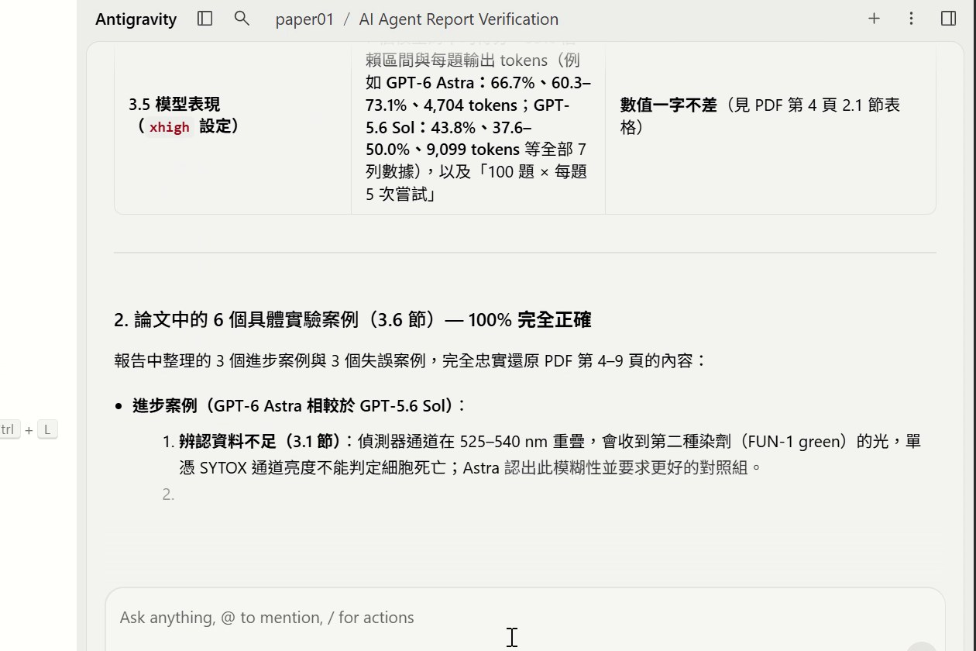
Cross-check with another model: Gemini vs the PDF
Prompt ⑤
report.docx contains questions and answers generated by an AI agent based on measuring-how-ai-agents-handle-wet-lab-science.pdf. Please verify whether the content is accurate.
Gemini · checks against the PDF (in Chinese)
Checked against the PDF: all correct ✓
Basic facts
Question counts per domain
Success and failure cases
Also flags paragraphs not in the paper
Background extensions, e.g. general remarks on self-driving labs
Notes:
Then we cross-check with Gemini: in the same editor, switch to Gemini and ask it to check report.docx against the PDF. It goes item by item: basic facts, question counts per domain, success and failure cases. All correct. It also points out which paragraphs are background that isn't in the paper. Claude writes, Gemini reviews: two models checking each other.

Slide 11
Revise as suggested, save a new file
Prompt ⑥
Please revise the report according to your suggestions and save it under a new filename.
report.docx
2.2 Why AI handles lab work
Only broad background (labs are the bottleneck, self-driving labs…), with nothing marking what isn't in the paper
report_revised.docx
[Core Reasons Identified in the Paper]
Interpreting and troubleshooting everyday raw data
[Broader Background Supplement]
General remarks such as self-driving labs
Notes:
The last sentence: revise according to the suggestions and save under a new filename. After revision, the background paragraphs are labeled as background and saved as report_revised.docx. Take section 2.2, why AI handles lab work: the revision splits it into Core Reasons Identified in the Paper and Broader Background Supplement, so readers can tell what the paper says from what the AI added.

Slide 12
Cloud vs. local
 | Cloud (ChatGPT web) | Local (editor + AI Agent)
Files | Upload the PDF, download the report | AI reads and writes files in your folder
Output | Download it, then open it | report.docx appears in the same folder
Checking | The same model | Switch to Gemini to cross-check
Getting started | Open a web page and go | Install the editor and skills first (Units 01–03)
Notes:
To compare: in the cloud you upload, ask and download, and you can start just by opening a web page. Locally, the AI reads and writes the files in your folder, the report appears in the same folder, and another model can cross-check it. The cost is installing the editor and skills first, which is what Units 01 to 03 do.

Slide 13
Move the AI Agent's brain onto your laptop
Read papers
Finds the PDF in your folder itself
Write reports
Saves report.docx straight into the folder
Cross-check
Claude writes, Gemini reviews
Your partner in research
Next: Unit 01, starting with installing Antigravity
Notes:
Working locally is like moving the AI Agent's brain onto your laptop. Right in your folder, it reads papers, writes reports, and cross-checks, becoming your research partner. To try it yourself, open the 00-ai-workshop-openai folder in the editor and paste the prompts in order. The next unit starts by installing Antigravity and builds this local AI workspace step by step.

