Slide 1
Unit 06 Research Paper Workflow
From analysis results to an English paper with citations
Read the brief → Find literature → Take notes → Write → Check and export PDF
Notes:
In the previous unit we ran a QIIME 2 analysis on NCHC HPC and answered three questions. In this unit we work with an AI Agent to turn those results into an English paper with citations, entirely inside a folder on your own computer, with no Zotero or NotebookLM needed. There are five steps: read the research brief, find literature, take notes, write the paper, and finally check everything and export a PDF. What this unit produces is a draft for writing practice and must not be submitted as is.

Slide 2
We already have three answers, but a report is not a paper
Q1 How does the microbiome change?
Richness drops sharply; Enterococcus takes over
1
Prior work
A paper must say what others have done
Q2 Do the groups differ?
Longitudinal model: auto-FMT declines more slowly (p = 0.016)
2
Traceable sources
For every number and every citation
Q3 Which bacteria track time?
Enterococcaceae and Lachnospiraceae
Unit 06: turn the results into an English paper with citations, together with AI
Notes:
The previous unit answered three questions: transplantation sharply reduces microbial richness; in the longitudinal model, the auto-FMT group declines more slowly; and the bacteria that rise and fall over time are Enterococcaceae and Lachnospiraceae. With questions, answers, and data in hand, writing a paper gets much easier. But a paper needs two more things: prior work, and a traceable source for every number and every citation.

Slide 3
What the folder already holds
Files already there
manuscript/00-research-brief.md ★ research brief
data/tables/ the only source of numbers
data/figures/ the report's 8 figures
data/Qiime2_Pipeline.sh Methods parameters
AGENTS.md rules the AI must follow
AGENTS.md already says
Numbers only from data/tables/
Cite only papers in the library
24 patients: never write "proves efficacy"
arxiv
Search papers
paper-library
Collect, build bibliography
research-paper-writing
Writing principles
arxiv-preprint
Typeset and check
Notes:
The folder already contains the research brief, the raw tables of numbers, the eight figures from the analysis report, the AI-produced analysis report and analysis script, and an AGENTS.md with the rules written down. There are also four skills: arxiv for searching, paper-library for collecting, research-paper-writing for writing principles, and arxiv-preprint for typesetting and checks. Because the rules and skills already specify the details, every prompt that follows can be very short.

Slide 4
What is the research brief?
3 research questions
Q1 microbiome change · Q2 group difference · Q3 which bacteria
Answers
Richness drops; gentler LME slope (p = 0.016); Enterococcaceae, Lachnospiraceae
Limitations
24 patients, LME not converged, time spans FMT… (6 in all)
Sources
Each number tagged with its file in data/tables/
Search keywords
One set per limitation, used directly in Step 2
No brief yet?
Ask the AI to write one from data/tables/ and save it as 00-research-brief.md
manuscript/00-research-brief.md: last unit's results on one page
Notes:
The research brief condenses the previous unit's results onto one page: three research questions, their answers, the study limitations, the raw table each number comes from, and search keywords for each limitation. With it, the AI knows from the start what the paper is about. When you switch to your own data there is no ready-made brief, so ask the AI to write one from your own results.

Slide 5
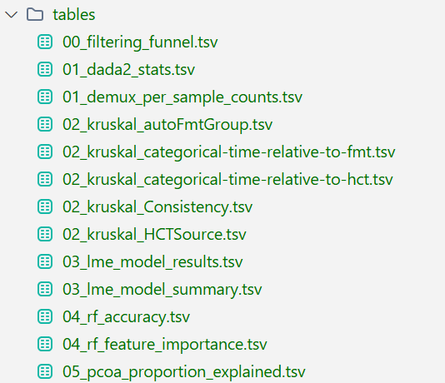
What is in data/tables/
data/tables/ · 13 files
Grouped by file-name prefix
00 Filtering: samples, ASVs, reads left at each step
01 DADA2 denoising stats, reads per sample
02 Kruskal-Wallis × 5: group, period, FMT period, stem cell source, stool consistency
03 LME coefficients, confidence intervals, summary (Converged: No)
04 Random forest: accuracy predicting week, taxon importance
05 PCoA explained variance for 4 beta diversity distances
Every number in the paper is read from here
Notes:
data/tables holds the results you produced on the HPC: 13 files, grouped by file-name prefix. 00 is the filtering steps; 01 is DADA2 denoising stats and reads per sample; 02 is five Kruskal-Wallis tests; 03 is the longitudinal model's coefficients and summary, which notes that the model did not converge; 04 is the random forest's accuracy and feature importance; 05 is the PCoA explained variance. Every number in the paper must be read from here.

Slide 6
Five steps, each with a purpose
Step 1
Read the brief
Align on the paper's direction
Step 2
Find literature
What others did; support for limitations
Step 3
Notes · matrix
Quotable passages; what others did, what we lack
Step 4
Write
Methods → Results → Intro → Discussion → Abstract → Title
Step 5
Check · export
Every citation and number traceable
Notes:
There are five steps, each with a purpose. Read the brief, to align on the paper's direction. Find literature, because a paper must say what others have done, and the limitations need support. Take notes and build a comparison table: copy quotable passages, and see what others did and what we are missing. Then write the paper. Finally, check every citation and number, and export the PDF.

Slide 7
Step 1: Read the research brief
no skill needed
Prompt
Please read manuscript/00-research-brief.md, cross-check the numbers against data/tables/, and tell me in plain language: what questions this paper answers, what the answers are, what the limitations are, and what literature we need to find.
AI reports
Checked against data/tables/: exact match ✓
The three questions and answers, in plain language
6 study limitations, with search keywords
The paper's storyline
Pooled: no difference; only the longitudinal model shows the slope difference
Positioning: a comparison of analysis methods, no efficacy claims
Notes:
Step one needs no skill. Ask the AI to read the research brief, cross-check the numbers against data/tables, and explain the questions, answers, limitations, and the literature to find in plain language. In the test run, the AI checked the tables one by one, reported that the numbers matched exactly, and explained six study limitations. The paper's storyline: pooled together the groups look the same, and only the longitudinal model shows the slope difference. The paper is positioned as a comparison of analysis methods and does not claim efficacy.

Slide 8
Step 2: Find literature
SKILL · arxiv
Prompt
Please use the arxiv skill to search for related papers using the search keywords in manuscript/00-research-brief.md. List the candidates for me to choose from, mark the most recommended ones with ★, and don't download anything yet.
Candidates · ★ 8 recommended
FMT engraftment: Herman 2024 ×2
Longitudinal models: Fontaine 2026, Barrera 2025
Repeated measures: Zhang 2026
Rarefying debate: McMurdie 2013, Raspet 2024
Compositional data: Zhou 2021
You decide what to collect
Off-target results?
abs:microbiome AND abs:longitudinal
Notes:
Step two searches with the arxiv skill. Ask it to find papers using the brief's search keywords and to list candidates without downloading anything, so you decide what to collect. In the test run, the AI listed candidates under five topics and marked eight as recommended. If unrelated papers creep in, ask the AI to search again with syntax such as abs:microbiome AND abs:longitudinal.

Slide 9
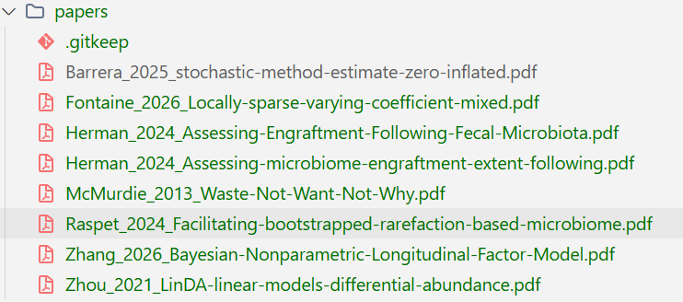
Step 2: Collect papers, register by DOI
SKILL · paper-library
Prompt ①
Please use the paper-library skill to add all the arXiv papers marked ★ as recommended.
papers/ · downloaded and renamed
Prompt ② not on arXiv
Please use the paper-library skill to register these 4 papers by DOI: the original Taur 2018 trial, QIIME 2, DADA2, and SILVA.
references.bib
The bibliography: papers may only cite from here
12 papers
8 arXiv + 4 by DOI
⚠ Don't skip the DOI step
Without it, the paper cites neither the trial nor the tools
Notes:
Next, the paper-library skill collects the recommended arXiv papers: it downloads the PDFs, renames them to author, year and title, and writes them into the bibliography file references.bib. The original clinical trial, Taur 2018, plus QIIME 2, DADA2 and SILVA are not on arXiv, so register them by DOI. Don't skip this step: without these four, the paper cites neither the original trial nor the analysis tools. The library holds 12 papers: 8 from arXiv and 4 by DOI.

Slide 10
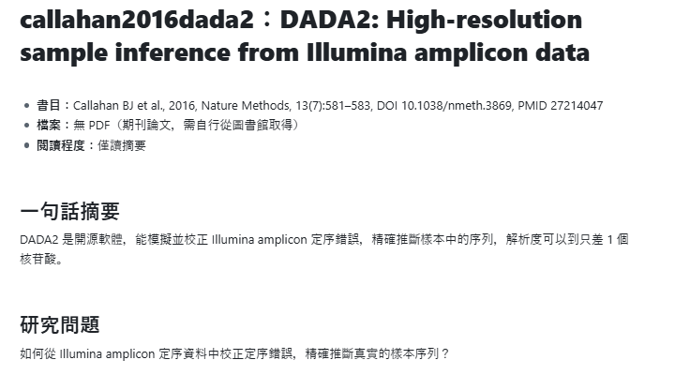
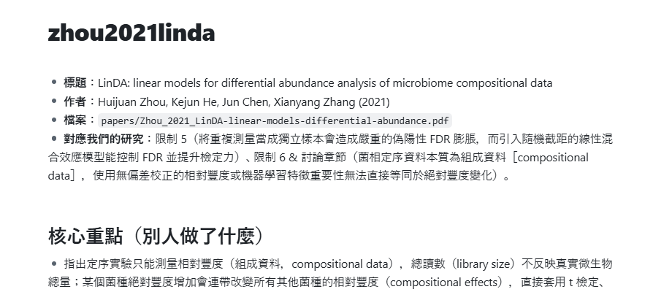
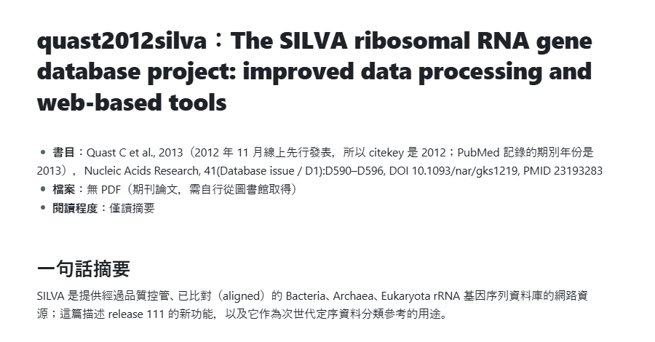
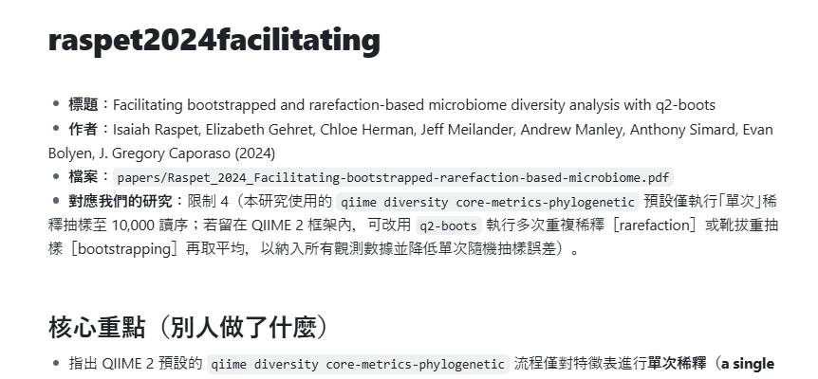
Step 3: Notes and a literature matrix
no skill needed
Prompt ①
Please read each paper in papers/ and write a note for each one in library/notes/, including quotable passages with page numbers. For papers that only have a DOI and no PDF, read the abstract instead and mark the note "abstract only" (僅讀摘要).
Prompt ②
Based on the notes in library/notes/ and the study limitations in manuscript/00-research-brief.md, put together a literature matrix: what others have done and what we are missing. Save it as library/literature-matrix.md.
literature-matrix.md · limitation → solution
LME not converged → SAEM (Barrera 2025)
Single rarefying → q2-boots (Raspet 2024)
Non-independence → LinDA-LMM (Zhou 2021)
Time spans FMT → time-varying model (Fontaine 2026)
Notes:
Step three needs no skill; the AI reads the PDFs directly. First ask it to write a note for each paper: citation, one-line summary, research question, methods, main findings, relation to our study, and most importantly, quotable passages copied word for word with page numbers. Papers with only a DOI get notes from the abstract, marked abstract only. Then ask for a literature matrix: each of the six limitations is matched to a solution from the literature, for example SAEM for the unconverged model, q2-boots for single rarefying, and LinDA-LMM for non-independent samples. The notes themselves were written in Chinese in the test run.

Slide 11
Step 4: First, set up the paper skeleton
SKILL · arxiv-preprint
Prompt
Please use the arxiv-preprint skill to set up an English paper skeleton in manuscript/, with one file per section under sections/.
main.tex + 7 section files
sections/01-methods.tex
sections/02-results.tex
sections/03-introduction.tex
sections/04-discussion.tex
sections/05-abstract.tex
sections/06-title.tex
sections/07-declarations.tex
Example: empty skeleton of 01-methods.tex
\section{Methods}
\subsection{Data source and participants}
% trial, filtering ← data/tables/00_filtering_funnel.tsv
\subsection{Processing}
% QIIME 2 version, DADA2, SILVA ← data/Qiime2_Pipeline.sh
\subsection{Statistical analysis}
% Kruskal-Wallis, LME, random forest
Notes:
Step four is writing. First, the arxiv-preprint skill sets up the structure: one main file, main.tex, that pulls in each section in reading order; seven section files containing only an outline, numbered in writing order; and an empty two-page skeleton that already compiles. On the right is the empty skeleton of 01-methods.tex: each subsection notes which file its data comes from. The actual subsection names may differ; the test run ended up with four subsections.

Slide 12
One sentence per section: writing order ≠ reading order
1
Methods
Most certain, easiest
2
Results
Facts only
3
Intro
Once results are set
4
Discussion
Prior work + limits
5
Abstract
Condensed at the end
6
Title
Decided last
Review each section before writing the next
AGENTS.md: numbers from data/tables/, cite only the library, wording must match the evidence
Notes:
Then write one section at a time, with just one sentence each. The writing order is not the reading order: first the Methods, the most certain part; then Results, which only describe the data; then the Introduction and Discussion; the abstract is condensed only after the full text is done; and the title comes last. The prompts can be this short because AGENTS.md and the skills already say that numbers come only from data/tables, only papers in the library may be cited, and a 24-patient study must not claim to prove efficacy. Review each section before writing the next.

Slide 13
Sentence 1: Methods
SKILL · research-paper-writing
Prompt
Please refer to the research-paper-writing skill and write the Methods in English.
sections/01-methods.tex (4 subsections)
2.1 Study design, data source, and cohort filtering
2.2 Upstream sequence denoising and taxonomic classification
2.3 Phylogenetic reconstruction and alpha/beta diversity analysis
2.4 Longitudinal linear mixed-effects modeling and random forest regression
Versions & parameters
From Qiime2_Pipeline.sh
QIIME 2 2026.7
Truncation 204 / 205 bp
Rarefaction depth 10,000
Notes:
Sentence one: refer to the research-paper-writing skill and write the Methods in English. The AI writes four subsections: data source and five-stage filtering, DADA2 denoising and SILVA classification, diversity analysis, and the longitudinal model and random forest. Software versions and parameters all come from the analysis script: QIIME 2 2026.7, truncation at 204 and 205 bp, and a rarefaction depth of 10,000.

Slide 14
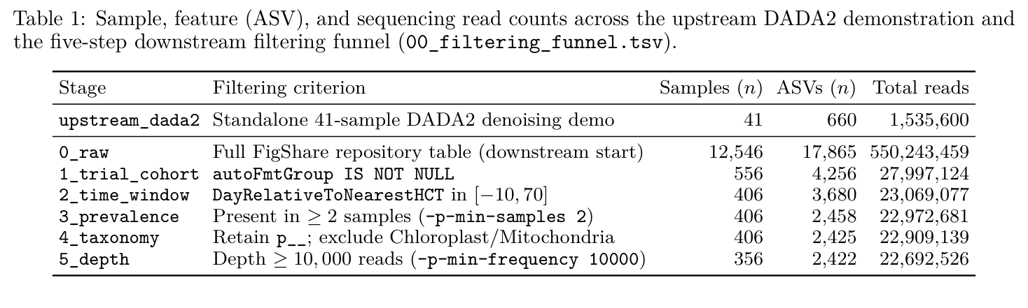
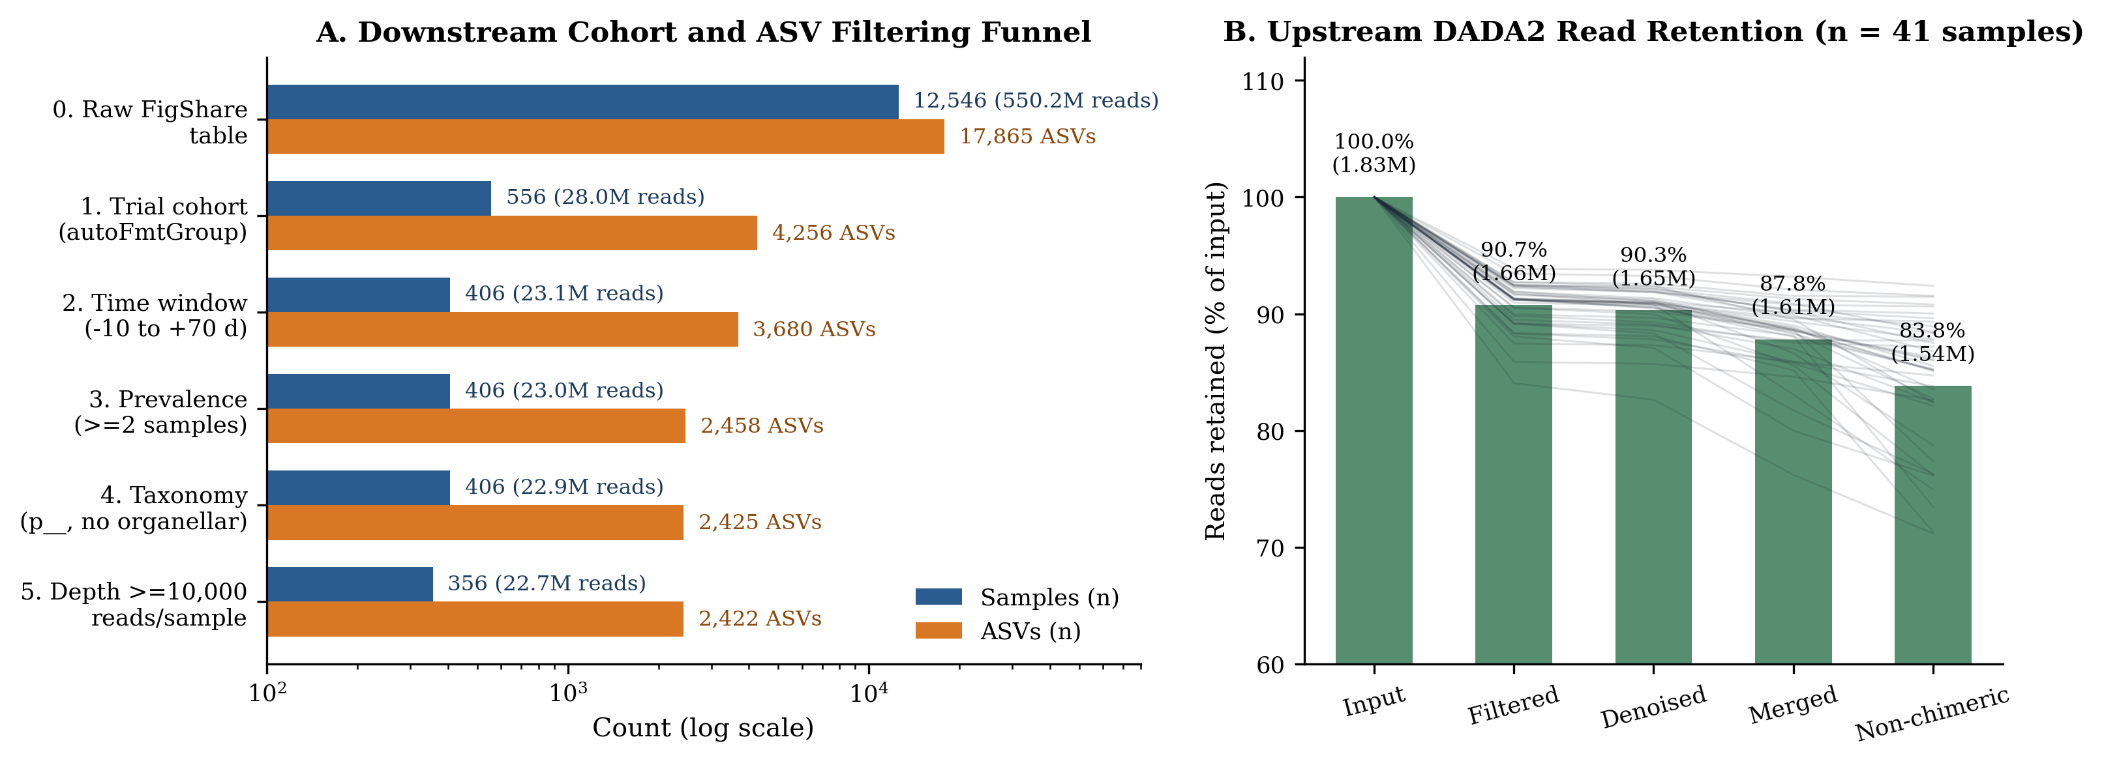
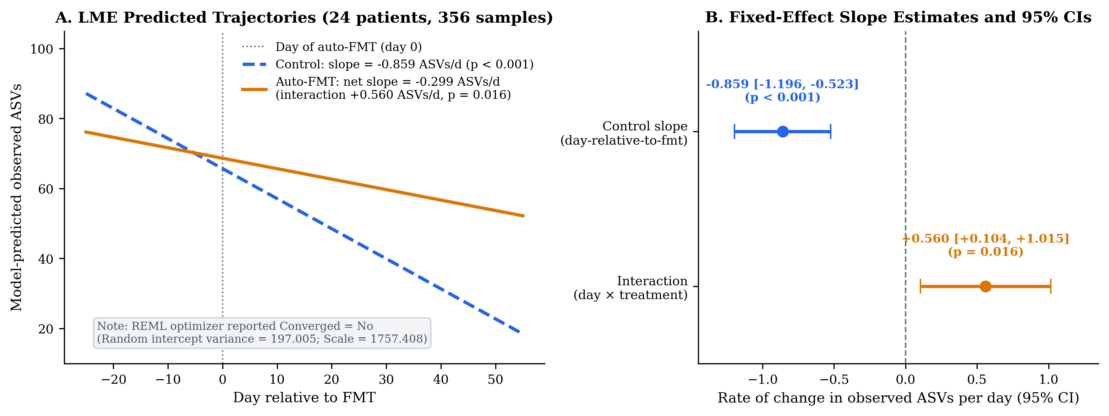
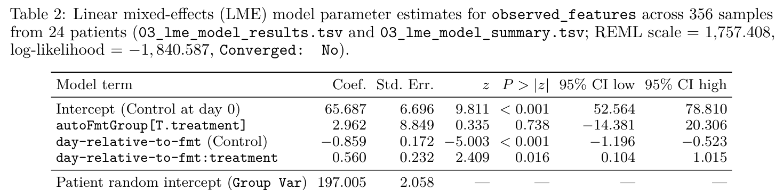
Sentence 2: Results, data only
Prompt
Please write the Results, describing only the data without interpretation. Redraw any needed figures from data/tables/.
Table 1 · filtering steps
Fig 1 · filtering and quality
Fig 3 · LME trajectories
Table 2 · LME coefficients
Notes:
Sentence two: write the Results, describing only the data without interpretation, and redraw any needed figures from the raw tables. We get two tables, Table 1 for the filtering steps and Table 2 for the longitudinal model's coefficients, plus four figures redrawn from the tables: filtering and quality, diversity and PCoA, LME trajectories, and random forest importance. This section reports numbers only, with no conclusions.

Slide 15
Sentence 3: Introduction, the most-cited section
Prompt
Please write the Introduction.
9 / 12
papers cited
03-introduction.tex · a sentence in paragraph 2
… rarefying … a practice that discards valid sequencing reads and excludes low-depth specimens …
\citep{mcmurdie2013waste, raspet2024facilitating}
Traced to library/notes/mcmurdie2013waste.md (p. 3)
"… rarefying biological count data is statistically inadmissible because it requires the omission of available valid data."
A line of background, a source
Ending with Q1–Q3
Notes:
Sentence three: write the Introduction. This is where most citations go: 9 of the 12 papers. Take this sentence: single rarefying discards valid sequencing data, followed by McMurdie 2013 and Raspet 2024. That claim traces back to the passage copied word for word in the notes, on page 3. That is how an introduction works: a line of background, a source, and finally the three research questions. The sentence-by-sentence check in Step 5 does exactly this for every citation.

Slide 16
Sentence 4: Discussion, interpretation + limitations
Prompt
Please write the Discussion based on the literature matrix, including the study limitations and conclusions.
Structure
4.1 Main findings
4.2 Comparison with the original trial and prior methods
4.3 6 limitations and how to address them
4.4 Conclusion
4.3 Limitations × 6
1 Small, unbalanced sampling
2 LME did not converge
3 One slope spans before and after FMT
4 Single rarefying
5 Non-independent samples (pseudoreplication)
6 Predicting time ≠ strain engraftment
Notes:
Sentence four: write the Discussion based on the literature matrix, including limitations and conclusions. It opens with the main findings, compares them with the original trial and earlier methods, then lists the six limitations and how to address them, such as the unconverged model and single rarefying, and ends with the conclusion.

Slide 17
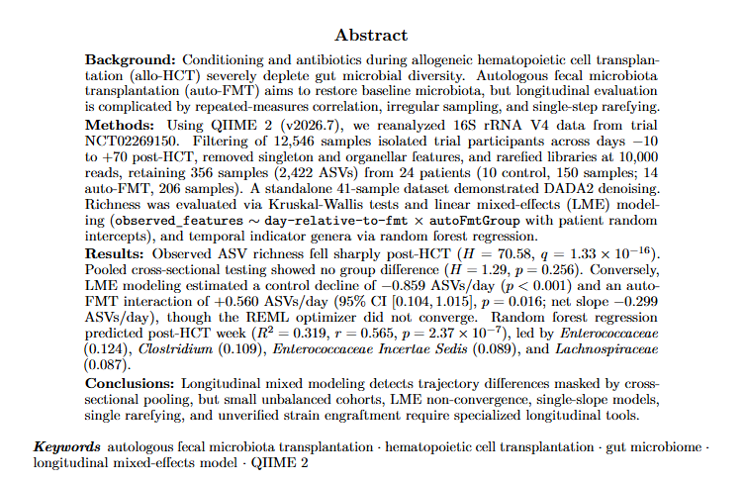
Sentence 5: Abstract, condensed last
Prompt
Please write a structured abstract.
Four parts
Background: microbiome damage; longitudinal challenge
Methods: 24 patients, 356 samples
Results: p = 0.256; interaction +0.560, p = 0.016
Conclusions: slope difference visible, with limitations
main.pdf · Abstract
1,910 / 1,920 characters ✓
Notes:
Sentence five: write a structured abstract. Only after the full text is done is it condensed into four parts: background, methods, results, and conclusions. It comes to 1,910 characters, just under the 1,920-character limit of the arXiv abstract field. On the right is the abstract in the compiled main.pdf.

Slide 18
Sentence 6: Title, then the declarations
Prompt ①
Please propose 3 candidate titles and explain which one you recommend.
Prompt ②
Use candidate title 1. Please add the declarations section at the end of the paper, leaving author contributions, conflicts of interest, and funding blank for the authors to fill in.
★ Recommended: candidate title 1
Longitudinal Reanalysis of Gut Microbiome Trajectories Following Autologous Fecal Microbiota Transplantation in Hematopoietic Cell Transplant Recipients: A QIIME 2 Methodological Case Study
Contributions, conflicts, funding: authors only
AI-written ethics statement (no IRB) must be confirmed by the authors
Notes:
Sentence six: propose three candidate titles and say which one you recommend. The AI recommends the first, framing the work as a methodological case study of a longitudinal reanalysis. Then: use candidate title 1 and add the declarations, leaving author contributions, conflicts of interest, and funding blank for the authors. Only the authors can provide these three; don't let the AI write them. In the test run, the AI wrote in the ethics paragraph that a secondary analysis of public data needs no separate IRB review. That is the AI's own judgment and must be confirmed by the authors.

Slide 19
Step 5: Check and compile
SKILL · arxiv-preprint
Prompt ①
Please use the arxiv-preprint skill to check and compile the paper, and tell me the check results.
Prompt ② LaTeX installed locally
Please first run which pdflatex to confirm the local LaTeX installation, then use the local pdflatex + bibtex to compile manuscript/main.tex directly into main.pdf. If there are errors, fix them and recompile, then tell me how many pages the PDF has and whether there are any warnings.
check-report.md
✓ All 12 citations are in the library
✓ All 4 figures found
✓ Abstract 1,910 / 1,920 characters
✓ 0 compile warnings
Only error flag: fields reserved for the authors (expected)
12
pages, in English
12
references
0 errors · 0 undefined citations
No LaTeX? → upload overleaf.zip to Overleaf
Notes:
Step five starts with the arxiv-preprint skill checking and compiling the paper: a script automatically checks that every cited paper is in the library, every figure file exists, the abstract is under the arXiv limit, and no placeholders remain. Test-run results: all 12 citations in the library, 4 figures, an abstract of 1,910 characters, and 0 compile warnings; the only error flag is the fields reserved for the authors, which is expected. With LaTeX installed locally, you can also ask the AI to compile with the local pdflatex and bibtex, giving a 12-page main.pdf with 12 references, 0 errors and 0 undefined citations.

Slide 20
Step 5: Check citations and numbers sentence by sentence
Prompt
Please check every citation in the paper sentence by sentence to see whether the original source supports the sentence; then trace every number in the paper back to data/tables/. Compile the results into manuscript/citation-check.md.
26
citations checked against quoted passages
22
numbers traced back to data/tables/
2
overstated citations → fixed
Plus 1 unsupported statement deleted
Notes:
build.py can only confirm that the cited papers exist. Does the source actually say what the sentence claims? Are the numbers really right? For that, ask the AI to check sentence by sentence. Test-run results: 26 citations compared against the quoted passages in the notes, and 22 numbers traced back to data/tables. Along the way it caught two citations that claimed too much and fixed them, and deleted one statement with no supporting literature.

Slide 21
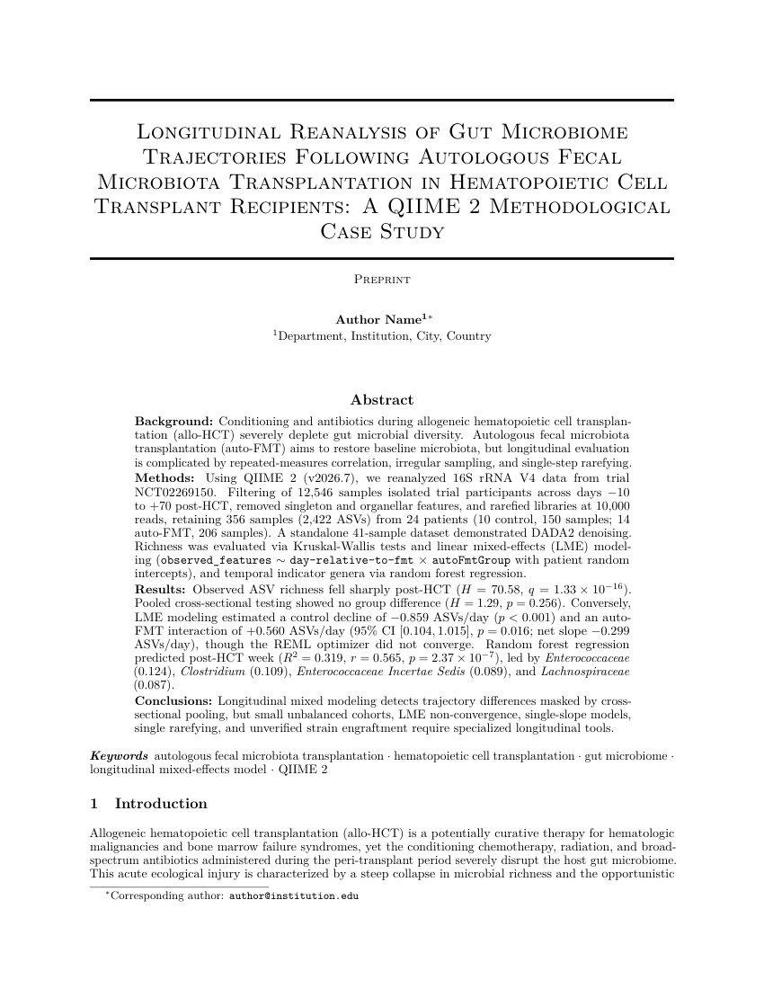
What format is main.pdf?
main.pdf page 1
arXiv preprint template
LaTeX article + arxiv.sty, compiled with pdfLaTeX; single column
Abstract → Introduction → Methods → Results → Discussion → Declarations → References
Numbered citations (natbib + plainnat)
Not a journal format; switch templates when submitting
No LaTeX: Overleaf
Upload Project → overleaf.zip
Compiler: pdfLaTeX
Don't upload to arXiv while practicing
arXiv papers cannot be deleted, only withdrawn
Notes:
main.pdf uses the arXiv preprint template: LaTeX article with arxiv.sty, compiled with pdfLaTeX, in a single column. The structure is abstract, introduction, methods, results, discussion, declarations, and references, with numbered citations. This is a preprint format, not a specific journal's; switch to the journal's template when you submit. Without LaTeX, upload overleaf.zip to Overleaf and choose pdfLaTeX as the compiler. Please don't actually upload to arXiv while practicing: arXiv papers cannot be deleted.

Slide 22
The whole paper used 4 skills
arxiv
Step 2 search
paper-library
Step 2 collect, register by DOI
research-paper-writing
Step 4 writing principles
arxiv-preprint
Steps 4–5 skeleton, checks, compile
Every other step: just tell the AI in plain language what to do next
Step 1 read the brief, Step 3 take notes: no skill needed
Notes:
Looking back, the whole paper used four skills: arxiv to search, paper-library to collect, research-paper-writing to write, and arxiv-preprint to typeset and check. Reading the brief and taking notes needed no skill. Every other step was just telling the AI, in plain language, what to do next.

Slide 23
Before submission
Authors check it all
Every number, every citation
Confirm the ethics
Authors must confirm any AI-written ethics text
Authors fill in
Contributions, conflicts of interest, funding
Disclose AI use
Per the journal's policy
Practice draft · swap in your own data and start from the research brief
Notes:
This is a practice draft and must not be submitted as is. Before submitting, the authors must personally check every number and citation, confirm the ethics statement the AI wrote, fill in author contributions, conflicts of interest and funding themselves, and disclose the use of AI according to the journal's policy. Swap in your own research data and start from the research brief.

