Slide 1
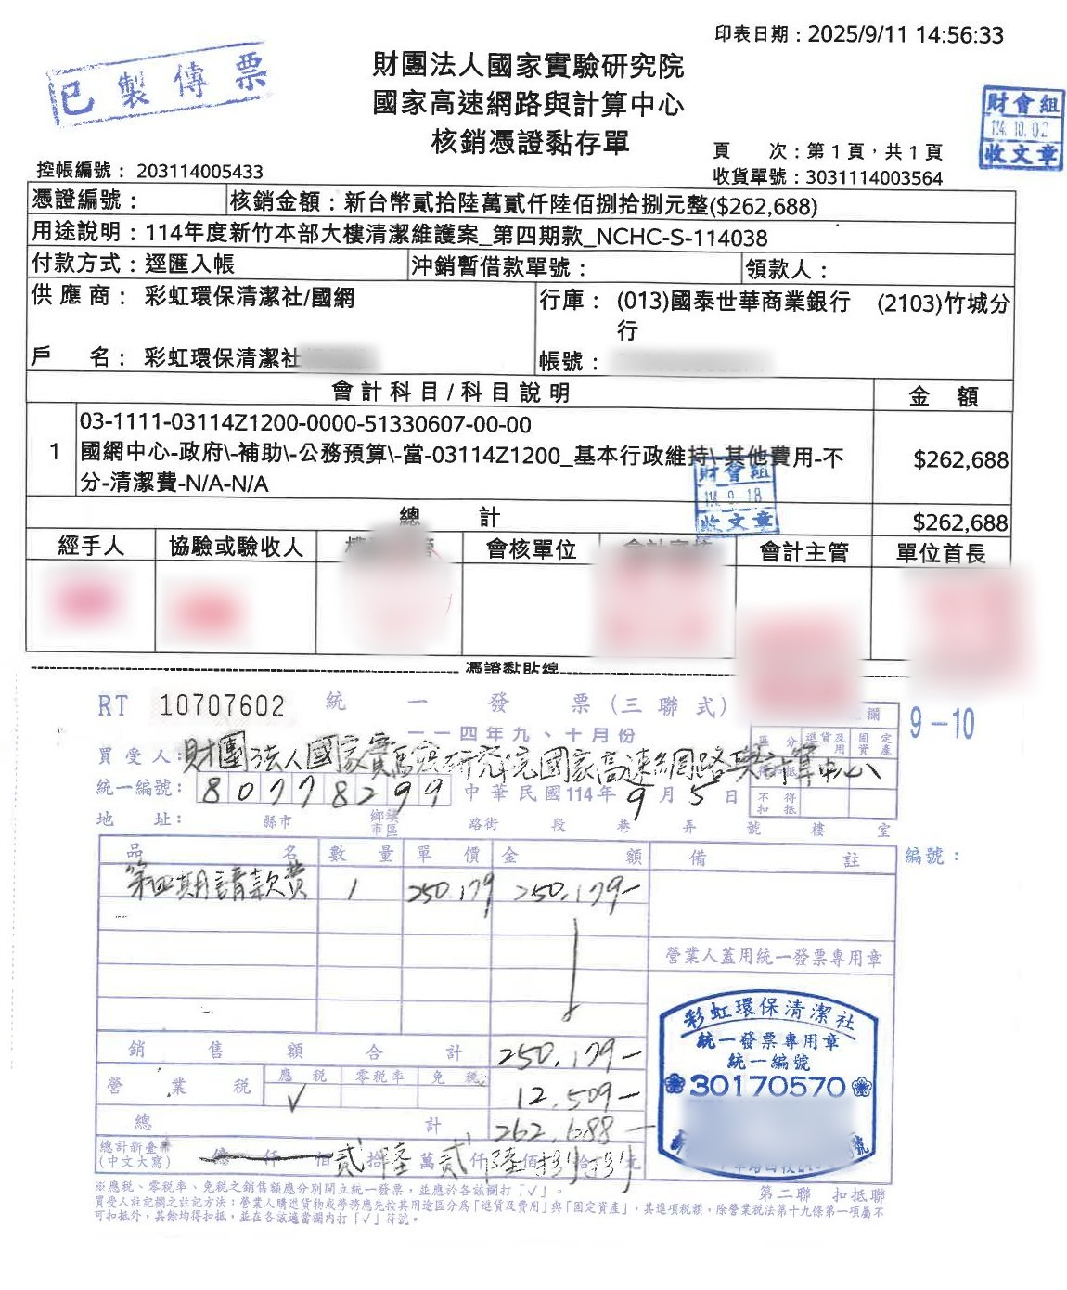
Voucher OCR
to Excel
AI Workshop · Unit 04
Ask AI in plain language
Read scanned invoices → fill Excel → make a skill
A demo for admin staff
No coding required
Notes:
Welcome to Unit 04: voucher registration.
This unit shows how to ask AI, in plain language, to read scanned invoice PDFs, fill the data into Excel, and finally turn the whole workflow into a skill.
This demo is for administrative staff, and no coding is required at any point.
[Click order] ① Voucher sample → ② Read scanned invoices → fill Excel → make a skill → ③ A demo for admin staff → ④ Arrow → ⑤ No coding required

Slide 2
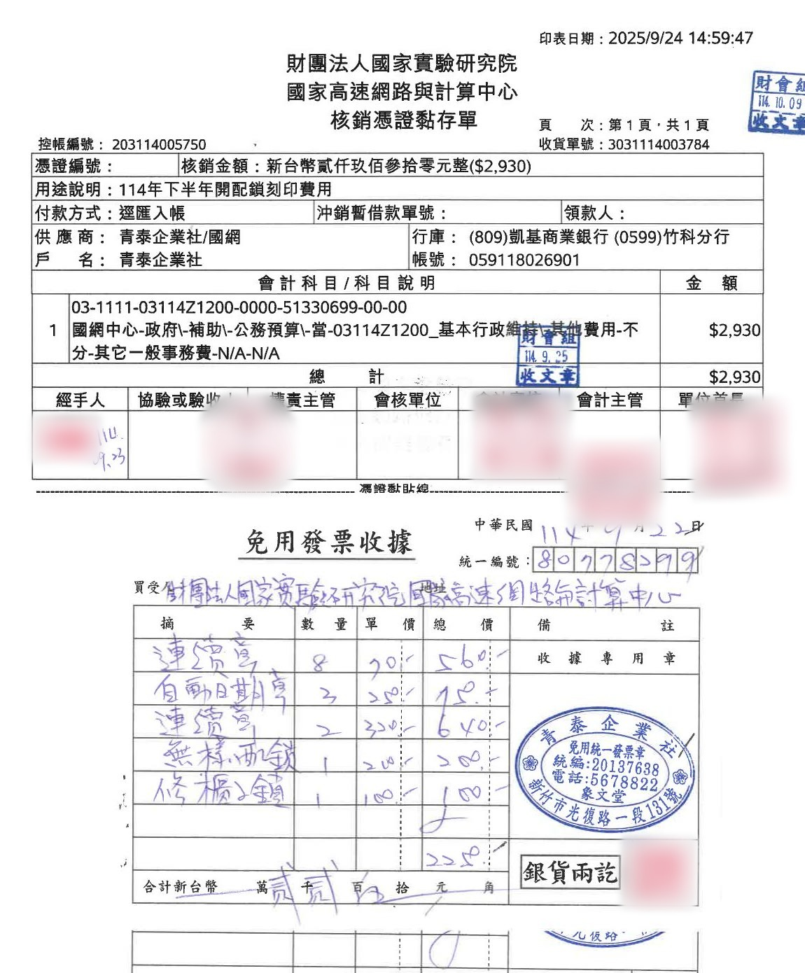
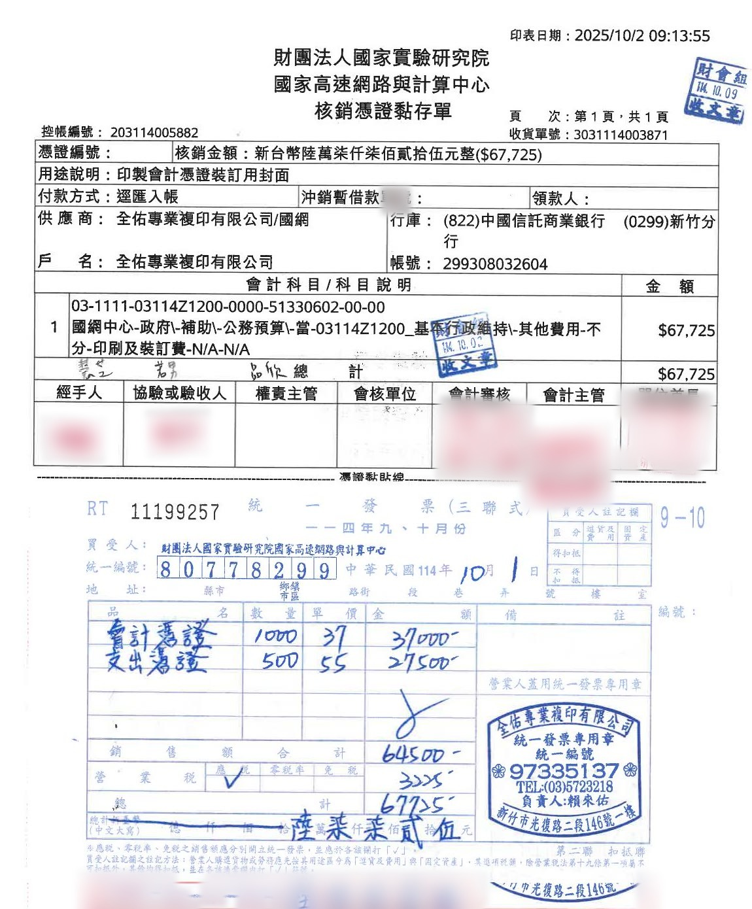
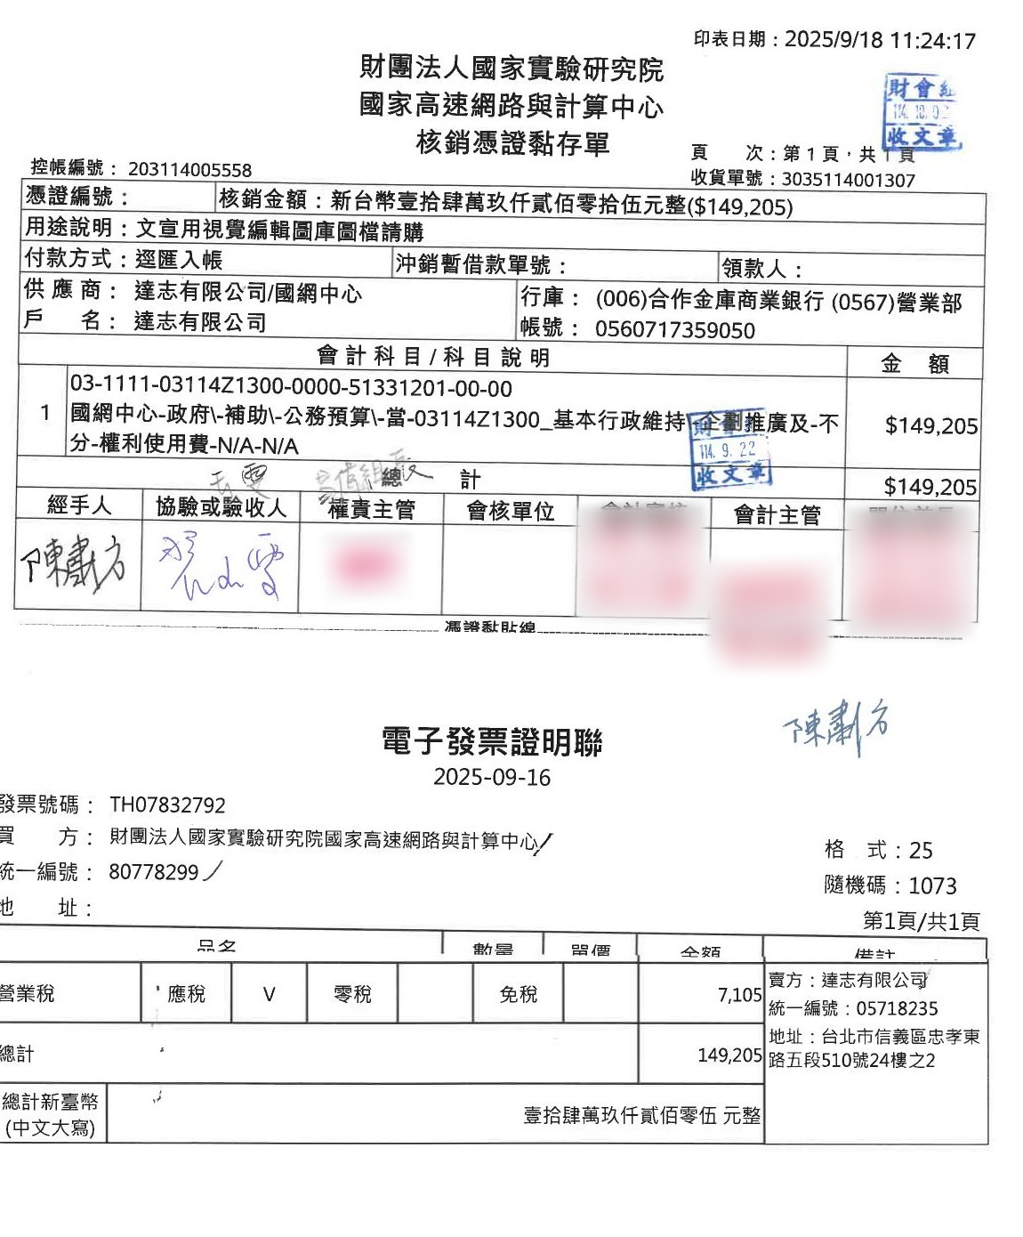
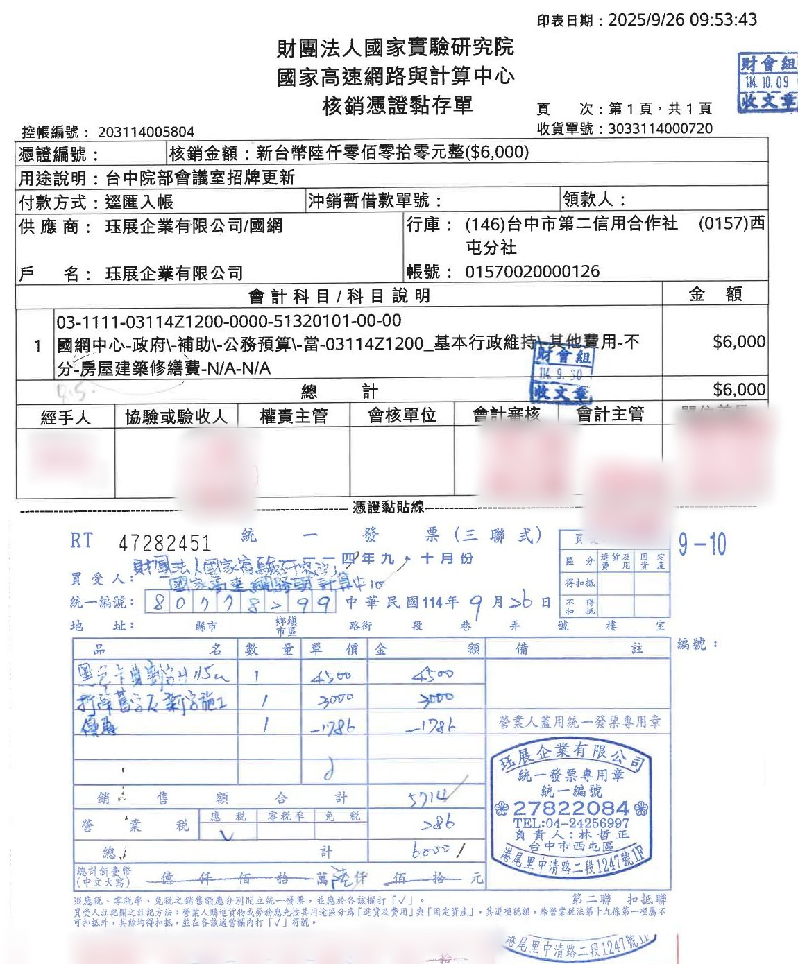
Five scanned expenditure vouchers
Data
Top half
Voucher mounting form
Bottom half
Invoice or receipt attached
…330.pdf
…340.pdf
…350.pdf
…331.pdf
…341.pdf
No text layer
The AI must read the images
Scans → AI reads the images
Notes:
The data are five scanned expenditure vouchers.
The top half of each is the voucher mounting form; the bottom half has an invoice or receipt attached.
These are scans with no text layer, so the AI can't read the text directly; it has to read the images.
[Click order] ① Five vouchers → ② Top half → ③ Bottom half → ④ No text layer → ⑤ Scans → AI reads the images

Slide 3
record.xlsx, copied from the template
THE EXCEL TO FILL
record.example.xlsx
template (never modified)
record.xlsx
the one we fill in
Account code
Control no.
Invoice no.
Invoice amount
Total amount
Vendor tax ID
Buyer title
Liability account
Project code
These 9 columns come from the PDFs
Notes:
The file to fill is record.xlsx, copied from the template record.example.xlsx; the template itself is never modified.
The columns are account code, control number, invoice number, invoice amount, total amount, vendor tax ID, buyer title, liability account, and project code. All nine come from the PDFs.
[Click order] ① record.example.xlsx → ② Arrow → ③ record.xlsx → ④ The 9 columns → ⑤ These 9 columns come from the PDFs

Slide 4
Let the AI look first, then act
How to ask
1
Let the AI look first
3
Do one record first
2
Agree on the rules
4
Package it as a skill
Don't dump it all on the AI at once
Notes:
The approach in this unit: let the AI look first, then act.
One, let the AI understand the data; two, agree on the rules; three, do one record and confirm it; four, package the workflow that worked into a skill.
The key is not to dump everything on the AI at once.
[Click order] ① Let the AI look first → ② Arrow → ③ Agree on the rules → ④ Arrow → ⑤ Do one record first → ⑥ Arrow → ⑦ Package it as a skill → ⑧ Don't dump it all on the AI at once

Slide 5
What does the Excel need? Is it in the PDFs?
Step 1 · Let the AI understand first
I ask the AI (typed in Chinese)
“There are five invoice PDFs and a record.xlsx in this folder. Please take a look at what fields need to be filled in the Excel file and check whether they can be found in the PDFs.”
SKM_…330.pdf
AI reply
The PDFs have no text layer,
so I'll turn each page into an image, then read it.
page-1.png
Notes:
Step one: ask first.
“There are five invoice PDFs and a record.xlsx in this folder. Please take a look at what fields need to be filled in the Excel file and check whether they can be found in the PDFs.” (The prompt was typed in Chinese in the demo.)
The AI finds that the PDFs have no text layer, so it converts each page to an image first, then reads it.
[Click order] ① Prompt → ② AI reply → ③ SKM_…330.pdf → ④ Arrow → ⑤ page-1.png

Slide 6
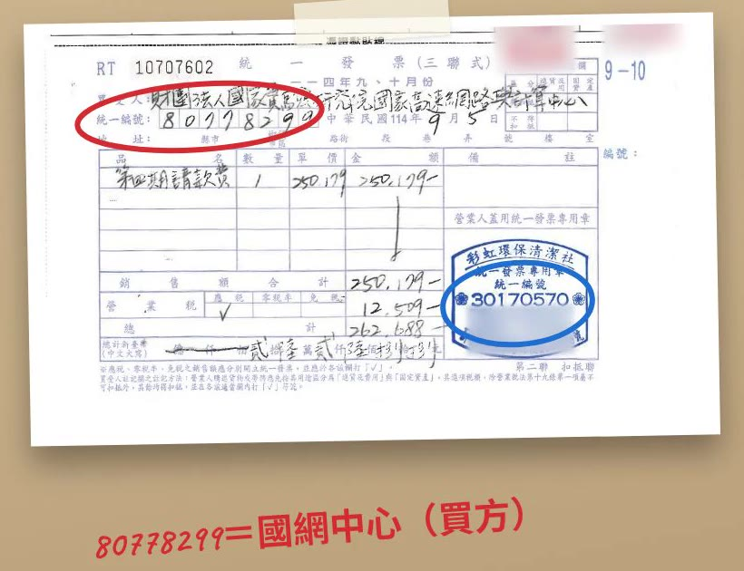
Infers from the sample, flags issues itself
Step 1 · The AI's answer
AI reply
Vendor tax ID should be the seller's tax ID,
not NCHC's own 80778299.
…340
A receipt: no invoice number
…331
Different project code
Liability account
Not on the PDFs
The AI flags 3 issues itself
Notes:
The AI also infers from the sample row: the tax ID 80778299 on the invoices is NCHC, the buyer; the “vendor tax ID” column in Excel needs the seller's tax ID.
(The clip ends here; the presenter then covers the three issues below, clicking in each sticky note.)
It also flags three issues on its own: 340 is a receipt with no invoice number; 331 has a different project code from the others; and the liability account isn't on the PDFs.
[Click order] ① Demo clip (autoplays, about 9 seconds, original Chinese narration; ends at “use the seller's tax ID”) → ② Seller's tax ID → ③ …340 → ④ …331 → ⑤ Liability account → ⑥ The AI flags 3 issues itself
(While the clip plays, one more click moves to the next object; click the clip to pause it.)

Slide 7

Yellow = missing, blue = uncertain
Step 2 · Agree on highlighting rules
I ask the AI (typed in Chinese)
“Highlight missing fields in bright yellow, highlight uncertain fields with a light blue background, and add a cell comment explaining the reason. Also add a note at the top of the Excel sheet explaining what these two colors mean.”
Yellow
Missing: cell left blank
Blue
Uncertain: best guess + comment
Legend, top right K1:L2 (in Chinese)
Anyone opening the file understands it
Notes:
Step two: agree on highlighting rules.
Yellow highlight for anything missing, blue for anything uncertain, plus a cell comment explaining why.
The color legend also goes in the top-right corner of the sheet, so anyone who opens the file understands it.
[Click order] ① Prompt → ② Yellow → ③ Blue → ④ Legend at the top right of the sheet → ⑤ Anyone opening the file understands it

Slide 8
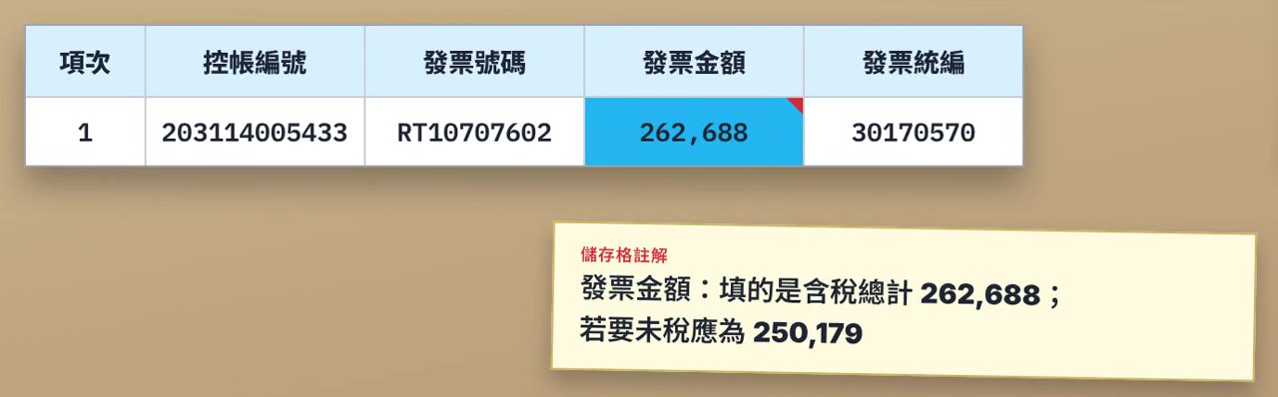
Confirm it is right, then continue
Step 3 · Do one first
I ask the AI (typed in Chinese)
“Just process the first file SKM_650i25101515330.pdf for now so I can verify that it is correct.”
Try one first
Catch gaps early
Blue + comment: invoice amount = tax-included total 262,688
Notes:
Step three: do one first. “Just process the first file for now so I can verify that it is correct.”
The AI fills uncertain cells in blue and adds a comment. For example, the invoice amount is the tax-included total, 262,688; before tax it is 250,179.
Trying one record first catches gaps early.
[Click order] ① Prompt (the clip starts after the AI has filled the first row, so read the prompt aloud first) → ② Demo clip (autoplays, about 10 seconds, original Chinese narration) → ③ Try one first → ④ Blue + comment
(While the clip plays, one more click moves to the next object; click the clip to pause it.)

Slide 9
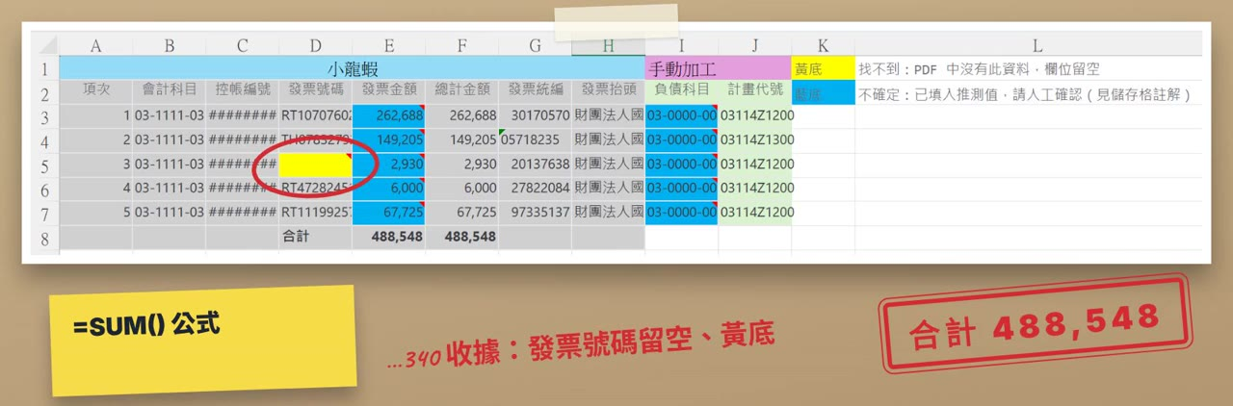
Same rules; explain every colored cell
Step 4 · Fill in the other four
I ask the AI (typed in Chinese)
“I checked the first record and it looks good. Please fill in the remaining four PDFs following the same rules, and explain the reason for each yellow or blue cell.”
Total 488,548
=SUM() formula
…340 receipt: invoice no. blank, yellow
Notes:
Step four: once the first record checks out, ask the AI to fill in the other four and explain the reason for every yellow and blue cell.
The five records total 488,548, and the total row becomes a SUM formula; 340 is a receipt, so its invoice number is left blank in yellow.
[Click order] ① Prompt (the clip starts when the Excel sheet appears, so read the prompt aloud first) → ② Demo clip (autoplays, about 12 seconds, original Chinese narration) → ③ Total 488,548 → ④ =SUM() formula → ⑤ …340 receipt
(While the clip plays, one more click moves to the next object; click the clip to pause it.)

Slide 10
Save today's workflow
★ STEP 5 · MAKE IT A SKILL
Which Excel fields to fill
Yellow / blue rules
SKILL
A work manual
Save the know-how, reuse it
Tax ID = the seller's
How to check amounts
A new chat forgets it all…
Notes:
Step five is the key: turn the workflow into a skill.
The details we confirmed (which Excel fields to fill, the yellow and blue rules, that the tax ID is the seller's, how to check amounts) live only in this conversation; start a new chat and they are forgotten.
A skill is a work manual that saves this knowledge so it can be reused.
[Click order] ① The four confirmed details → ② A new chat forgets it all → ③ Arrow → ④ SKILL: a work manual

Slide 11
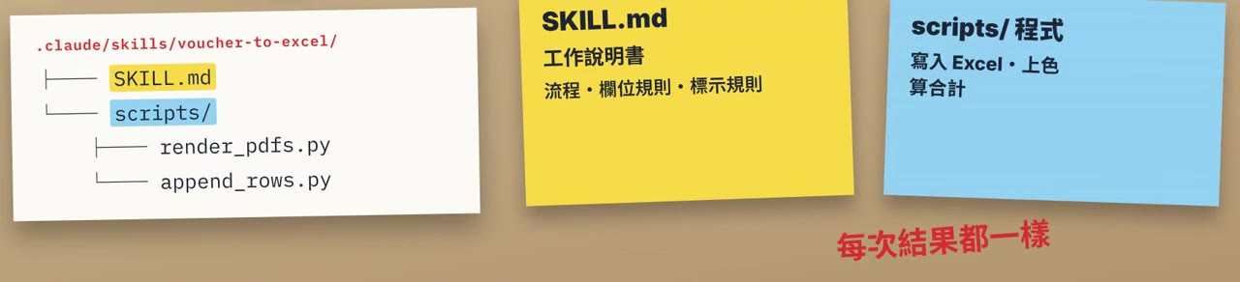
Just ask the AI to make it a skill
★ STEP 5 · MAKE A SKILL IN PLAIN LANGUAGE
No coding
I ask the AI (typed in Chinese)
“Please package the procedure we confirmed today into a skill, including where to read each field from the PDF, the yellow and blue highlighting rules, and how to cross-check the amounts.”
Natural language
= the way you normally talk
Notes:
How do you make a skill? No coding: just ask the AI in natural language, the way you normally talk:
“Please package the procedure we confirmed today into a skill, including where to read each field, the yellow and blue rules, and how to cross-check the amounts.”
The AI creates voucher-to-excel. SKILL.md is the work manual, with the workflow, field rules and highlighting rules; the scripts folder holds code that writes to Excel, applies colors and computes totals, with the same result every time.
[Click order] ① No coding → ② Natural language → ③ Prompt → ④ Demo clip (autoplays, about 16 seconds, original Chinese narration; starts at “The AI creates voucher-to-excel”, so read the prompt aloud first)
(While the clip plays, one more click moves to the next object; click the clip to pause it.)

Slide 12
New chat, one sentence
★ USING IT LATER
I ask the AI (typed in Chinese)
“I've added three new invoice PDFs, please help me enter these records into Excel”
AI reply
✓ Found the voucher-to-excel skill
Before reusing, check:
Which company's agent are you using?
Claude
.claude/skills/
in the project folder
Other agents
.agents/skills/
in the project folder
Notes:
Later, in a new chat, just say: “I've added three new invoice PDFs, please help me enter these records into Excel.” The AI finds the voucher-to-excel skill automatically.
Before reusing it, check which agent you are using: Claude reads .claude/skills in the project folder; other agents use .agents/skills.
[Click order] ① Prompt → ② Finds the skill automatically → ③ Check which agent → ④ .claude/skills/ → ⑤ .agents/skills/

Slide 13
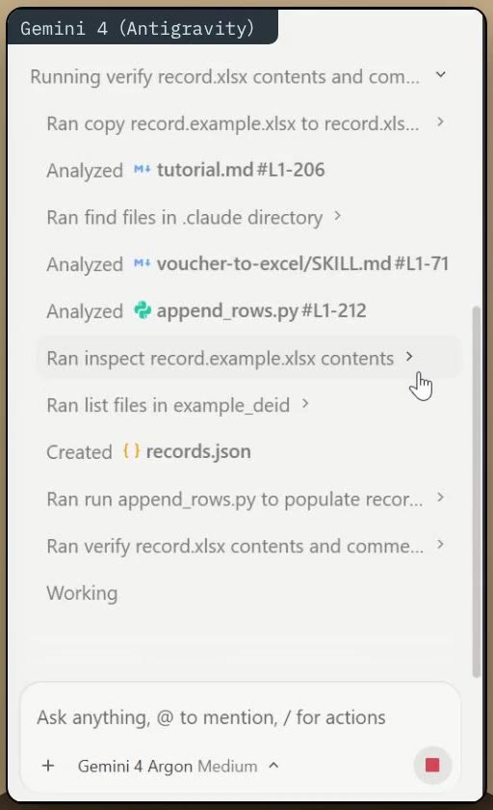
One does, one reviews
BONUS · TWO AI AGENTS TOGETHER
Gemini
does the work
Claude
reviews it
I ask the AI (typed in Chinese)
“First copy record.example.xlsx to record.xlsx, then recognize SKM_650i25101515330.pdf, …331, …340, …341, …350.pdf and fill them into record.xlsx”
Finds the skill automatically
voucher-to-excel/SKILL.md
Notes:
Bonus demo: two AI agents working together, one doing and one reviewing.
First, Gemini copies the template, reads the five invoice PDFs and fills in record.xlsx.
It finds the voucher-to-excel skill we made earlier and follows its rules.
[Click order] ① Gemini does the work → ② Arrow → ③ Claude reviews it → ④ Prompt for Gemini → ⑤ Finds the skill automatically → ⑥ Demo clip (autoplays, about 16 seconds, original Chinese narration)
(While the clip plays, one more click moves to the next object; click the clip to pause it.)

Slide 14
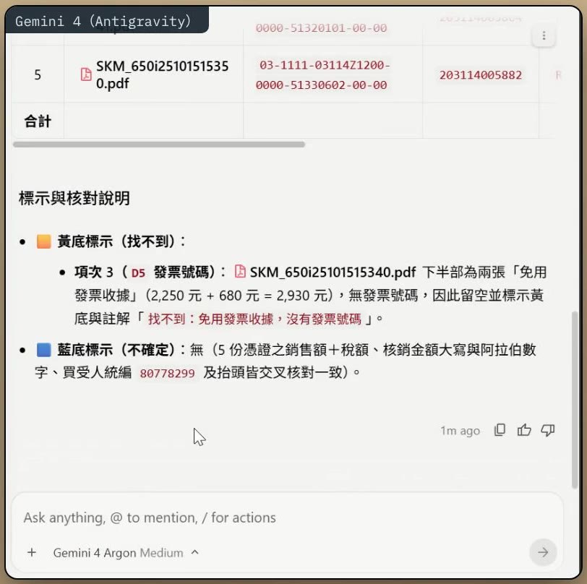
All five filled, same highlighting rules
BONUS · GEMINI'S RESULT
Total 488,548
…340 receipt
No invoice no. → blank + yellow
Looks right…
but is it really?
Notes:
Gemini fills in all five: a total of 488,548; receipt 340 has no invoice number, so it is left blank in yellow.
It all looks right. But is it really?
[Click order] ① Demo clip (autoplays, about 12 seconds, original Chinese narration) → ② Total 488,548 → ③ …340 receipt → ④ Looks right… → ⑤ but is it really?
(While the clip plays, one more click moves to the next object; click the clip to pause it.)

Slide 15
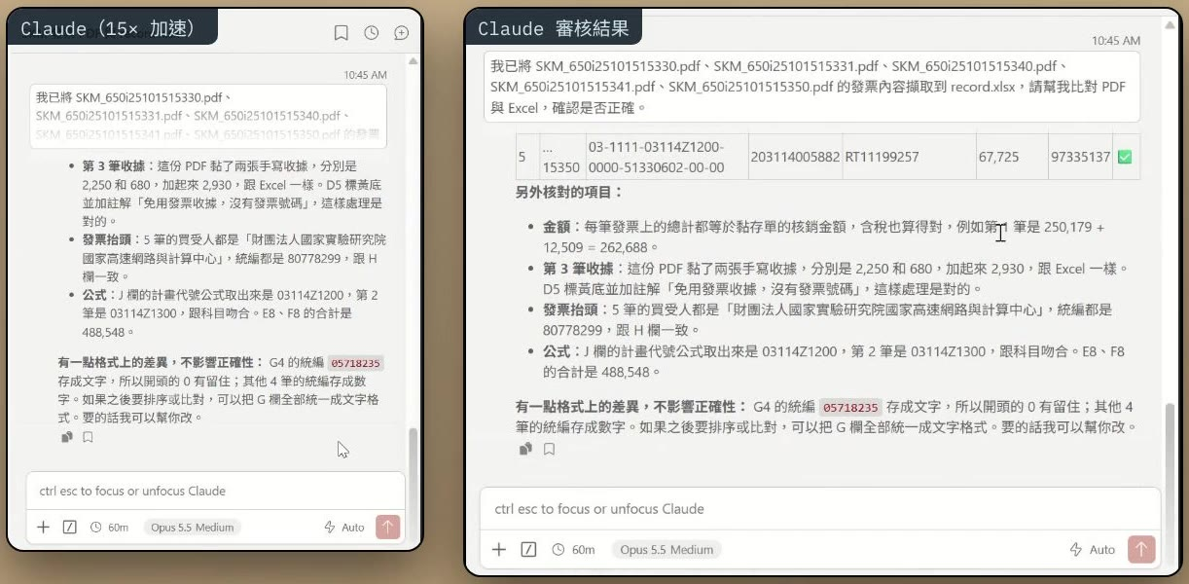
Claude checks PDF against Excel, row by row
BONUS · CLAUDE REVIEWS
I ask the AI (typed in Chinese)
“I have extracted the invoice contents of SKM_650i25101515330.pdf, …331, …340, …341, …350.pdf into record.xlsx. Please cross-check the PDFs against the Excel sheet and verify whether everything is accurate.”
✓ All 5
Correct, nothing to change
Format note
Some tax IDs are stored as text, some as numbers
→ use one format
Notes:
Now Claude takes the reviewer's role: “Please cross-check the PDFs against the Excel sheet and verify whether everything is accurate.”
(The clip starts once Claude begins working, so read the prompt aloud first.)
Claude converts each PDF to images and checks invoice numbers, amounts and tax IDs row by row. The verdict: all five are correct, with nothing to change. It also notes that some tax IDs are stored as text and some as numbers, and suggests using one format.
[Click order] ① Prompt for Claude → ② Demo clip (autoplays, about 15 seconds, original Chinese narration; left is the process at 15× speed, right is the review result) → ③ ✓ All 5 correct → ④ Format note
(While the clip plays, one more click moves to the next object; click the clip to pause it.)

Slide 16
One does, one reviews
BONUS
Gemini
Does: reads PDFs, fills Excel
Claude
Reviews: checks each row, flags notes
Like colleagues double-checking
THE SAME SKILL
.claude/skills/voucher-to-excel/
Mistakes are easier to catch
Gemini ✓
Claude ✓
Notes:
One does, one reviews: having another company's agent cross-check is like colleagues reviewing each other's work, so mistakes are easier to catch.
And the same skill works across different agents.
[Click order] ① Gemini does → ② Arrow → ③ Claude reviews → ④ Like colleagues double-checking → ⑤ Mistakes are easier to catch → ⑥ The same skill: Gemini ✓ Claude ✓

Slide 17
Unit 04 complete
Recap
1
Let the AI understand first
3 → 4
One record first, then the rest
2
Agree on the rules
5
Turn what worked into a skill
Refine it through conversation
★ The conversation is the best material
Notes:
Recap:
Let the AI understand first, then agree on rules; do one record, confirm it, then process the rest; turn the workflow that worked into a skill, and keep refining it through conversation.
The conversation is the best material. Unit 04 complete!
[Click order] ① Let the AI understand first → ② Agree on the rules → ③ One record first, then the rest → ④ Turn what worked into a skill → ⑤ Refine it through conversation → ⑥ The conversation is the best material

