Slide 1
Unit 03 Office Document Processing
Four official skills: docx, pdf, pptx, xlsx
Turn one CSV into Excel, slides, a Word report and a PDF handout
Video: movies/03-office-skills.en.mp4 (Chinese: youtu.be/FwIpKAJ2-vk)
Notes:
This unit uses Anthropic's four official Office skills: docx, pdf, pptx and xlsx. We take one CSV of Taiwan's Purchasing Managers' Index, first turn it into an Excel workbook with a chart, then build an animated slide deck and a Word analysis report from that Excel file, and finally convert the report into a PDF handout with page numbers and a watermark. The four examples are linked: each one's output is the next one's input, so please do them in order.

Slide 2
Open the right folder, install four skills
Run in the terminal
npx skills add anthropics/skills@docx -a antigravity -a claude-code --copy -y
npx skills add anthropics/skills@pdf -a antigravity -a claude-code --copy -y
npx skills add anthropics/skills@pptx -a antigravity -a claude-code --copy -y
npx skills add anthropics/skills@xlsx -a antigravity -a claude-code --copy -y
Open the right folder
Antigravity → Open Folder
Open 03-ai-workshop-office-skills
Not the outer folder
When it's installed
The folder now has
.agents/skills/
Four subfolders, one skill each
Start a new conversation
Open a new chat after installing so the skills take effect
Old chats don't load new skills
Notes:
First check the folder: in Antigravity, use Open Folder on 03-ai-workshop-office-skills, not the outer ai-workshop-research, or the skills get installed in the wrong place. Then run these four lines in the terminal, one skill per line, installed for both Antigravity and Claude Code. Afterwards the folder contains .agents/skills. Finally, always start a new AI Agent conversation: old conversations don't load newly installed skills, and this is the step people most often forget.

Slide 3
Four skills, one file type each
docx
Word documents
Heading levels
Tables, TOC
Tracked changes
pdf
PDF
Extract text and tables
Merge, split, forms
OCR for scans
pptx
Presentations
Layout, charts
Speaker notes
Animations and transitions
xlsx
Spreadsheets
Formulas
Formatting
Charts
Notes:
Each skill handles one file type. docx handles Word, including heading levels, tables, tables of contents and tracked changes. pdf extracts text and tables, merges and splits files, fills forms, and can OCR scanned files. pptx handles presentations: layout, charts, speaker notes, and even animations. xlsx handles spreadsheets, with a focus on formulas, formatting and charts. Today's pipeline uses all four.

Slide 4
With or without a skill: what changes
Without a skill
Writes throwaway code to read files
Breaks on slightly complex formats
Excel and slides: content, but no layout
With a skill
Reads and writes with the official workflow and scripts
Formulas, charts and animations work
Renders to images to check its own layout
Triggers automatically
No need to name it
Loads whenever a task involves docx, pdf, pptx or xlsx
Notes:
Without these skills, an AI Agent often writes throwaway code to read files and breaks as soon as the format gets a little complex; the Excel files and slides it makes often have content but no layout. With the skills, it follows the officially curated workflow and scripts, so reading and writing are more reliable, and it renders slides as images to check its own layout. You don't have to name the skills: whenever a task involves these file types, they load by themselves.

Slide 5
Prerequisites
uv, Node.js
Used for
All skills run their scripts with them
uv manages Python; packages go into .venv automatically
Without it
Nothing runs
LibreOffice
Used for
Recalculate Excel formulas
Convert docx to PDF
Render slides to images so the AI checks the layout
Remember
The terminal must be able to run soffice
Microsoft Office
Used for
Open and check the results
Without LibreOffice, convert to PDF with Word
Note
Animations and transitions are most accurate in PowerPoint
Notes:
Three tools. uv and Node.js are the basis for running every skill's scripts; uv manages Python, and the AI installs the packages it needs into .venv automatically. Without them nothing runs. LibreOffice does three things: recalculates Excel formulas, converts docx to PDF, and renders slides to images so the AI can check the layout itself. On Windows, make sure the terminal can run the soffice command, and add its install path to PATH if needed. Microsoft Office is for opening and checking the results; animations and transitions must be checked in PowerPoint to be accurate.

Slide 6
One CSV, four examples in a relay
Sample data
example/
臺灣採購經理人指數(pmi及nmi).csv
Monthly PMI and NMI, 2012/07–2026/09
output/
Everything the AI makes is saved here
Created automatically on the first save
Example 1 xlsx
CSV
↓
pmi.xlsx
Example 2 pptx
pmi.xlsx
↓
pmi.pptx
Example 3 docx
pmi.xlsx
↓
pmi-report.docx
Example 4 pdf
pmi-report.docx
↓
pmi-report.pdf
Notes:
There is only one sample file: a CSV of Taiwan's Purchasing Managers' Index, with monthly PMI and NMI from July 2012 to September 2026. Everything the AI makes is saved in the output folder. The four examples form a pipeline: example one turns the CSV into Excel with xlsx; example two builds a deck from the Excel file with pptx; example three writes a Word report from the same Excel file with docx; and example four turns the report into a handout with pdf. Each step's output is the next step's input, so skipping ahead means the files won't be there.

Slide 7
Example 1 (xlsx): CSV into Excel with a chart
Task prompt
Convert example/臺灣採購經理人指數(pmi及nmi).csv into an Excel workbook saved as output/pmi.xlsx:
Put the raw data on the first worksheet, calculate the annual average PMI and NMI on the second worksheet, and add a line chart showing the multi-year trend.
Expected behavior
Two worksheets
Yearly averages are formulas, not hard-coded numbers
Line chart has labeled axes and a legend
What to check
NMI before 2014/08 is "-": missing data, not 0
2012 and 2026 are partial years; ideally noted
Notes:
Example one turns the CSV into Excel: raw data on the first worksheet, yearly PMI and NMI averages on the second, plus a line chart of the multi-year trend. When you check the result, click a yearly-average cell: you should see a formula, not a hard-coded number. Two details: in the CSV, NMI before August 2014 is a dash, which means no data. The AI should treat it as empty, not as zero, or the averages will be pulled down. Also, 2012 and 2026 are partial years and should ideally be noted.

Slide 8
Example 2 (pptx): an animated teaching deck
Task prompt
Based on output/pmi.xlsx, create a 5-slide presentation saved as output/pmi.pptx explaining the meaning of Taiwan's Purchasing Managers' Index (PMI/NMI), recent trends, and key observations, including charts.
All text must be editable in PowerPoint (do not render text as images).
Lay out each slide's content using cards (rounded rectangles) with the slide title shown immediately. Have the cards appear one by one in sequence: on each click, reveal only the next card with a fade-in animation; hide all cards when the slide starts. Background and decorative elements should not be animated.
Use a slow fade transition between slides, and include speaker notes.
Expected behavior
5 slides: title, indicator overview, trend charts, key observations
All text is in editable text boxes
Charts are native: click to edit the data
Chart numbers match Excel
No text overflows
Notes:
Example two builds a five-slide deck from the Excel file. The second half of the prompt is the key: editable text, a card layout, one card fading in per click, a slow fade between slides, and speaker notes. The more specific these requirements are, the less the AI misses. Expect a title slide, an indicator overview, trend charts and key observations; the charts should ideally be native PowerPoint charts whose data you can edit, and the numbers must match Excel.

Slide 9
Example 2 check: look in PowerPoint
Animation pane
Only the cards are animated
"On Click" + "Fade"
Order = reading order
Slide show
Only the title shows at first
One more card per click
Why the skill matters
Libraries like python-pptx don't support animations and transitions directly
The AI has to write the presentation XML directly
Without the skill: animations go missing, or the file won't open
Transitions
"Fade" on every slide
About 1.5–2 s (default 0.7)
Notes page
Speaker notes on every slide
What to say, not a copy of the slide
Notes:
When it's done, always open it in PowerPoint and check four things. First, the Animation pane: only the cards are animated, each a fade triggered on click, in reading order; the background and title should have no animation. Second, the slide show: at first only the title is visible, and each click adds one card. Third, transitions: every slide uses a fade, longer than the default 0.7 seconds. Fourth, the Notes page: every slide has speaker notes, and they are what the speaker should say, not a copy of the slide text. Libraries like python-pptx don't support animations and transitions directly, so the AI has to write the XML itself, which is exactly where the pptx skill comes in.

Slide 10
Example 3 (docx): write a Word analysis report
Task prompt
Based on output/pmi.xlsx, write a Word analysis report saved as output/pmi-report.docx:
Include a cover page, an automatic table of contents, and chapters divided into "Indicator Overview", "Multi-Year Trends", "Recent Year Observations", and "Conclusion".
In "Multi-Year Trends", include the annual average table and the line chart.
Expected behavior
Headings use the built-in Heading 1 / Heading 2 styles
The TOC is an updatable field
Table numbers match Excel
What to check
An empty TOC is normal: right-click → "Update Field"
A line chart as an image is fine
Notes:
Example three writes a Word report from the same Excel file, with a cover page, an automatic table of contents and four chapters; the Multi-Year Trends chapter holds the yearly-average table and the line chart. Check three things: whether headings use Word's built-in Heading 1 and Heading 2 styles; whether the table of contents is an updatable field, so right-clicking it and choosing Update Field changes it; and whether the table numbers match Excel. A freshly generated table of contents may be blank or say there are no entries. That's normal: the page numbers appear after updating, and you should update it before converting to PDF in example four. The line chart is usually an image, which is fine.

Slide 11
Example 4 (pdf): turn it into a course handout
Task prompt
Convert output/pmi-report.docx to PDF using LibreOffice and save it as output/pmi-report.pdf:
Add page numbers at the bottom of every page and a light gray "Course Handout" ("課堂講義") watermark.
Expected behavior
Chinese renders correctly: no boxes or garbled text
Page numbers and watermark on every page
Watermark doesn't hide the text; text stays selectable
What to check
Overlaid text needs a Chinese font, or it becomes boxes
Conversion needs LibreOffice or Word
Notes:
The last step converts the Word report to PDF, adds page numbers at the bottom of every page, and adds a light gray Course Handout watermark, written in Chinese. Expect the Chinese text to render correctly, page numbers and the watermark on every page, a watermark that doesn't hide the text, and text you can still select and copy. The most common mistake: when page numbers and the watermark are overlaid by a script without specifying a Chinese font, the four Chinese characters turn into boxes, so specify a font such as Microsoft JhengHei or Noto Sans TC. Conversion also needs LibreOffice or Word; with neither, the AI may lay out the PDF itself, and the layout will differ from Word.

Slide 12
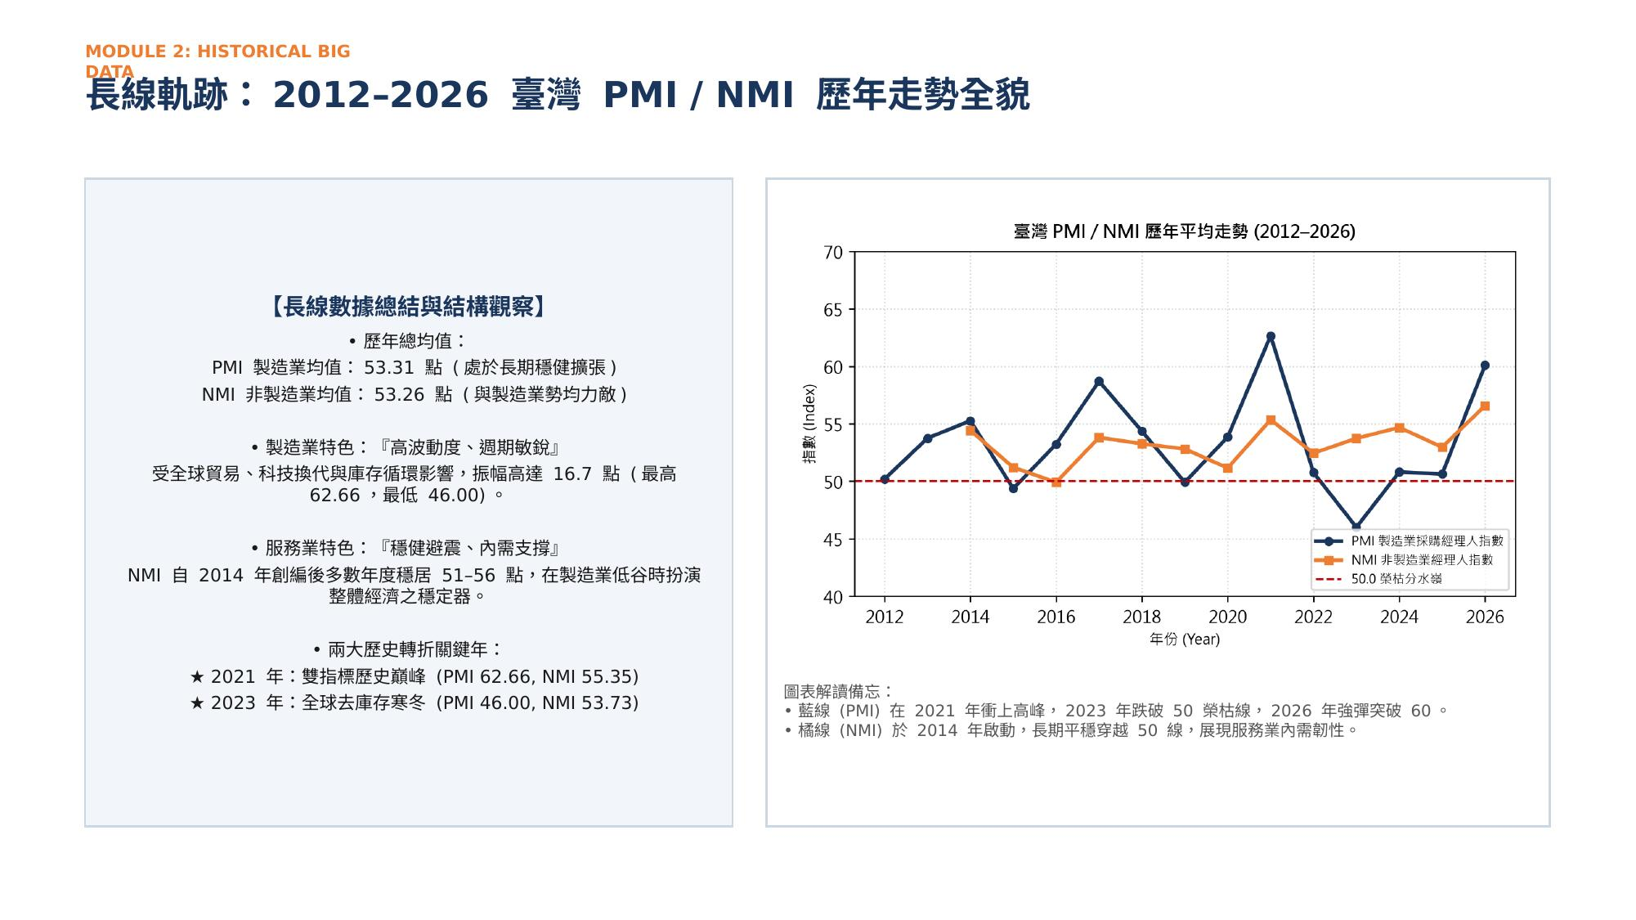
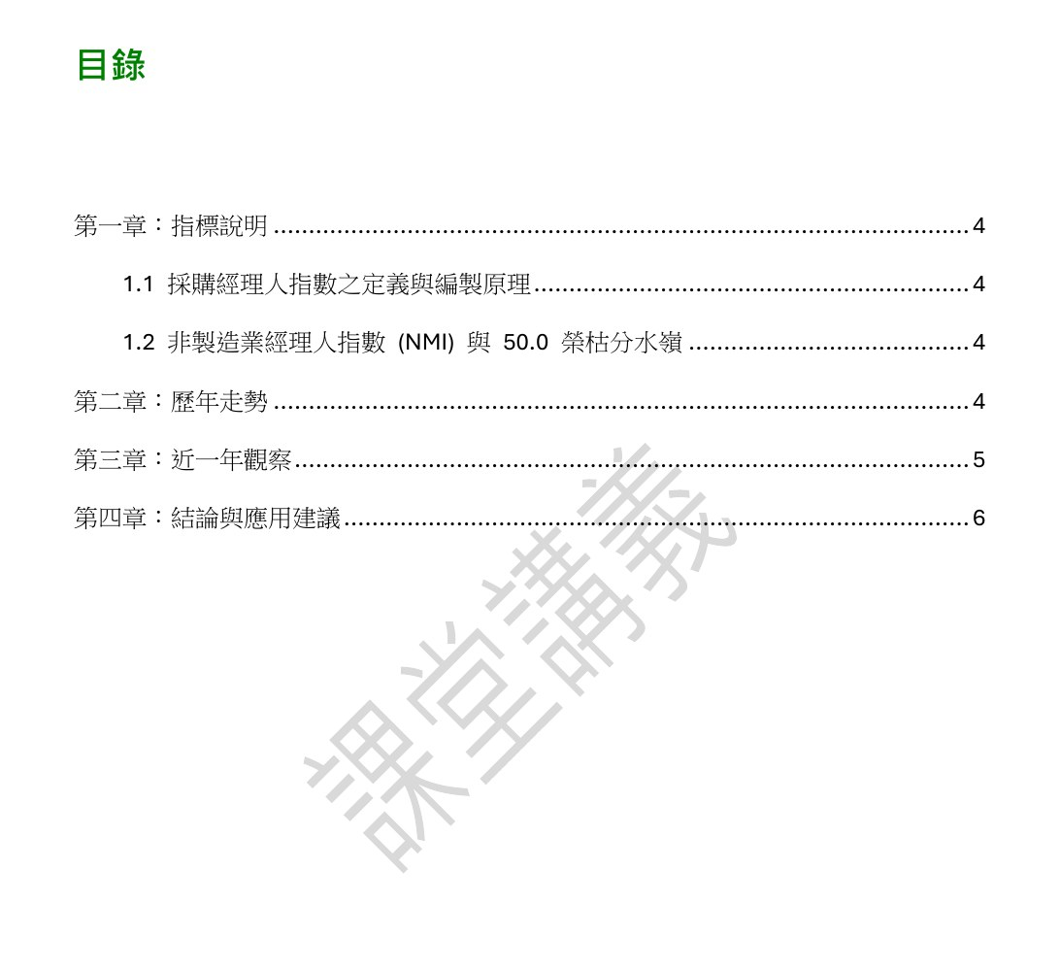
Results: the deck and the PDF handout
Ex 2: trend slide (Chinese)
Numbers match; the chart is an image → ask for a native chart
Ex 4: handout TOC (Chinese)
TOC has page numbers; watermark renders
Notes:
These are real results. On the left is the trend slide from the example two deck: a card layout, text on the left and the yearly trend chart on the right, with numbers matching the Excel yearly averages. Look closely, though: this trend chart is an inserted image, not a native PowerPoint chart, so you can't edit its data. When that happens, just ask the AI to make it a native chart. On the right is the table-of-contents page of the example four PDF handout: the table of contents has page numbers, which means the fields were updated before conversion, and the diagonal Chinese Course Handout watermark is light gray and renders correctly, not as boxes. Both screenshots show the original Chinese output.

