Slide 1
Unit 05 QIIME 2 Gut Microbiome Analysis
Run a complete 16S analysis on NCHC HPC in plain language
Download data → Account & queue → Submit job → Analysis report
Notes:
This unit shows how to open an AI Agent on the NCHC HPC system and, with a few plain-language sentences, have it download the data, confirm the project account and queue, submit the job, report progress on a schedule, and finally deliver a nine-page analysis report with eight figures. The first half is about operating on the HPC, which is quick; the second half walks through the results, which become the material for writing a paper in the next unit.

Slide 2
Why this analysis
1
Stem cell transplant
A curative treatment for some cancers and blood diseases
2
Chemo + antibiotics
Required before the transplant
3
Gut microbiome damaged
Patients who lose diversity have higher transplant-related mortality
Autologous fecal microbiota transplant (auto-FMT)
① Bank the patient's own stool microbes before chemotherapy
② Return them after the transplant → hoping to restore the microbiome
Notes:
Hematopoietic stem cell transplantation can cure some cancers and blood diseases, but the chemotherapy and antibiotics given beforehand badly damage the gut microbiome, and patients who lose microbial diversity have higher transplant-related mortality. Autologous fecal microbiota transplantation, or auto-FMT, banks the patient's own stool microbes before chemotherapy and returns them after the transplant, hoping to restore the microbiome.

Slide 3
Three questions to answer
Q1
How does the gut microbiome change during transplantation?
Q2
Do auto-FMT patients change differently from the control group?
Q3
Which bacteria rise and fall with transplant timing?
Notes:
In this unit we use sequencing data to answer three questions. First, how does the gut microbiome change during transplantation? Second, do patients who receive auto-FMT change differently from the control group? Third, which bacteria rise and fall with transplant timing? The summary slide comes back to answer each one.

Slide 4
Example data: clinical trial NCT02269150
Two patient groups (randomized)
auto-FMT group
Control group: no intervention
Upstream: raw reads (demo)
41 samples × R1/R2 = 82 .fastq.gz files
Quality check, DADA2 denoising
Downstream: public table (main analysis)
12,546 samples × 17,865 ASVs
feature-table.qza, rep-seqs.qza, sample-metadata.tsv
SILVA 138.2 classifier (V4 region)
!
The two datasets are separate
The 41 samples only demo raw-read processing
Notes:
The data come from a clinical trial used in the official QIIME 2 tutorial: stem cell transplant patients were randomly assigned to an auto-FMT group or a control group. Upstream are raw sequencing files for 41 samples, used to demonstrate quality checks and DADA2 denoising. Downstream is a public table of 12,546 samples and 17,865 ASVs, which is the main analysis. Note that the upstream and downstream datasets are separate: one does not feed into the other.

Slide 5
How: no commands to memorize, just ask
Used to require
Linux
sbatch · squeue
qiime dada2 …
NCHC HPC login node
Start an AI Agent (Antigravity CLI, Claude Code, Gemini CLI)
AGENTS.md
Template, Slurm defaults, report format; always read numbers from output files
Step 1
Download the data
Step 2
Confirm account & queue
Step 3
Submit the job
Step 4
Generate the report
Notes:
This kind of analysis usually means knowing Linux, Slurm, and QIIME 2 commands. This unit shows another way: log in to NCHC HPC and start an AI Agent in your own working folder. This session uses Antigravity CLI; Claude Code or Gemini CLI also work. Put AGENTS.md in the folder: it holds the analysis template, Slurm defaults, and report rules. From then on, each step is just one plain-language sentence, in four steps.

Slide 6
Step 1: Download the data
Prompt
Download https://drive.usercontent.google.com/download?id=1JXGPT2bhLJvOnpTY9-oYBKxvZ45M0qPN&export=download&authuser=1 and extract it
QIIME2.tar.gz
About 60 MB, extracted to QIIME2/
Input_Data/
Reads, sample metadata, feature table, SILVA classifier
Qiime2_Pipeline.sh
Slurm script for the whole analysis
Notes:
Step one: paste the download link and ask the AI to download and extract it. The AI downloads QIIME2.tar.gz, about 60 MB, and extracts it into a QIIME2 folder. Inside are Input_Data, with the sequencing files, sample metadata, feature table and classifier, plus the Slurm script for the whole analysis, Qiime2_Pipeline.sh.

Slide 7
Step 2: Confirm project account and queue
Prompt ①
Which projects can my account use? Should it be MST109178?
MST109178 ✓ available
Prompt ②
Change it to MST109178. Is ngscourse8g enough, or should I use ngs62g and increase the number of CPUs?
AI's queue advice
ngscourse8g: 1 CPU / 8 GB
Enough this time (DADA2 denoising is precomputed)
ngs62g: up to 8 CPU / 62 GB
Re-run DADA2, train classifiers, large data
Not sure? Just ask: the AI checks and explains why
Notes:
Jobs on the HPC consume project credits, so first ask the AI which projects your account can use. The AI checks the Slurm settings itself, confirms that MST109178 is available, and switches the script to that account. Then ask about the queue: the AI judges that the course queue ngscourse8g, with one CPU and 8 GB, is enough, because the heaviest steps, DADA2 denoising and classifier training, are precomputed. You only need ngs62g to re-run DADA2 yourself or to process large real-world data.

Slide 8
Step 3: Submit the job, get regular updates
Prompt ①
Go ahead and submit it
Prompt ②
Report progress every five minutes
0 min
Submitted: Job 570915, Running
8 min
Import, four-stage filtering, taxonomy done
15 min
Diversity, group tests, LME, UMAP done
18 min
COMPLETED (17 min 57 s); reporting stops
Notes:
Say "Go ahead and submit it" and the job is submitted as job 570915. Then ask for a progress report every five minutes, so you don't have to watch squeue yourself. At 8 minutes, import, filtering and taxonomy are done; at 15 minutes, diversity analysis, group tests, LME and UMAP are done; at 18 minutes the job completes, in 17 minutes 57 seconds total, and the AI stops reporting on its own.

Slide 9
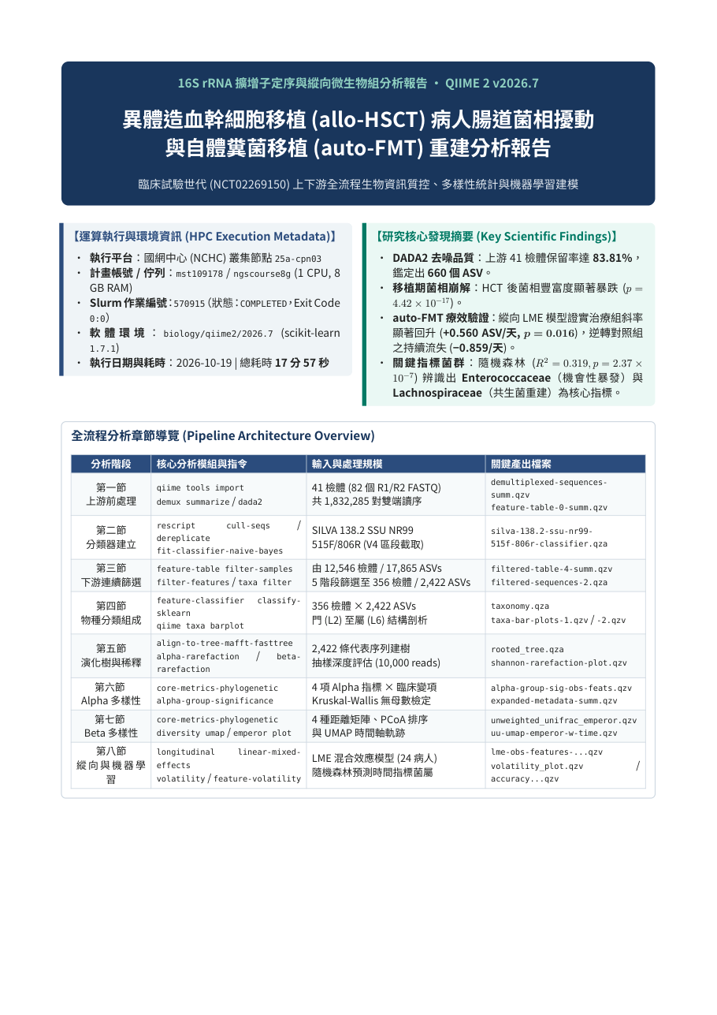
Step 4: Ask the AI for an analysis report
Prompt
Please produce a PDF report for me. Report on each analysis in its own section and include the corresponding analysis figures. You can handle it yourself, and finish with a summary and conclusions.
Report p. 1 (in Chinese)
17 min
9-page report · 8 figures
Output
report/QIIME2_Analysis_Report.pdf
report/figures/fig01–fig08.png
Notes:
The run leaves a pile of qza and qzv files that are hard to read at a glance. Step four: ask the AI for a report with one section per analysis, the matching figures, and a summary and conclusions at the end. The AI extracts the archives, reads the numbers, draws the figures and lays out the document. About 17 minutes later it delivers a nine-page PDF report, written in Traditional Chinese, plus eight 300-DPI composite figures. The next six slides walk through the report.

Slide 10
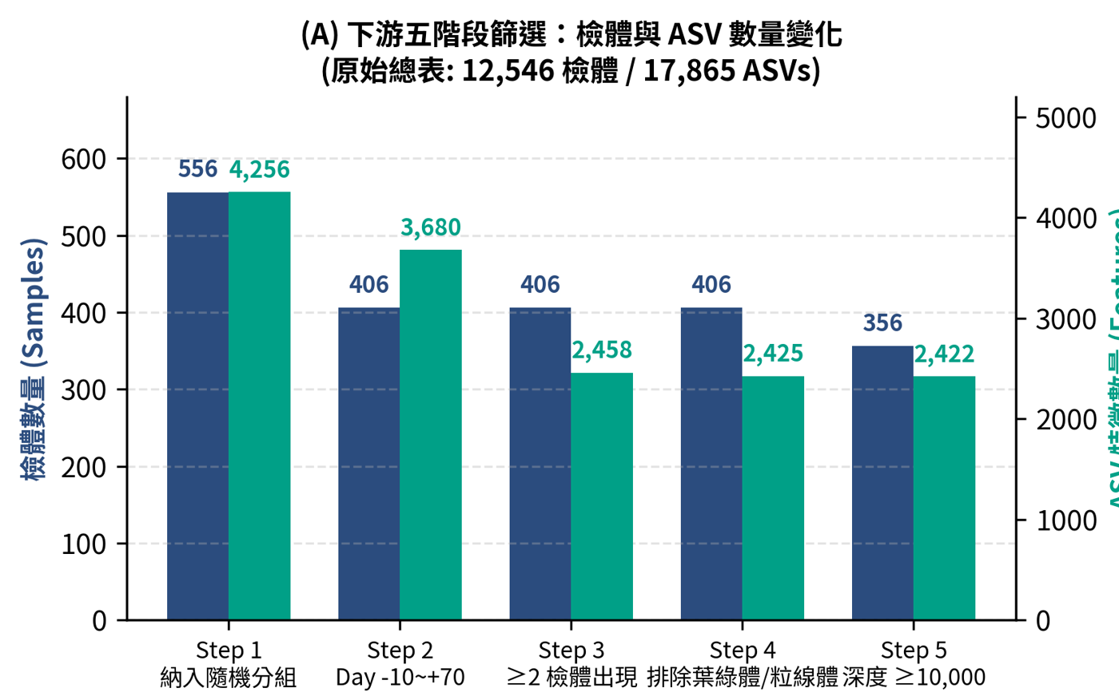
Results 1/6: filtering 12,546 → 356 samples
Report Fig. 2A · five-stage filtering
Filtering steps (samples)
12,546 → 556 (this trial)
→ 406 (day −10 to +70)
→ 356 (reads ≥ 10,000)
24 patients
356 samples, 2,422 ASVs
14.8
samples per patient (2–34)
Notes:
First, filtering. The public table has 12,546 samples. Filtering keeps the 556 in this trial, then the 406 from 10 days before to 70 days after transplant; after removing rare ASVs and non-bacterial sequences, samples with fewer than 10,000 reads are dropped. That leaves 356 samples and 2,422 ASVs from 24 patients: 10 control patients with 150 samples and 14 auto-FMT patients with 206. Each patient was sampled 2 to 34 times, 14.8 on average. Because the same patient was sampled many times, this decides which statistics we use later. Figure labels in the report are in Chinese; the captions here give the English.

Slide 11
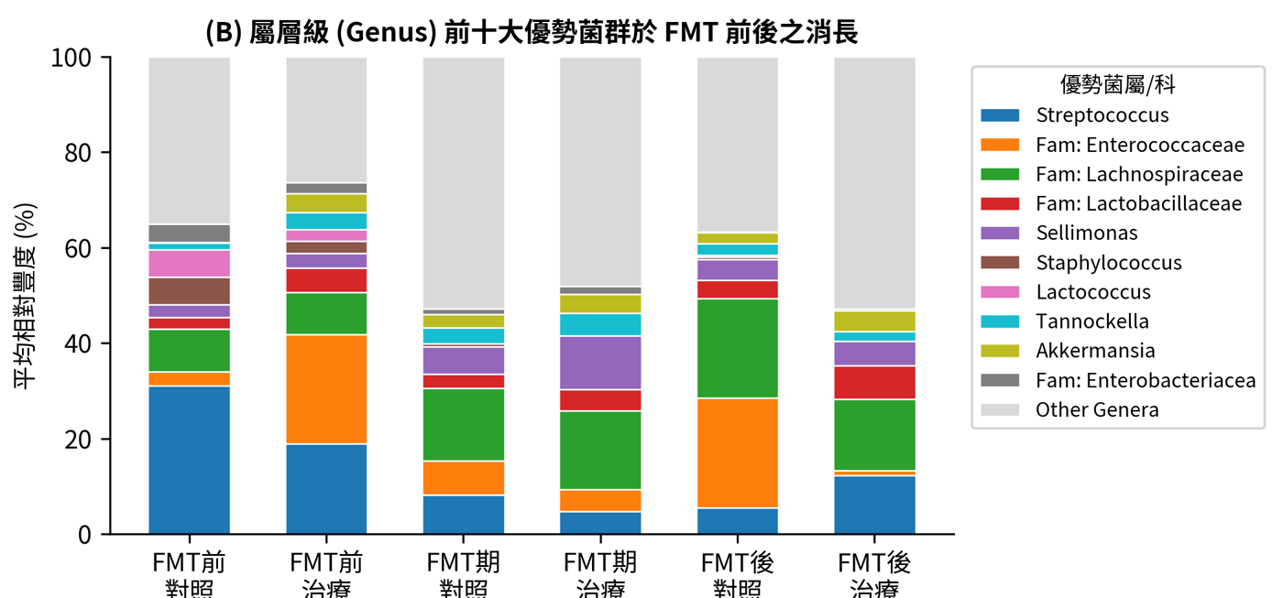
Results 2/6: Enterococcus surges after transplant
Report Fig. 3B · top 10 genera (orange = Enterococcaceae)
0.9% → 22%
Enterococcaceae: before → after
48 / 225
post-transplant samples > 50% Enterococcus
Phylum: Bacillota ≈ 84%
Notes:
In taxonomic composition, Enterococcaceae averages only 0.9% before transplant and rises to 22% after. Of the 225 post-transplant samples, 48 are more than half Enterococcus: the single-taxon domination often seen after transplantation. At the phylum level, Bacillota, formerly Firmicutes, dominates at about 84%.

Slide 12
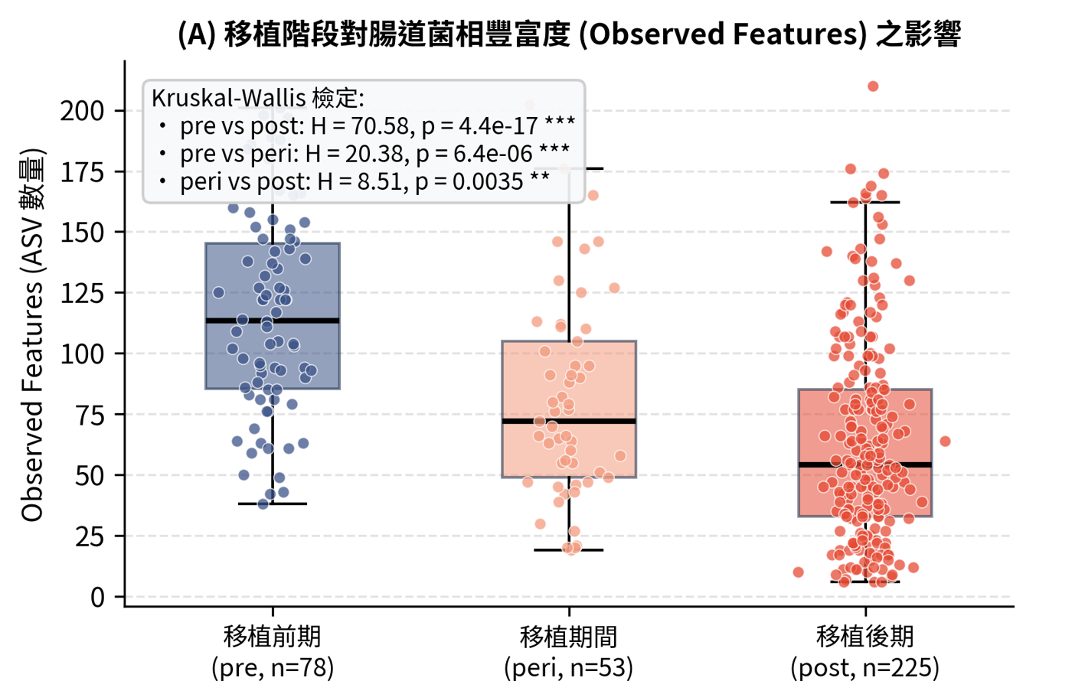
Results 3/6: richness drops, groups look alike
Report Fig. 5A · richness before, during, after transplant
Before (78) vs after (225)
H = 70.58
q = 1.3 × 10⁻¹⁶
Groups pooled
Control (150) vs auto-FMT (206)
p = 0.256 → no difference
Samples are not independent: exploratory
Notes:
Observed ASVs serve as the measure of richness. The difference between before and after transplant is highly significant: Kruskal-Wallis H equals 70.58, q equals 1.3 times 10 to the minus 16. But with all time points pooled, the auto-FMT and control groups show no difference, p equals 0.256. That is why the next step uses a longitudinal model. Note: multiple samples from the same patient are treated as independent here, so these comparisons are exploratory.

Slide 13
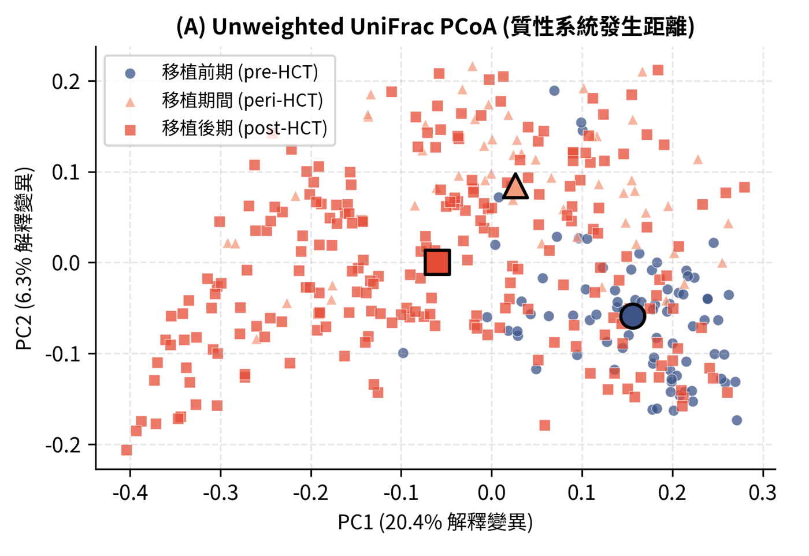
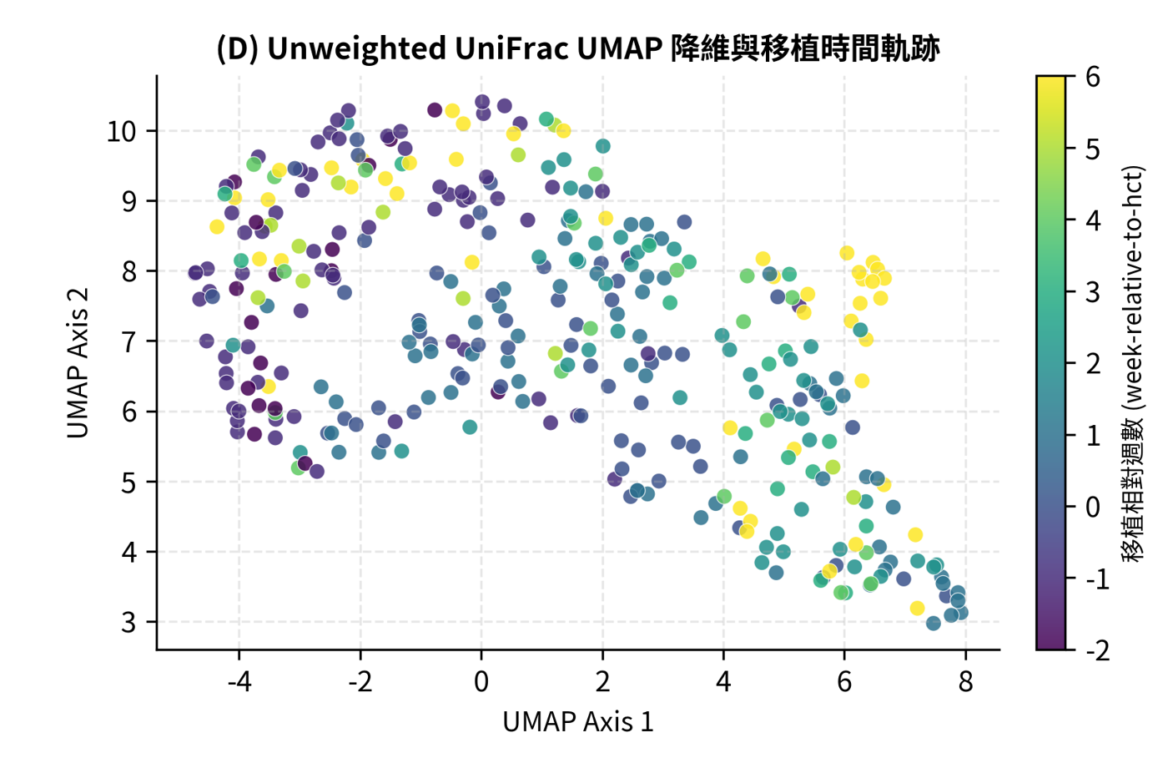
Results 4/6: composition drifts over time
Report Fig. 6A · Unweighted UniFrac PCoA
Report Fig. 6D · UMAP (color = week after transplant)
Before: clustered; after: shifted away and spread out (PC1 = 20.4%)
Notes:
Beta diversity measures how different the communities in two samples are, then projects them onto a plane. PC1 of unweighted UniFrac explains 20.4% of the variation. Pre-transplant samples cluster together; during and after transplant, the community centroid clearly shifts away and spreads out. The UMAP on the right is colored by week after transplant and shows the microbiome moving continuously over time.

Slide 14
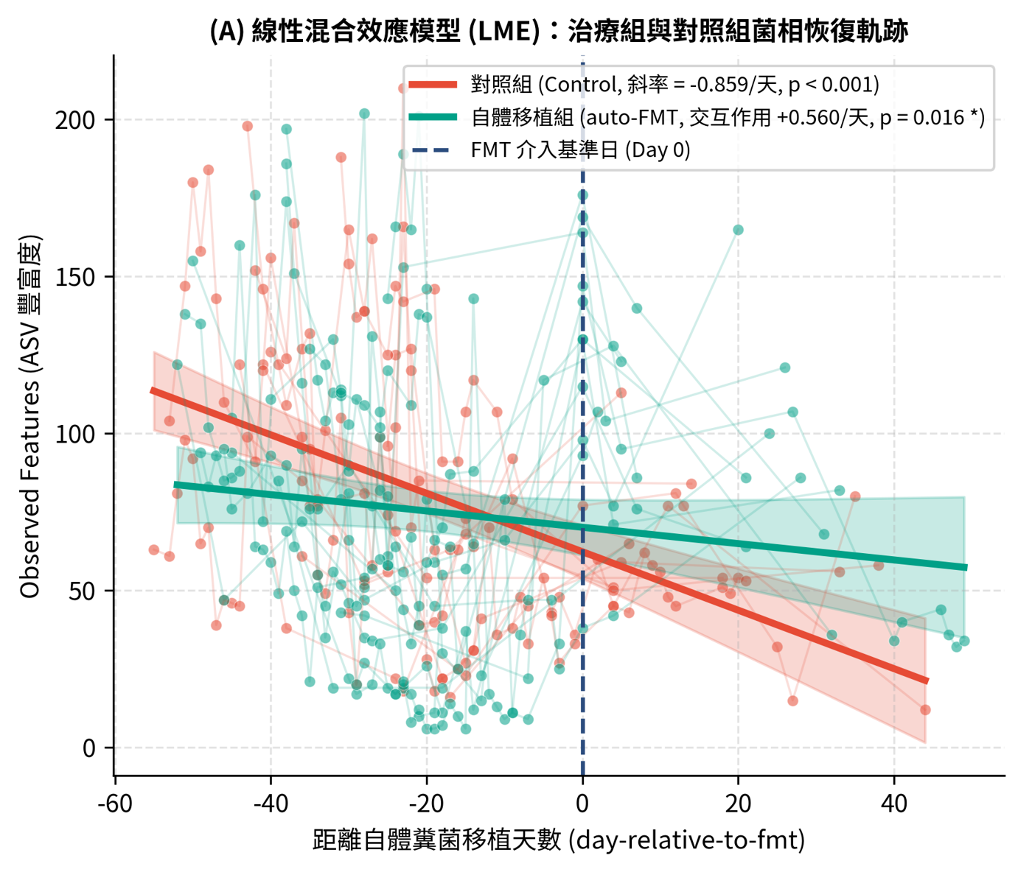
Results 5/6: auto-FMT declines more slowly
Report Fig. 7A · red = control, green = auto-FMT
LME results (richness / day)
Control: −0.859 (p < 0.001)
Interaction: +0.560 (p = 0.016)
95% CI 0.104–1.015
auto-FMT ≈ −0.30 / day
Group main effect 2.96 (p = 0.738)
⚠ Model did not converge
Notes:
Each patient was sampled many times, so we need a longitudinal model. A linear mixed-effects model with patient as a random effect shows: richness in the control group falls by 0.859 per day, 95% confidence interval minus 1.196 to minus 0.523. The time-by-group interaction is plus 0.560 per day, p equals 0.016, meaning the auto-FMT group declines more slowly, about minus 0.30 per day. The group main effect is 2.96, p equals 0.738, so the two groups are similar on the day of FMT. Caution: the model output notes that it did not converge, so interpret the result carefully.

Slide 15
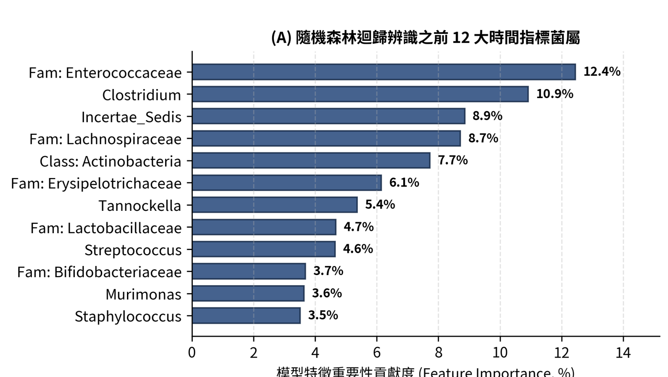
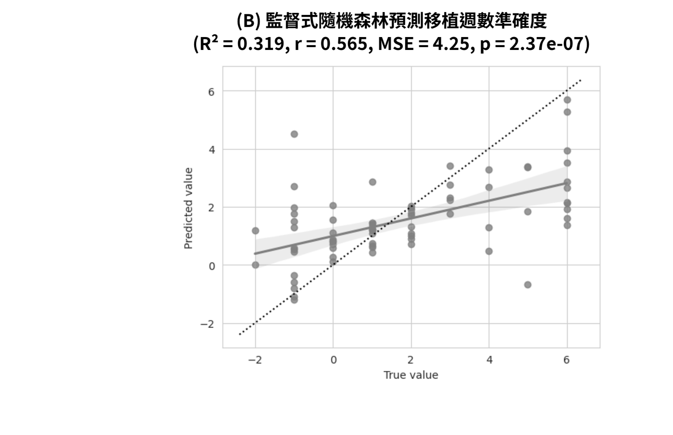
Results 6/6: which bacteria track time
Report Fig. 8A · top 12 feature importances
Report Fig. 8B · predicted vs actual week
R²
0.319
Predicts time, not treatment effect
Enterococcaceae 12.4% Clostridium 10.9% Lachnospiraceae 8.7%
Notes:
The random forest aggregates genus-level proportions into 22 core genera and predicts the week after transplant: R-squared 0.319, r 0.565, p equals 2.4 times 10 to the minus 7. The top features are Enterococcaceae at 12.4%, Clostridium at 10.9%, and Lachnospiraceae at 8.7%. Note that it predicts time, not treatment group: these are bacteria that rise and fall with transplant timing, not markers of treatment effect.

Slide 16
Caveats for interpretation
Wording too strong
"validated the treatment effect", "confirmed a significant reversal"
→ gentler slope (p = 0.016); needs further validation
Why not "confirmed"
Only 24 patients
Time span crosses FMT
LME did not converge
AI's chat summary got 4 numbers wrong (the PDF itself is correct)
e.g. group effect given as β = −4.254; the output file says 2.962
Check every number for the paper against the raw output files (results/tables/)
Notes:
The numbers in the AI's report all check out, but its wording is stronger than the evidence. For example, the report says it "validated the treatment effect" and "confirmed a significant reversal", but with only 24 patients, a time span that crosses FMT, and an LME that did not converge, a fairer statement is: richness declined with a gentler slope in the auto-FMT group, which needs further validation. Also, a summary the AI wrote separately in the conversation got 4 numbers wrong; for example, it gave the group effect as minus 4.254 when the output file says 2.962. So every number that goes into a paper must be checked against the raw output files.

Slide 17
Summary: back to the three questions
Q1 How does the microbiome change?
Richness drops sharply; Enterococcus takes over
Q2 auto-FMT vs control?
Pooled: no difference (p = 0.256); longitudinal model: auto-FMT declines more slowly (p = 0.016)
Q3 Which bacteria track timing?
Mainly Enterococcaceae and Lachnospiraceae
Only 24 patients → a lead worth following, not proof that the treatment works
Notes:
Back to our three questions. Q1: transplantation sharply reduces gut microbial richness, and Enterococcus takes over. Q2: pooling all samples, the two groups look the same; with a longitudinal model, the auto-FMT group declines more slowly. Q3: the bacteria that rise and fall with transplant timing are mainly Enterococcaceae and Lachnospiraceae. But with only 24 patients, this is a lead worth following, not proof that the treatment works.

Slide 18
Next unit: a report is not a paper
Analysis report
Next unit: Research Paper Writing
Search literature, take notes
Write Methods, Results, Introduction, Discussion
Check citations and numbers
Output an English paper with citations
≠
A report is not a paper
Notes:
The analysis is done and the report is ready, but an analysis report is not yet a paper. A paper also needs prior work, and every number and every citation must be traceable to its source. The next unit, Research Paper Writing, takes these results and works with AI to search the literature, take notes, and write an English paper with citations.

