Slide 1
State Population
An (subjective) Analysis
Aggregated
20 April 2023

Slide 2
What we will cover...
The “Haves”
The “Have-nots”
Gainers
Losers
Takeaways
*Disclaimer: this presentation assumes that no one
present today is attending with the genuine expectation of
garnering insights based on state population data… enjoy!

Slide 3
The “Haves”
1. California
California is massive, so, naturally, it haves a lot.
393,46,023
2. Texas
Texas is also massive, but, as we just saw, California is better. So Texas becomes our first loser.
28,635,442
3. Florida
Florida is massively deceptive deceptively massive, for now. This state is likely doomed to vestige.
21,216,924
4. New York
New York is thicc with two Cs and a personality to match; this is the only explanation I can think of for how it convinced that many humans to live that close to one another.
19,514,849
5. Pennsylvania
Pennsylvania is alright.
12,794,885

Slide 4
The “Have-nots”
46. North Dakota
It borders Canada so this strikes me as poor judgment on an epidemic level; my guess is aliens.
760,394
47. Alaska
736,990 Americans traveled through Canada – and then past Canada – and opted not to correct their mistake.
48. District of Columbia
Is this a state?
701,974
49. Vermont
Vermont also saw the greatest population stability from 2013 to 2020, losing only 1564 occupants. For this reason I formally propose that they change their state motto to “They come for the cheese and most of them stay for the cheese.”
624,340
50. Wyoming
Have you been here?... Me either.
581,348

Slide 5
Gainers
01
03
Texas
California
Texas wins with a Texas-big influx of 2,996,069. Or whatever…
A solid influx of 1,686,842.
02
04
Florida
North Carolina
+2,125,768… Now why would that – OH. Boomers. Bout that time.
So it’s north but still south? Anyways +734,847

Slide 6
LOSERS
-1
-3
Illinois
Connecticut
Coming in as the biggest loser (-1) is Illinois with a loss of 132,390. My interpretation of this data is that the state is terrible.
I drove through Connecticut while racing a winter storm once; it’s a beautiful state.
-2
-4
West Virginia
Vermont
Coming in as the 2nd biggest loser (-2) with a loss of 46,193. This state is probably also terrible, but must be less terrible than Illinois.
Cheeeeeeeesse...

Slide 7
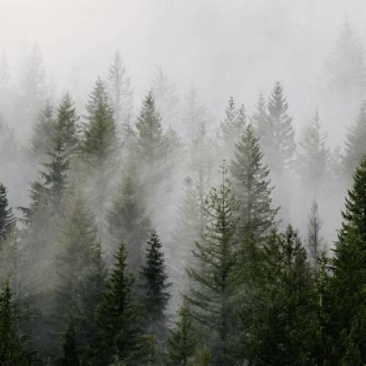
Takeaways (aside from time)
I sincerely hope that everyone enjoyed this presentation.
TBD – will complete 4/21
Id volutpat lacus laoreet non curabitur gravida arcu. Felis bibendum ut tristique et egestas quis ipsum suspendisse. Quam viverra orci sagittis eu. Risus commodo viverra
Photo by Dave Hoefler on Unsplash

