Slide 1
The model-adapter subsystem
loading_from_pretrained.py deep dive
Bram Chen-Nakagawa - TransformerLens (TransformerLensOrg) - Berlin

Slide 2
Registry
- A family registers: canonical/HF names, a config translator, a weight-conversion fn, per-family flags
- Flags: GQA, tied embeddings, RoPE variant, norm placement, embedding scaling, local/global schedule

Slide 3
The traps (real ones from this year)
- head_dim assumed = d_model // n_heads (LLaMA-4)
- QK-norm tensors dropped (Qwen-3)
- norm eps placed outside the rsqrt (Gemma-3 -> the v2.16.0 miss -> v2.16.1 hotfix)
- input embedding scaling dropped (Gemma)

Slide 4
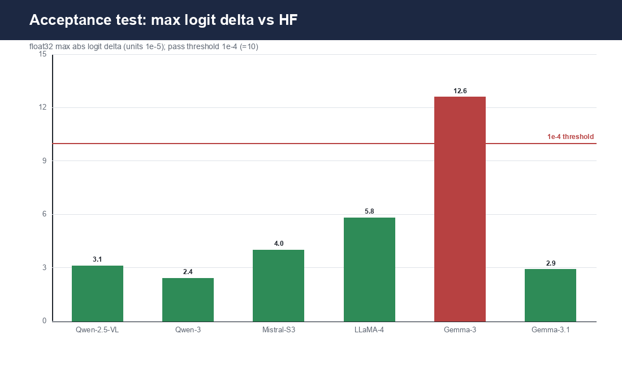
Acceptance-test deltas
float32 max logit delta vs HF per adapter; 1e-4 threshold; Gemma-3 miss fixed in 2.16.1

Slide 5
Policy
- Every adapter ships a weight-conversion test (float32 logits to 1e-4 abs)
- Published weights + architecture only; adapters land upstream; no private forks
- A shared helper (RoPE, a signature) is cross-cutting -> needs a peer +1

