Slide 1
TransformerLens: a walkthrough
ICML-adjacent interpretability workshop
Bram Chen-Nakagawa - TransformerLens (TransformerLensOrg) - Berlin

Slide 2
What TransformerLens is
- The standard OSS library for mechanistic interpretability of GPT-style models
- HookedTransformer: load a pretrained model with hooks at every residual-stream, attention-head, and MLP position
- ActivationCache: capture and edit activations (run_with_cache)
- Analysis-first, not a training framework
- MIT licensed; pip install transformer-lens

Slide 3
The hook surface
- Stable hook names are the public contract downstream tools depend on
* hook_resid_pre / mid / post, attn.hook_q/k/v/z, mlp.hook_pre/post
- SAEs and activation patching splice onto these hook points
- New model families reuse the same names via the adapter subsystem

Slide 4
Adding a model (the adapter workflow)
- Read the public HF modeling file; note attention flavor, norm, RoPE, tied weights, quirks
- Draft the weight-conversion table in loading_from_pretrained.py
- Acceptance test: float32 logits match HF to 1e-4 absolute on the smallest public checkpoint
- Open the PR (code + docs + test); merge on green CI

Slide 5
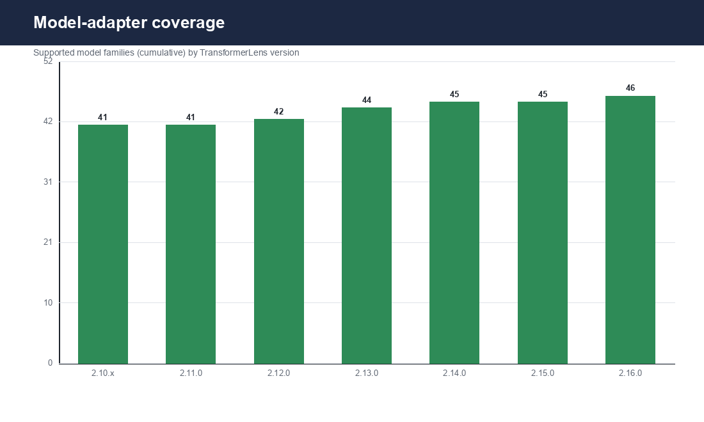
Coverage today
Supported model families (cumulative) by TransformerLens version

Slide 6
Get involved
- Issues + PRs on github.com/TransformerLensOrg/TransformerLens
- Community Discord (~2.4k members) for user support
- Good first PRs: new public model adapters (bring the acceptance test)

