Slide 1
Maintainer quarterly review
Q2 2026 (Apr-Jun)
Bram Chen-Nakagawa - TransformerLens (TransformerLensOrg) - Berlin

Slide 2
Shipped
- v2.14.0 (LLaMA-4), v2.15.0, v2.16.0 (Gemma-3 + security fix), v2.16.1 hotfix
- 72 PRs merged in Q2
- One coordinated security advisory disclosed (GHSA-qm7x-2v9r-4c8p)

Slide 3
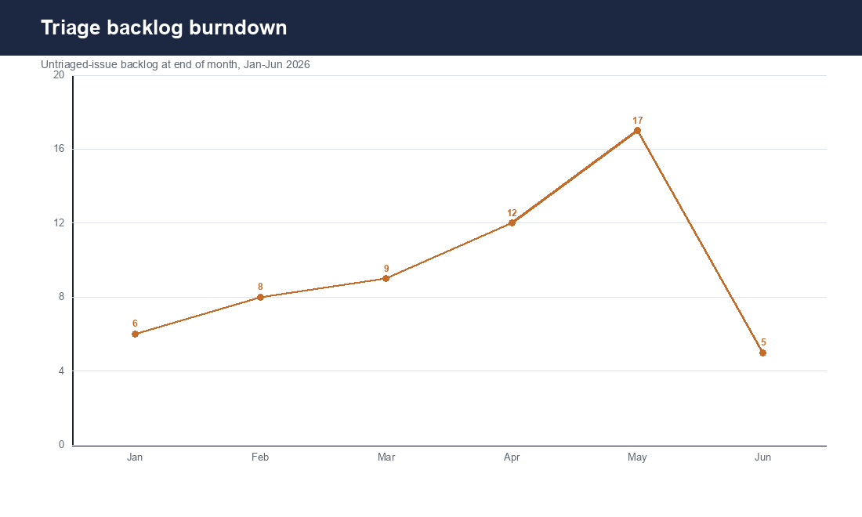
Triage backlog burndown
Untriaged-issue backlog end-of-month; May spike = ICML surge (Saturday triage-jam)

Slide 4
What went well / badly
- Well: LLaMA-4 landed on cadence; SLA held except the May ICML week
- Badly: Gemma-3 norm-eps miss shipped in v2.16.0; caught in 48h, hotfixed, recorded honestly
- Process: dropped consulting hours in May to protect the PR SLA (worked)

