Slide 1
TransformerLens roadmap
H2 2026 maintainer roadmap
Bram Chen-Nakagawa - TransformerLens (TransformerLensOrg) - Berlin

Slide 2
Themes
- Adapter breadth: track new public model families as they ship
- Hook-surface maintenance: finish the ActivationCache device-arg deprecation path
- Release reliability: keep the last-Thursday cadence and the 48h monitoring window
- Docs: keep supported-models current with each adapter

Slide 3
Next releases
- v2.17.0 on 2026-07-30 (next monthly cut)
- Monthly minors through H2; hotfixes only for post-release regressions
- No dependency bump in a patch line; permissive-only dependencies

Slide 4
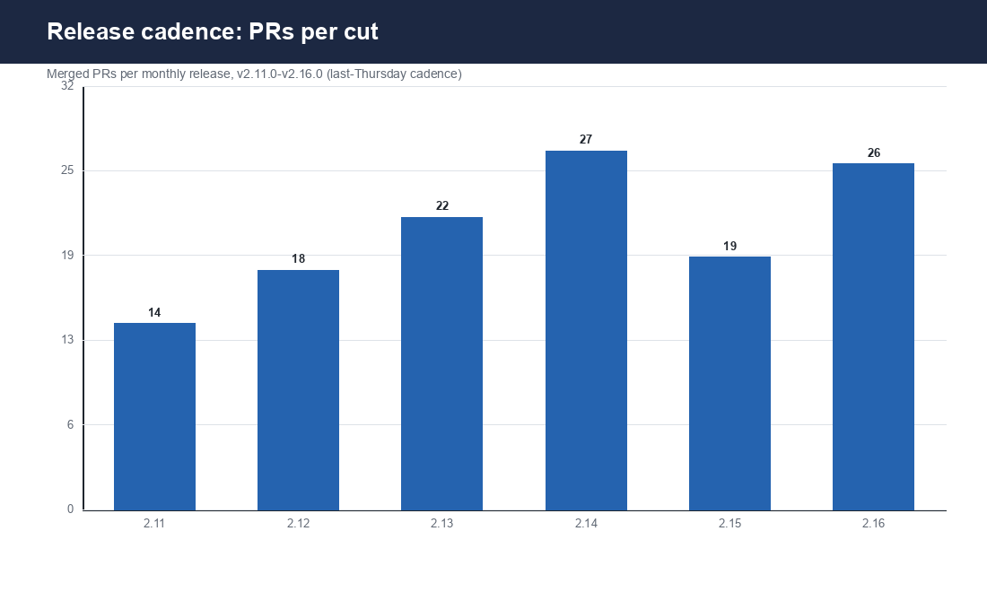
Release cadence so far
Merged PRs per monthly release, v2.11.0-v2.16.0

Slide 5
Risks
- A major model-family drop can create a multi-week backlog (LLaMA-4 in April)
- September (NeurIPS + MATS onboarding) raises triage volume
- Watch the PR-queue > 15 trigger (drop consulting hours to protect the SLA)

