Slide 1
LTFF milestone readout - Q1 2026
TransformerLens maintenance + model-adapter breadth
Bram Chen-Nakagawa - TransformerLens (TransformerLensOrg) - Berlin

Slide 2
Metrics (real, unrounded)
- PRs merged: 54
- PyPI downloads (end of period): 205,800
- Google Scholar cited-by: 524 -> 556
- Releases shipped on cadence

Slide 3
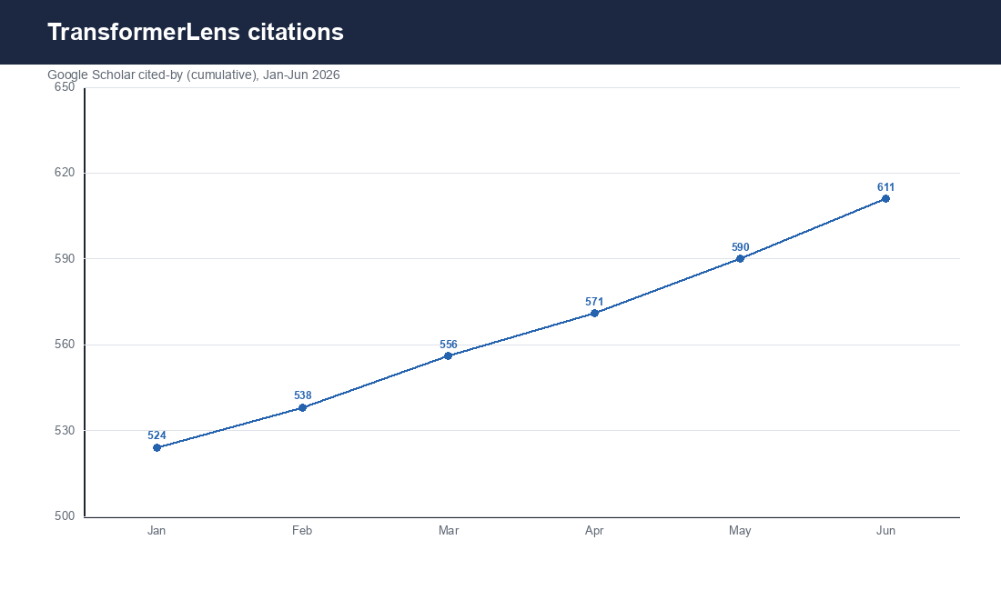
Trend
Source: pepy.tech / Google Scholar

Slide 4
Scope + stewardship
- Adapters landed and releases shipped on cadence
- Grant and consulting kept as separate ledgers
- No client attribution; no inflated claims (Priya review)

