Slide 1
LTFF milestone readout - Q2 2026
TransformerLens maintenance + model-adapter breadth
Bram Chen-Nakagawa - TransformerLens (TransformerLensOrg) - Berlin

Slide 2
Metrics (real, unrounded)
- PRs merged: 72
- PyPI downloads (end of period): 263,100
- Google Scholar cited-by: 571 -> 611
- Releases shipped on cadence

Slide 3
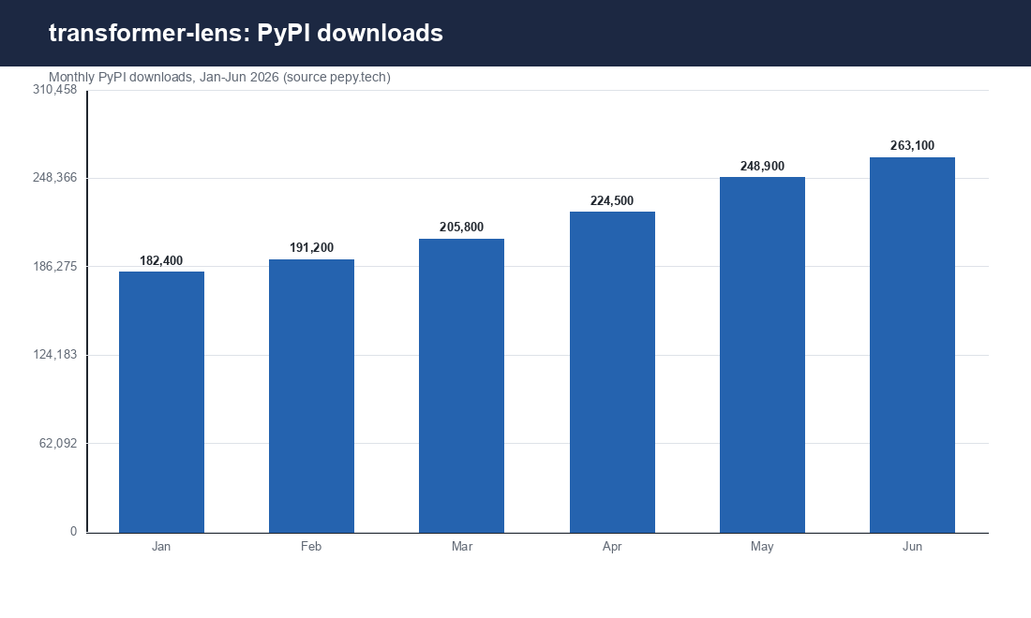
Trend
Source: pepy.tech / Google Scholar

Slide 4
Scope + stewardship
- Adapters landed and releases shipped on cadence
- Grant and consulting kept as separate ledgers
- No client attribution; no inflated claims (Priya review)
- Honest note: Gemma-3 miss in v2.16.0, hotfixed v2.16.1 (reported, not hidden)

