Slide 1
LTFF renewal pitch
$92k / 12 months for TransformerLens
Bram Chen-Nakagawa - TransformerLens (TransformerLensOrg) - Berlin

Slide 2
The ask
- $92,000 over 12 months, 4 tranches of $23,000 on quarterly milestone acceptance
- Wired via Wise to the German account

Slide 3
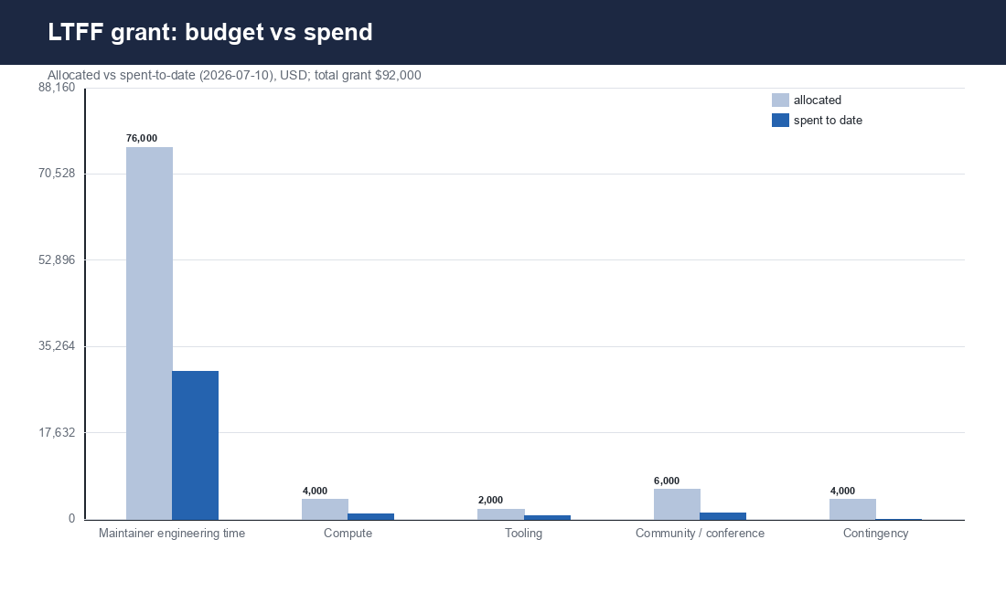
Budget
Allocated vs spent-to-date by category

Slide 4
Why fund it
- TransformerLens is the standard mech-interp tooling layer
- Adapter breadth must track a fast-moving field
- Reliable releases + triage are what downstream researchers depend on
- Honest stewardship: separate ledgers, real metrics, honest slips

