Slide 1
H1 2026 release retrospective
v2.11.0 through v2.16.1
Bram Chen-Nakagawa - TransformerLens (TransformerLensOrg) - Berlin

Slide 2
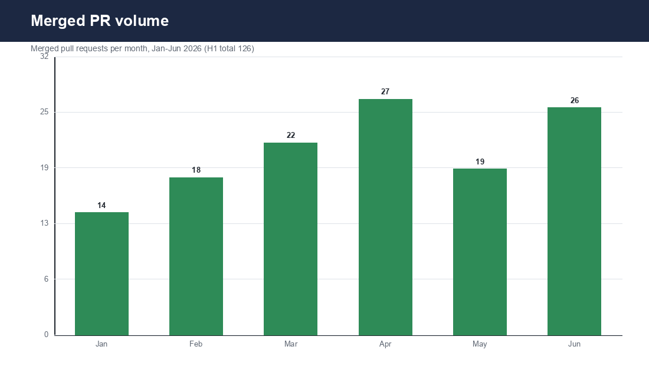
PR merge volume
Merged PRs per month, Jan-Jun 2026 (H1 total 126)

Slide 3
Highlights
- 6 monthly releases on cadence + 1 hotfix (v2.16.1)
- Adapters: Qwen-2.5-VL, Qwen-3, Mistral-Small-3, LLaMA-4, Gemma-3
- License gate held (GPL dep declined, #1101); permissive-only CI check added
- One security advisory coordinated and disclosed

Slide 4
Lessons
- Read config fields, never infer (head_dim); map new tensors (QK-norm); eps inside rsqrt
- Longer acceptance-test prompts would have caught the Gemma-3 miss pre-release
- The consulting-drop trigger protected the PR SLA during the ICML surge

