Slide 1
Release summary - v2.16.0
Cut 2026-06-25 (last Thursday)
Bram Chen-Nakagawa - TransformerLens (TransformerLensOrg) - Berlin

Slide 2
What shipped
- Gemma-3 family adapter (#1112)
- ActivationCache signature change: explicit device arg (cross-cutting, +1 rehan-ob)
- Security: bound-check checkpoint config fields before allocation (GHSA-qm7x-2v9r-4c8p)

Slide 3
Process
- Green Wednesday demo-notebook sweep (06-24) gated the cut
- Yusuke confirmed green CI in the maintainer thread before the tag
- Security advisory disclosed ONLY at the tag (embargo held until then)
- 48h post-release monitoring: caught the Gemma-3 miss -> v2.16.1 hotfix (06-27)

Slide 4
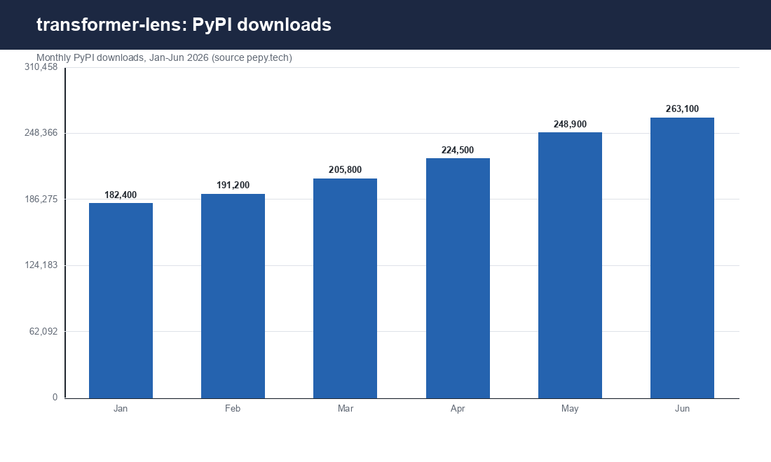
Downloads context
Monthly PyPI downloads through June

