Slide 1
Java Spring Framework and Inversion of Control
November 13, 2010
Donaby Henton

Slide 2
Software Goals
Lower cost
  Overall cost of software maintenance
Code reuse
Speed of deployment
Reduce errors
Flexible response for future needs

Slide 3
Things we do for those goals
Code reviews
Design patterns
Other examples of best practice
  Error trapping
  Logging strategies
Frameworks
  J2EE
  JSF, Struts…..
  Spring

Slide 4
‘Behavioral’ Model of Coding
Who
  Classes/Objects
What
  Messages, information, data flow
  Function calls
  Code Use
Connections
  Messages flow via connections
  The relation of one object to another
  Configuration of code

Slide 5
‘Behavioral’ Model of Coding
Object A ‘uses’ B and C
Object B
Object A
Object C

Slide 6
‘Behavioral’ Model of Coding
Object A ‘uses’ B and C
Object B
Object A
Object C
Composition
Inheritance

Slide 7
Object Dependencies
Objects use other objects
  Creates relationships (composition, inheritance)
These dependencies/relationships:
  Determined at compile time
  Determined at run time
Pull methods for dependencies
  Direct instantiation
  Factory
  Service Lookup

Slide 8
Object Dependencies
Push methods for dependencies
  Outside container “pushes” the relations at run time onto the object (Spring)
Overall:
  Need to wire up the relationships of objects
  Objects combine to do work
  Need to be aware of separating configuration of code from use of code

Slide 9
public void doDBAction() throws SQLException {
Connection conn = null;
Properties connectionProps = new Properties();
connectionProps.put("user", "user");
connectionProps.put("password", "@@@@@@");
conn = DriverManager.
getConnection("jdbc:mysql://localhost:3306/",
connectionProps);
//TODO:
// use connection for some actions
Statement stmt = conn.createStatement(ResultSet.TYPE_FORWARD_ONLY,
ResultSet.CONCUR_READ_ONLY);
ResultSet rs = stmt.executeQuery("SELECT * FROM ORDERS");
}

Slide 10
public void doDBAction() throws SQLException {
Connection conn = null;
Properties connectionProps = new Properties();
connectionProps.put("user", "user");
connectionProps.put("password", "@@@@@@");
conn = DriverManager.
getConnection("jdbc:mysql://localhost:3306/",
connectionProps);
//TODO:
// use connection for some actions
Statement stmt = conn.createStatement(ResultSet.TYPE_FORWARD_ONLY,
ResultSet.CONCUR_READ_ONLY);
ResultSet rs = stmt.executeQuery("SELECT * FROM ORDERS");
}
Configuration

Slide 11
public void doDBAction() throws SQLException {
Connection conn = null;
Properties connectionProps = new Properties();
connectionProps.put("user", "user");
connectionProps.put("password", "@@@@@@");
conn = DriverManager.
getConnection("jdbc:mysql://localhost:3306/",
connectionProps);
//TODO:
// use connection for some actions
Statement stmt = conn.createStatement(ResultSet.TYPE_FORWARD_ONLY,
ResultSet.CONCUR_READ_ONLY);
ResultSet rs = stmt.executeQuery("SELECT * FROM ORDERS");
}
Configuration
Use

Slide 12
Configuration and Use
In this example, these are in one class
Difficult to change
  Code change for each different database you want to connect to
  Hard coded configuration
  Properties files, JNDI will help
    But still the user of the code has to have knowledge of the configuration of the code

Slide 13
public void doDBAction() throws SQLException {
Connection conn = getDataSource().getConnection();
Statement stmt = conn.createStatement(ResultSet.TYPE_FORWARD_ONLY,
ResultSet.CONCUR_READ_ONLY);
ResultSet rs = stmt.executeQuery("SELECT * FROM ORDERS");
}

Slide 14
Configuration and Use
Now the class code does not configure
  Assumes that configuration has been done ahead of time
  Simply calls getDataSource.getConnection()
Advantages of this assumption
  The configuration could be done at run time
    Test
    Production
But who will do the configuration?

Slide 15
Another Example
External
Web Service
Class
Database
Download orders via Web Service
Process and format for db write
Write to database
Handle transactions (e.g. what if db write fails?)
As shown, the class must know all about the db and web service
Monolithic code
Not flexible

Slide 16
Another Example Using Composition
External
Web Service
Class
OrderService
DBService
Database

Slide 17
Another Example Using Composition
External
Web Service
Class
OrderService
DBService
Database
Web service download object

Slide 18
Another Example Using Composition
External
Web Service
Class
OrderService
DBService
Database
Tranformation Code

Slide 19
Another Example Using Composition
External
Web Service
Class
OrderService
DBService
Database
Database
Object
Composition partitions the relations of components
Order Service and DB Service are instance variables of the main class

Slide 20
Advantages
Code is partitioned so changing one part doesn’t modify another
  Different web service
  Different web service libraries (Axis, CXF)
  Different db methods
Class code will see the services as an interface
  Code to interface not implementation
Class code does not configure the relations it just uses them

Slide 21
Dependency Injection
Order Service and Db Service are dependencies for the class
The class code only knows the services via their interface, no knowledge of internal details
But how does the class get these services?
Do we have to create a class for each combination of webservice and db we can think of?

Slide 22
Spring to the Rescue
In our examples, we need a run time method of filling in the services
We need an ‘outside referee’ that is concerned about configuration of code, NOT the use of code
A factory design pattern that generalizes the creation of objects and their component parts
Takes care of these relations

Slide 23
Spring to the Rescue
Uses a configuration file in which you name concrete "beans" for the interfaces.
"Wire" the application together by stating which beans are dependent on each other.
Instantiate a Spring object called an ApplicationContext. This is a type of bean factory that will instantiate requested beans

Slide 24
Spring to the Rescue
Configuration file is xml
  Can also figure using code
  Spring 2.5 and up provides for annotations
The xml file is the home to configuration , but not code use
Injects dependencies via
  Get/set
  Constructors
  Factory method

Slide 25
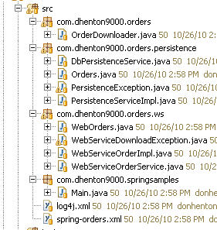
Spring Example

Slide 26
Spring Example Config file
<?xml version="1.0" encoding="UTF-8"?>
<beans xmlns="http://www.springframework.org/schema/beans"
xmlns:xsi="http://www.w3.org/2001/XMLSchema-instance"
xsi:schemaLocation="http://www.springframework.org/schema/beans
http://www.springframework.org/schema/beans/spring-beans.xsd">
<bean class="com.dhenton9000.orders.persistence.PersistenceServiceImpl"
id="dbInsertService">
<property name=“dataSource” ref="dataSourceBean" />
</bean>
<bean class="com.dhenton9000.orders.ws.WebServiceOrderImpl"
id="wsOrdersService">
</bean>
<bean id="setterDownloader"
class="com.dhenton9000.orders.OrderDownloader">
<property name="dbPersistance" ref="dbInsertService" />
<property name="wsDownloader" ref="wsOrdersService" />
</bean>
<bean id="constructorDownloader"
class="com.dhenton9000.orders.OrderDownloader">
<constructor-arg index="0" ref="wsOrdersService" />
<constructor-arg index="1" ref="dbInsertService" />
</bean>

Slide 27
Spring Terminology
Bean tag refers to a class
  Must specify full class name
  Unique id (used for ref attribute)
Properties are java bean properties
  Setter must exist
Property tag attribute can be
  Ref: reference to another defined bean
  Value: primitive, e.g. String or int
    <property name=“title” value=“Doctor” />

Slide 28
Spring Terminology
Container
  Application Context
This is a Static factory that uses xml config to
  Create the beans
  Apply the relationships (“wiring”)
Can get at the container via static factory
  ClassPathXmlApplicationContext

Slide 29
Spring Example Config file
The other bean
<?xml version="1.0" encoding="UTF-8"?>
<beans xmlns="http://www.springframework.org/schema/beans"
xmlns:xsi="http://www.w3.org/2001/XMLSchema-instance"
xsi:schemaLocation="http://www.springframework.org/schema/beans
http://www.springframework.org/schema/beans/spring-beans.xsd">
<bean class="com.dhenton9000.orders.persistence.PersistenceServiceImpl"
id="dbInsertService">
<property name=“dataSource” ref="dataSourceBean" />
</bean>
<bean class="com.dhenton9000.orders.ws.WebServiceOrderImpl"
id="wsOrdersService">
</bean>
<bean id="setterDownloader"
class="com.dhenton9000.orders.OrderDownloader">
<property name="dbPersistance" ref="dbInsertService" />
<property name="wsDownloader" ref="wsOrdersService" />
</bean>
<bean id="constructorDownloader"
class="com.dhenton9000.orders.OrderDownloader">
<constructor-arg index="0" ref="wsOrdersService" />
<constructor-arg index="1" ref="dbInsertService" />
</bean>
Ref refers to another bean

Slide 30
Spring Example Config file (con’t)
<bean id="dataSourceBean" class="com.mysql.jdbc.jdbc2.optional.MysqlDataSource">
<property name="user"><value>root</value></property>
<property name="password"><value></value></property>
<property name="serverName"><value>localhost</value></property>
<property name="port"><value>3306</value></property>
<property name="databaseName"><value>businessdb</value></property>
</bean>
</beans>

Slide 31
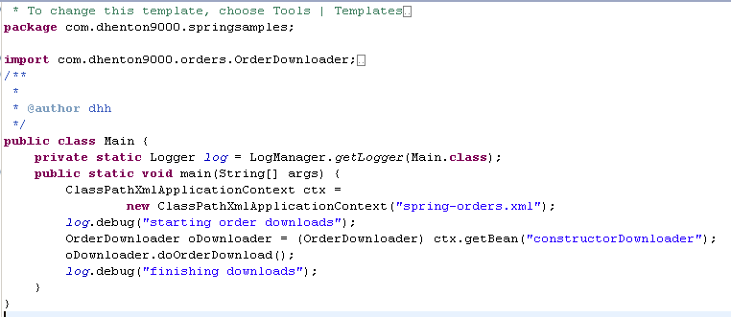
Spring Example main method

Slide 32
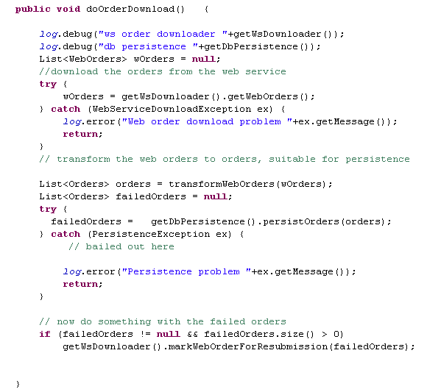
Spring Example (OrderDownloader)
The services are interfaces

Slide 33
Spring Example (OrderDownloader)
The services are interfaces
This code only knows the interface

Slide 34
Spring Example (OrderDownloader)
Filled In By Spring
The services are interfaces
This code only knows the interface

Slide 35
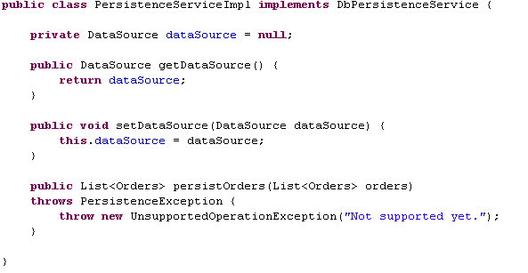
Spring Example (PeristenceServiceImpl)
Injected via Spring

Slide 36
Spring Example (PeristenceServiceImpl)
<bean class="com.dhenton9000.orders.persistence.PersistenceServiceImpl"
id="dbInsertService">
<property name=“dataSource” ref="dataSourceBean" />
</bean>
Spring bean
Injected via Spring

Slide 37
Spring Example Config file (con’t)
<bean id="dataSourceBean" class="com.mysql.jdbc.jdbc2.optional.MysqlDataSource">
<property name="user"><value>root</value></property>
<property name="password"><value></value></property>
<property name="serverName"><value>localhost</value></property>
<property name="port"><value>3306</value></property>
<property name="databaseName"><value>businessdb</value></property>
</bean>
</beans>

Slide 38
Spring fills in the blanks
External
Web Service
Class
OrderService
DBService
Database
Also configures the DB Service via the data source

Slide 39
Advantages
Final ‘wiring’ at runtime
  Can be configured for test vs. production with a simple change in the dataSourceBean spring entry
    Nothing else has to change
  Creates segments where change in one service doesn’t effect the others
  Divide and conquer:
    Code for use
    XML config for configuration

Slide 40
Advantages
Consuming code knows only the interface
  Swapping a new implementation is done via the xml file
Helps foster ‘code to interface not implementation’
This allows for easy mock implementations when testing

Slide 41
Disadvantages
Xml file can get complicated
  Import capability can help
Life cycle
  Does Spring only create one copy of a bean on startup?
    scope=singleton (create on startup)
    scope=prototype (on each request)
  Thread safety

Slide 42
Other Spring capabilities
Application Contexts
  classpath based
  File based
Beans can be created from static factories
  Older code that uses factories
Autowiring
  Will scan classpath for matches
  Removes need for xml config in simple cases

Slide 43
Spring So Far
Separate configuration from code use
Code to interfaces vs. implementations
Allow for flexible runtime configuration
Beans can be configured with beans that are then in turn configured allowing for quite complex relationships

Slide 44
Example: Spring and Design Patterns
Using Spring to Support Design Patterns
Spring is about Configuration
Design patterns are often about the relationships of objects to one another
A good match

Slide 45
EBay Inventory Attributes
Mason Shoe Company
  Sells items on Ebay
  Alternative channel
    Web sites
    Catalogs
    Phone orders
Need to categorize our items
  Must match EBay's designated categories
  Map internal categories/data to EBay categories

Slide 46
EBay Inventory Attributes
Take a POJO representing a row in a record set
  Mason internal representation of attributes
Map POJO attributes to CXF class used for web service submission
Mapping
  Dependent on type of shoe (men's, women's, boys…)
  Each type will have different attribute lists
  Some of those attributes are the same for each type (condition attribute is always “new”)
  Some are different (men's sizes vs. women’s)

Slide 47
EBay Inventory Attributes
Attributes are name value pairs
EBay has mandatory attributes which they determine
  Provides for some uniformity
  Also mandate the name of the attribute
Also allows for arbitrary attributes that sellers can add to improve communication with buyers
In our case some internal items for our use

Slide 48
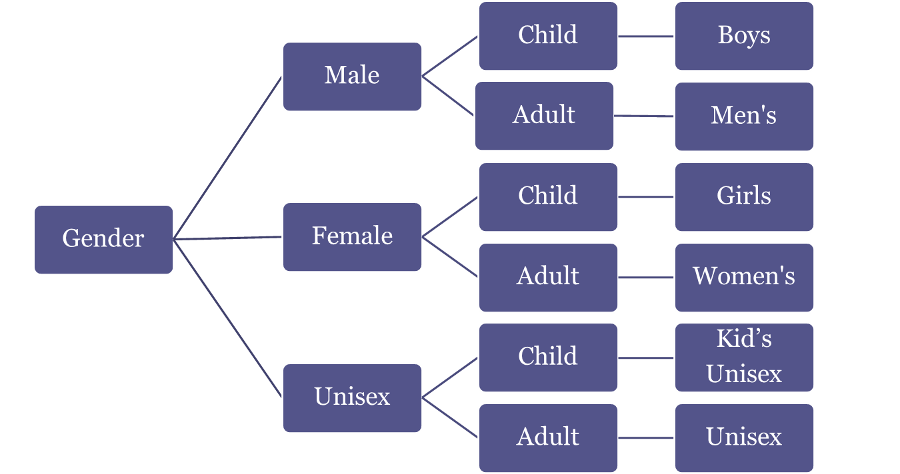
EBay Shoe Types

Slide 49
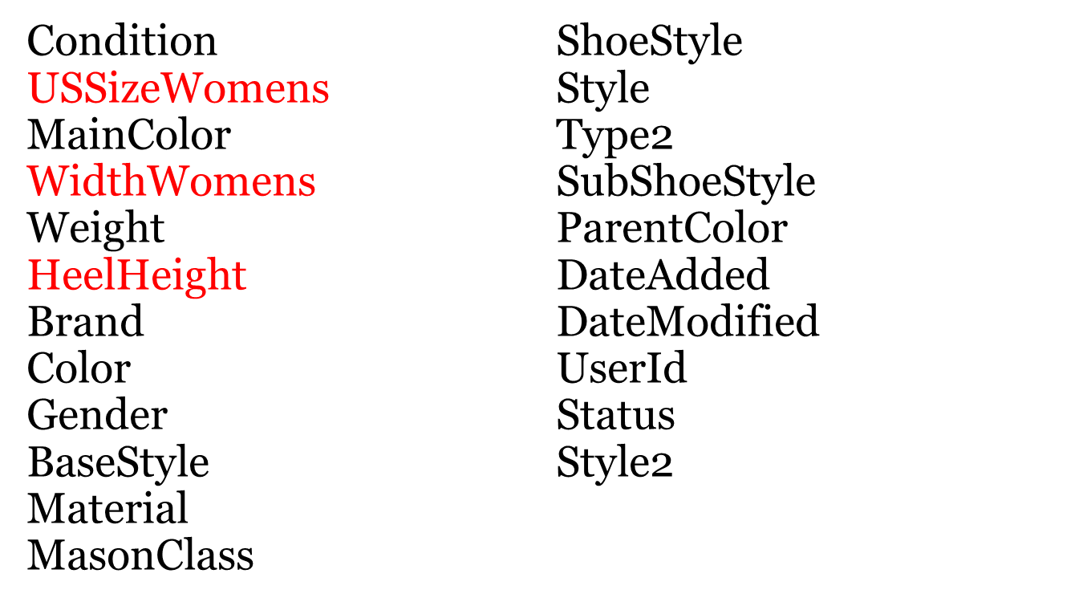
Women's Attributes

Slide 50
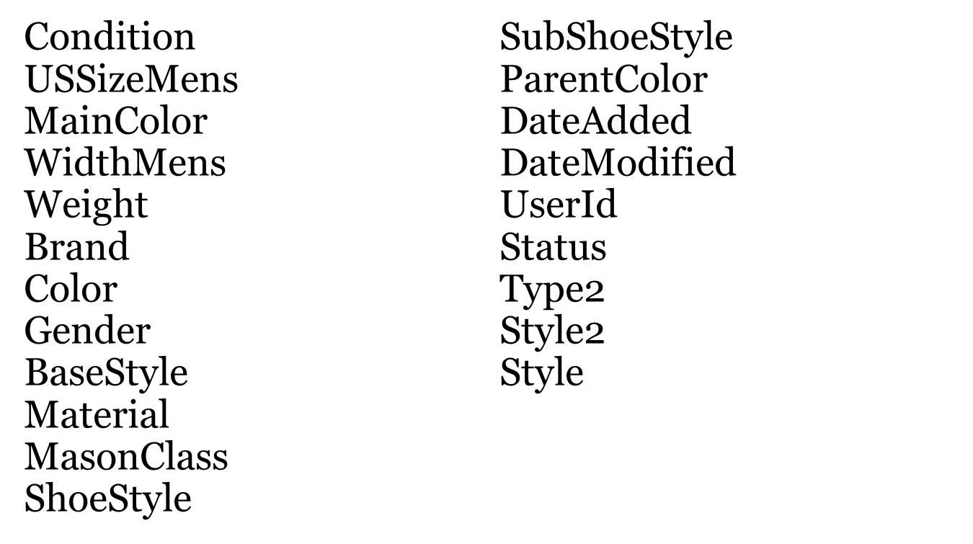
Men's Attributes

Slide 51
Attribute Calculation Types
Constants
  Condition: “New in Box”
Simple Look ups
  Hashmap with mason internal as key, EBay value as result
Simple Calculations
  Width is formatted from internal mason representation
Complex Short Circuit Logic Sieves
Must also track the precise name of the attribute

Slide 52
Attribute Calculations
For each POJO rObj in ResultSet
create WS submission object wsObj
select processor (men’s, women's, girls….)
For each attr in processor’s attribute collection
attr.configureAttribute(wsObj, rObj)
End for
End For

Slide 53
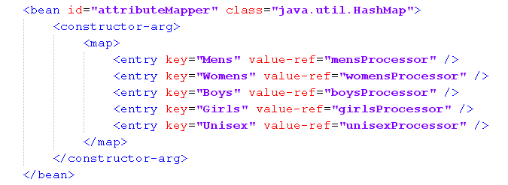
Spring Collection of Processors

Slide 54
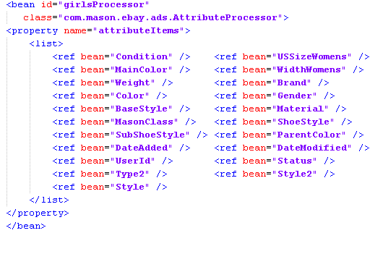
Spring Processor

Slide 55
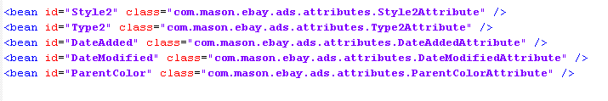
Sample Attribute Items

Slide 56
Design Pattern In Use (Strategy)
An object controls which of a family of methods is called. Each method is in its' own class that extends a common base class.
  http://www.fluffycat.com/Java-Design-Patterns/Strategy/
Spring sets up the collection of methods
  Calculations don’t depend on each other so just loop through
Spring allows mix match and swap
  reuse

Slide 57
Attribute Processing Summary
Spring allows the assembly of task hierarchy
  AttributeProcessor Collection
    Attribute processor
      Individual attributes
Defined at runtime
Meta data all in one place
Design patterns are often about configuration which can be done in Spring config files

Slide 58
Spring Summary
Spring allows the assembly of task hierarchy
  AttributeProcessor Collection
    Attribute processor
      Individual attributes
Defined at runtime
Meta data all in one place
Design patterns are often about configuration which can be done in Spring config files

Slide 59


Slide 60
CSE (Comparison Shopping Engines)
Regular information about our products
Essentially our inventory updated daily
  Image urls to our web sites
  Prices
  Other Data
Used for competitive advantage, generating traffic to our websites

Slide 61
CSE (Comparison Shopping Engines)
Sent by Mason to various providers
  Amazon
  Ebay
  Google
  Commission Junction
Require Different Formats
  CSV
  Pipe delimited
  XML

Slide 62
CSE (Comparison Shopping Engines)
SQL1
Output1
SQL2
Output2
SQL3
Output3
Different formats same data
Same data, different formats
Mix of data and formats
Different divisions
Different feed requirements
Many queries are similar

Slide 63
CSE SQL Input
Using Ibatis
Allows composition of sql by parts
Mix and match
  Try for as much reuse as possible
Outputs POJOs for each row
Bottom Line
  Sql is messy
  When done we have a POJO to represent a row

Slide 64
CSE Feed File Output
Need to take a POJO and send it to multiple file formats
For CSV, pipe delimited, tab delimited
Use Spring and the strategy design pattern
An object represents each column in the feeds
objects can be reused for feeds that have common columns

Slide 65
CSE Feed File Output
Create csvFileObj
For each POJO rowObj
fileRow = csvFileObj.createNextRow();
for each colObj in columnCollection
v = colObj.getValue(rowObj)
fileRow.write(v)
end for
end for

Slide 66
CSE Column Collection
Every column class derives from an abstract class
Derived classes must provide definition of getValue
Provides for polymorphism
This is a form of the strategy design pattern
The loop has no knowledge of the different types
Defers action to the individuals items

Slide 67
CSE Column Collection
Using Spring the collection can be created at runtime
Different column collections for different feeds
  Can reuse an entire collection
  Can reuse individual columns
    A date timestamp generator for example
So different sources can use the same column collection
Same source can use different column collections to get at different feed output

